Slide 1
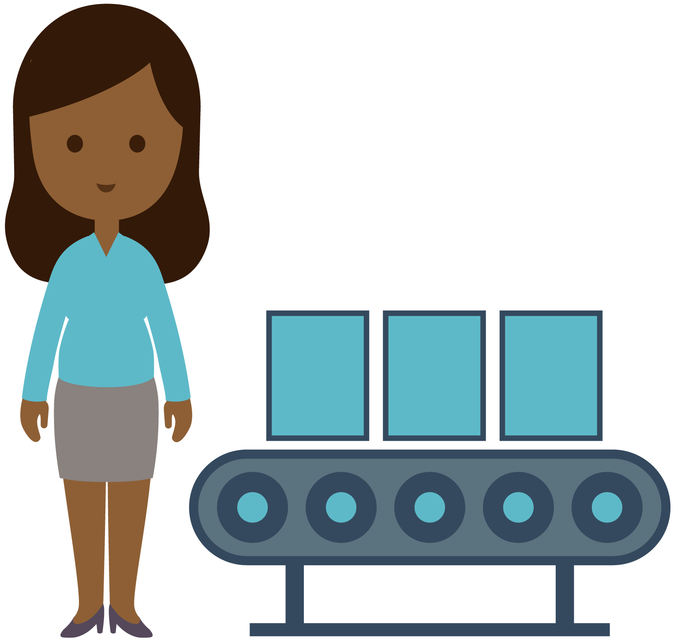
The Supply Chain and Lean Manufacturing
STEM²D Topic: Manufacturing
[Presenter Name]
[Presenter Organization]
[Date]

Slide 2
Today’s Plan
Welcome and introductions
Manufacturing and the world of work
What is supply chain?
Making things lean
Reflection

Slide 3


Tell My Story

Slide 4
My Story (delete if not using)

Slide 5




What Is a Supply Chain?

Slide 6
Links of a Supply Chain?
Plan
Source
Make
Deliver
Return
Develop a plan for sourcing materials and making products based on customer needs and constraints.
Purchase the materials and products needed to manufacture.
Transform or
manufacture the product to a finished state.
Provide the product to customers (logistics).
Handle products returned by customers.

Slide 7
Supply Chain Link 1: Plan
Material
requirement
planning
Production
control
Parts
procurement
Plan
Production
Planning
Develop a plan for sourcing the materials and making the products.
Production
accounting
Warehouse
management

Slide 8
Supply Chain Link 2: Source
Supplier
nomination
Receive & analyze quotes
Identify potential suppliers
Source
Sourcing
Purchase the materials and products needed to manufacture.
Supplier
audit & validation
RFQ
Negotiation

Slide 9
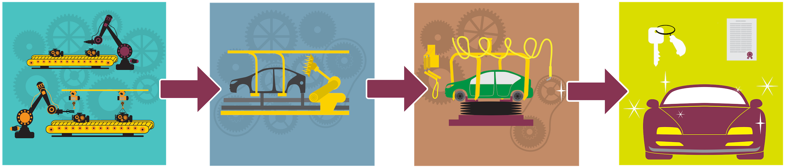
Supply Chain Link 3: Make
Make
Transform or manufacture the product to a finished state.

Slide 10
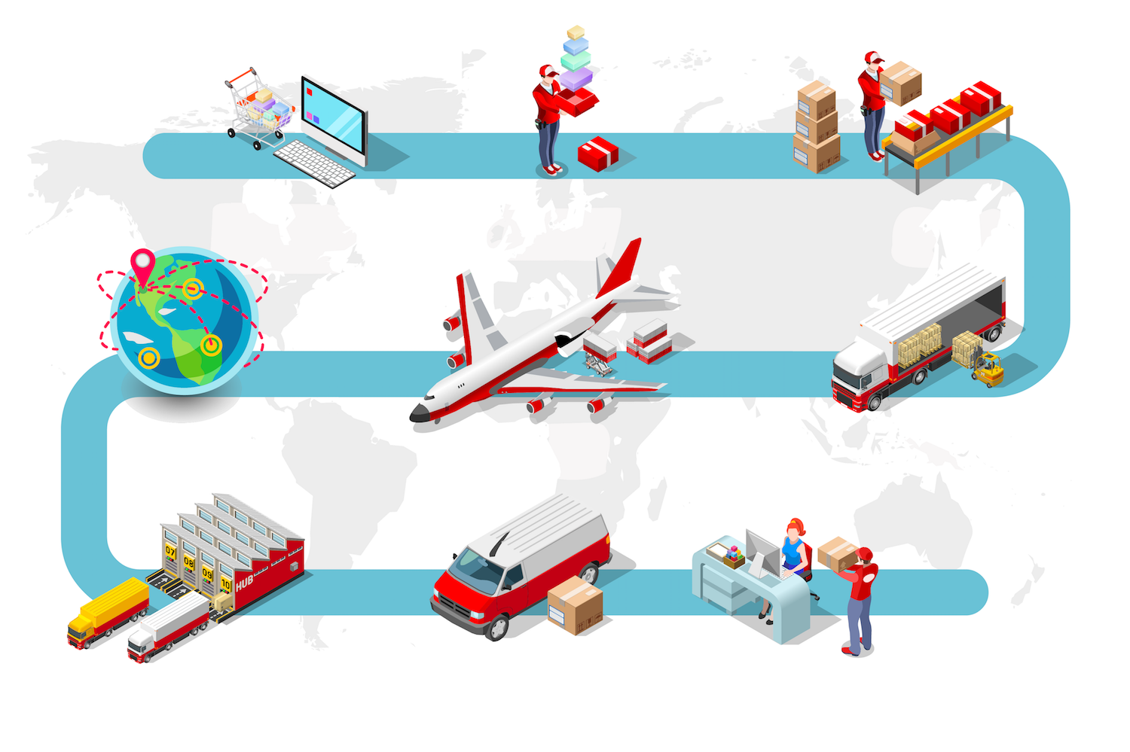
Supply Chain Link 4: Deliver
Deliver
Provide the product to customers; logistics.

Slide 11
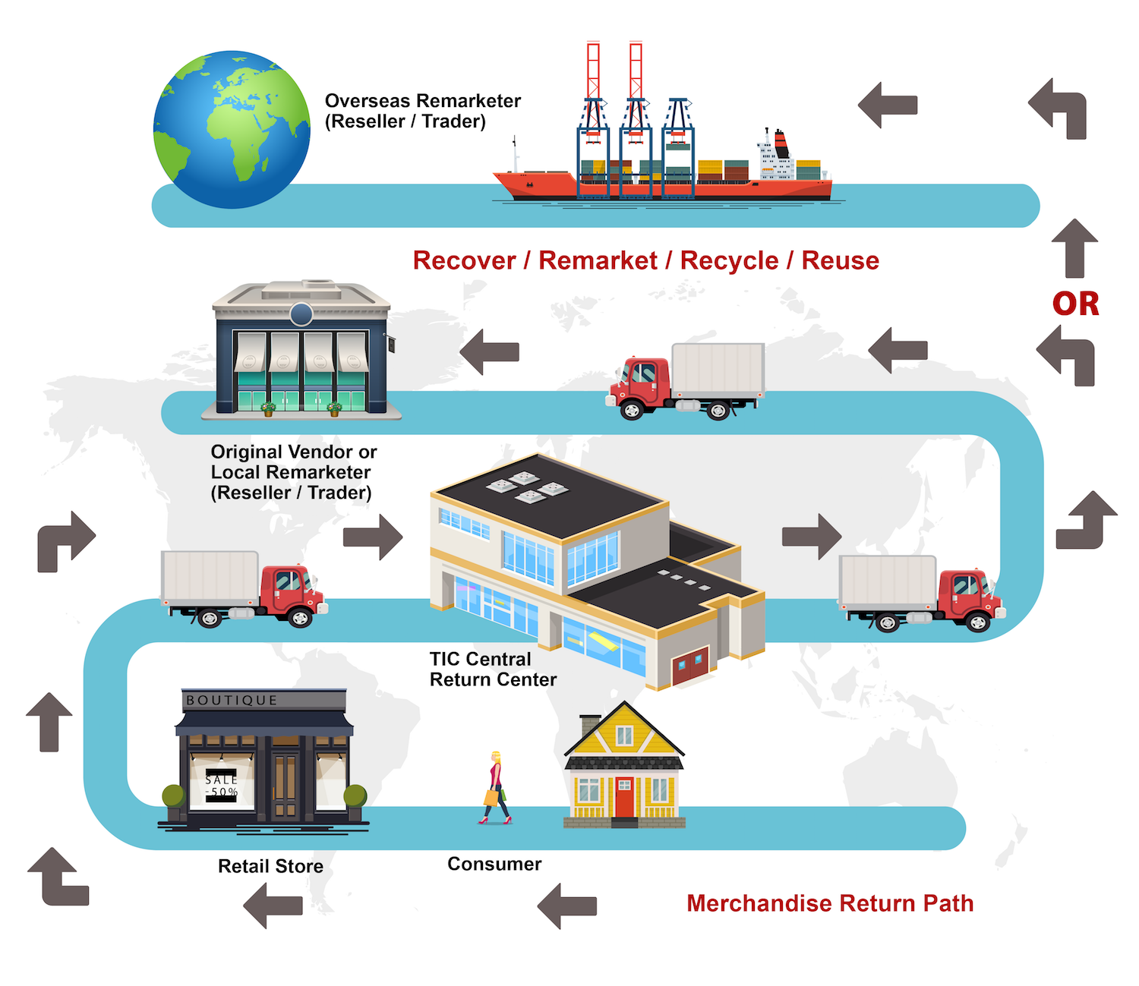
Supply Chain Link 5: Return
Return
Handle products returned by customers.

Slide 12


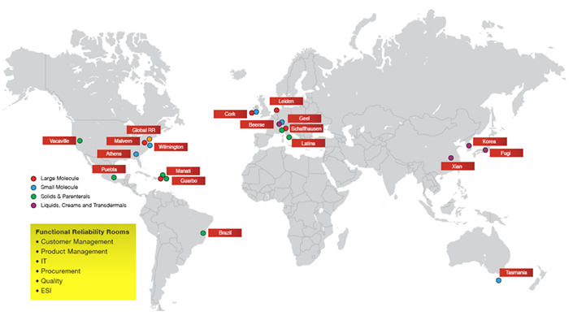

A Supply Chain in Action
21 JSC manufacturing sites
Manufacture in 12 different countries
Hundreds of suppliers
Deliver to customers on all continents (except Antarctica!)

Slide 13

The Supply Chain Challenge
Experience a supply chain in action and evaluate
how to make it work more efficiently.

Slide 14
The Supply Chain Challenge Directions
The company received a large order for news cars and tasked teams of engineers to produce 6 cars.
  Each team is comprised of 6 engineers.
  Each engineer must make 1 car.
All cars must meet quality standards—no mistakes accepted! Each car must match the directions perfectly.
    Each engineer should place their assembled car in the “done basket.”
    Teams will be timed and have no more than 5 minutes to assemble all 6 cars!
See the Student Handout for detailed assembly instructions.
Ready! Set! Go!

Slide 15
What Did We Learn?
How many cars did your team produce?
Did each cars meet all quality standards?
What went right?
What went wrong?
Which supply chain “links” did you see in action?

Slide 16

Lean Manufacturing

Slide 17
Making Things LEAN
Lean manufacturing: a practice to eliminate waste from the manufacturing process.
Waste: anything the customer doesn’t value.
Tools used to eliminate waste:
  Producing only what is needed
  Implementing one-piece flow (producing the parts you need one at a time, in a natural flow)
  Using visual aids to illustrate the process

Slide 18


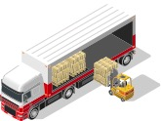
The 8 Wastes
Overproduction
Waiting
Excess inventory
Excess motion
Defects
Waste
Inappropriate processing
Transporting
Unused creativity

Slide 19

The Lean Supply
Chain Challenge
Complete the Supply Chain Challenge again, using lean-manufacturing principles.

Slide 20
The Lean Supply Chain Challenge
Form an assembly line:
  Assign each engineer with a specific task for assembling one part of the car.
  Pass the partially assembled car to the next engineer to continue building, once each task is complete.
  Place completed cars in the “done basket.”
All cars must be approved by the quality controller.
Timing:
  Teams have three minutes to plan and develop their assembly line.
  Teams have five minutes to produce cars.

Slide 21
What Did We Learn?
How was this challenge different from the first?
Did the preparation time make a difference? If so, how?
Which of the “eight wastes” did your team identify and eliminate in its assembly line?
How can your team improve? Eliminate more waste?
How many cars did your team produce?

Slide 22

More Lean Manufacturing

Slide 23
Lean Gone Wrong!

Slide 24
Being Lean
The supply chain
  Plan | Source | Make | Deliver | Return
Lean principles
  Make what you need | One-piece flow | Visual aids
Eight Wastes
  Waiting | Overproduction | Excess inventory | Defects | Transporting | Unused creativity | Inappropriate processing | Excess motion

Slide 25
Being Lean in Life
  Every time you finish a food item from the fridge or cupboard, write it down. Next time you go grocery shopping, only buy what’s on your list to keep your inventory at the correct level. (Excess inventory.)
  Keep your personal items in one place, after using them, return them to their proper place. This way you never spend time searching because your items are always in the right place. (Waiting and excess motion.)
  Fold your clothes right from the dryer and put them away to avoid the defects of wrinkles. (Waiting, defects, and excess motion.)
  If you want a snack late at night, remember to brush your teeth after, not before. (Inappropriate processing.)
  When studying for an exam; read the information first, highlight key points, transfer the information to flashcards, and take practice exams to ensure you have a structured process. (Excess motion, inappropriate processing.)
  When managing school and extracurricular deadliness; schedule your tasks, and start working on harder tasks first. That way you can allocate time to all of your tasks and avoid cramming too much work into one sitting. (Waiting, overproduction.)

Slide 26

Thank you for participating!

