Slide 1

The Design Challenge
STEM²D Topics: Design, Engineering, and Technology
[Presenter Name]
[Presenter Organization]
[Date]

Slide 2
Agenda
Introduction
Meet your STEM²D professionals
Warm-up with an activity: the Marshmallow Challenge
Learn about human-centered design principles
Complete the Design Challenge

Slide 3
Objectives
Understand the components of human-centered design principles.
Learn and apply new tools and skills in design.
Experience the design process while completing a challenge.
Apply design principles with engineering, technology, mathematics, and science.
Learn to work effectively within a team.
Meet STEM²D professionals and learn about STEM²D careers.

Slide 4
Reflect: What do you know about STEM²D?
Turn to your Student Handouts.
Reflect on what you currently know about science, technology, engineering, mathematics, manufacturing, and design.
What do you think professionals in these areas do and look like?
You can write or draw your responses.

Slide 5


Tell My Story

Slide 6
My Story (delete if not using)

Slide 7

The Marshmallow
Challenge

Slide 8
Build the Tallest Freestanding Structure with:
one marshmallow
20 sticks of spaghetti
one yard of string
one yard of tape

Slide 9
Rules for the Marshmallow Challenge
The structure must be able to stand on its own.
The entire marshmallow must sit on top.
Use as much or as little of the materials as you want.
You are allowed to break up the spaghetti, string, or tape.
You have 20 minutes to complete this challenge.

Slide 10
Time’s Up!

Slide 11
Reflection: The Marshmallow Challenge
Turn to your Student Handouts.
Reflect on what worked and didn’t work about your design.
Reflect on how it felt to work with a team.
You can write or draw your responses.

Slide 12
Video: Tom Wujec on the Marshmallow Challenge and Design Principles
Notes:
http://www.tomwujec.com/design-projects/marshmallow-challenge/
OR
https://www.youtube.com/watch?v=H0_yKBitO8M

Slide 13

Design: Putting People at the Center of Problem-Solving

Slide 14
Sophistication and Individualized Experiences in the Modern World
Welcome to the Donut Store
Would you like to customize your donut?
Yes No
Before: Everyone got the same donut or type of donut.
Now: People want to customize
their donuts!

Slide 15
Design Thinking Process

Slide 16
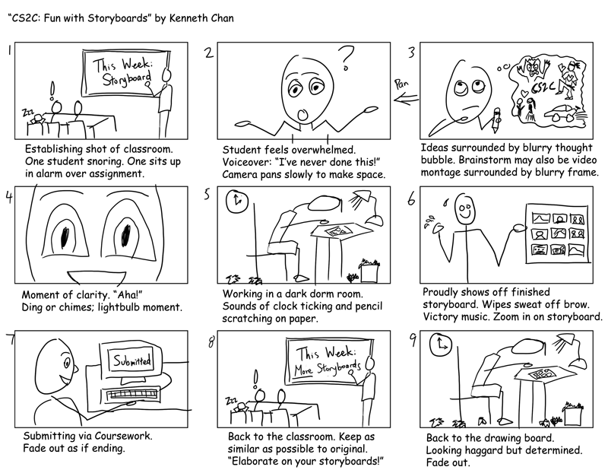
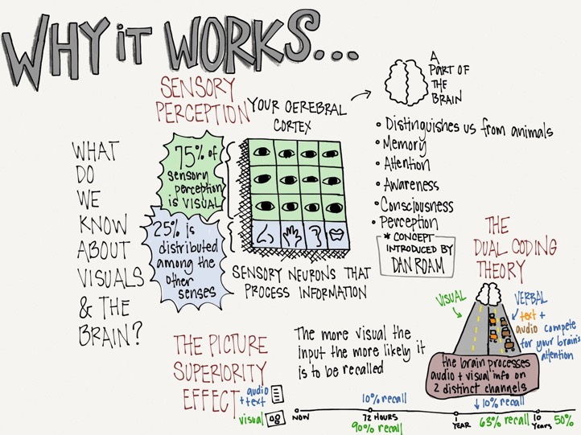
Tools and Strategies for Empathy and
Defining Needs: Visual Storytelling

Slide 17
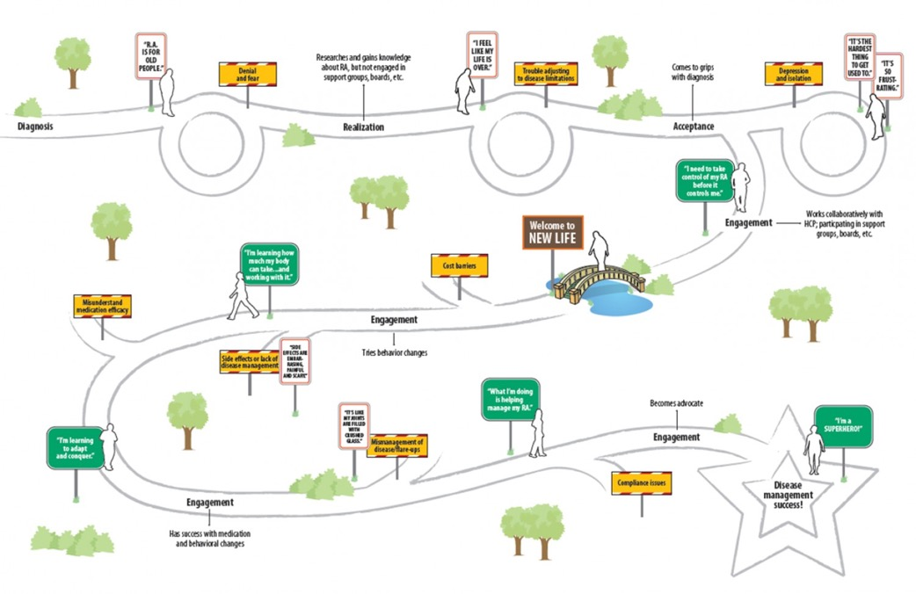
Tools and Strategies for Empathy and
Defining Needs: Journey Mapping

Slide 18
Tools and Strategies for Ideation and Prototypes: Brainstorming and Sketching

Slide 19

Recap: What Is Design?

Slide 20
Design Is Not Just Aesthetics

Slide 21
Design Is Not Just an Event

Slide 22
Design Is Not Just a Product

Slide 23
Design Is a Process

Slide 24

The Design Challenge

Slide 25
Setting the Stage

Slide 26
Setting the Stage

Slide 27
Challenge Question
How might we improve oral health throughout the day? What product can we design to help with that?
We will go through the design process to tackle this challenge.

Slide 28

Ask the Adults!
The adult assigned to your table will
serve as the end user of your product.

Slide 29
Empathy: Journey Mapping
On your Student Handouts, individually journey-map your oral health throughout a day.
Share your journey map within your group. Any commonalities?
You have 10 minutes for this exercise.

Slide 30
Empathy: Ask the End User
Draft interview questions
  On your Student Handouts, work as a team to come up with a list of questions that you want to ask your end users. What do you want to learn or find out about them that will help you build the best product?
  You have 5 minutes to come up with questions.
Interview your end user
  They will provide you their oral health journey map to start.
  Ask them the questions you created.
  You have 5 minutes for the interview.

Slide 31
Define the Needs: Brainstorm
On your Student Handouts, with your team, brainstorm and capture possible needs of your end user.
What things do they need or want?
Think of how their mouth makes them feel.
Your team should circle one need and one insight from the list
you create.
You have 5 minutes to brainstorm.

Slide 32
Define the Needs: Identify a Focus
On your Student Handouts, with your team, identify a focus of your solution based on the need and insight you circled.
What is currently being used for oral health?
What do you see for the future?
Get creative!
You have 5 minutes to identify a focus.

Slide 33
Ideate: Generate Potential Solutions
Independently generate potential ideas and solutions.
Be creative and think big!
Write or draw your ideas on sticky notes. One idea/solution per sticky note.
You have 5 minutes to generate these solutions.

Slide 34
Ideate: Share Solutions
Share your ideas with your team.
Pick your top three solutions from the ones the team shared.
You have 10 minutes to share and select the top three solutions.

Slide 35
Ideate: Reflections
On your Student Handouts, reflect on the ideation process:
Why were the top three ideas chosen?
How do you feel about the design process so far?
Reflect on the journey mapping process. How was your oral health journey different or similar to the end user?
Pick one of the top three ideas and sketch out what you think the product should look like.

Slide 36
Ideate & Test: Summarize Learning
As a team, summarize what you learned from the feedback. You can document this feedback on your Student Handouts.
  What new things did you learn about the end user and his/her needs?
  What new things did you learn about your solutions?
Your team will decide on one of the concepts that you came up with and tweaked.
You have 8 minutes to talk about what you learned and select one idea to move forward.

Slide 37
Prototype: Build Your Concept!
Using materials at your table, sketch and build your idea!
  Be creative!
  Give your product a name!
You have 15 minutes to build your concept.

Slide 38
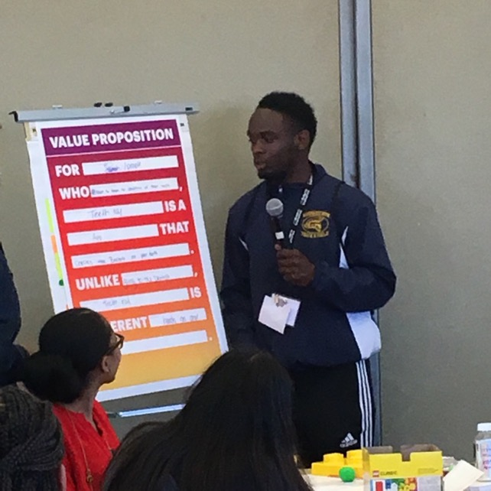
Prototype: Value Proposition
On the chart paper provided, fill out a value proposition for your product.
  A value proposition is statement of the innovation or feature that makes your product attractive to customers. What makes your product unique and why would people buy it?
  Select a writer from your team who will fill out the chart paper.
You have 10 minutes to fill out a value proposition for your product.

Slide 39
Presentations
Each team will now present their products to the class!
Be creative! You may present a skit, commercial, jingle, or anything else you can think of. Presentations should be no more than 5 minutes.
The presentations should address the following:
  Introduce your end users.
  Share the need you decided to address.
  Tell us the name of your product and what it does.
  Demonstrate the prototype.
  Tell us the benefits of this product and how it is different from other products.
You have 20 minutes to prepare this presentation.

Slide 40
Recap: The Design Process
Design is a process.

Slide 41
Final Reflections
On your Student Handouts, reflect on the Design Challenge and this entire activity.
How can you use the design process in your school, work, and everyday life?
What did you learn about STEM²D careers and professionals? What did you learn about women in these fields?
How did what you learned and what you originally thought about STEM²D careers and professionals differ?
Can you see yourself as a STEM²D professional? Why or why not?
  What courses do you need to take in the future to be successful in the STEM²D fields?
  What are your goals and how does STEM²D help you reach those goals?

Slide 42

Thank you for participating!

