Slide 1

Technology Everywhere
STEM²D Topics: Technology and Engineering
[Presenter Name]
[Presenter Organization]
[Date]

Slide 2
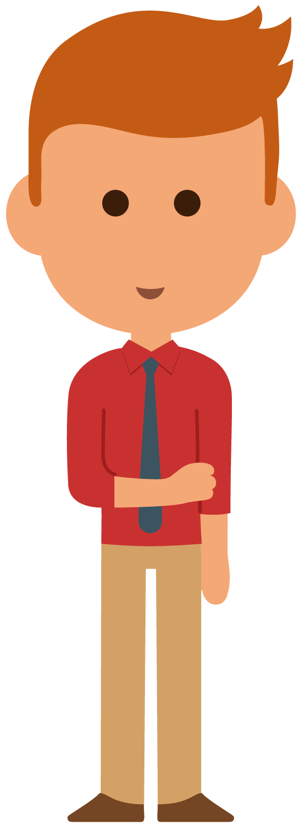
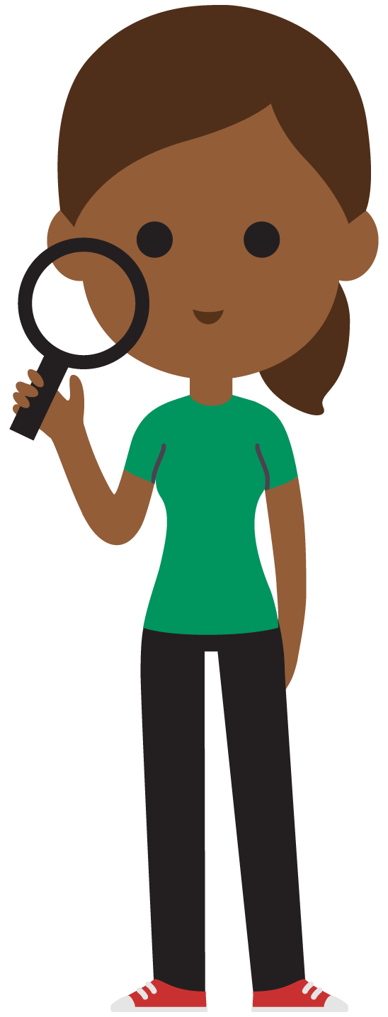
Tell My Story

Slide 3
My Story (delete if not using)

Slide 4
Today’s Plan
Define technology:
  Putting science and other knowledge to practical use to solve problems, invent useful tools, envision new possibilities, and establish meaningful connections among people and the world that surrounds them.
  Identify products and discuss possible improvements.
Practice using circuits:
  Review engineering design.
  Build a hidden alarm.
Reflection

Slide 5
Define Technology
New and innovative technologies and products often result when an individual or a team of people apply their understanding of science (our natural world) and human behavior to design products and services that people want to use. Sometimes, the intention is not to create something new, but to make something better, less expensive, or more useful.

Slide 6
Try It
Use your Student Handout to identify three different items/products located around the room that you and your partner are familiar with or use often throughout the day.
Brainstorm ways to improve these items:
  Ask each other what are some different ways to think about these items?
  Who uses them? Are they easy to use? Too difficult?
  How creative can you be?
  Off-the-wall suggestions often spark amazing ideas.
Consider these constraints:
  Your improvement cannot result in a new product. It should only make the product easier to use, more efficient, or less expensive. It is okay if your improvement results in a new or unexpected use for the product.
Evaluate:
  Which idea is really possible, given your identified constraints?
  Circle it on your handout.

Slide 7
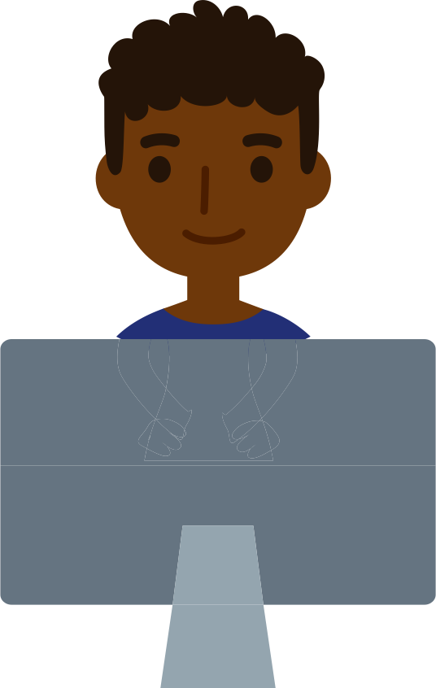
Hidden Alarm Challenge
Design an alarm that you can turn on and
off and that is small enough to hide.

Slide 8
Engineering Design
Problem: Design an alarm that you can turn on and off and that is small enough to hide.
Criteria:
  The team must be able to turn the alarm on and off.
  It must be small enough to hide.
Before the team starts designing, ask each other:
  Where is the best place to hide your alarm?
  How small does the alarm need to be to fit in the designated hiding place?
  What is your plan for turning it on and off?

Slide 9
Using Circuits
A circuit is simply a path for electricity to travel along. When all the parts are connected, and electricity is allowed to flow uninterrupted from the battery to the buzzer and back to the battery, you have a closed circuit.
When parts become disconnected, preventing the electricity from flowing uninterrupted, it becomes an open circuit.

Slide 10
Adding Switches
A switch starts and stops the flow of electricity. Switches open and close a gap in the circuit.
When the switch is closed (also called a closed circuit), electricity flows to the buzzer and it buzzes, non-stop!
When the switch is open (open circuit), electricity is interrupted and the buzzer stops buzzing.
Brainstorm ways to open and close the circuit to ensure the buzzer will turn on and off.

Slide 11
Building Hidden Alarms
Does the alarm fit in the initial hiding place?
Does the buzzer buzz as expected?
Consider other places to hide the alarm that will surprise the other teams. Keep looking for unexpected hiding places around the room.
Tape the alarm parts in the identified hiding place. Use additional wire, if necessary, to hide the circuit.
Be sure to keep the circuit open until the person finds and closes the circuit by connecting the electrical pathway.
Try it out! Work together to test the alarms and evaluate the hiding spots.

Slide 12
Reflection
New and innovative technology is applied to many products. How can you take what you learned today and apply it in your daily life?
How can you use circuits to build something or modify one of your favorite products?
What would you change about your alarm if you had time to test it again?
If you had the opportunity to explain why STEM²D skills are important to acquiring your ultimate career goal, what would you say?
Did your original thinking about STEM²D careers and professionals change? Why or why not?
Can you see yourself working in STEM²D? Why or why not?

Slide 13

Thank you for participating!

