Slide 1






SensoREAL
Science, Design, Mathematics
Presenter Name & Organization
Date

Slide 2
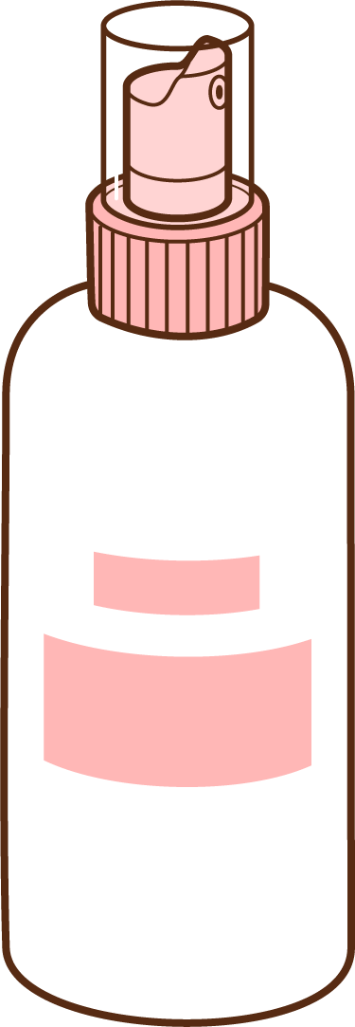
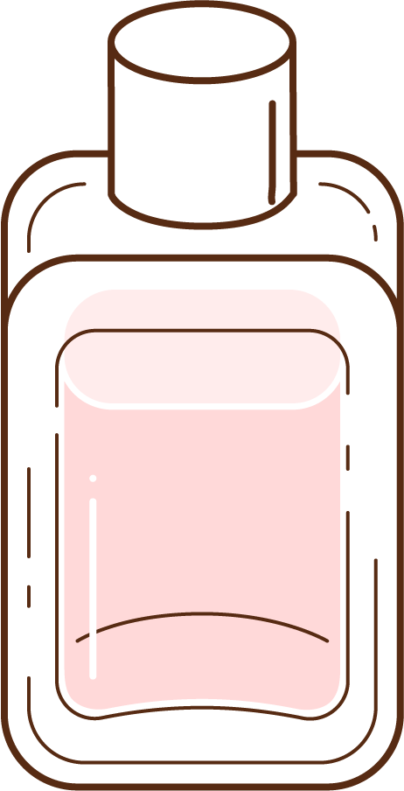
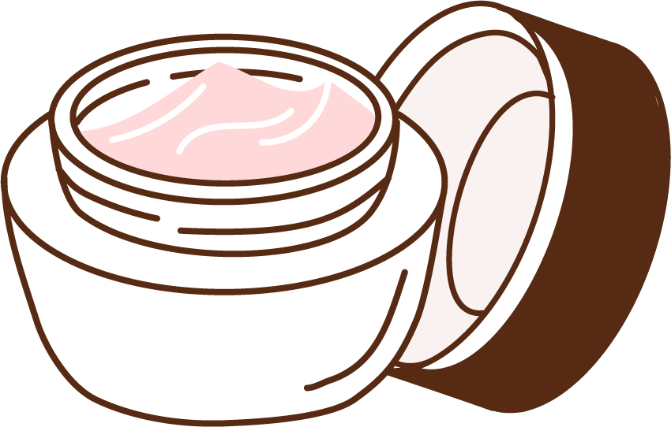

Today’s Plan
Introduction
Cosmetics
  What are they?
  How are they improved?
Activity: Cosmetic Products Sensory Testing
Reflection
Notes:
Review the agenda. Explain

Slide 3






What is STEM²D?
Science
Technology
Engineering
Mathematics
Manufacturing
Design
Notes:
Explain that STEM²D refers to: Science, Technology, Engineering, Mathematics, Manufacturing, and Design.
Ask students and other volunteers to introduce themselves and state their favorite areas of STEM²D (Science, Technology, Engineering, Mathematics, Manufacturing, and Design).

Slide 4
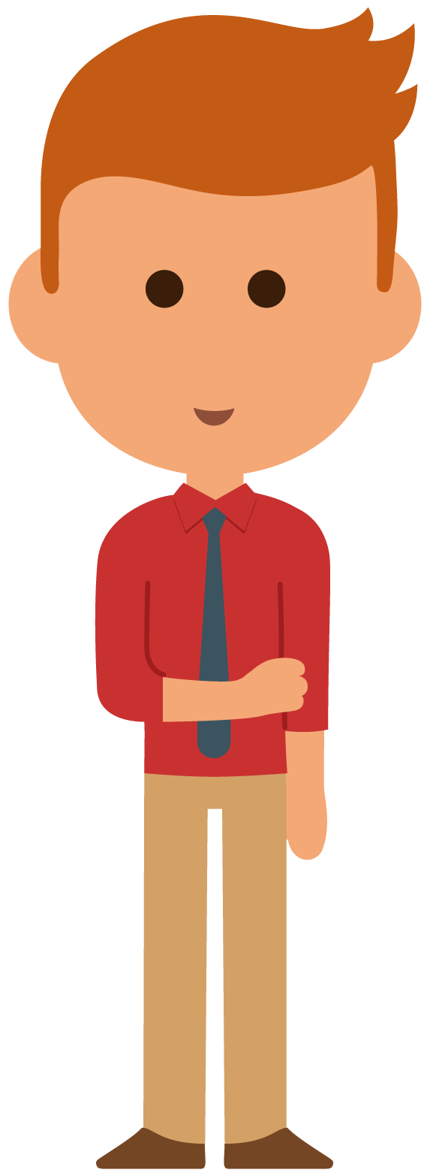

My Story
(Delete slide if not needed)

Slide 5
My Story
About Me

Slide 6
Warm Up Activity
(Delete slide if not needed)

Slide 7
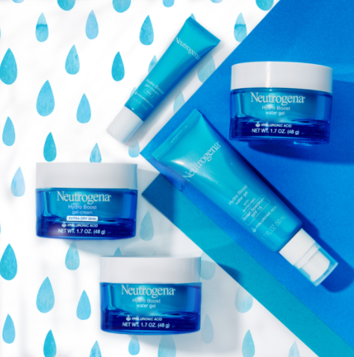
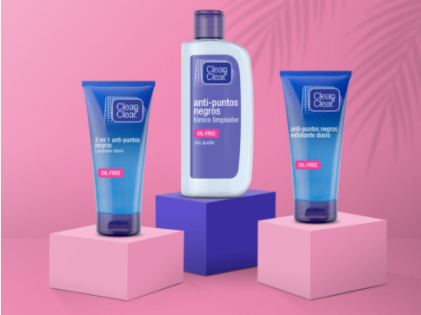
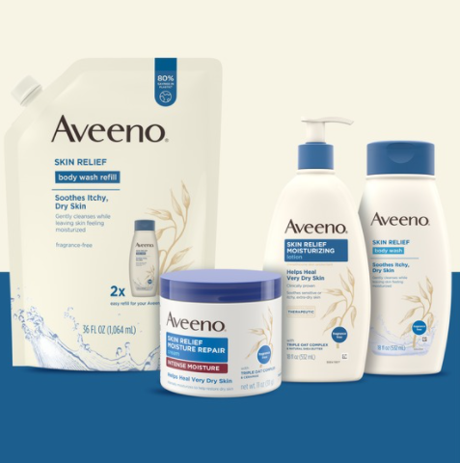
How Much Do You Know About Cosmetics Products?
Review the images and try to answer the following:
Can you identify each image? What are they?
What are some reasons why people use cosmetic products?
Do you know of any cosmetic brands that belongs to Johnson & Johnson?
Do you believe consumer (the person using the product) feedback is involved in the design and creation of cosmetic products? Why? Why not?

Slide 8
Cosmetic Products
Cosmetic products are mixtures of chemical compounds, some naturally derived, and others created synthetically in a laboratory.
Cosmetic use includes personal care, skincare (pimples), medical, and enhancing one’s appearance
The four (4) general types of cosmetic products are:
1
  Decorative – lip gloss, lip sticks, foundation, eyebrow pencils, mascara etc.
3
  Haircare – shampoos, conditioners, moisturizer, oil, and scalp treatments
2
  Skincare – moisturizers, lotions, face cream, face masques, sunscreen, etc.
4
  Perfume – body mist, perfume, cologne etc.

Slide 9
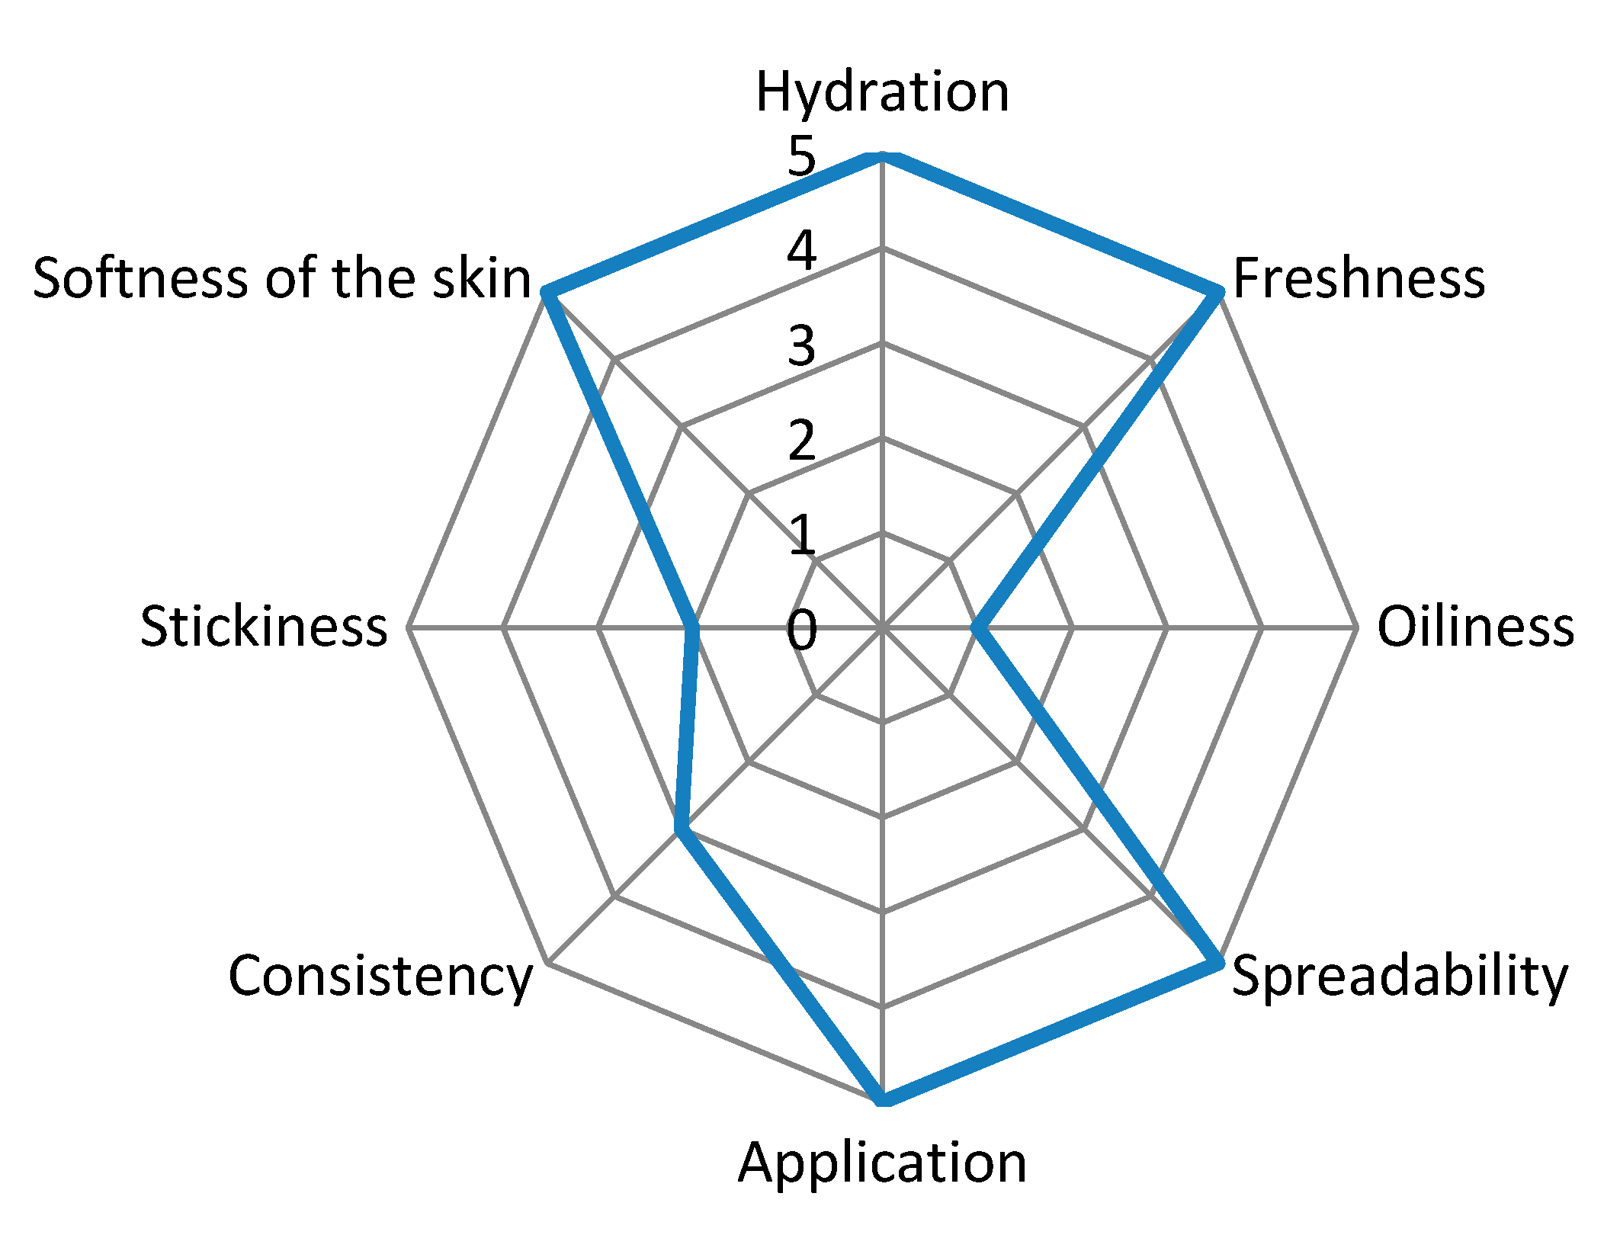
Sensory Testing and Attributes
The cosmetic industry is a very competitive market for the companies (producers) and people using the items (consumers).
Companies use sensory testing to consider consumer feedback, when making more suitable products.
The process of improvement is critical to the Research and Development (R&D) field.
The sensory attributes guide is a list of common features used to determine a product's qualities.
Censi, Roberta, Dolores Vargas Peregrina, Giovanna Lacava, Dimitrios Agas, Giulio Lupidi, Maria G. Sabbieti, and Piera Di Martino. 2018. "Cosmetic Formulation Based on an Açai Extract" Cosmetics 5, no. 3: 48. https://doi.org/10.3390/cosmetics5030048
© 2018 by the authors. Licensee MDPI, Basel, Switzerland. This article is an open access article distributed under the terms and conditions of the Creative Commons Attribution (CC BY) license (http://creativecommons.org/licenses/by/4.0/). No changes were made to the figure.

Slide 10
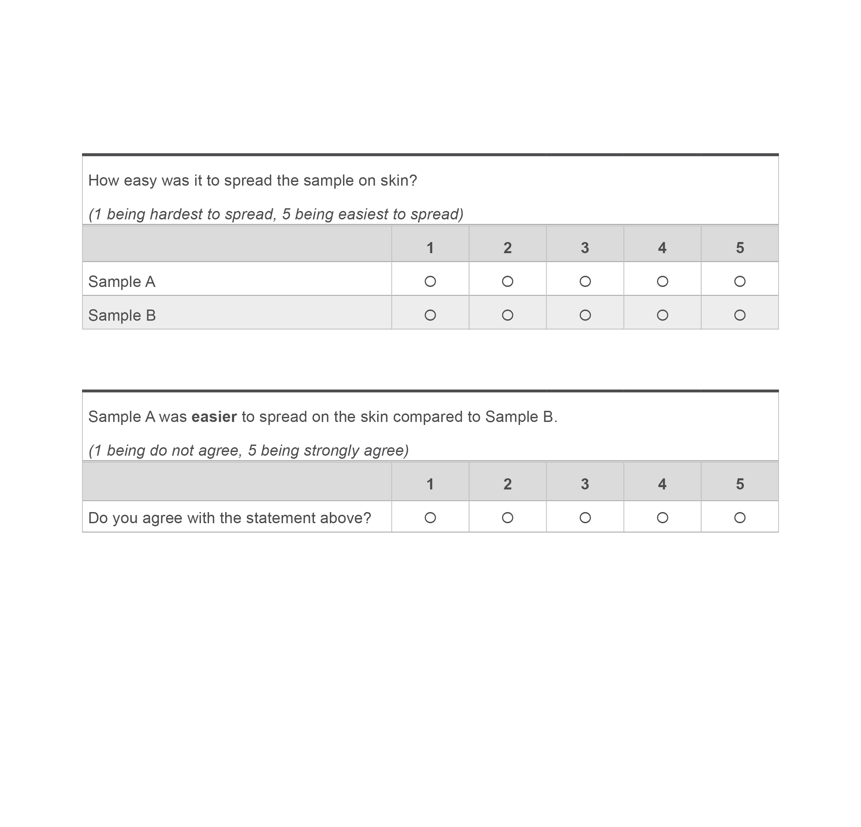
Sensory Test Questionnaire
Sensory Test Questionnaire:
Set of questions on a scale.
The scale is generally from 1 to 5:
  1 – Dislike, disagree, difficult etc.
  5 – Like, strongly agree, easy etc.
Information collected can be used for:
  Comparison
    Sample A spreads easier than Sample B
  Majority Perception
    8 out of 10 responses said Sample C is somewhat greasy

Slide 11
Sensory Testing of Cosmetic Products
Notes:
Beak the group into teams of X people per team. Instruct teams to sit together.
Distribute the student handouts and materials to each team.

Slide 12
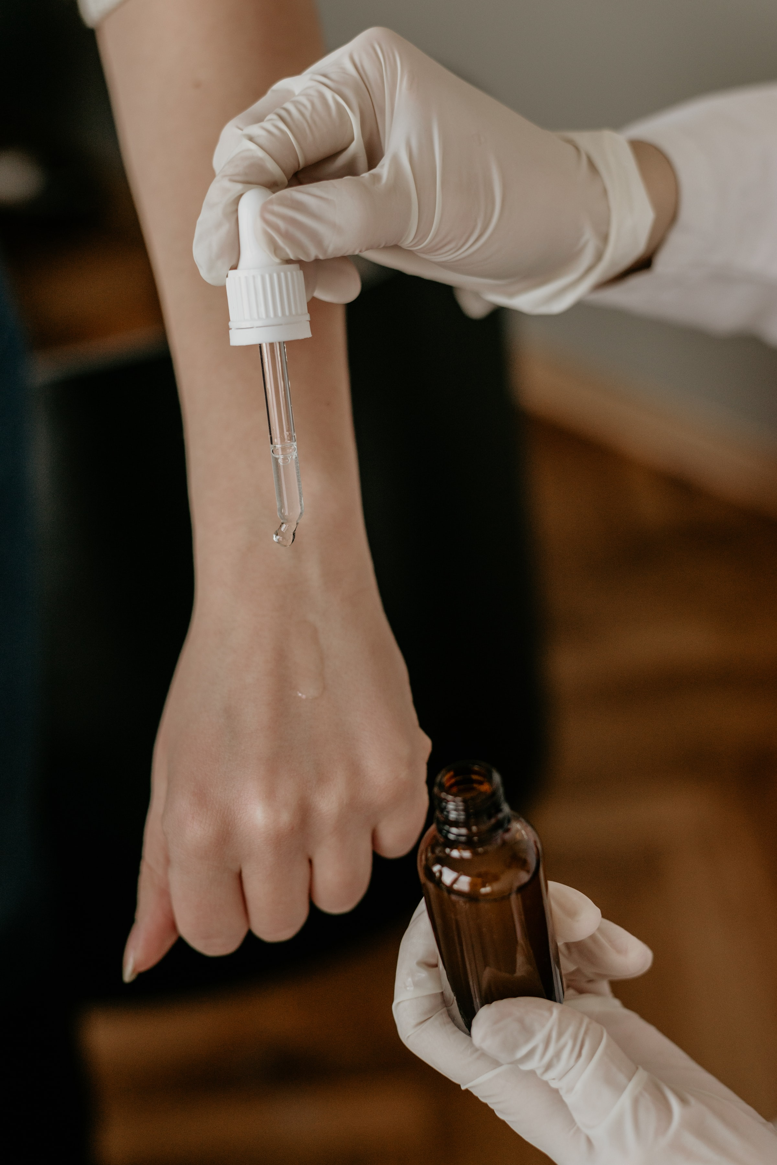
Sensory Testing of Cosmetic Products
In this team-based activity, you will:
In this team-based activity, you will:
  Design and craft questions to develop a sensory test.
  Use your sensory test to rate two or three (2 or 3) different textured cosmetics products.
  Determine which of the products has the highest score.
  Discuss your results and thought process as a class.
Notes:
Step 1-5 how to execute a sensory test

Slide 13
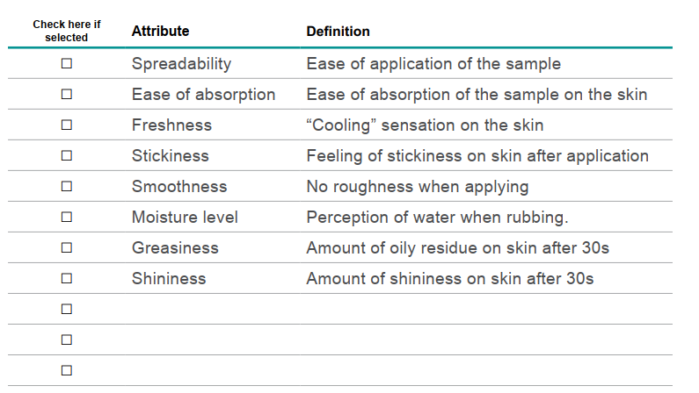
Define the Test
Select 2 attributes to investigate from a list of eight (8).
Or choose your own attribute
and write it in the empty space.
Notes:
Example of 10 questions – pick 3 out of 10
Empty template to fill in questions and prototypes
2 pre-filled – evaluate attribute
1 open ended

Slide 14
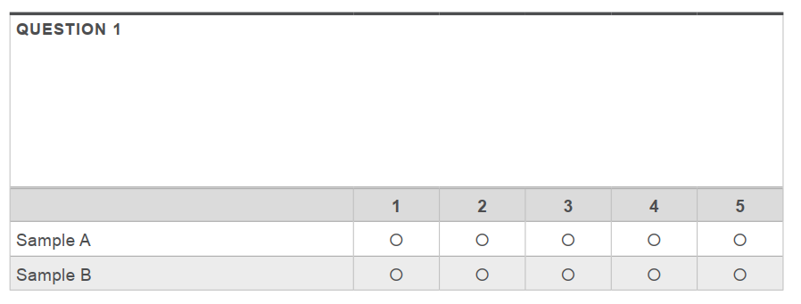
Design the Questionnaire
Generate four to five (4-5) questions to test your attributes, using examples below as a guide.
  How sticky was the sample on skin 30s after application?
  How fast did the sample absorb in the skin?
Be sure to define what 1–5 will mean and add the questions to the template provided.
Notes:
Generate 4-5 questions about the attributes and add them to the template provided below. The questions need to be clear, straightforward, and subjective. Be sure to define what 1–5 will mean (see
examples below).
Here are some examples to inspire you:
• How sticky was the sample on skin 30s after application?
• How fast did the sample absorb in the skin?

Slide 15
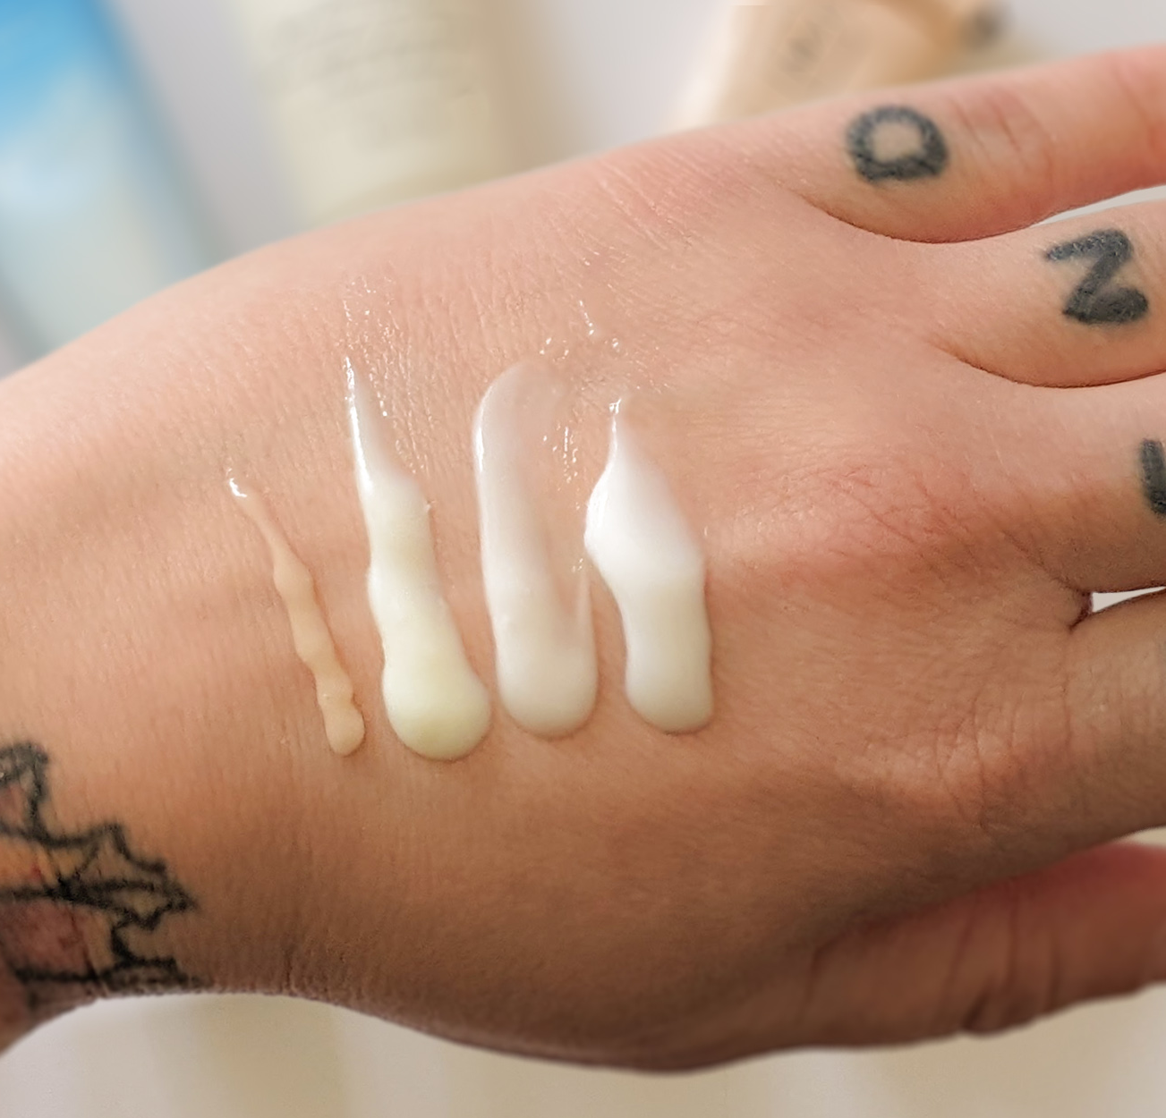
Conduct the Test
INSTRUCTIONS
Test your cosmetic products using your team’s questionnaire.
Decide the roles of your team members then follow the instructions:
Tester – person testing the products on skin
Recorder – person asking the questions and recording the ratings
Notes:
Example of 10 questions – pick 3 out of 10
Empty template to fill in questions and prototypes
2 pre-filled – evaluate attribute
1 open ended

Slide 16
Discussion
Think about the following questions:
Were the results as you expected?
Why did you choose the 2 attributes to test?
What was your team’s thought process in the design of your questions?
Are there any other attributes you would test? What are they? Why?
How might you or a lab scientist improve your cosmetic product with the lowest rating?
How does this activity relate to you? Do you use cosmetic products?
Notes:
Why did we choose these 3 attributes?
How to improve the products?

Slide 17
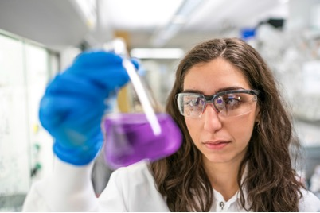

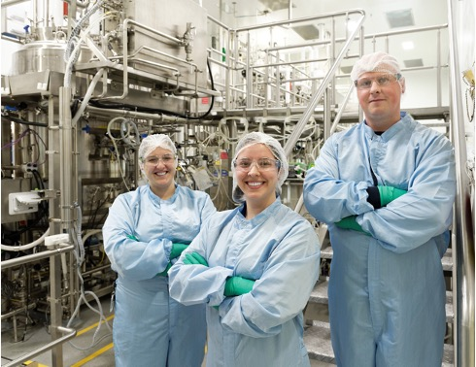

STEM²D Careers in the Cosmetic Industry
Analytical Chemist
Clinical Scientist
Consumer Scientist
Fragrance Evaluator
Medical Safety Analyst
Microbiologist
Perfumer
Product Developer
Regulatory Specialist
Research & Development Scientists
Research & Development Engineers
Technical Transfer Process Engineer
Notes:
Existing stem R&D slide
Formulator video

Slide 18
Reflection
What did you learn about cosmetics and sensory testing?
What would you change about the sensory activity if you were to do it again?
Can you see yourself as a STEM²D professional? Why or why not?
What is one thing you learned that you did not know coming into today?

