Slide 1


Pollution Solution
STEM²D Topics: Science
[Presenter Name]
[Presenter Organization]
[Date]

Slide 2






What is STEM²D?
Science
Technology
Engineering
Math
Manufacturing
Design

Slide 3
Today’s Plan
Introductions
Science in the World of Work
What is Pollution?
Activities:
Pollution Lake
What’s the Solution?
Eco-Friendly Practices
Reflection

Slide 4

STEM²D in the World of Work
How do you think STEM2D is used every day in the workplace?
What do kinds of careers do you think people with an interest, aptitude for, or degree in science would have?
Notes:
Share that STEM²D careers are high-demand, high-growth careers.
Share some sample careers in the STEM²D fields that align with this activity.

Slide 5


Tell My Story

Slide 6
My Story (delete if not using)

Slide 7

Pollution

Slide 8
What is Pollution?
Pollution is…
Any contamination of air, soil, water, and environment.
+

Slide 9
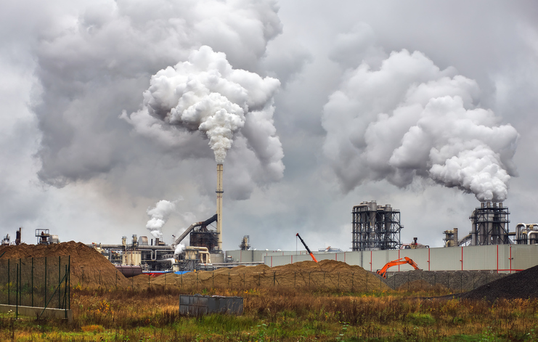
Air Pollution
Carbon Monoxide (CO)
Particulate Matter (PM)
Nitrogen Dioxide (NO2)
Sulfur Dioxide(SO2)
Lead (Pb)
Ground Level Ozone (O3)
Notes:
Air pollution occurs when gases, dust particles, fumes (or smoke) or odors are introduced into the atmosphere in a way that makes it harmful to humans, animals and plant.
Human activities that result in air pollution are: emissions from industries and manufacturing activities, burning fossil fuels, and household and farming chemicals.
Some common air pollutants are:
Carbon Monoxide – CO - fuel combustion from vehicles and engines;
Ground-level Ozone – O3 - formed by chemical reaction of volatile organic compounds and nitrous oxide in the presence of sunlight;
Lead – Pb - coming from metal refineries also called smelters and other metal industries, waste incinerators, and battery manufacturing;
Nitrogen Dioxide – NO2 – from fuel combustion by vehicles, big industrial boilers, and electric utilities and from wood burning;
Particulate Matter – PM - formed through chemical reactions; fuel combustion e.g. burning coal, wood, diesel; farming; road construction
Sulfur Dioxide – SO2 – from fuel combustion (especially high sulfur coal); industrial processes, natural occurrences like volcanoes
Effects of Air Pollution: Health issues (heart disease, reduced oxygen to breath, lung disease, worsened asthma, damage to nervous system, respiratory problems); particulate matter (irritation to the eyes, nose, and throat, upper respiratory infections, lunch cancer, heart disease, damage to brain, nerves, liver, or kidneys); acidification (acid rain which harms vegetation, kills trees, and harms animals, fish, and other wildlife); and ground-level ozone (chemical reactions involving air pollutants that create a poisonous gas ozone – affecting health and damaging vegetation and animal life);

Slide 10
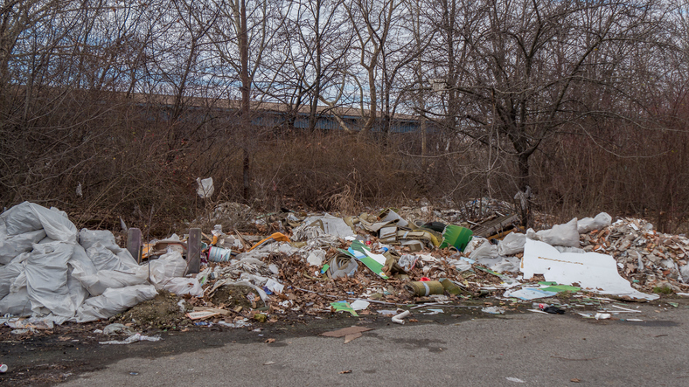
Land Pollution
Solid Waste
Pesticides and Fertilizers
Deforestation
Chemicals
Notes:
Land pollution is the deterioration (destruction) of the earth’s land surfaces, often directly or indirectly as a result of man’s activities and their misuse of land resources.
It occurs when waste is not disposed of properly, or can occur when humans throw chemicals onto the soil in the form of pesticides, insecticides and fertilizers during agricultural practices. Exploitation of minerals (mining activities) has also contributed to the destruction of the earth’s surface.
Since the Industrial Revolution, natural habitats have been destroyed, and environments have been polluted, causing diseases in both humans and many other species of animals.
Human actions have also caused many large areas of land to lose or reduce their capacity to support life forms and ecosystems. This is known as land degradation. Note that land degradation can result from many factors, and soil pollution is only one of them.
Types of Soil Pollution:
Solid Waste (garbage from home, school, hospitals, market, and workplaces). Paper, plastic containers, bottles, cans, food, used cars, broken electronic goods and furniture, and hospital waste are all examples. Some are biodegradable. Share the definition of biodegradable. Biodegradable – able to be broken down by the action of living organisms such as bacteria. Examples include: paper products and vegetation (grass and twigs) and some are not (plastics, metals, aluminum cans, broken computer and car parts)
Pesticides and Fertilizers. Many farming activities use fertilizers, pesticide, and insecticides for higher crop yield. While it helps us get more food, the chemicals that end up in the soil can kill insects and small animals, along with larger animals that eat the smaller animals. The chemicals can also be washed down into the soil with rain and over time end up in the water table.
Chemicals. Chemical and nuclear plants produce waste materials that have to be stored somewhere. In many cases they are stored in an environmentally safe way, but there are some that find their way into landfills and other less safe storage facilities. They may also find their way into leaking pipes and gutters. The chemicals end up polluting soils and making crops harmful to our health.
Deforestation. Definition: The clearing or cutting down of forests. Trees absorb carbon dioxide (a greenhouse gas) from the air and enrich the air with oxygen. They also provide habitat to many land animals, insects, and birds, replenish soils, and help retain nutrients from being washed away. Millions of acres of trees have been cut down for wood, construction, farming and mining purposed and new trees were never planted.
Effects of Soil Pollution: the consequences can be catastrophic. Contaminated land and environments can cause problems in the human respiratory system, cause problems to skin, and cause various kinds of cancer. The toxic materials that pollute the soil can get into the human body directly by: coming into contact with the skin; being washed into water sources like reservoirs and rivers; eating fruits and vegetables that have been grown in polluted soil; and breathing in dust or particles.

Slide 11
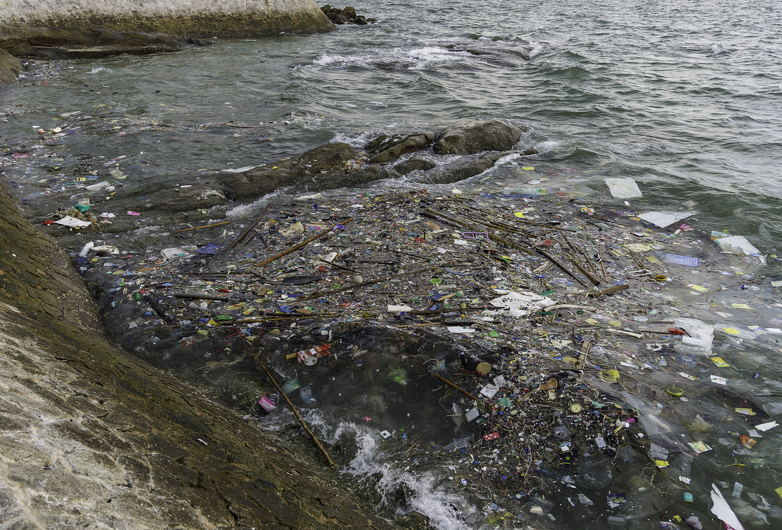
Water Pollution
Ground Water Pollution
Chemical Water Pollution
Nutrients Pollution
Surface Water Pollution
Oil Spillage
Notes:
Water pollution occurs when pollutants (particles, chemicals, or substances that make water contaminated) are discharged directly or indirectly into water bodies without enough treatment to get rid of harmful compounds.
Share that they will now complete the Pollution Lake Challenge to find out what water pollution looks like up close.

Slide 12
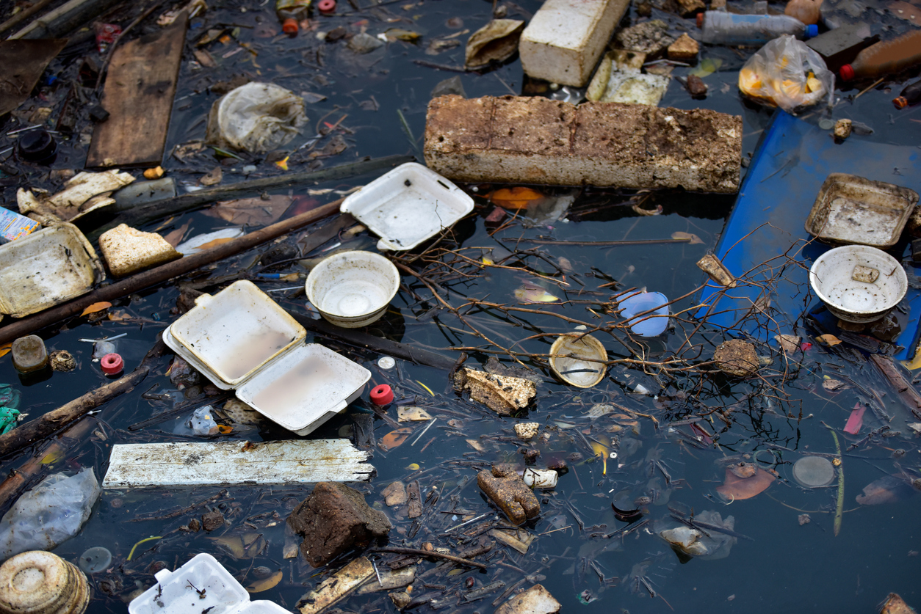
Pollution Lake Challenge
What does water pollution look like up close?
Let’s find out!
Notes:
Pollution Lake Challenge (5 minutes)
Explain to students that they will need to follow directions closely during the Pollution Lake challenge.
Explain to the students that the tub of water in front of them represents a water source that provides water for plants, animals, and human.
Explain that while the water source looks clean now, when different types of pollutants are introduced to the water, the water becomes polluted.
Hold up the cup of red water. Explain that the red water represents fertilizer that is used by large farms. It is a type of ground water pollution. While the fertilizer helps the crops to grow, it contains chemicals that are harmful to plants, animals, and humans. When it rains, the fertilizer in the soil finds its way into underground rivers and streams, ending up in a larger body of water.
Pour the cup of water into the plastic tub and ask students to do the same.
Hold up the cup of green water. Explain that the green water is nutrient pollution. Nutrients pollution is wastewater, fertilizers, a and sewage containing nutrients that encourage algae and weeds to grow, making the water undrinkable while the algae uses up all the oxygen causing the other water organisms to die of oxygen starvation.
Pour the cup of water into the plastic tub and ask students to do the same.
Hold up the cup of cooking oil. Explain that the oil comes from cars and trucks that travel the roadways near water sources and is called oil spillage. While the oil has a localized effect on wildlife it can spread for miles. The oil is not only harmful when ingested by humans, it can cause the death of many fish and can cover the feathers of the seabirds living along the seashore, preventing the seabirds from being able to fly and catch food or return to their nests.
Pour the cup of water into the plastic tub and ask students to do the same.
Hold up the cup of yellow water. Explain that many industries and farmers work with chemicals that end up in the water. This is considered chemical water pollution. Chemical water pollution includes chemicals that are used to control weeds, insects, and pests. Metals and solvents from industries can pollute water bodies as well. They are poisonous to many forms of aquatic life and may slow their development, cause them to be unable to reproduce, or kill them.
Pour the cup of yellow water into the plastic tub and ask students to do the same.
Hold up the plastic straws. Explain that while plastic straws with their small size may not appear to be a major source of pollution, they are surface water pollution and they often find their way into water sources on the earth’s surface, mixing physically with the water.
Place the straws in the plastic tub and ask students to do the same.
Hold up the plastic bottle caps. Explain that the plastic bottle caps represent plastic bottles and other types of packaging that are not recycled and find their way into water sources and are also surface water pollution. Explain that plastic is manmade and is not biodegradable. Share that the plastic rings that hold plastic soda bottles together can trap animals who live in and around the water, often leading to death of the animal.
Place the plastic bottle caps in the plastic tub and ask students to do the same.
Hold up the aluminum soda can. Explain that aluminum cans are also not biodegradable and therefore must be recycled as they often find their way into water sources, not only contaminating the water but also posing a threat to the animals that use the water and area around it as their habitat.

Slide 13
How Does Pollution Affect the
World Around You?
What does it do to the…
Water you drink?
Air you breathe?
Food you eat?
Plants and animals in the natural environment?
Notes:
How does pollution affect the water you drink? Choose 2 or 3 students with hand raised to answer.
How does pollution affect the air you breathe? Choose 2 or 3 students with hand raised to answer.
How does pollution affect the food you eat? Choose 2 or 3 students with hand raised to answer.
How does pollution affect the plants and animals in the natural environment? Choose 2 or 3 students with hand raised to answer.
(If students are unable to answer the questions, give them examples they can relate to. i.e. air pollution makes it difficult to breathe and may cause respiratory problems)

Slide 14
What’s the Solution? Challenge
Instructions
With your group, choose a type of pollution discussed today and that you see in the world around you.
Brainstorm solutions to reduce or eliminate the pollution.
Create a poster detailing your group’s solution or solutions.
Hang your poster.
LET’S GET STARTED!

Slide 15
Eco-Friendly Practices
Environmentally-Friendly Packaging and Products
Solar Facilities
Geo-thermal Energy Initiative
Certified LEED Sites
Notes:
Content and eco-friendly policies pulled from the Johnson & Johnson website: www.jnj.com.
As stated in its Credo, Johnson & Johnson is committed to protecting the environment and natural resources. There are many examples of how Johnson & Johnson is living the Credo and instituting eco-friendly policies.
Band-Aid Brand Adhesive Bandage™ boxes are made with materials certified by the international Forest Stewardship Council (FSC), assuring that the trees used come from responsibly managed forests.
The U.S. Environmental Protection Agency (EPA) Green Power Partnership lists Johnson & Johnson as the nation’s seventh largest purchaser of renewable energy. At its Titusville, N.J. campus in the United States, there is a 4.1 megawatt ground mounted solar system with an array of 13,496 solar panels that track the sun from east to west; it is estimated to generate over 70 percent of the campus’ annual electricity needs, or roughly the amount needed to power 600 homes annually. Sheep graze within, underneath and around the solar panels. By constantly trimming the grass and clover they act as a built-in landscaping crew.
At the Beerse, Belgium campus, J&J extracts the vast reserves of hot water lying deep beneath the facility. The geo-thermal energy powers everything on the site, from washing machines to air conditioners. The geothermal energy initiative, which will help slash the site’s CO₂emissions by nearly one-third, is the first of its kind for Johnson & Johnson—and just one of the clever ways the company is investing in smart sustainability innovations across the globe.”
Finally, J&J incorporates sustainability into the design and construction of all new facilities and major renovations. LEED (Leadership in Energy and Environmental Design) is the standard used in the Americas and the Asia Pacific region for design, construction, and high-performance buildings. In Europe, the EU Green Building Programme (GBP) is used for energy considerations, and LEED is used for other aspects of building design. The U.K. relies on the Building Research Establishment’s Environmental Assessment Method (BREEAM). Several J&J facilities are Certified LEED platinum sites – the ranking system’s highest level, ensuring water and energy efficiency, selecting construction components with sustainability in mind, and using high-efficiency air filtration systems.

Slide 16
Reflection
  Think about the following questions…
    What did you learn about Pollution?
    What did you learn about Environmentally Friendly Practices?
    How do you think this activity relates to a career in Science and/or
    working at Johnson & Johnson?
    Can you see yourself as a STEM²D professional? Why or why not?
    What would you need to do to make that happen?

