Slide 1
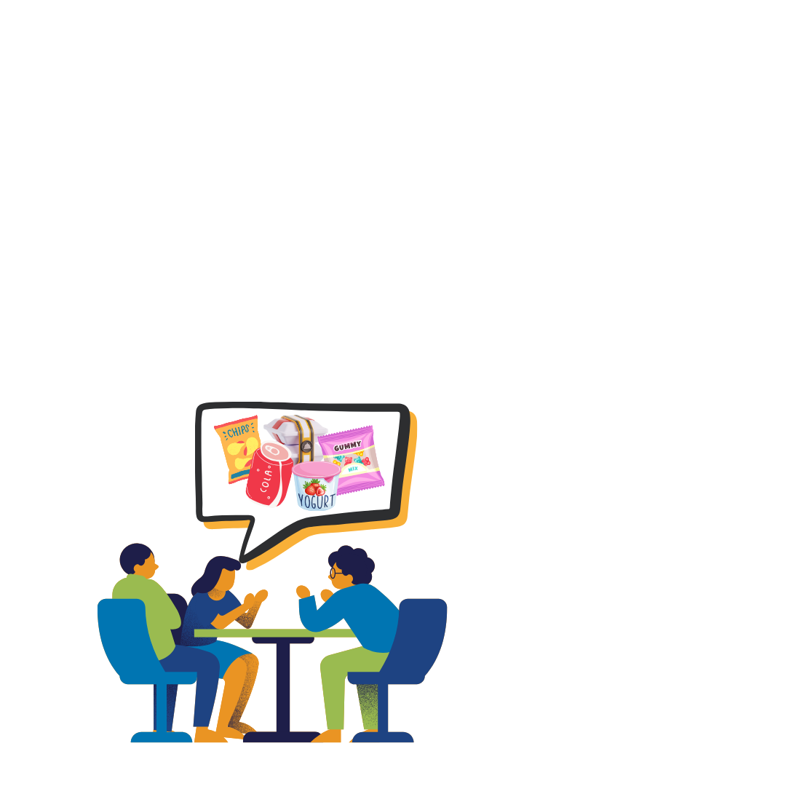

Packaging Pioneers
STEM²D Topics: Science, Design, Engineering
Presenter:
Date:

Slide 2

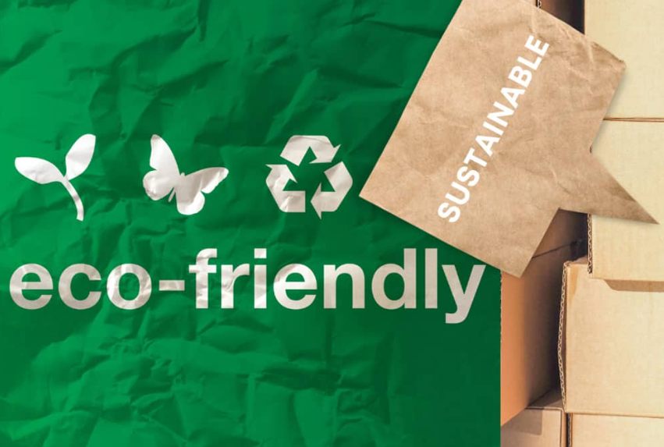
Today’s Plan
Introduction
Plastic Waste
  Biggest Contributors
  Environmental Effects
  Making a Difference
  Engineering Design Process
Activity: Eco-Friendly Packaging
Reflection
Notes:
Review the agenda. Explain that today students will learn about the effects of plastic waste and will use the engineering design process to develop eco-friendly packaging solutions to help reduce plastic waste.
Break the large group into teams of four and instruct them to sit together for the remainder of the session.
Image:
https://tipa-corp.com/blog/eco-friendly-packaging-guide/

Slide 3

What is STEM²D?
Science
Technology
Engineering
Mathematics
Manufacturing
Design
Notes:
Explain that STEM²D refers to: Science, Technology, Engineering, Mathematics, Manufacturing, and Design.
Tell the students there is high growth and demand among STEM²D careers. Tell them your own career is only one of many in STEM²D fields.
Explain that some STEM²D careers do not require college degrees and still offer exciting, high-paying opportunities. Stress the importance of gaining mathematics skills to succeed in any STEM²D career.

Slide 4


My Story
Notes:
Continue the introductions by talking about your educational and career path.
Use the Tell My Story form as a basis for your remarks and be prepared to share your interest in STEM²D and how your work is connected to STEM²D.
Be prepared to describe your job or a typical day and provide information about your background.
(Delete this slide if not needed.)

Slide 5


My Story
Name:
Fun facts or other thoughts:
Job Title:
Company:
Education:
Notes:
Duplicate this slide for multiple volunteers.

Slide 6

Science & Engineering in the World of Work
What is environmental sustainability?
How might engineering, design, and science be used in environmental sustainability fields?
What kinds of careers fit within the environmental sustainability pathway?
Notes:
Environmental sustainability refers to the responsible management of natural resources to fulfill current needs without compromising the ability of future generations to meet theirs. It aims to balance ecological, economic, and social goals, such as reducing carbon emissions, promoting renewable energy, and ensuring equitable resource access. It’s all about maintaining an ecological balance in our planet’s natural environment and conserving resources to support the well-being of both present and future generations.
Careers in environmental sustainability: Environmental Scientist, Geologist, Ecologist, Urban Planner, Landscape Architect, Environmental Consultant, Air Quality Engineer, Environmental Engineer and many many more!

Slide 7

Packaging
Pioneers

Slide 8
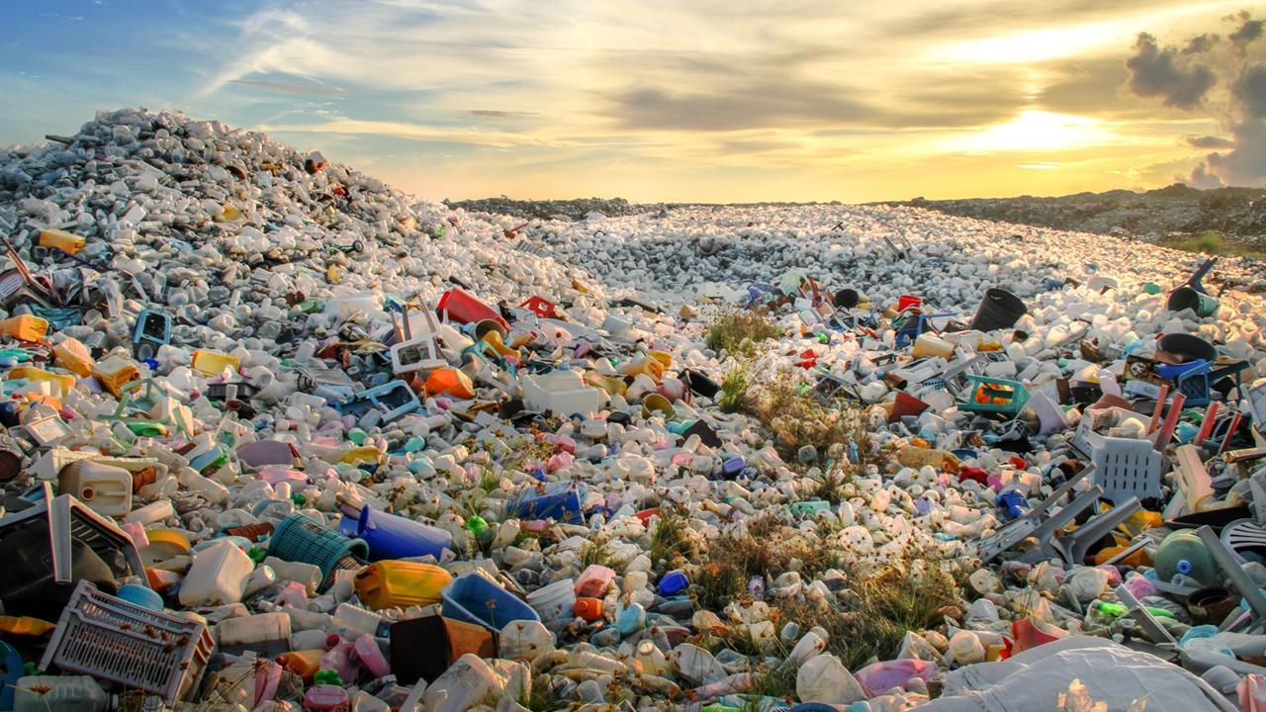
What is Plastic Waste?
Plastic waste results from the production, use, and disposal of plastic products.
Plastic waste is made up of synthetic plastic products that can cause problems for wildlife, habitats, and people. Plastic is not biodegradable and doesn't break down naturally.
Plastic is strong, bendable, and can be found in many everyday items like clothes, beauty products, and packaging.
Plastic sticks around, polluting our oceans and damaging soil. It can even find its way into the human food chain.
According to the Organization for Economic Cooperation and Development (OECD), humans produce more than 430 million tons of plastic each year.
Notes:
Begin by asking what the students already know about plastic waste. Provide a definition of plastic waste and discuss how humans produce more than 430 million tons of plastic each year according to the Organization for Economic Cooperation and Development (OECD).
Plastic pollution is a part of the climate crisis because the production of plastic from fossil fuels releases a large amount of greenhouse gases—specifically carbon dioxide or CO₂.
Plastic waste is made up of synthetic plastic products that can cause problems for wildlife, habitats, and people. Plastic is not biodegradable and doesn't break down naturally.
Plastic is strong and bendable and can be found in many everyday items like clothes, beauty products, and packaging.
Plastic sticks around, polluting our oceans and damaging soil. It can even find its way into the human food chain!
Image:
https://edu.rsc.org/feature/plastic-waste/3009361.article

Slide 9

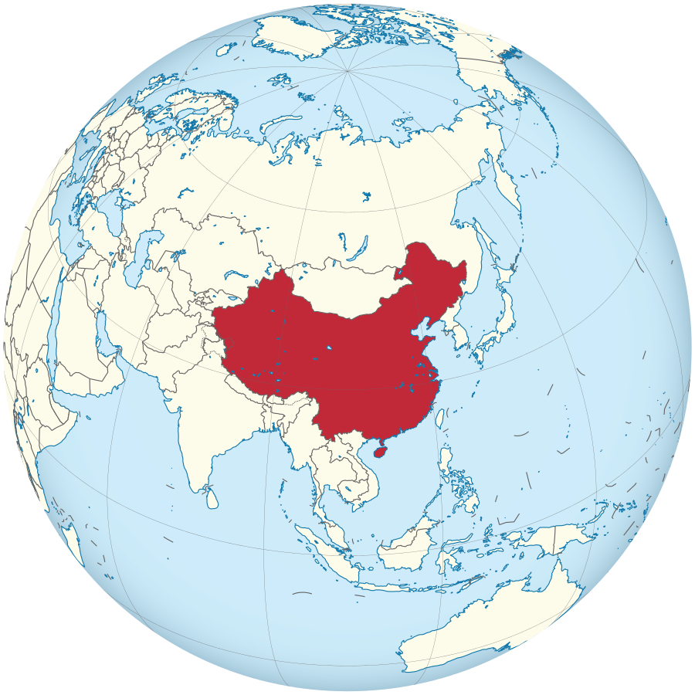
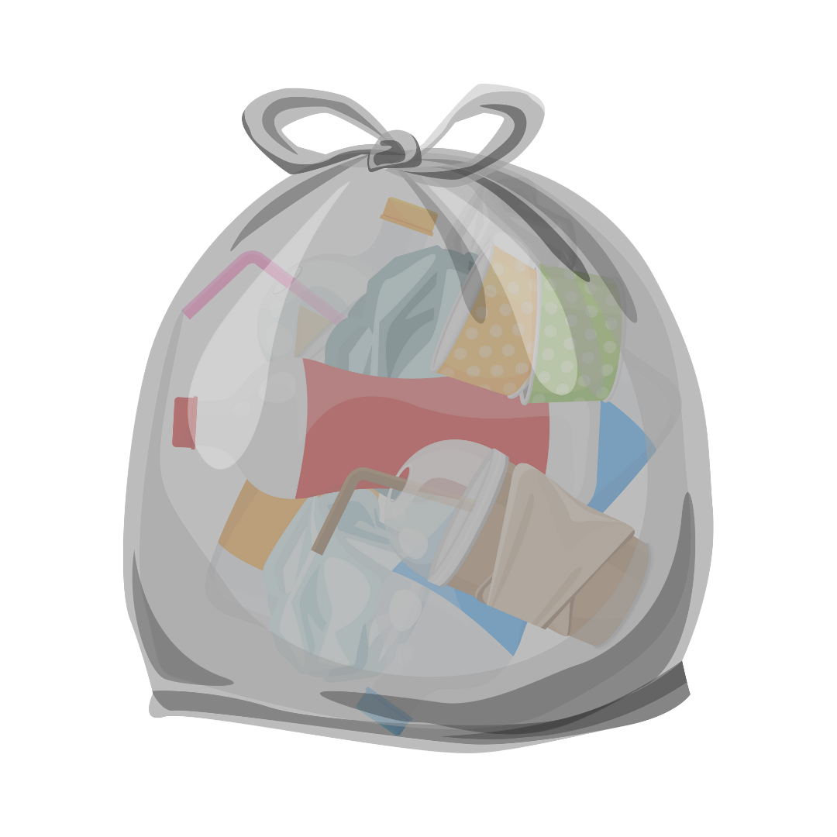
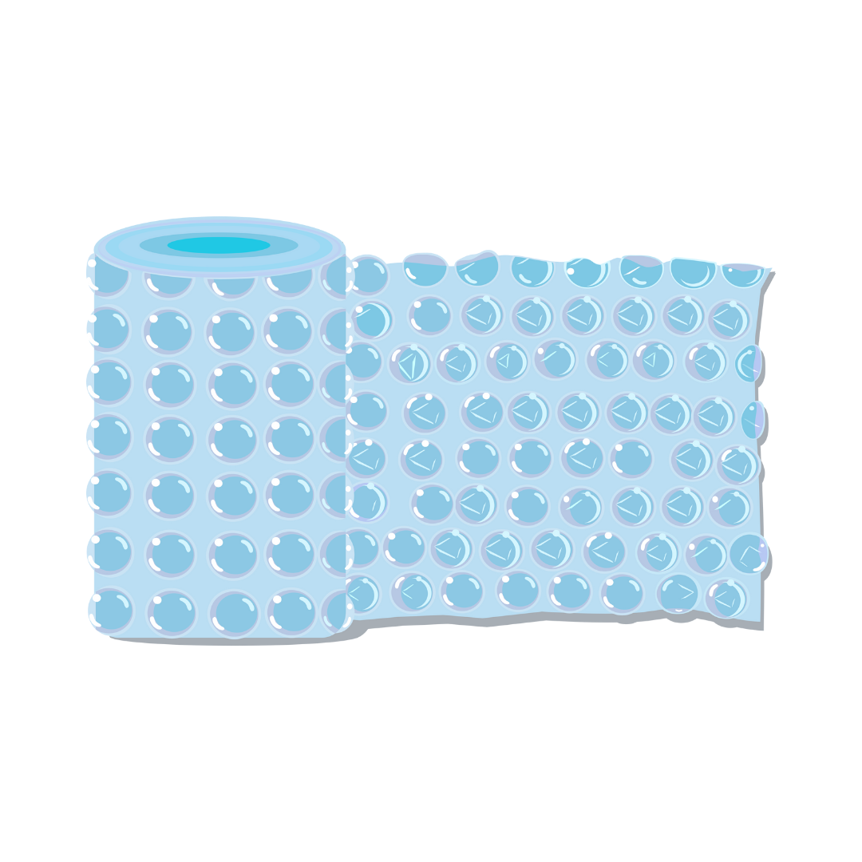
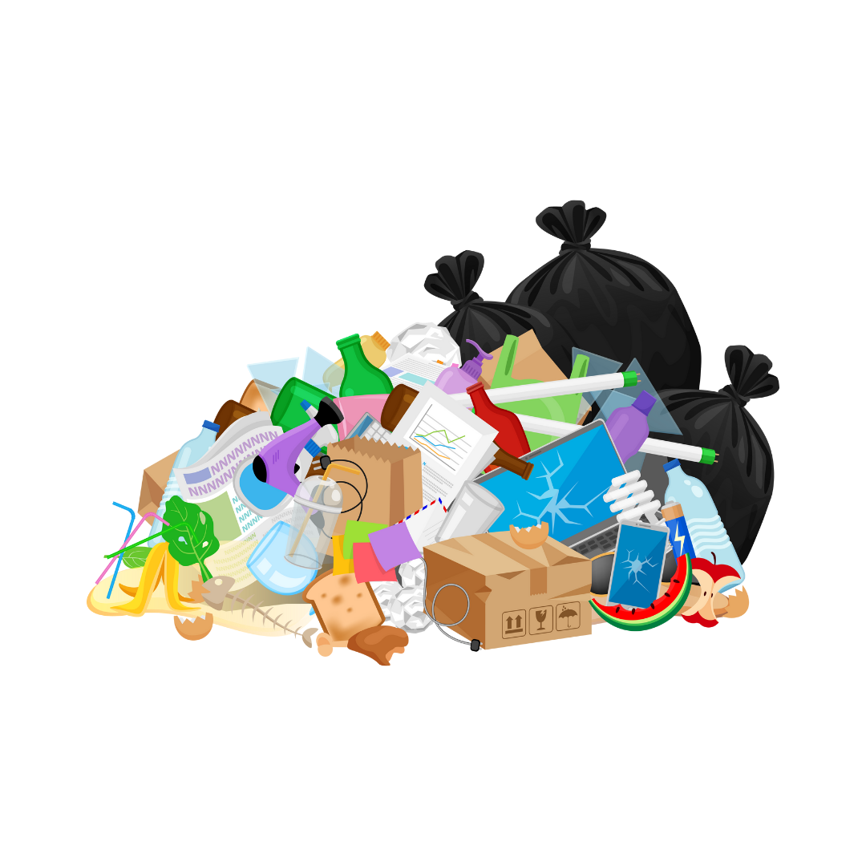

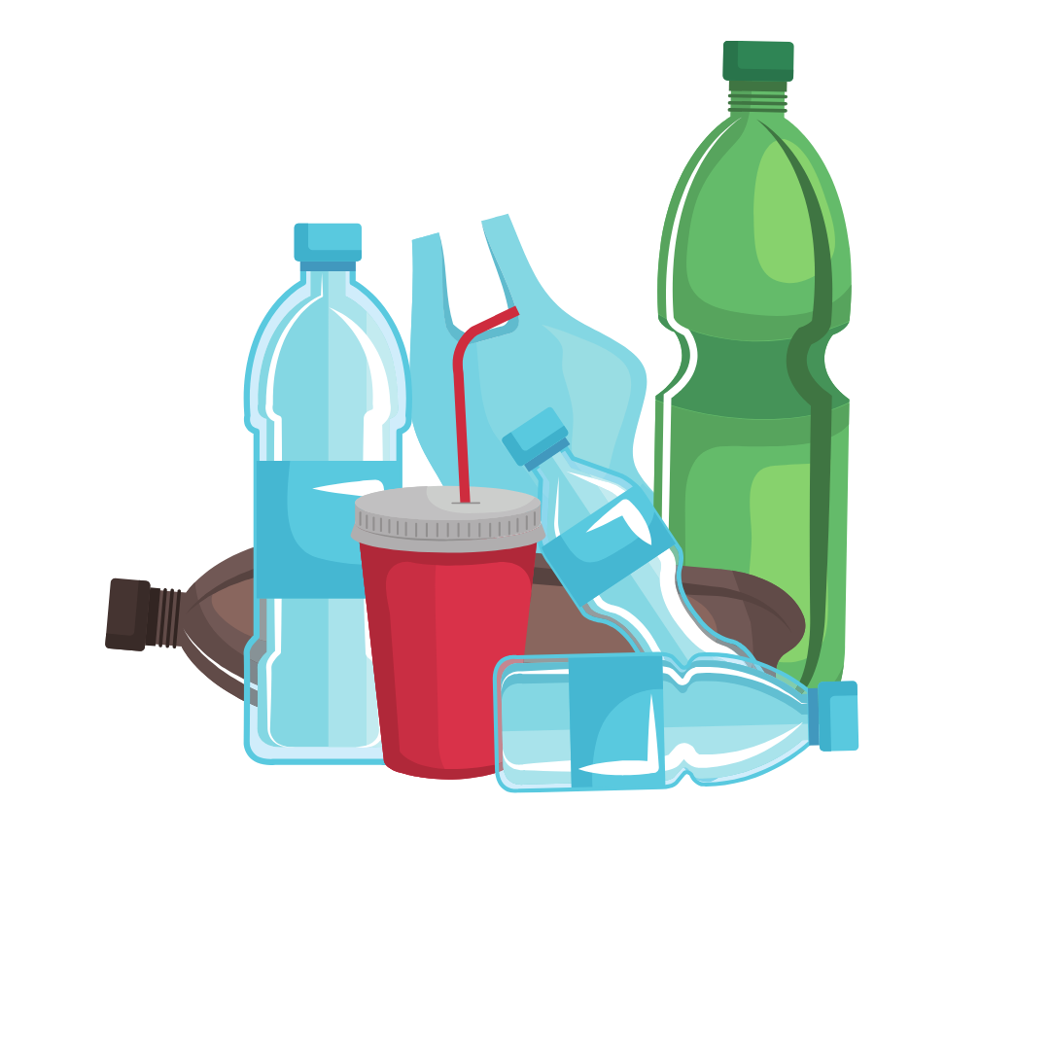

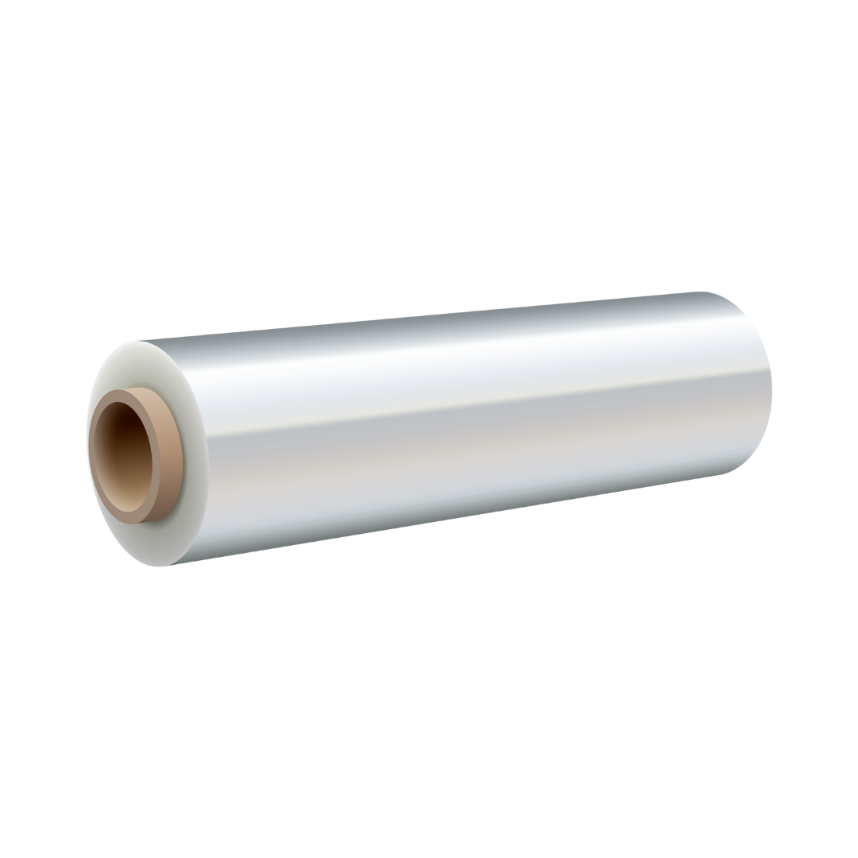
Biggest Plastic Waste Contributors
Containers & Packaging
Construction
Notes:
Explain that plastic waste is a global problem that mostly impacts our oceans, landfills, and environment. Ask students where they think the majority of plastic is produced and in what sectors.
China is the world’s largest producer of plastic materials, accounting for 32% of global plastic production in 2022. Additionally, the rest of Asia contributes 19%, while North America holds 17% of global plastic production.
Containers and packaging make up the most significant plastic producing sector, which used over 14.5 million tons of plastic in 2018. Items created in this sector include bags, sacks, wraps, bottles, and other containers. Manufacturers also use plastic in durable goods like appliances and furniture.
The Construction industry is the second-largest producer of plastics, utilizing them in pipes, insulation, and various building components.
Image:
https://en.m.wikipedia.org/wiki/File:China_in_the_world_%28undisputed%29_%28W3%29.svg

Slide 10
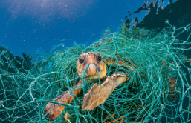
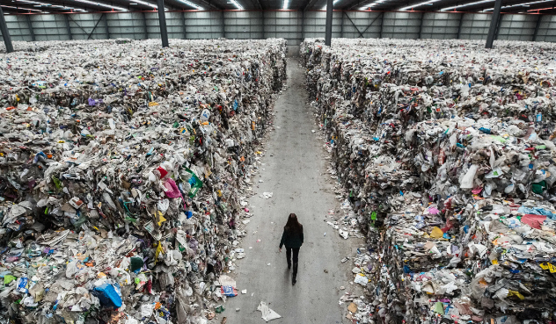
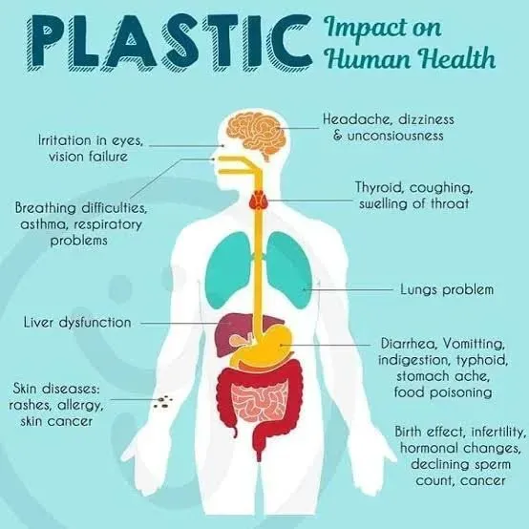
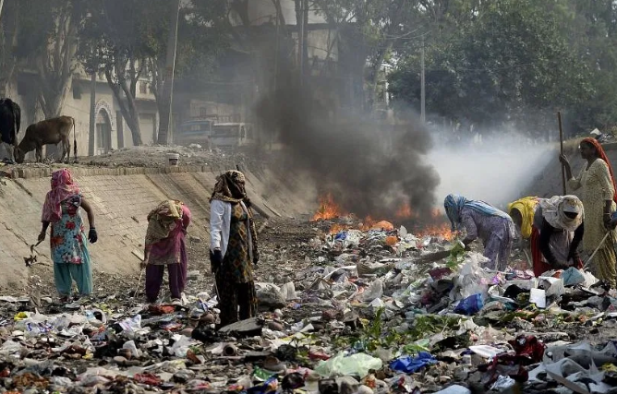
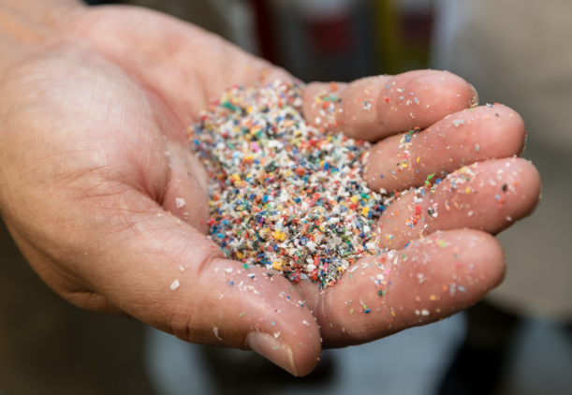
Plastic Waste Impact
Notes:
Ask the students how they think plastic waste affects the environment and to hypothesize why companies use plastic packaging despite it being so bad for the environment.
Some examples of how plastic waste affects the environment can be seen in marine ecosystems, greenhouse gas emissions, and human health.
Marine ecosystems are affected by plastic entanglement, ingestion, and toxic contamination.
The refinement of plastic emits 184 to 213 million metric tons of greenhouse gasses each year.
Human health is affected by the carcinogenic chemicals found in plastic products that can spread into tap water, which could cause developmental, reproductive, neurological, and immune disorders. Additionally, microplastics found in many places, including the air, oceans, food supply and blood have been linked to poor health outcomes affecting multiple systems of the human body.
Plastic is easy to produce, lightweight, and can be made with a wide range of physical characteristics, making it ideal for packaging materials. Additional responses could include durability, versatility, and cost-effectiveness.
Images:
https://www.nationalgeographic.com/magazine/article/plastic-planet-animals-wildlife-impact-waste-pollution
https://news.wisc.edu/new-recycling-process-could-find-markets-for-junk-plastic-waste/
https://www.rollingstone.com/culture/culture-features/plastic-problem-recycling-myth-big-oil-950957/
https://www.bbc.co.uk/newsround/48251420
https://sustainability.evccblogs.com/2024/04/the-impact-of-plastic-on-human-health/

Slide 11

Making a Difference
What can you do?
Use a reusable water bottle.
Bring a reusable bag to the store.
Avoid overly packaged items at the grocery store, such as pre-cut fruits and vegetables.
Repurpose old bottles or containers.
Cook at home instead of ordering takeout, which often includes extra plastic packaging.
Buy products from companies committed to reducing plastic use.
For a larger impact, consider:
Raising awareness by educating community members on the adverse effects of plastic.
Advocating for change by supporting legislation that reduces plastic use or by supporting organizations addressing plastic pollution.
Collaborating with community members to organize and participate in a local cleanup day or recycling demonstration.
Notes:
Discuss with students what they can do to reduce plastic waste and how they can lead by example and encourage others to follow in their footsteps. Some examples include:
Use a reusable water bottle.
Bring a reusable bag to the store.
Avoid overly packaged items at the grocery store, such as pre-cut fruits and vegetables.
Repurpose old bottles or containers.
Cook at home instead of ordering takeout, which often includes extra plastic packaging.
Buy products from companies committed to reducing plastic use.
If youth are looking to have a larger impact on the battle against plastics, encourage them to do the following:
Raise Awareness by educating community members on the adverse effects of plastic.
Advocate for change by supporting legislation that reduces plastic use or by supporting organizations addressing plastic pollution.
Collaborate with community members to organize and participate in a local cleanup day or recycling demonstration.
Image:
https://www.thehappyturtlestraw.com/impact-of-plastic-wastes-on-climate-change/

Slide 12

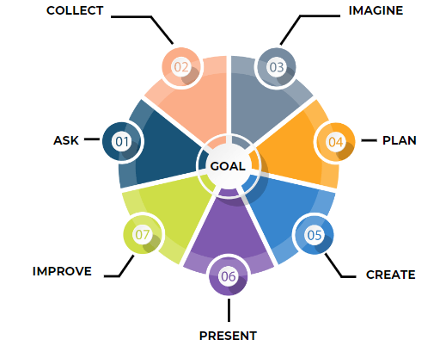
What is the Engineering Design Process?
Notes:
Introduce the engineering design process and how its use will help teams find inventive solutions by working through smaller, actionable steps.
Explain that for today's activity, we will use one of the several existing forms of the engineering design process.
The engineering design process is a series of steps that engineers follow to find a solution to a problem. It emphasizes open-ended problem solving and encourages students to take risks and learn from failure. This process nurtures students’ ability to create innovative solutions to challenges.
We will be using the following seven steps: ask, collect, imagine, plan, create, present, and improve.

Slide 13

Design Process: Ask
During this step, it’s important for teams to ask questions to fully understand the problem to develop an effective solution.
Consider asking about important criteria or limitations associated with the project.
Identifying the goals and objectives of the project are key to success!
Notes:
Discuss the importance of identifying the problem you’ve been asked to solve. Students may need to ask questions to fully understand the problem and develop a viable solution to that problem.
Team members must have the same understanding of the goals and objectives of the project. This step requires the team to identify the criteria or limitations associated with the project.

Slide 14

Design Process: Collect
This step requires teams to conduct research, collect information, and gain a better understanding of the product that needs to be developed.
Additionally, in this step teams will dig deeper into the problem by identifying why it is a problem, who it affects, and why the problem is worth solving.
Notes:
Explain that it’s important for engineers and designers to learn from the experiences of others, avoid mistakes that were made in the past, and improve current solutions. During this step, it’s important to gather detailed information and network with other people to create a solid foundation for your design.
This step requires engineers to conduct research, collect information, and gain a better understanding of the product that needs to be built.
Additionally, in this step students will dig deeper into the problem by identifying why it is a problem, who it affects, and why the problem is worth solving.

Slide 15

Design Process: Imagine
Brainstorming is a technique design teams use to generate ideas to solve clearly defined problems.
Brainstorming helps teams to draw into all their team member’s experience and consider several approaches to the challenge to generate the most successful design solution.
Explain that there are several important rules of a successful brainstorming session. Those rules include:
  Accept all creative and wild ideas without judgement
  Build on other participants’ ideas
  Don’t criticize other collaborators’ ideas
  Aim for quantity over quality
  Make it collaborative and fun!
During this step, creating sketches of the proposed designs could help the team fully understand the proposed solutions.
Notes:
Discuss with students that brainstorming is a technique design teams use to generate ideas to solve clearly defined problems. Brainstorming helps teams to draw into all their team member’s experience and consider several approaches to the challenge to generate the most successful design solution.
There are several successful brainstorming techniques teams can utilize during this step of the design process including mind-mapping, brain dumping, and brain netting (online brainstorming).
Explain that there are several important rules of a successful brainstorming session. Those rules include:
Accept all creative and wild ideas without judgement
Build on other participants’ ideas
Don’t criticize other collaborators’ ideas
Aim for quantity over quality
Make it collaborative and fun!
During this step, creating sketches of the proposed designs could help the team fully understand the proposed solutions.

Slide 16


Design Process: Plan
  After assessing each possible solution, teams must choose the best design to proceed with. This could include merging features from several designs or altering a design to better match the needs of the challenge.
    One tool engineers and designers use to narrow down their list of solutions to a single solution is a decision matrix. A decision matrix evaluates each potential solution based on a set of criteria, such as material type, cost, performance, safety, and ease of use.
Notes:
Explain that, after assessing each possible solution, engineers and designers must choose the best design to proceed with. This could include merging features from several designs or altering a design to better match the needs of the challenge.
One tool engineers and designers use to narrow down their list of solutions to a single solution is a decision matrix. A decision matrix evaluates each potential solution based on a set of criteria, such as material type, cost, performance, safety, and ease of use.

Slide 17
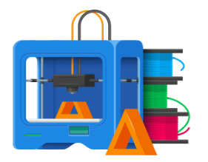



Design Process: Create
  During this step, teams get to use their hands to build and test their selected design. Creating a prototype is a key step in the development of a final solution because it allows designers to test how the solution will work. Prototypes can help teams to develop the structure, function, and appearance of their solution.
  Once a prototype has been developed based on the initial proposed design, it’s important to take time and evaluate the prototype through testing and feedback, then incorporate that feedback into the next iteration of the design. Teams should repeat this process until the desired outcome is achieved, regardless of how many iterations they go through!
Notes:
Explain that this is often the most exciting part of the engineering design process! During this step, teams get to use their hands to build and test their selected design.
Creating a prototype is a key step in the development of a final solution because it allows designers to test how the solution will work. Prototypes can help teams to develop the structure, function, and appearance of their solution.
Prototyping is an important step in the iterative design process. Once a prototype has been developed based on the initial proposed design, it’s important to take time and evaluate the prototype through testing and feedback. Then, that feedback gets incorporated into the next iteration of the design. Teams should repeat this process until the desired outcome is achieved, regardless of how many iterations they go through!

Slide 18
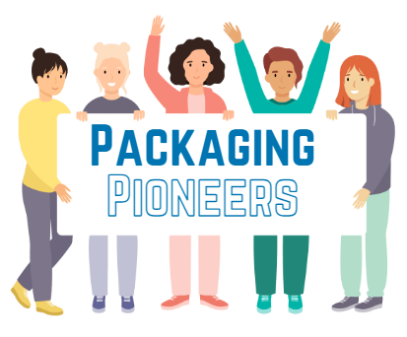
Design Process: Present
When teams present their solutions, it allows them to visually convey their message, making it easier for the audience to understand their information or ideas. Well-designed presentations enhance the quality of communication and engagement with the audience.
Presenting a solution to an audience is the opportunity to receive feedback on the design’s functionality, aesthetics, and overall design.
Additionally, public speaking and communication are highly sought-after professional skills. Without these skills, the ability to progress in the working world would be more difficult.
Notes:
Engage in conversations about how public speaking and communication are highly sought-after professional skills. Without these skills, the ability to progress in the working world would be more difficult.
Explain that public speaking allows you to inform, educate, and motivate change. Additional benefits of presenting your solution to an audience is the opportunity to receive feedback on the design’s functionality, aesthetics, and overall design.

Slide 19

Design Process: Improve
  The engineering design process is iterative, meaning that engineers and designers often repeat some or all these steps several times to refine their solution.
  Teams are not expected to develop a perfect solution the first time. It’s important to reflect on received feedback and determine how to improve on their original solution.
  It is perfectly acceptable, and expected, for teams to go back to previous steps in the design process. This iterative process teaches grit, as there is a difference between being done and doing your best work!
Notes:
The engineering design process is iterative, meaning that engineers and designers often repeat some or all of these steps several times to refine their solution.
Remind teams that they are not expected to develop a perfect solution the first time. Teams must reflect on received feedback and determine how to improve on their original solution.
It is perfectly acceptable, and expected, for teams to go back to previous steps in the design process. This iterative process teaches grit as there is a difference between being done and doing your best work.

Slide 20

Learning Activity
    Teams will work through the steps of the engineering design process to design a new, environmentally friendly packaging solution for an existing product.
Notes:
Introduce the challenge with these instructions:
Today, we are going to do a team-based activity in which you will design new, environmentally friendly packaging for an existing product. We will work through the steps of the engineering design process to complete this challenge.
Consider sharing the following resources with students for inspiration.
24 Eco Friendly Packaging Examples that Benefit your Brand | Packhelp
12 Packaging Designs That Are As Good As the Product (interestingengineering.com)
11 Most Innovative Sustainable Packaging Ideas (remesh.ai)
Each team will select a product to redesign the packaging for. Note: if physical examples of the products are provided, allow students take their selected product back to their group for further investigation.
Distribute the student activity workbook to each student. Ask students to turn to page 2 in the Student Activity Workbook, which shows the steps of the engineering design process that will be used today. Explain that utilizing this workbook will help students stay organized as they work through the steps of the engineering design process.

Slide 21
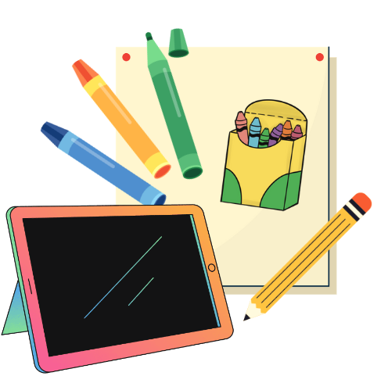
Materials
Student Activity Workbook: Packaging Pioneers, 1 per student
Computer, Chromebook, Tablet, etc. that has internet capabilities, 1 per group
Poster board (22” x 28” or 56cm x 71cm), 1 per group
Markers/crayons, 1 package of markers or crayons containing multiple colors per team
Pencil, 1 per student
Physical examples of items for groups to choose from to redesign, (optional)
Notes:
Note: Distribute materials to teams.

Slide 22
Design Process in Action! Ask & Collect
  Teams will be given 10 minutes to ask questions, research examples of sustainable packaging, and identify key characteristics of their assigned product using the internet.
  Potential research topics could include the following:
      The difference between sustainable and non-sustainable packaging.
      Examples of sustainable packaging that reduces waste.
      The cost of various eco-friendly packaging materials.
      Positive and negative characteristics of the current packaging solution for their assigned product.
      Temperature requirements for their assigned product to consider during shipping.
      Size constraints for their assigned product.
*Record research in the Student Activity Workbook to ensure all information is captured.
Notes:
Ask students to turn to page 3 in their Student Activity Workbook. Explain that ‘ask’ and ‘collect’ will be combined into a single step for the purpose of this activity. Students will be given 10 minutes to ask questions, research examples of sustainable packaging, and identify key characteristics of their assigned product using the internet.
Potential research topics could include the following:
The difference between sustainable and non-sustainable packaging.
Examples of sustainable packaging that reduces waste.
The cost of various eco-friendly packaging materials.
Positive and negative characteristics of the current packaging solution for their assigned product.
Temperature requirements for their assigned product to consider during shipping.
Size constraints for their assigned product.
Remind students to record their research in their Student Activity Workbook to ensure all information is captured.

Slide 23

Design Process in Action! Imagine
  Using what they learned from the content presentation and their research, teams will spend the next 20 minutes brainstorming a list of eco-friendly packaging solutions for their assigned product.
  Teams should sketch their proposed designs to help team members fully understand the proposed solutions.
  Brainstorming Rules:
    Accept all creative and wild ideas, delay judgement
    Build on other participants’ ideas
    Don’t criticize other collaborators’ ideas
    Aim for quantity over quality
    Make it collaborative and fun!
  Toward the end of the 20 minutes, teams should have narrowed down their solutions to the top five ideas.
*Record all ideas in the Student Activity Workbook to ensure all information is captured.
Notes:
Ask students to turn to page 4 in their Student Activity Workbook. Using what they learned from the content presentation and their own research, engage students in a 20-minute brainstorming session to create a list of eco-friendly packaging solutions for their assigned product.
Remind students to record all ideas from the brainstorming session in their Student Activity Workbook.
Encourage teams to think big, be creative, and consider everything.
Walk around to hear about some of the ideas and ask questions to get more detail from team members.
Encourage teams to use page 5 in the Student Activity Workbook to sketch potential solutions.
Toward the end of the 20 minutes, ensure that every team has selected their top five ideas.

Slide 24

Design Process in Action! Plan
Using a decision matrix provided in the Student Activity Workbook, teams will have 5 minutes to select the final design solution for their product.
Decision Matrix steps:
    List the top 5 solutions determined by the team in the first column.
    Determine the factors or criteria that matter most to each team. List those factors across the first row. Possible factors could include cost, strength, access to materials, eco-friendliness, ease of development, aesthetics, etc.
    Evaluate each solution option against the criteria (usually on a scale of 1 to 5).
    Add up the scores in each row.
    The highest-scoring solution is the best choice!
Notes:
Ask students to turn to page 6 in their Student Activity Workbook. Explain that teams will be using a decision matrix to select the final design solution for their product. Allow students 5 minutes to complete this step of the design process.
Assist each team with the following steps:
List the top 5 solutions determined by the team in the first column.
Determine the factors or criteria that matter most to each team. List those factors across the first row. Possible factors could include cost, strength, access to materials, eco-friendliness, ease of development, aesthetics, etc.
Evaluate each solution option against the criteria (usually on a scale of 1 to 5).
Add the scores across each row.
The highest-scoring solution is the best choice!

Slide 25


Design Process in Action! Create
  Using the poster and markers, teams will have 15 minutes to create a poster to help them present their solution to the larger group.
  Teams should include the following information in their poster presentations:
    Product title and names of team members.
    Steps taken to develop the final solution.
    Key words from research that were most helpful in developing a solution.
    Criteria used to determine the final solution.
    Illustration of the final solution.
    Strengths of the solution.
    Most unique feature of the design.
    How the new solution is more environmentally friendly than the existing solution.
    New vocabulary learned throughout this activity.
    Remember: Your presentation should be no longer than 5 minutes.
Notes:
Using the poster and markers, ask teams to create a poster that they will use to help them present their solution to the larger group. Review the presentation requirements with each team.
Teams should include the following information in their poster presentations:
Title and names of team members.
The steps your team took to develop the final solution.
Key words from research that were most helpful in developing a solution.
Criteria used to determine the final solution.
An illustration of the final solution.
The strengths of the solution.
The most unique feature of the design.
An explanation of how the new solution is more environmentally friendly then the existing solution.
Encourage teams to use new vocabulary learned throughout this activity in their presentation.
Presentation should be no longer than 5 minutes.

Slide 26

Design Process in Action! Present
  Teams will be given 5 minutes to present their solution to the larger group.
  After each presentation, teams should be prepared to answer questions from other teams and volunteers regarding their new, eco-friendly solution.
Notes:
Reconvene the large group. Explain it’s now time for teams to present their eco-friendly packaging solution to the group.
Ask for a team to volunteer to present first. Request that the presenters stand where everyone in the room can see them.
After each presentation, allow students time to ask the presenting team questions.
Provide brief feedback and ask the team questions you may have on their design. Consider asking any of the following questions.
Did you discover any unexpected obstacles or solutions?
What would you change about your design if you were to do it again?
Which step of the engineering design process do you think is most important?
Ask students to write down feedback received from the audience on page 8 of the Student Activity Workbook. Repeat the process until all teams have shared their solutions.
Ask for a team to volunteer to be the first presenters. Request that the presenters stand where everyone in the room can see them.
After each presentation, allow students time to ask the presenting team questions.
Provide brief feedback on the design presented and ask the team questions you may have on their design. Consider asking any of the following questions.
Did you discover any unexpected obstacles or solutions?
What would you change about your design if you were to do it again?
Which step of the engineering design process do you think is most important?
Ask the larger group if there are any questions for the presenters.
Repeat the process until all teams have shared their solutions.

Slide 27

Design in Action! Improve
  Teams will have 5 minutes to regroup in their groups to incorporate any input from volunteers and peers received during their presentation into their designs.
  It’s important to remember that the engineering design process is iterative, which means you can repeat some or all the design process steps multiple times to fine-tune your solution!
Notes:
Allow students 5 minutes to regroup in their teams to incorporate any input from volunteers and peers received during their presentation into their designs.
Remind students that the engineering design process is iterative, which means they can repeat some or all of the design processes multiple times to fine-tune their solution.
Encourage teams to document any updates to their design on page 8 of the Student Activity Workbook.

Slide 28
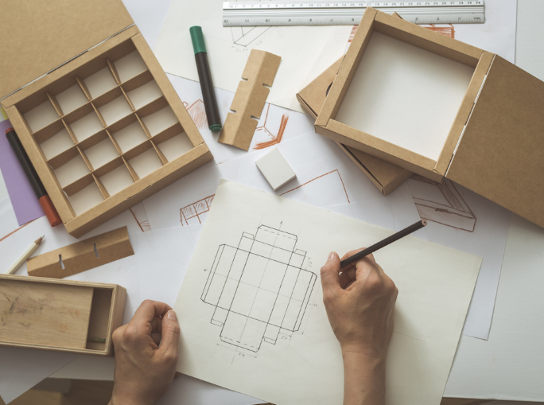
STEM²D Careers in Engineering Design
Material Science Engineer
Packaging Engineer
Mechanical Engineer
Industrial Engineer
Waste Management Engineer
Recycling Coordinator
Plastics Recycling Technician
Environmental Scientist
Green Transportation Professional
Research Scientist
Notes:
Review the list of STEM2D careers that are connected to packaging and design. Encourage students to research some of the careers listed to determine if one of them might be a match based on their interests.
Image:
https://creopack.com/en/articles/what-is-a-packaging-engineer/

Slide 29
Reflection
  How do you think this activity relates to a career in science and/or working at Johnson & Johnson?
  Can you see yourself as a STEM²D professional? In what role? Why or why not?
  What do you need to do to make this happen?
  What is one thing you learned that you did not know coming in today?
Notes:
Ask students to reflect on the challenge. Have students spend a few minutes thinking about the listed questions and then ask for volunteers to share their thoughts on any of the following:
How do you think this activity relates to a career in science and/or working at Johnson & Johnson?
Can you see yourself as a STEM2D professional? In what role? Why or why not?
What do you need to do to make this happen?
What is one thing you learned that you did not know coming in today?
Thank students for joining you today and encourage them to continue exploring careers in STEM2D

Slide 30
Packaging Pioneers
  Thank you for participating!
Notes:
Thank students for joining you today and encourage them to continue exploring careers in STEM²D.

Slide 31
Image Sources
Slide 2:
https://tipa-corp.com/blog/eco-friendly-packaging-guide/
Slide 8:
https://edu.rsc.org/feature/plastic-waste/3009361.article
Slide 9:
https://en.m.wikipedia.org/wiki/File:China_in_the_world_%28undisputed%29_%28W3%29.svg
Slide 10:
https://www.nationalgeographic.com/magazine/article/plastic-planet-animals-wildlife-impact-waste-pollution
https://news.wisc.edu/new-recycling-process-could-find-markets-for-junk-plastic-waste/
https://www.rollingstone.com/culture/culture-features/plastic-problem-recycling-myth-big-oil-950957/
https://www.bbc.co.uk/newsround/48251420
https://sustainability.evccblogs.com/2024/04/the-impact-of-plastic-on-human-health/
Slide 11:
https://www.thehappyturtlestraw.com/impact-of-plastic-wastes-on-climate-change/
Slide 28:
https://creopack.com/en/articles/what-is-a-packaging-engineer/

