Slide 1
Egg Drop Challenge
STEM²D Topics: Design and Manufacturing
[Presenter Name]
[Presenter Organization]
[Date]

Slide 2






What is STEM²D?
Science
Technology
Engineering
Math
Manufacturing
Design

Slide 3
Today’s Plan
Introductions
STEM²D in the World of Work
Design and Manufacturing Overview
Science Concepts
Egg Drop Challenge
Recap and Reflect

Slide 4

STEM²D in the World of Work
How do you think design and manufacturing are used every day in the workplace?
What kinds of careers do you think people with an interest, aptitude for, or degree in design or manufacturing would have?
Notes:
Share that STEM²D careers are high-demand, high-growth careers.
Initiate an opening discussion and brainstorming activity. Consider asking:
How do you think design and manufacturing are used every day in the workplace?
What kinds of careers do you think people with an interest, aptitude for, or degree in design or manufacturing would have?

Slide 5


Tell My Story

Slide 6
My Story (delete if not using)
Notes:
Talk about your educational and career path. Use the “Tell My Story” form as the basis for your remarks. Be prepared to describe your job or a typical day, and provide information about your background including:
When/why you developed an interest in design or manufacturing.
The classes/courses you took in secondary school.
Your post-secondary path, including the institution you attended and your degree. If you switched disciplines, make sure you explain why to the students.
What your current position entails. Be sure to include how you use design and manufacturing and what you do on a typical work day.
Weave in facts about design and manufacturing and STEM²D careers:
Tell the students that your career is only one of the many careers available in the STEM²D disciplines—science, technology, engineering, math, manufacturing, and design.
Explain that STEM²D careers are high-demand, high-growth careers and are predicted to remain in demand over the next ten years.
Share a few Johnson & Johnson job titles and careers that may align with this activity:
Design Engineer
Quality Engineer
Manufacturing Engineer
Test Engineer

Slide 7

Design and Manufacturing

Slide 8
What Do You Know About…
Design and Manufacturing?
Notes:
Ask students to raise their hands and share what they know about Design and Manufacturing. Choose 3–4 students to answer.

Slide 9
The Design Process
Define the Need
Brainstorm
Design
Build
Rebuild
Test & Evaluate
Share the Solution
Notes:
The design process can have many steps. Today we will learn about a seven-step design process:
Define the Need: Determine the problem or challenge that needs to be solved.
Brainstorm: Think about different ways to tackle the challenge. Share different ideas. Record all potential ideas for further discussion.
Design: During this phase, teams collaborate and determine which ideas have the most potential given the available time, tools, and materials. Explore these ideas in further detail. Create sketches of ideas. Determine materials to be used. Create working drawings so the selected idea can be built.
Build: Make a model or prototype of the proposed design using the available materials.
Test and Evaluate: Test the model in a controlled and working environment to see if it produces the desired outcome. Gather data on the performance of the model. Check the results to determine if the model solved the problem. Identify areas of concern and shortcomings. Determine any changes to be made.
Rebuild: Perfect the working prototype. Make any necessary changes to the design based on testing and evaluation.
Share the Solution: Answer the following questions: What’s the best feature of the design? What different steps were taken to get the project to work? What modifications were made? Should this prototype be recommended for “market testing” and manufacturing?

Slide 10
Manufacturing
Creating something from raw materials, by hand or by machinery.
Video: Manufacturing Contact Lenses (Johnson & Johnson)
  https://www.youtube.com/watch?v=0qRXyCQHkoM
Video: Inside Ford’s Moving Assembly Line https://www.youtube.com/watch?v=jLud5XYfY_c
Notes:
Manufacturing is creating something from raw materials, either by hand or by machine.
Click the links to watch one or both videos.
The Johnson & Johnson video is four minutes long.
The Ford Motor Company video is two minutes long.

Slide 11
Questions?

Slide 12
Science Concepts
Video: The Science Behind Egg Drop Experiments
  https://www.youtube.com/watch?v=HeNBef3IQEI
Notes:
First we will learn about the role science has in design and manufacturing.
Click the link to show the video Science Concepts Behind the Egg Drop Experiment – 2 ½ minutes long. Review the key words from the video:
Acceleration – an increase in speed
Force – a push or pull on an object
Gravity – a force which tries to pull two objects towards each other
Impact – the striking of one thing against another
Mass – the amount of matter or substance that makes up an object
Physics – the study of matter, energy, and the interaction between them

Slide 13

The Egg Drop Challenge

Slide 14
The Rules
Work as a team.
Build a device that can safely deliver an egg from a height of 10 ft. (3 meters) using the LEAST costly materials.
ONLY the materials provided can be utilized:
  Each of the materials is allocated a cost.
  Teams can purchase as many of the materials as needed.
  Keep track of the total cost (including materials purchased but not used) using the Student Handout: Material Cost Form.
Only 1 (final) design will be tested per team.
THE WINNING TEAM = Lowest cost device that protects the egg from any cracks or breaks from a 10 ft. drop.
Notes:
Your team’s task is to build a device that can safely deliver an egg from a minimum height of 10 ft. using the least costly materials to do so.
Only the materials provided here can be utilized to build the device. Each material is assigned a cost.
You may purchase as many of the materials your team would like, but you must keep track of the total cost of your purchases (even if you did not use them all) using the Materials Cost Form.
Only one final design will be tested per team.
The winner of the Egg Drop Challenge will be the team whose device cost the least while protecting the egg from any cracks or breaks from a minimum 10 ft. drop.

Slide 15

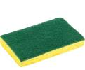


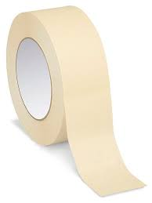

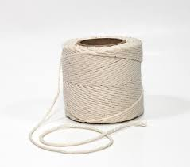

The Materials
  Cotton Balls – $1 each
  Straws - $1 each
  Marshmallows - $2 each
  Sponge - $5 each
  Tape – No Cost
  Piece of Paper - $1 each
  String - No Cost
  Pipe Cleaner - $1
Notes:
These are the only materials that you may use to build your device.
Each material is listed on the Materials Cost Form, along with its assigned cost.
Remember to keep track of how many of each item you purchase.
Even if you don’t use an item, if you have purchased it from the market, you must count it on your Materials Cost Form.

Slide 16
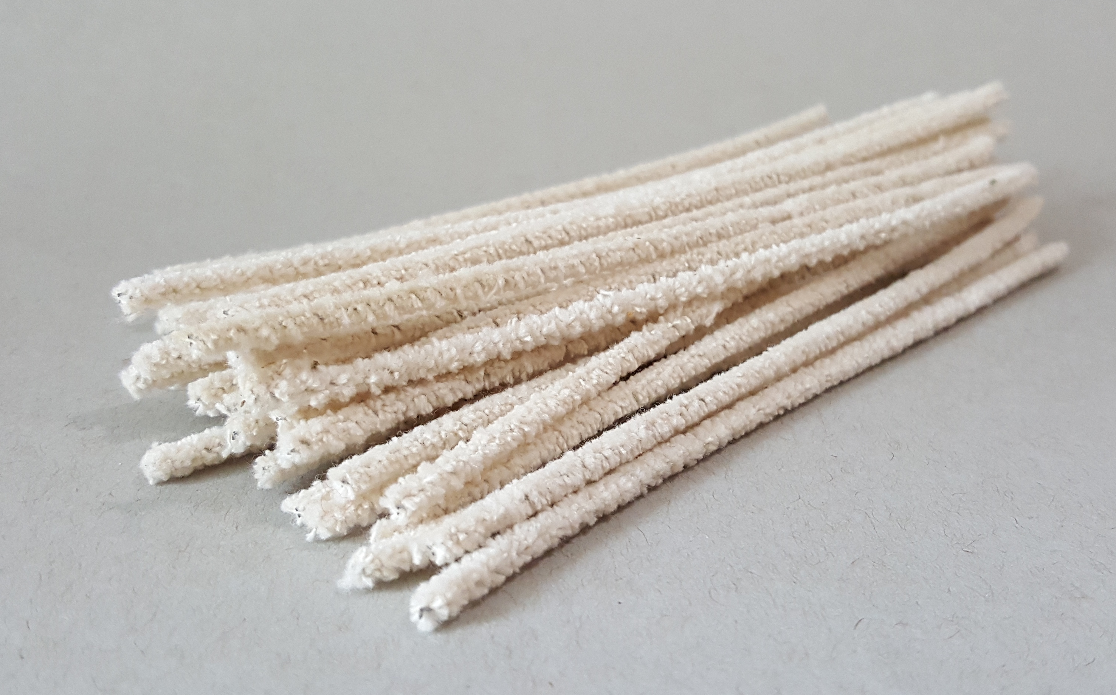
The Materials
  Cotton Balls – $1 each
  Straws - $1 each
  Marshmallows - $2 each
  Sponge - $5 each
  Tape – No Cost
  Piece of Paper - $1 each
  String - No Cost
  Pipe Cleaner - $1
Notes:
These are the only materials that you may use to build your device.
Each material is listed on the Materials Cost Form, along with its assigned cost.
Remember to keep track of how many of each item you purchase.
Even if you don’t use an item, if you have purchased it from the market, you must count it on your Materials Cost Form.

Slide 17
Scrap
Scrap is the discarded or rejected material from an operation.
  The cost of scrap to a project can be very high.
  Scrap costs are a manufacturing reality that affects organizations across all industries and product lines.
  Scrap costs are higher than necessary when the wrong parts are ordered, when engineering changes aren’t effectively communicated, and when designs aren’t properly executed on the manufacturing line.
Notes:
See slide for information to share

Slide 18
Scrap (continued)
Example: If I purchase five marshmallows at $1 each to build my device for the Egg Drop Challenge and I only use one marshmallow, then I have four excess marshmallows (Scrap = 4 marshmallows).
The apparatus cost me $4 more than it should have because of the excess (scrap) marshmallows.
Notes:
See slide for information to share

Slide 19
Let’s Get Started!
Review the Challenge
Brainstorm
  Discuss potential ideas
  Sketch potential designs
  Think about the materials
Design
  Decide on the the best design
  Determine the materials to be used
Build the Prototype
Test & Evaluate
  Think about critical items to inspect in your design
  Test the design
  Evaluate the prototype
  Ask yourself: What did we learn? What needs to be changed?
Rebuild
  Manufacture the final design
Share the Solution
  Calculate the total cost of materials
  Determine the amount of scrap
Notes:
Give teams 30 minutes to design and manufacture their egg-carrying device.
Instruct teams to think about the following as they go through the steps of the product design process:
Review the Challenge: Build a device that will safely deliver an egg from a minimum height of 10 ft. (3 meters) using the least costly materials.
Brainstorm: Discuss potential ideas and/or sketch potential designs. Think about what materials are needed.
Design: Determine the best design. Develop instructions for building the model or prototype.
Build the prototype.
Test and Evaluate: Think about critical items to inspect in your product design, then test your design. Evaluate the prototype. Ask yourself: What did we learn? What needs to be changed?
Rebuild: Manufacture the final design.
Share the Solution: Calculate the total cost of materials. The final cost must include all materials purchased (including scarp), not just the materials used in the device.

Slide 20
Questions?

Slide 21

Performance Testing
Notes:
After 30 minutes, reconvene the large group. Indicate that it is time to test each team’s device. Instruct each team to bring their device and Materials Cost Form listing their costs to the performance testing area.
Establish the order in which the teams will test their devices. In that same order, first have a representative of each team state the total cost of their materials and record this on flipchart paper or a white board.
Give the first team representative an egg and instruct him/her to drop the device (with egg inside) from 10 ft. (3 meters).
Once the device hits the ground, ask the team to open the device. Inspect the egg for any cracks or breaks. Disqualify the team if the egg is cracked or broken.
Continue in the same manner until all teams have completed the performance testing.
State which teams “passed the test”—i.e., their devices protected the egg from any cracks and breaks. Then determine which of these teams had the lowest materials costs.
Announce the winning team: the team whose egg did not crack or break in testing and had the lowest materials costs among the “passing” teams.

Slide 22
What Did We Learn?
What was the most critical decision your team made during the
design phase?
What was the most critical decision your team made during the
build phase?
What was the most critical decision your team made during the testing and evaluation phase?
What was difficult about designing and manufacturing the device?
What would you change about your design if you were to build it again?
Notes:
See slide for questions to ask

Slide 23
Reflection
What did you learn about Design and Manufacturing?
How do you think this activity relates to a career in Design and Manufacturing and/or working at Johnson & Johnson?
Can you see yourself as a STEM2D professional? In what role? Why or why not?
What would you need to do to make that happen?
What is one thing you learned that you did not know coming into today?
Notes:
See slide for questions to ask

Slide 24

Performance Testing
Notes:
After 30 minutes, reconvene the large group. Indicate that it is time to test each team’s device. Instruct each team to bring their device and Materials Cost Form listing their costs to the performance testing area.
Establish the order in which the teams will test their devices. In that same order, first have a representative of each team state the total cost of their materials and record this on flipchart paper or a white board.
Give the first team representative an egg and instruct him/her to drop the device (with egg inside) from 10 ft. (3 meters).
Once the device hits the ground, ask the team to open the device. Inspect the egg for any cracks or breaks. Disqualify the team if the egg is cracked or broken.
Continue in the same manner until all teams have completed the performance testing.
State which teams “passed the test”—i.e., their devices protected the egg from any cracks and breaks. Then determine which of these teams had the lowest materials costs.
Announce the winning team: the team whose egg did not crack or break in testing and had the lowest materials costs among the “passing” teams.

