Slide 1

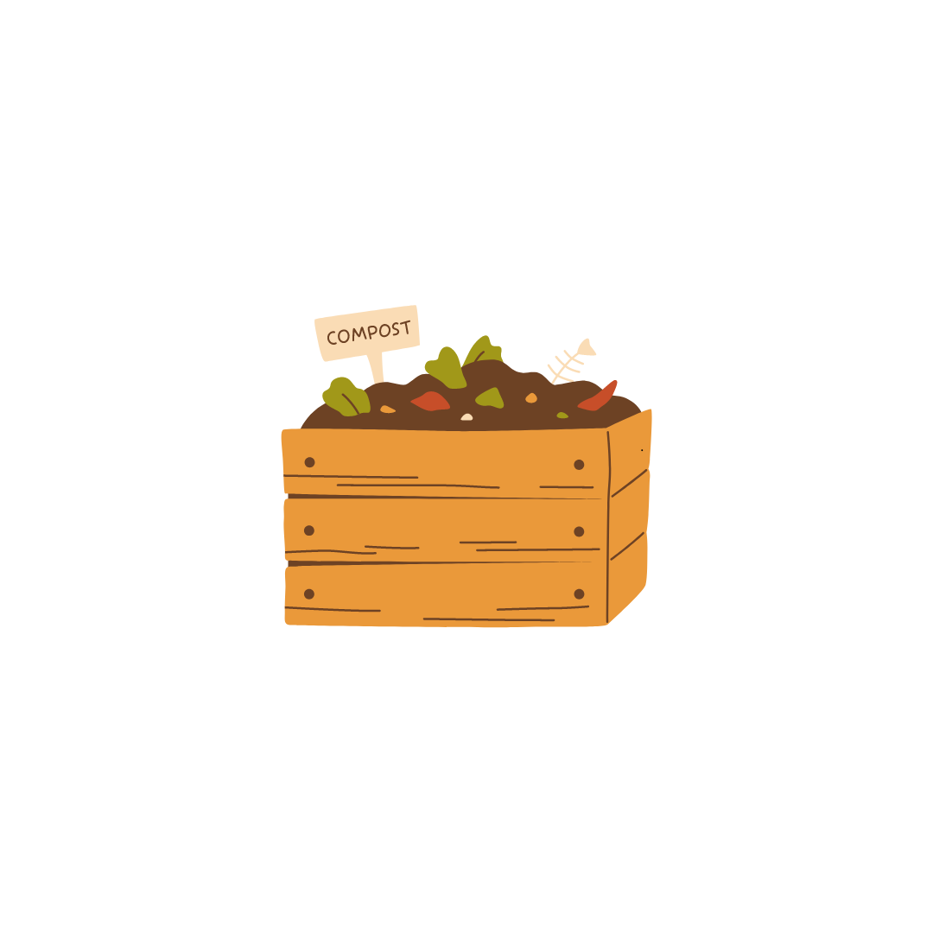

Eco-Enrichment Expedition
STEM²D Topics: Science, Engineering
Presenter:
Date:

Slide 2

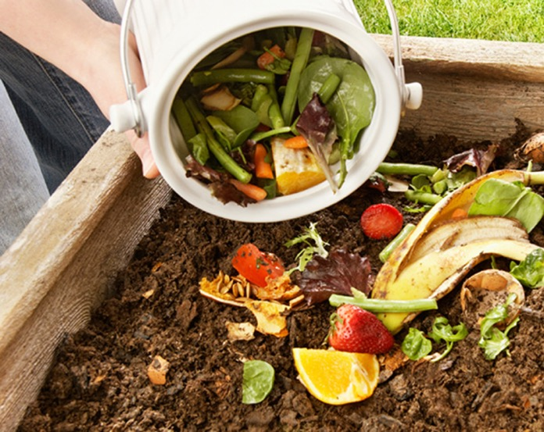
Today’s Plan
Introduction
Composting
  What is composting?
  Different types of composting
  Utilization of compost
Activity: Soda Bottle Composting
Reflection
Notes:
Review the agenda. Explain that today students will learn about composting and related practices.
Students will create a mini composter that allows them to observe the process of composting at home over several weeks.
Divide the large group into teams of two and instruct them to sit together for the remainder of the session.
Image:
https://ngorisefoundation.com/2022/06/28/chemistry-of-aerobic-composting/

Slide 3

What is STEM²D?
Science
Technology
Engineering
Mathematics
Manufacturing
Design
Notes:
Explain that STEM2D refers to: Science, Technology, Engineering, Mathematics, Manufacturing, and Design.
Tell the students there is high growth among STEM2D careers and high demand in this area. Tell them your own career is only one of many in STEM2D fields.
Explain that some STEM2D careers do not require college degrees and still offer exciting, high-paying opportunities. Stress the importance of gaining mathematics skills to succeed in any STEM2D career.

Slide 4


My Story
Notes:
Continue the introductions by talking about your educational and career path.
Delete this slide if not needed.

Slide 5


My Story
Name:
Fun facts or other thoughts:
Job Title:
Company:
Education:
Notes:
Duplicate this slide for multiple volunteers.
Be prepared to describe your job or a typical day and provide information about your background including:
When/why you developed an interest in your field.
The classes/courses you took in secondary school.
Your post-secondary path, including any university and non-university institutions, certificates, or degrees. If you switched disciplines, make sure you explain why to the students.
What your current position entails. Be sure to include how you use STEM²D concepts and skills and what you do on a typical workday.

Slide 6

Science & Engineering in the World of Work
What is environmental sustainability?
How are science and engineering used in environmental sustainability fields?
What kinds of careers do you think fit within the environmental sustainability pathway?
Notes:
According to the US Environmental Protection Agency, environmental sustainability refers to long-term maintenance of ecosystem components and functions for future generations. Sustainability is based on a simple principle: Everything that we need for our survival and well-being depends, either directly or indirectly, on our natural environment. To pursue sustainability is to create and maintain the conditions under which humans and nature can exist in productive harmony to support present and future generations.
Careers in environmental sustainability: Environmental Scientist, Geologist, Ecologist, Urban Planner, Landscape Architect, Environmental Consultant, Air Quality Engineer, Environmental Engineer and many, many, more!

Slide 7

Eco-Enrichment
Expedition

Slide 8
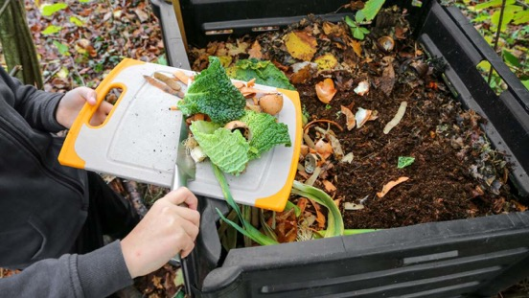
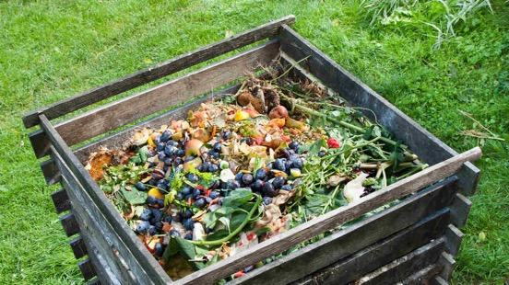
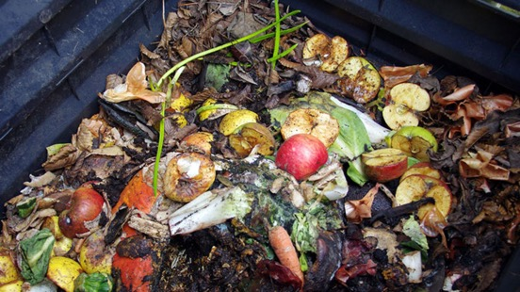
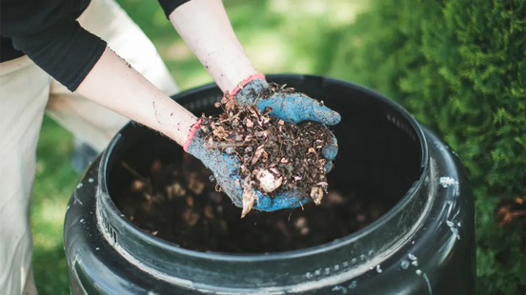
What is Compost?
Compost is a type of organic matter that you can add to soil to help plants grow.
To make it, you collect natural materials that you would otherwise discard, such as food scraps, leaves, and yard trimmings, and let them decompose over time.
The resulting material is nutrient-rich and can be used in gardens as a soil conditioner and natural pesticide.
Notes:
Begin by asking what the students already know about compost. Explain what composting is and how composting can contribute to environmental sustainability.
Compost is organic material that has decomposed.
In nature, composting happens as part of the decomposition process. Organic materials like leaves, dead plants, and animal matter break down over time through the action of microorganisms, insects, and other decomposers.
In a controlled environment, composting is an accelerated, aerobic (oxygen-using) biological decomposition process in which humans use specific kinds of microorganisms and other decomposers to turn organic materials like food waste into soil.
Anything that grows decomposes eventually; composting simply speeds up the process by providing an ideal environment for bacteria, fungi, and other decomposing organisms (such as worms, sowbugs, and nematodes) to do their work. The resulting decomposed matter, which often ends up looking like fertile garden soil, is called compost.
It is made by combining “green” items like food scraps and grass cuttings with “brown” items like leaves and wood chips, which then break down over time.
Adding compost to a garden or creating optimal conditions for creating compost through vegetative blankets and reduced tilling enhances soil life.
Images:
https://lifehacker.com/the-five-laziest-ways-to-compost-1850602707
https://www.healthline.com/nutrition/composting-beginners-guide
https://sustainability.yale.edu/explainers/yale-experts-explain-compost
https://www.worldcentric.com/journal/compost-at-home

Slide 9


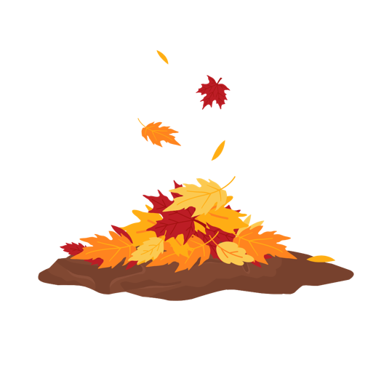


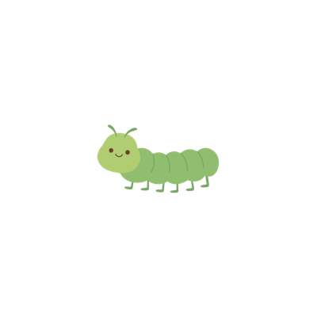

How Does Composting Happen in Nature?
Organic material falls to the ground
Organisms feed on
organic matter
Organisms release nutrients back into the soil promoting new plant growth
Notes:
Indicate that composting doesn’t have to be intentional, and that composting is nature’s way of recycling. The mechanics of intentional or planned composting are very similar to the natural decomposition of dead organics that happens everywhere, all the time. When plants, leaves, and other organic materials fall to the ground, they begin to break down and decompose.
Millions of tiny organisms, such as bacteria, fungi, and insects, play a crucial role in breaking down these materials. As organic materials decay and accumulate, different kinds of organisms are needed to keep the process going. Different organisms work to break down organic molecules of different sizes and complexity. As these organisms feed on the organic matter, they release nutrients such as nitrogen and phosphorus back into the soil. These nutrients become available for new plant growth.
Composting is essentially nature’s recycling process, but when we intentionally create ideal conditions—such as temperature, moisture, and aeration—we can accelerate decomposition. The end result is nutrient-rich compost that enriches soil and supports plant growth.
Composting has a positive impact on creating healthy ecosystems and sustaining life on our planet. Plus it gives us a way to recycle our food waste right at home!

Slide 10
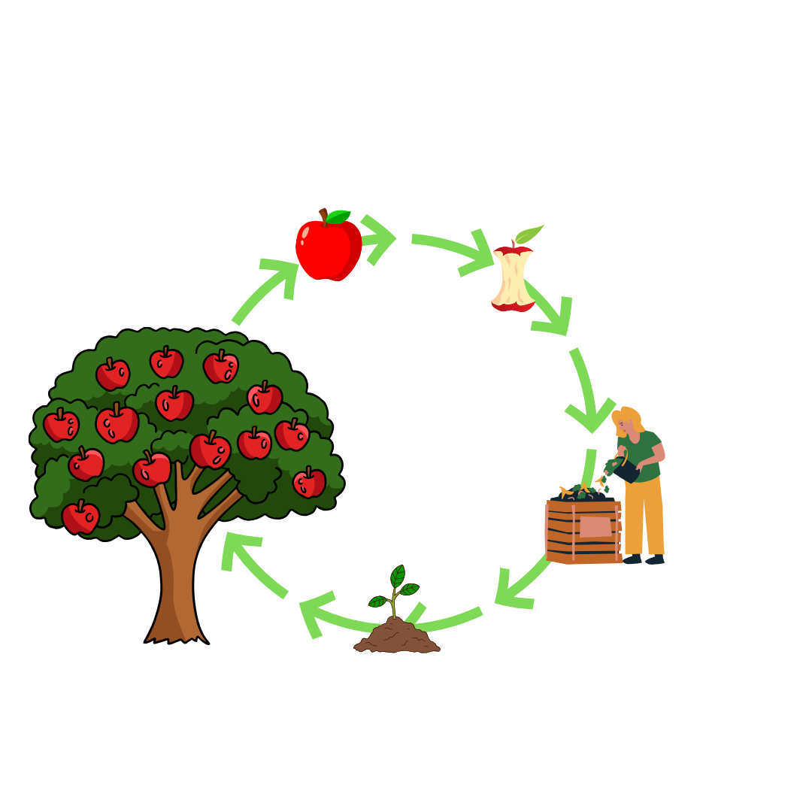
Composting Life Cycle
Fruits and vegetables
Leftover food scraps and other organic material
Organic material goes in the compost bin
New plant growth
When decomposed compost is mixed with soil it supports plant growth
Notes:
Review the life cycle of compost illustrated on this slide.
By composting you are not just dealing with food waste, but also creating a valuable product which helps to build healthy soils.
So, when leftover food scraps, peelings, leaves and other organic material go through a composting process, they are broken down and eaten by billions of microscopic bacteria, fungi and organisms.
The resulting compost is a rich source of nutrients for plants.
Other benefits of compost for plants are that it improves the drainage of soil, improves the amount of oxygen getting to plant roots, improves the pH, the soil structure and the beneficial microorganisms.
The microorganisms living in soil (including worms) are the great recyclers of the natural world.
Images:
https://www.fast-growing-trees.com/pages/composting-guide
Resources:
https://sustainability.yale.edu/explainers/yale-experts-explain-compost
Composting as Food and Climate Action | Glasgow Community Food Network (glasgowfood.net)

Slide 11
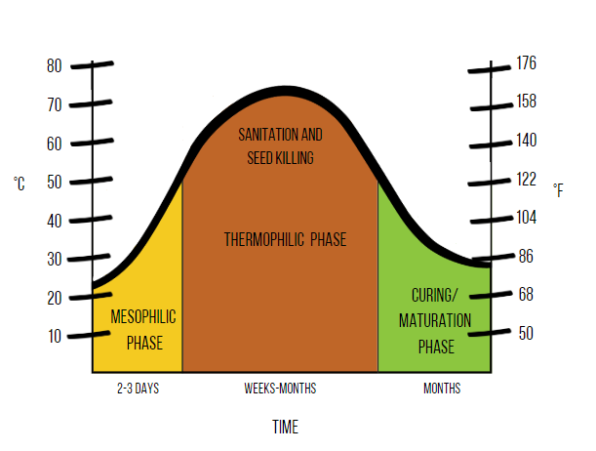
Compost Decomposition Phases
Rotting organic matter in a compost heap goes through three distinct phases of decomposition:
Mesophilic: During this initial phase, decomposition speeds up, and heat is generated. It typically lasts a short amount of time.
Thermophilic: In this more active phase, high temperatures break down organic waste further. It usually lasts a couple of weeks.
Curing: The final stage involves cooling down and maturing. Composting materials reach their nutrient-rich state during this longer phase.
It should be noted that these stages refer to “aerobic” decomposition (with oxygen), which is the preferred and more efficient method of making compost.
Notes:
Explain that there is a decomposition process that organic matter goes through in order to create compost.
Rotting organic matter in a compost heap goes through three distinct aerobic phases of decomposition. Through these phases, simpler to more complicated and smaller to larger organic molecules are broken down. The three decomposition phases include:
Mesophilic: During this initial phase, decomposition speeds up, and heat is generated. It typically lasts a short amount of time.
Thermophilic: In this more active phase, high temperatures break down organic waste further. It usually lasts a couple of weeks.
Curing: The final stage involves cooling down and maturing. Composting materials reach their nutrient-rich state during this longer phase.
Resource:
Stages Of Composting (How Composting Works) (helpmecompost.com)
Images:
https://untamedscience.com/biology/ecology/ecology-articles/the-science-of-compost/

Slide 12

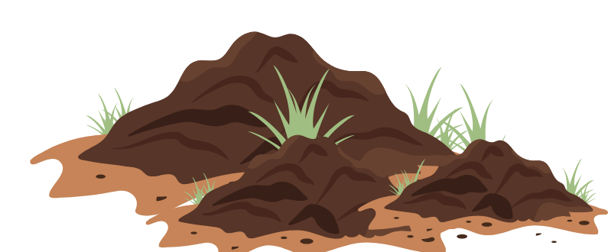
Why is Composting Important?
Reduces waste that enters landfills
Increases soils’ ability to absorb carbon
Healthier and more nutritious vegetable growth
Saves taxpayers money
Brings people together
Notes:
Composting is a powerful practice with far-reaching benefits for our planet. For example:
Compost reduces the amount of waste that goes to the landfill or gets incinerated and re-uses valuable nutrients that would have otherwise gone to waste.
Composting saves taxpayers money, as less waste needs to be transported (sometimes 100s of miles) to waste processing facilities.
Carbon from the atmosphere is transferred into the soil through the release of organic compounds into the soil by plant roots or through the decay of plant material or soil organisms when they die.
Vegetables grown in soils with added compost are healthier, more productive, and more nutritious.
When done at a neighborhood level, composting can even help to bring people together and strengthen the community.
Resource:
The Science of Compost - Basic to Advanced (untamedscience.com)

Slide 13
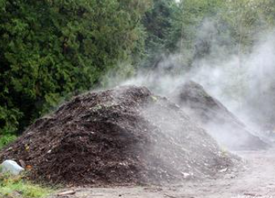
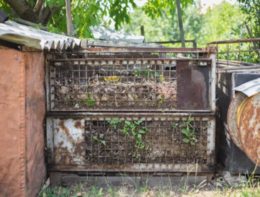
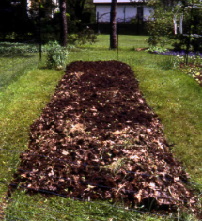
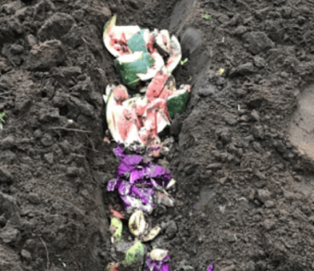
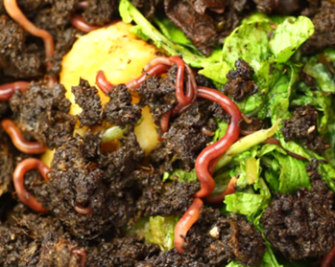
Traditional Composting Methods
Hot Composting
Cold Composting
Sheet Composting
Trench Composting
Vermicomposting
Notes:
There are many different composting methods. Each method has different advantages and disadvantages, and the best method depends on the materials, space, and climate.
Hot Composting:
Hot composting is an aerobic (with oxygen) process whereby oxygen-needing microorganisms use heat to rapidly decompose organic wastes.
Most efficient system for producing quality compost in a relatively short time.
Favors the destruction of weed seeds, fly larvae, and the pathogens.
Cold Composting:
In contrast, cold composting is an anaerobic (without oxygen) process when microorganisms that don’t need oxygen to live slowly ferment organic wastes.
Ideal for adding organic matter around trees or gardens.
The time required to decompose organic matter is controlled by environmental conditions and could take years.
Sheet Composting:
Spreading organic material on the surface of the soil and allowing it to decompose naturally.
Ideally suited for forage land, erosion control, roadside landscaping, etc.
Time is controlled by environmental conditions and can be lengthy.
Trench Composting:
Dig a trench 6-8 inches deep, fill with 3-4 inches of organic material and cover with soil. Wait a few weeks and plant directly above the trench.
This process can be relatively slow.
Vermicomposting:
Use of worms in a bin, bed or windrow to create compost.
Primary vermicomposting is feeding raw materials directly to the worms.
Secondary vermicomposting, fungi and microorganisms compost raw material before it is fed to worms.
https://www.agrifarming.in/what-is-compost-types-of-compost-compost-methods#google_vignette
https://extension.okstate.edu/fact-sheets/the-basics-of-vermicomposting.html#:~:text=composting%20and%20vermicomposting.-,Types%20of%20Vermicomposting%20Systems,(Figures%202%20and%203).
The Basics of Bokashi Composting (thespruce.com)
Hot Compost Vs. Cold Compost (Which Is Better?) (helpmecompost.com)
Soil & Fertilizing Articles - Farmers' Almanac - Plan Your Day. Grow Your Life. (farmersalmanac.com)
Cold Composting: Step-by-Step Guide (treehugger.com)

Slide 14
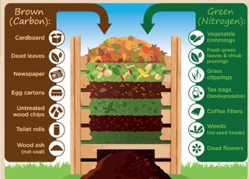
Best Materials for Composting
The best compost is produced from a combination of green (source of nitrogen) and brown (source of carbon) waste.
Alternate layers of green and brown waste in your compost.
Notes:
Students should know that not all materials can be used in composting. There are specific guidelines that must be followed to ensure effective composting. The best compost is produced from a combination of green (source of nitrogen) and brown (source of carbon) waste.
Green matter materials include fruit and vegetable scraps, grass clippings, and coffee grounds.
Brown matter materials include wood ash, brown leaves, eggshells, shredded newspaper, wood chips, sawdust, toothpicks, and burnt matches.
Image:
https://coldcreekcompost.com/kaitlin-wuz-here-composting-how-it-works/

Slide 15

What to Keep Out of Composting
Animal Products
Meat, fish, dairy, eggs, fatty foods, grease, and cooked foods with lots of salt or preservatives can decompose slowly, smell bad, and attract animals.
Some Plants
Diseased plants, plants treated with pesticides or preservatives, and weeds that have gone to seed should not be composted. Some leaves, like black walnut, horse chestnut, beech, and holly, should also be avoided because they contain toxins.
Other Materials
Plastic, bioplastics, polystyrene foam, treated wood, pet feces, and charcoal ash can also harm your compost.
Notes:
Explain that composting certain materials may lead to contamination, health risks, or unpleasant odors during decomposition. Composting certain materials can release harmful substances into the soil, affecting plants and nearby ecosystems.
Materials that should not be composted include meat and dairy products, oils or greasy foods, pet waste, human waste, diseased plants, plastic, synthetic fabrics, nutshells, and toxic plants.
https://www.azdeq.gov/compost-guide-can-and-cant-compost

Slide 16
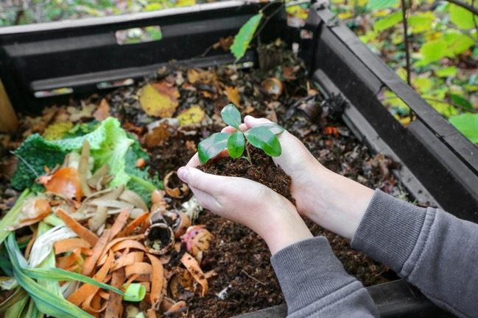
Who Uses Compost?
Agriculture and Horticulture
Green
Infrastructure
Landscape and Nursery
Soil Remediation and Land Reclamation
Vegetable and Flower Gardens
Sports Fields and Golf Courses
Sod Production and Roadside Projects
Sediment and Erosion Control
Wetland
Creation
Stormwater Management
Notes:
Discuss the different industries that make use of compost. Most students will be able to identify the more obvious uses, like agriculture and gardening, but they may be less familiar with compost usage in other fields.
Agriculture and Horticulture: Farmers and gardeners use compost to enrich soil, improve its structure, and enhance plant growth.
Landscaping and Nursery: Compost serves as a soil conditioner, promoting healthy landscapes and supporting plant health.
Vegetable and Flower Gardens: Gardeners apply compost to their vegetable beds and flower gardens to boost nutrient content and enhance soil quality.
Sod Production and Roadside Projects: Compost contributes to soil health in sod production and roadside landscaping.
Wetlands Creation: Compost aids wetland restoration and establishment.
Green Infrastructure: Compost helps create green roofs, rain gardens, and other sustainable urban features.
Soil Remediation and Land Reclamation: Compost assists in rehabilitating contaminated soils and reclaiming disturbed land.
Sports Fields and Golf Courses: Groundskeepers use compost to maintain healthy turf and soil.
Sediment and Erosion Control: Compost helps prevent erosion and stabilize soil in construction and restoration projects.
Stormwater Management: Compost improves soil’s ability to absorb and filter stormwater runoff.
Links:
Composting | US EPA
Image:
The benefits of composting for the environment - PlantGrow

Slide 17
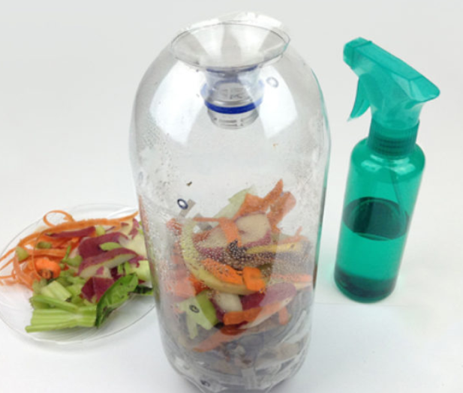
Learning Activity
    Soda bottle composters are designed to be used as tools for composting research.
    They are small and inexpensive enough to enable you to design and carry out individualized research projects, comparing variables such as reactor design, moisture content, and nutrient ratios of mixtures to be composted.
Notes:
Introduce the challenge with these instructions:
Today, we are going to do a team-based activity in which you will create your own mini composter out of soda bottles.
Soda bottle composters are designed to be used as tools for composting research. They are small and inexpensive enough to enable students to design and carry out individualized research projects, comparing variables such as reactor design, moisture content, and nutrient ratios of mixtures to be composted.
Consider playing the following 8-minute video that helps explain the individual steps of the activity: Creativity TV: Composting with a 2 Liter Bottle.
Image:
Make a Composter | Crafts for Kids | PBS KIDS for Parents

Slide 18
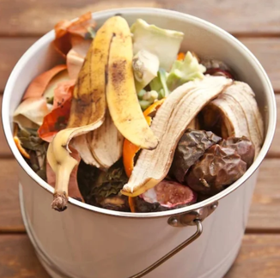
Materials
Spray bottle containing water
1 Two-liter bottle (empty and clean)
Utility knife
Plastic lid or paper plate
Duct tape
Sharpie
Pushpin
Latex gloves
1 Cup of soil (optional)
Organic materials
  Bulking (Brown) Agents – wood shavings, small wood chips, newspaper strips, pieces of paper egg cartons
  Food for the Microbes (Green) – lettuce, carrot peelings, apple core, bread crusts, banana peels, weeds, grass clippings
2 Empty paper grocery bags
Chef’s knife
Cutting board
Notes:
Review the materials required to create a Soda Bottle Composter. Including soil as the base layer of the mini composter is not required but could help expedite the decomposition of organic materials by introducing microorganisms into the pile.
Note: Depending on the number of students, consider asking students to collect their own organic waste prior to the activity.
Image:
The Scrap Bucket - The Anglican Parish of Hamilton (hamiltonanglican.org.au)

Slide 19
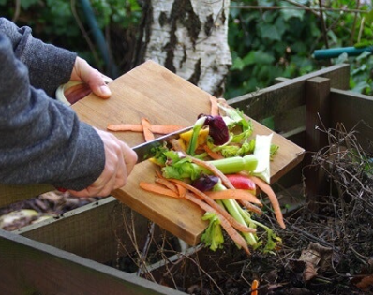
Instructions
Preparing the Composter
Step 1: Cut off the top of the soda bottle approximately 1-2 inches below the neck of the bottle using the utility knife.
Step 2: Turn the top upside down and tape on edge of the top to the edge of the soda bottle. This will create a funnel for water to easily enter the body of the soda bottle.
Step 3: Use a pushpin to punch 8-10 small air and drainage holes along the sides and bottom of the bottle approximately 2-3 inches apart vertically and horizontally.
Organizing Organic Material
Step 4: While wearing plastic gloves, sort through the organic material. Use the empty grocery bags to help separate the green from brown organic materials.
Step 5: Once sorted, use the chef’s knife and cutting board to cut the organic material into small 1-inch pieces. Cutting
the material into smaller
pieces will help speed up
decomposition.
Notes:
Step 1: Using the utility knife, cut off the top of the bottle, approximately 1-2 inches below the neck of the bottle. Facilitators can perform this step ahead of the activity if preferred.
Step 2: Turn the top upside down and tape one edge of the top to the edge of the soda bottle. Use the tape as a hinge so you can open and close the top easily. Taping the top of the bottle upside down creates a funnel for water to easily enter the body of the soda bottle.
Step 3: Use a pushpin to punch 8-10 small air and drainage holes along the sides and bottom of the bottle.
Step 4: Put on latex gloves and sort through the organic material. Separate your green material into one bag and your brown material into the other. Use the empty grocery bags to help organize the organic material.
Step 5: Once sorted, use the chef’s knife and cutting board to cut the organic material into small 1-inch pieces. Ask students why they think the mini composter will work best if the organic material is cut into small pieces. Cutting the material into smaller pieces will help speed up decomposition.
Image:
Composting at Home: Everything You Need to Know | The Eco Experts

Slide 20
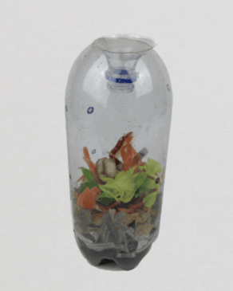
Fill Your Composter
    Step 9: Now your bottle is ready! Tape the top of the bottle closed to keep the moisture in.
    Step 10: Place the bottle on top of the plastic lid or paper plate in case any of the moisture leaks out of the holes previously created by the pushpin.
    Step 11: Use the marker to draw a line on the side on the bottle at the top of your organic material so you can see how much the volume changes over time.
    Step 12: Place your Soda Bottle Composter in a warm sunny place and observe.
    Step 6: If you choose to include soil, add a layer of soil to the bottom of the bottle. Soil contains microbes that can help jumpstart the microbial activity that breaks down compost. Keep in mind that this step is optional and not required for a successful compost.
    Step 7: Fill your soda bottle with organic layers by alternating between brown and green material. Keep your mix light and fluffy and do not pack it down.
    Step 8: Once your soda bottle is full of organic material, use a fine spray bottle and dampen the materials in your soda bottle with water.
Notes:
Step 6: If you choose to include soil, start your mini composter by adding a layer of soil to the bottom of the compost. Soil contains microbes that can help jumpstart the microbial activity that breaks down compost. Keep in mind that this step is optional and not required for a successful compost but will help the process work more efficiently.
Step 7: Fill your soda bottle with organic layers by alternating between brown and green material. Remember that you want air to be able to diffuse through the pores in the compost, so make sure to keep your mix light and fluffy, do not pack it down.
Step 8: Once your soda bottle is full of organic material, use a fine spray bottle and dampen the materials in your soda bottle with water.
Step 9: Now your bottle is ready! Tape the top of the bottle closed to keep the moisture in
Step 10: Place the bottle on top of the plate in case any of the moisture leaks out of the pushpin holes.
Step 11: Use a marker to draw a line on the side on the bottle at the top of your organic material so you can see how much the volume changes over time.
Step 12: Place your Soda Bottle Composter in a warm sunny place and observe. Explain to students that the sun increases the heat inside the mini composter, which will help microbes quickly break down the pile into useful soil fertilizer.
Image:
Make a Composter | Crafts for Kids | PBS KIDS for Parents

Slide 21
Potential Issues
Home composting is easy, but there are a few common issues that first-time composters run into:
Strange Smell
Gently mix or turn the compost pile and add some additional brown organic material (carbon).
Too Dry
Spray some additional water, add in green organic material (nitrogen), and mix the compost by gently shaking it.
Fruit Flies
Cover food scraps with brown organic material (carbon) like shredded paper, carboard or twigs to absorb excess liquid.
Notes:
Discuss the potential problems and solutions that could arise throughout the composting process.
Strange compost smell: Turn the compost pile and add some additional brown organic material.
The compost is dry to the touch: Spray some water, add in greens, and mix the compost by gently shaking it.
Fruit flies are present: Add more brown material and stir the compost to allow more air into the pile.

Slide 22
What Do You Think?
How long do you think it will take for the materials to start decomposing?
How do you think water plays a role in decomposition?
Do you think the volume of the compost will increase or decrease with time?
Are there any materials that won’t decompose?
Which items do you think will decompose first?
Notes:
Engage the students in a discussion around what they think will happen inside the Soda Bottle Composter. Consider asking the following questions:
How long do you think it will take for the materials to start decomposing? Depending on the materials used, students could start to see changes as early as three weeks. Encourage students to look for changes in volume, color, temperature or moisture content.
Do you think the volume of the compost will increase or decrease with time? It’s possible for the volume to shrink by ½-2/3 of the original size.
Which items do you think will decompose first? Students will know that decomposition has occurred when the original organic materials are no longer recognizable, and the compost has a dark, crumbly, soil-like texture. Leaves can take anywhere from a few weeks to a few years. Fruit and vegetable scraps like peels and cores can take between two weeks and a month to decompose. Small pieces of eggshells and toilet paper rolls can decompose within a few months.
Are there materials that don’t decompose? Inorganic materials like glass, metal, stones, and plastics cannot decompose.
How do you think water plays a role in decomposition? When there is little or no water, decomposers may not be able to survive, which can slow down decomposition. Too much water slows down the composting process by limiting oxygen availability for microorganisms and can cause harmful bacteria growth. Proper moisture encourages the growth of microorganisms that break down organic matter.

Slide 23

Student Activity Handout
Composting is a long process, make sure to record your observations at home!
*Be sure to share the responsibility with your partner or team
Compost
Color
Compost
Volume
Decomposition
Rate
Additional
Notes
Notes:
Complete the table in the handout based on what students see inside the Soda Bottle Composter.
Compost Color: The color of your compost will change with time. Record how the colors fade or get brighter with time.
Volume: Use a marker to draw a line at the top of the compost pile each week. Note whether the compost pile volume is increasing or decreasing with time.
Material Not Present (Decomposition Rate): Identify the week you can no longer see specific organic material inside the Soda Bottle Composter.
Notes: Use this column for additional notes (e.g., odor, moisture level, temperature, etc.)

Slide 24
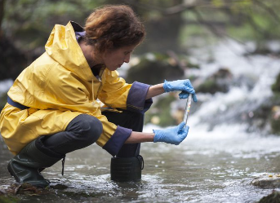
STEM²D Careers in Composting
Ecologist
Environmental Engineer
Industrial Engineer
Environmental Scientist
Agricultural Specialist
Environmental Educator
Biochemist
Climate Change Specialist
Waste Management Specialist
Sustainability Managers
Organics Recycling Specialists
Notes:
Review the list of STEM²D careers that are connected to composting. Encourage students to research some of the careers listed to determine if one of them might be a match based on their interests.
Image:
What Is Environmental Science? Courses, Jobs, Salaries (thoughtco.com)

Slide 25
Reflection
  How do you think this activity relates to a career in science and/or working at Johnson & Johnson?
  Can you see yourself as a STEM²D professional? In what role? Why or why not?
  What do you need to do to make this happen?
  What is one thing you learned that you did not know coming in today?
Notes:
Ask students to reflect on the activity. Have students spend a few minutes thinking about the listed questions and then ask for volunteers to share their thoughts on any of the topics.

Slide 26

Eco-Enrichment Expedition
  Thank you for participating!
Notes:
Thank students for joining you today and encourage them to continue exploring careers in STEM²D.

Slide 27
Image Sources
Slide 2:
https://ngorisefoundation.com/2022/06/28/chemistry-of-aerobic-composting/
Slide 8:
https://lifehacker.com/the-five-laziest-ways-to-compost-1850602707
https://www.healthline.com/nutrition/composting-beginners-guide
https://sustainability.yale.edu/explainers/yale-experts-explain-compost
https://www.worldcentric.com/journal/compost-at-home
Slide 9:
https://www.fast-growing-trees.com/pages/composting-guide
Slide 10:
https://untamedscience.com/biology/ecology/ecology-articles/the-science-of-compost/
Slide 12:
Soil & Fertilizing Articles - Farmers' Almanac - Plan Your Day. Grow Your Life. (farmersalmanac.com)
Cold Composting: Step-by-Step Guide (treehugger.com)
Slide 13:
https://coldcreekcompost.com/kaitlin-wuz-here-composting-how-it-works/
Slide 14:
The benefits of composting for the environment – PlantGrow
Slide 15:
The benefits of composting for the environment - PlantGrow
Slide 17:
Make a Composter | Crafts for Kids | PBS KIDS for Parents
Slide 18:
The Scrap Bucket - The Anglican Parish of Hamilton (hamiltonanglican.org.au)
Slide 19:
Composting at Home: Everything You Need to Know | The Eco Experts
Slide 20:
Make a Composter | Crafts for Kids | PBS KIDS for Parents
Slide 24:
5 Major Fields Of Environmental Science - WorldAtlas

