Slide 1

Create It, Try It, Manufacture It
STEM²D Topics: Manufacturing and Design
[Presenter Name]
[Presenter Organization]
[Date]

Slide 2


Tell My Story

Slide 3
My Story (delete if not using)

Slide 4
Today’s Plan
Career planning
  Identify personal interests and skills
  Determine what or who is the biggest influence on a person’s future career and work choices
  Note that STEM²D careers are high-demand, high-growth careers and are predicted to remain in demand over the next 10 years
Manufacturing presentation
  Create awareness through generating lists of manufactured products across multiple industries
Create It! Challenge
Reflection

Slide 5
More About Me
Three skills:
Three interests:
What or who is the biggest influence on a person’s future career or work choices?
If you could create or build anything, it would be . . .

Slide 6
More About Manufacturing
Manufacturing: Creating something from raw materials by hand or by machinery
Try It: Working with someone sitting near you, generate a list of products you both use daily. Consider different industries, including electronics, automotive, industrial, health care, clothing, and even sports. Record the responses on the Student Handout.

Slide 7

Create It! Challenge

Slide 8
Create It! Challenge
Required manufacturing steps:
  Step 1: Disassemble (take apart) the fountain pen.
  Step 2: Catalog (generate a list) the raw materials and tools needed to assemble the pen.
  Step 3: Write a simple assembly process to manufacture the pen.
  Step 4: Share the materials lists and assembly process.
Think about:
  Workstations are key to a manual manufacturing process (workers completing separate tasks on a production line).
  Does your assembly process include workstations? Could another team use the instructions to assemble the pen?
  Is each worker able to complete a separate task to manufacture the pen?
Try It:
  Now that there is a list of materials and assembly instructions, as a team, estimate the number of pens you can assemble in 10 minutes.

Slide 9
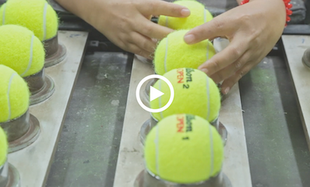
Automation
This film was shot in one day and demonstrates the complex manufacturing process, including the 24 different processes required to create the final tennis ball.
Check out the machinery and the different steps.
Notes:
https://vimeo.com/162803063
Filmmaker Benedict Redgrove’s How to Make a Tennis Ball is a video short from inside Wilson’s tennis ball factory near Bangkok, Thailand. Redgrove was commissioned to make a film by ESPN for Wilson, to show the manufacturing process of their tennis balls for the U.S. Open. The film was shot in one day and demonstrates the complex manufacturing process, including the 24 different processes required to create the final tennis ball.
Check out the machinery and the different steps.

Slide 10
Create It! Challenge Optional Activity
Required manufacturing steps to produce the product prototype:
Worker 1: Fold the sheet of paper in half the long way to form a crease. Unfold. Next, fold down the top corners toward the centerline to form a triangle at the top.
Worker 2: Fold the two edges in toward the centerline.
Worker 3: Fold the paper in half along the original center crease to form a valley. Rotate the paper 90 degrees.
Worker 4: Create a wing crease that begins at the nose.

Slide 11
Optional Activity
Need more of a challenge? Test a plane and determine what modifications could be made to improve the design. Be prepared to “send” three new plane designs in two minutes.
Discuss your strategy before and after manufacturing the planes to determine possible modifications.
Talk about your designs using the following questions:
  What is the best feature of the design? Why?
  Describe the steps it took to get the design to work.
  What was the hardest problem to solve?
  Did the team do anything more than once? If so, what?
  If you had more time, how would you improve the design?

Slide 12
Learning Game Concept Challenge
Consider how to manufacture your learning game (board or card) after developing your concept and prototype during the Change It, Create It, Solve It, Engineer It activity.
List all the game pieces involved, including those you need to design and create, in order to manufacture the game. Consider the following questions as you begin designing and creating your game:
  What materials are needed if you decide to sell this game?
  What is the current demand on supply?
  How many game sets do you need to make?

Slide 13
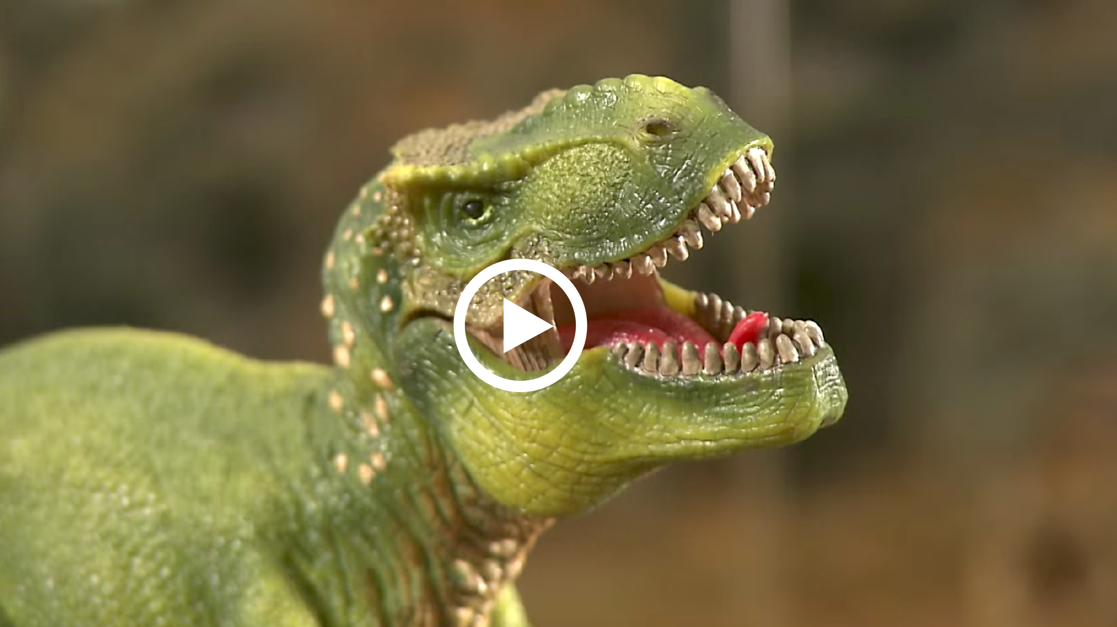
How It’s Made
Take a look at how toy figurines are made, from design and molding through painting and finishing.
Notes:
https://www.youtube.com/watch?v=w5KRawOXy4U

Slide 14
Reflection
What are three things you’re learning in school that will help you prepare for a career in STEM²D?
Complete the statement: “I’m interested in creating a personal experience by spending time with or learning more about someone who works as a _____.”
If you had the opportunity to explain why STEM²D skills are important to acquiring your ultimate career goal, what would you say?
Did your original thinking about STEM²D careers and professionals change? Why or why not?
Can you see yourself working in manufacturing? Why or why not? What is needed to make this happen?

Slide 15

Thank you for participating!

