Slide 1

Cotton Ball Catapult
STEM²D Topics: Design and Engineering
[Presenter Name]
[Presenter Organization]
[Date]

Slide 2






What is STEM²D?
Science
Technology
Engineering
Mathematics
Manufacturing
Design

Slide 3
Today’s Plan
Introductions
STEM²D in the World of Work
What is Product Development?
Product Development at Johnson & Johnson
Team Activity: Cotton Ball Catapult Challenge
Reflection

Slide 4

STEM2D in the World of Work
How do you think STEM²D is used every day in the workplace?
Notes:
Share that STEM²D careers are high-demand, high-growth careers.
Share with students that there are many different kinds of careers related to STEM²D
STEM²D careers related to this activity:
Biomedical engineer
Environmental engineer
Mechanical engineer
Automotive engineer
Wildlife biologist
Aquatic biologist
Industrial designer

Slide 5


Tell My Story

Slide 6
My Story (delete if not using)

Slide 7


Product
Development

Slide 8
What is Product Development?
Product Development is the overall process of strategy, organization, concept generation, product and marketing plan creation and evaluation, and commercialization of a new product.
Notes:
Definition:
Biomimicry: an approach to innovation that seeks sustainable solutions to human challenges by imitating nature’s patterns and strategies.
Sustainable: capable of being maintained at a steady level without exhausting natural resources or causing severe ecological damage

Slide 9
5 Stages of Product Development
Generating Ideas
Evaluating and Screening Ideas
Protecting Ideas
Research and Development (R&D)
Marketing, Promotion, and Distribution

Slide 10
Generating Ideas
Creating an idea and developing it for commercial sale.
Brainstorming is a technique used for generating ideas. This is also called concept generation.

Slide 11
Evaluating and Screening Ideas
    Ideas for inventions and innovations are assessed for their commercial potential.
    While some ideas may seem great in theory, it may not be possible for the designs to be brought to life, or the cost to bring the designs to life may be too great.

Slide 12
Protecting Ideas
    Make sure your idea is protected! This can be done through acquiring patents or using trade secrecy.
    Patents are rights granted to inventors that exclude others from making, selling, or using the invention for a period of time.
    Trade secrecy is simply a matter of keeping knowledge of the ideas, designs, processes, techniques, or any other unique component of the creation limited to a small group of people. The formula for Coca-Cola is one of the best-recognized and most successful trade secrets.

Slide 13
Research and Development (R&D)
    Research and Development (R&D) is the process by which a company works to obtain new knowledge that it might use to create new technology, products, services, or systems that it will either use or sell.
    R&D often takes place in an internal department in a company but can also be outsourced.
    R&D is often an expensive part of product development.

Slide 14
Marketing, Promotion, and Distribution
    The final stage of product development.
    Examples of marketing and promotion are: television and radio commercials, billboards, and magazine and newspaper ads.
    Distribution is the system for making the product available for a consumer to purchase.

Slide 15
Cotton Ball
Catapult Challenge

Slide 16
Cotton Ball Catapult Challenge
You will work with a partner to perform three of the five stages of product development:
    Generating Ideas
    Evaluating and Screening Ideas
    R&D
The product your team is developing is a cotton ball catapult.

Slide 17
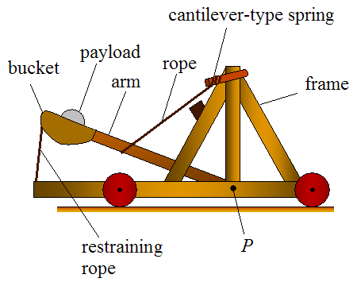
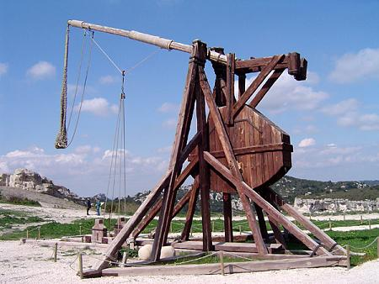
Catapults
Notes:
Explain that a catapult is a device that is used to hurl an object some distance. Point out the parts of the catapult.

Slide 18
Cotton Ball Catapult Challenge Instructions
    Generate Ideas! As a team and using the Student Handout, sketch possible designs for your cotton ball catapult. Keep in mind you may only use the materials provided when building your design.
    Choose a Design. With your teammate, choose one design to build.
    Build the Catapult. You have 15 minutes to build your catapult as a team. Use the materials provided to build your catapult based on your design. Keep an eye on the time.
    Test. Test the catapult and make changes as needed in order to get the cotton ball to fly as far as possible. Do not launch the cotton ball at other students or teams.
    Determine the Winning Team. Once all catapults are built, we will test the catapults as a group to see which design works the best.
    LET’S GET STARTED!

Slide 19
Reflection
  Think about the following questions…
    What did you learn about product design?
    How do you think this activity relates to a career in design and engineering and/or working at Johnson & Johnson?
    Can you see yourself as a STEM²D professional? In what role? Why or why not?
    What would you need to do to make that happen?

Slide 20

Thank you for participating!

