Slide 1






The Breakdown –
Exploring Corrosion Science
Science, Engineering

Slide 2
Notes:
Explain that STEM²D refers to: Science, Technology, Engineering, Mathematics, Manufacturing, and Design.
Ask students and other volunteers to introduce themselves and state their favorite areas of STEM²D (Science, Technology, Engineering, Mathematics, Manufacturing, and Design).

Slide 3


My Story
(Delete slide if not needed)

Slide 5
Warm Up Activity
(Delete slide if not needed)

Slide 6
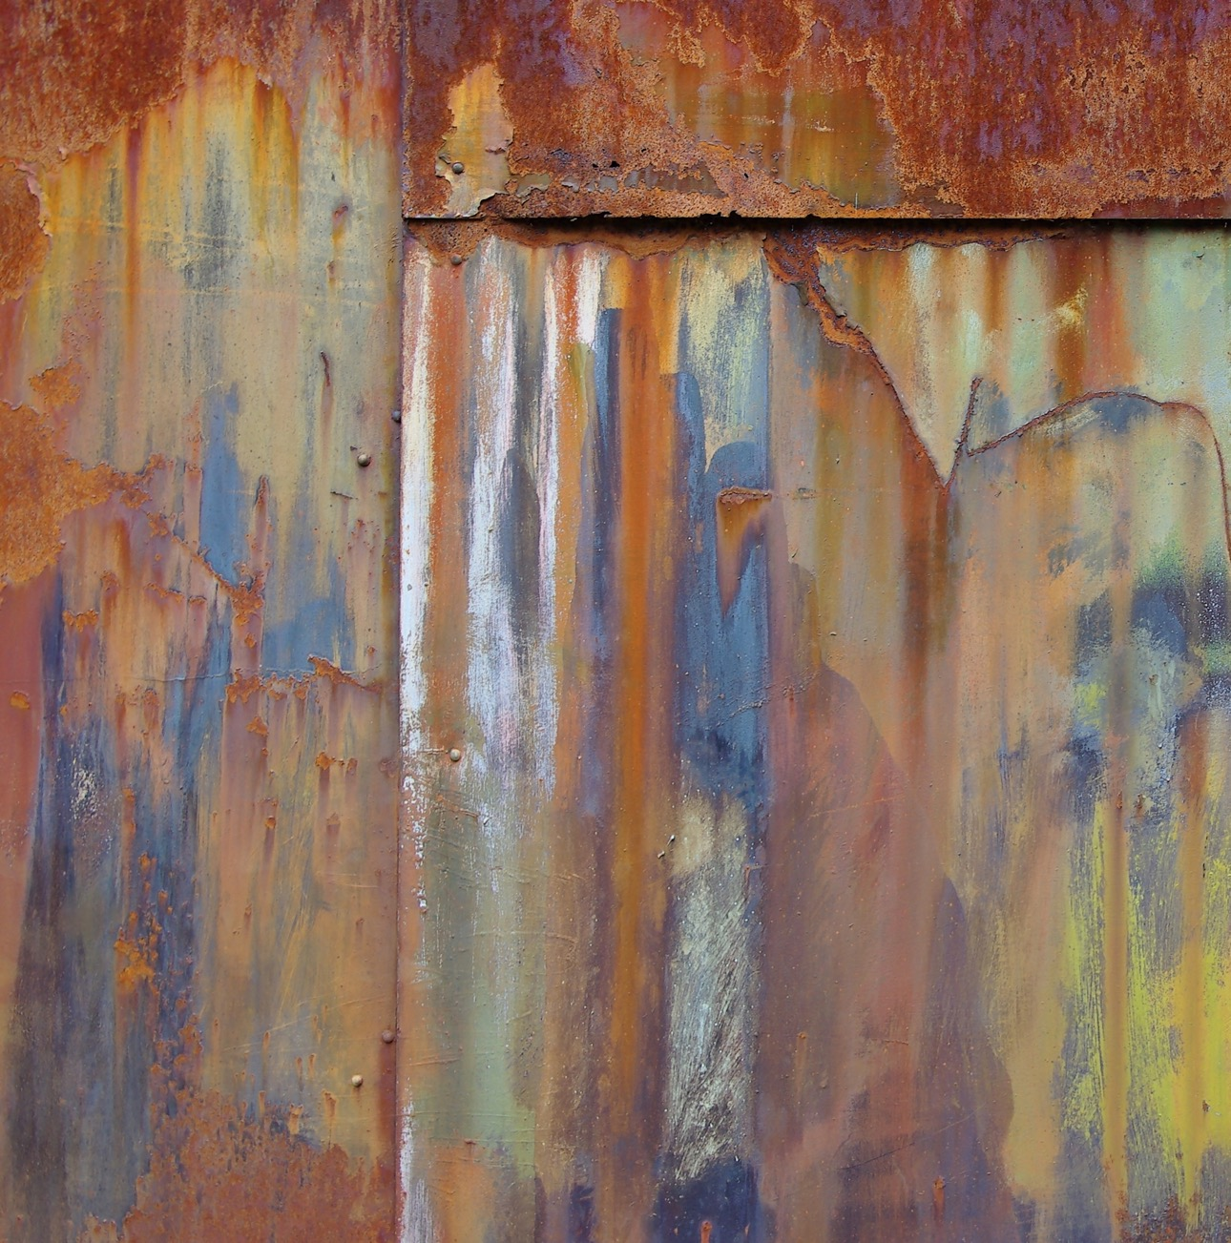
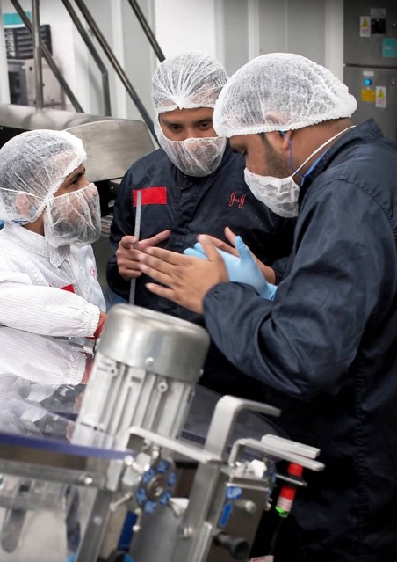

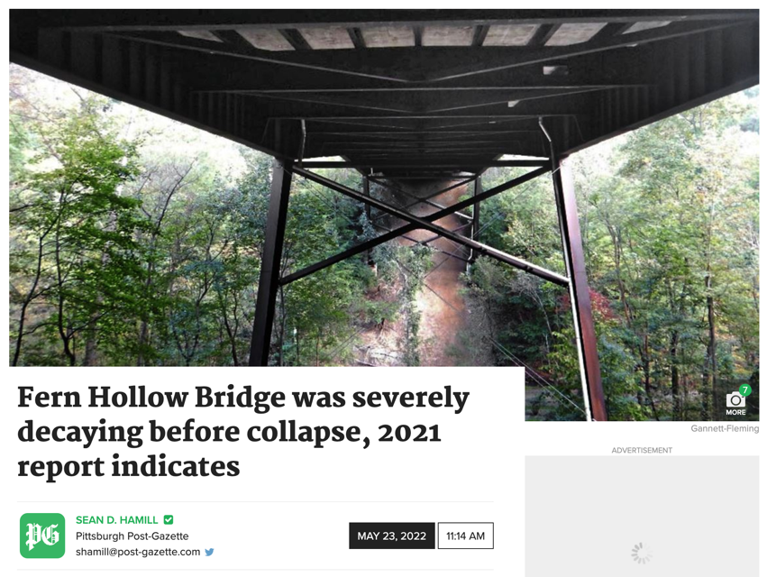
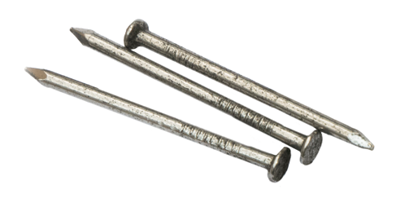
Today’s Plan
Introduction
Corrosion
  What is corrosion?
  Instances of corrosion and their consequences
Activity: Corrosion of
Iron-Based Nails
Reflection
Notes:
Welcome the students, introduce yourself and review the agenda.

Slide 7
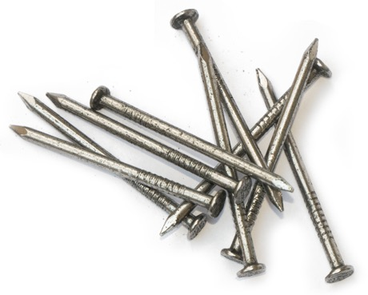
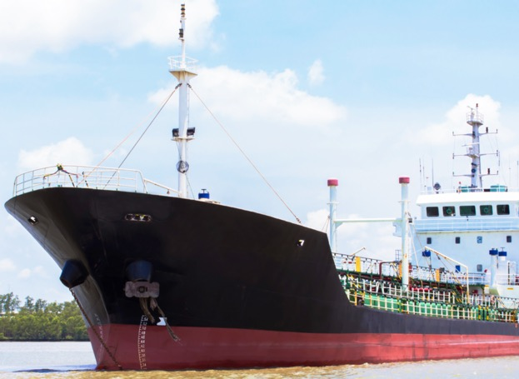
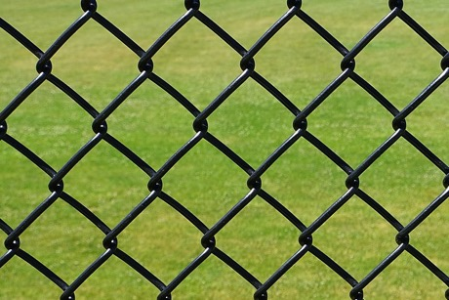
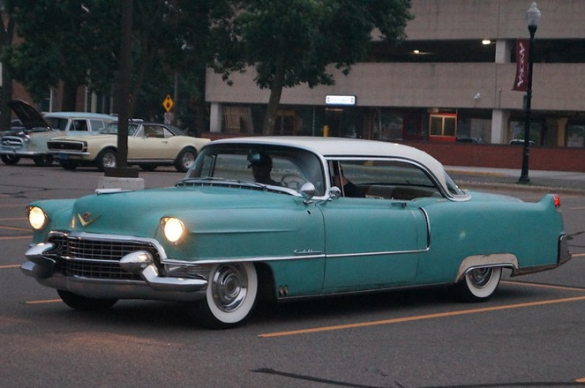
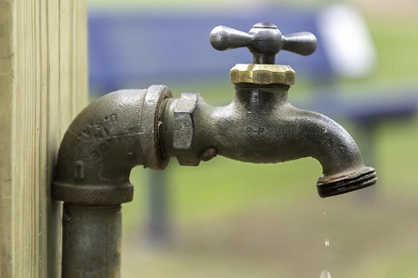
What’s That Structure?
Can you name each of the items at left?
How might you group them by type?
What are some things they have in common?
What will happen over time if you expose these items to water and do not let
them dry?
What might these look like in 3, 5, and 15 years?

Slide 8
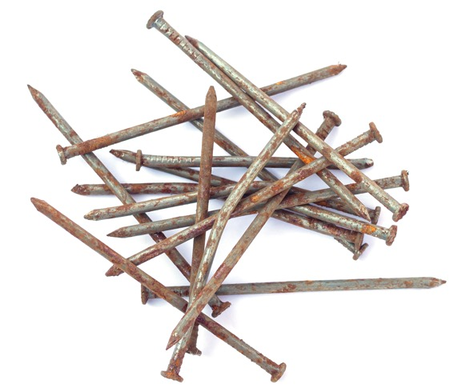
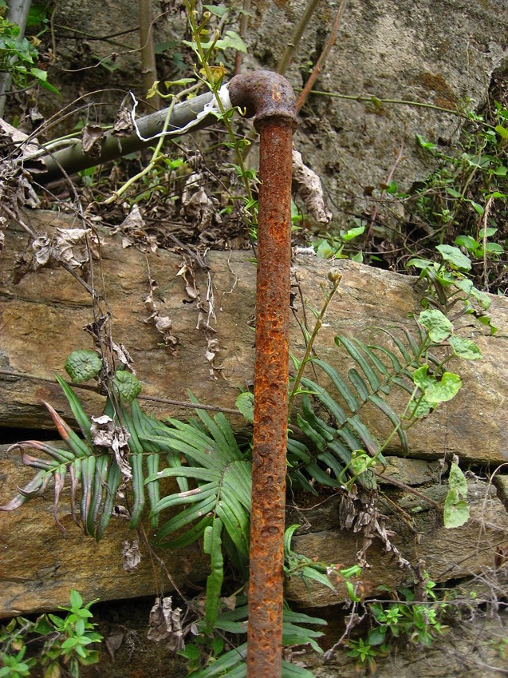
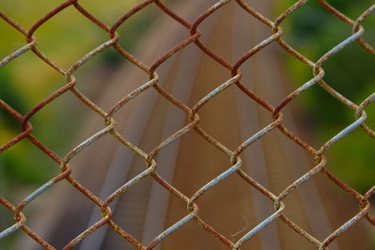
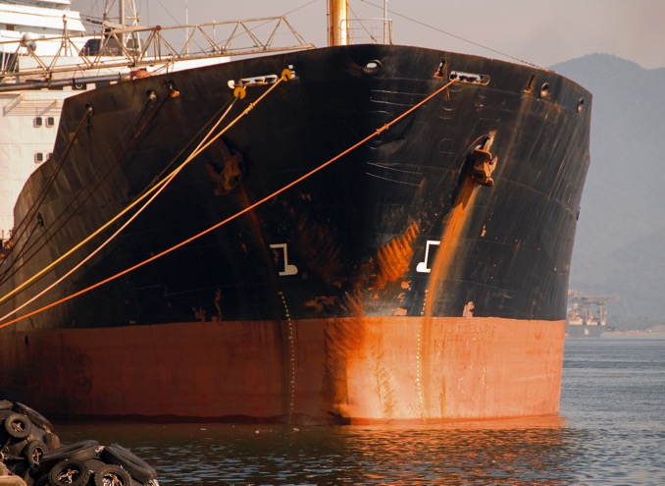
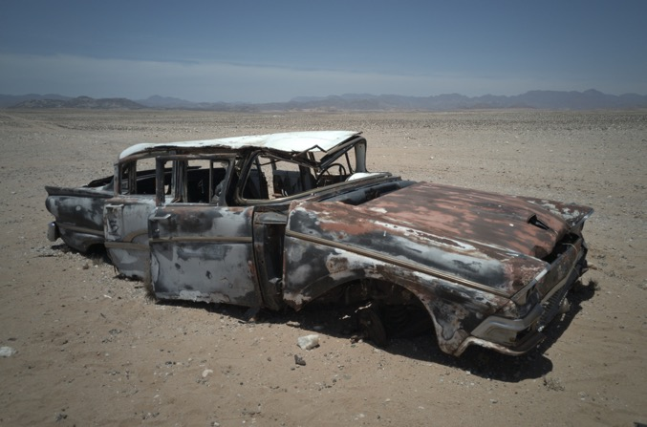
What’s That Structure
NOW?

Slide 9
Corrosion
Corrosion is an unintentional process that breaks down materials when they are exposed to water and air.
Corrosion of metals causes them to deteriorate and become unstable over time, through chemical reactions known as oxidation reactions.
  Silver → dark grey
  Iron → rust
  Copper → green
Chemical reaction is a process that changes the structure of atoms or molecules that make up a substance.

Slide 10
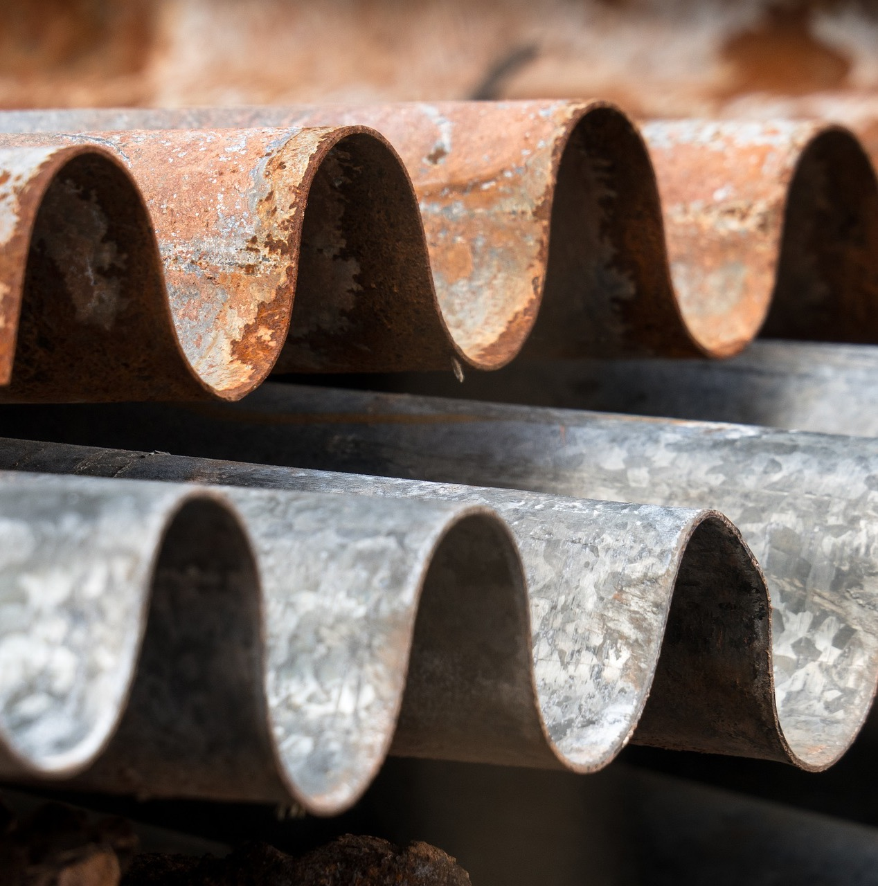
Corrosion
A metal is a class of chemical elements that are often shiny, ductile solids that easily change their shape without breaking, and good conductors of heat.
The most common type of corrosion is the rusting of the iron (Fe) metal.
  Iron + Oxygen + Water → rust, reddish-brown
    4Fe + 3O₂ +2H₂O → 2Fe₂O₃.H₂O
    Rust = 2Fe₂O₃H₂O
      hydrated ferric oxide or hydrated iron (III) oxide

Slide 11
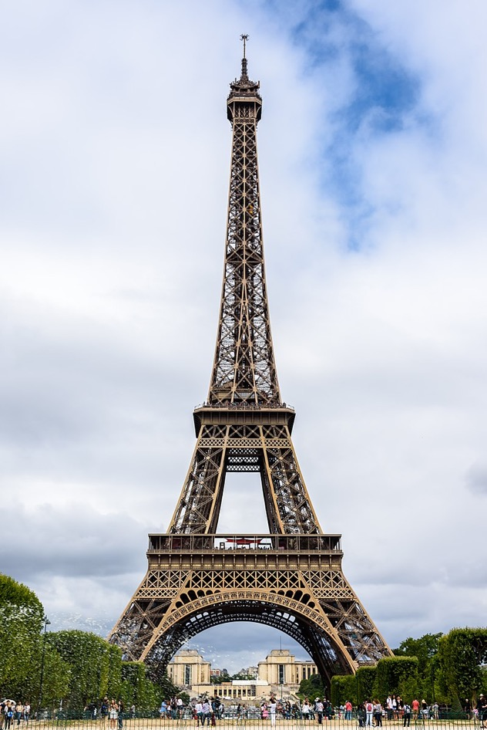
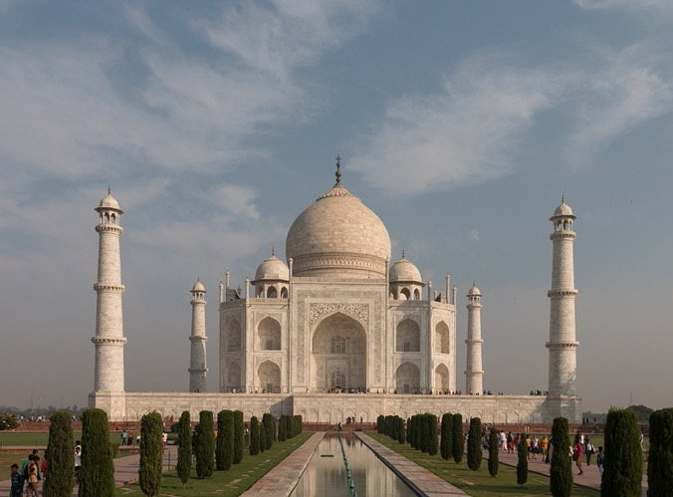
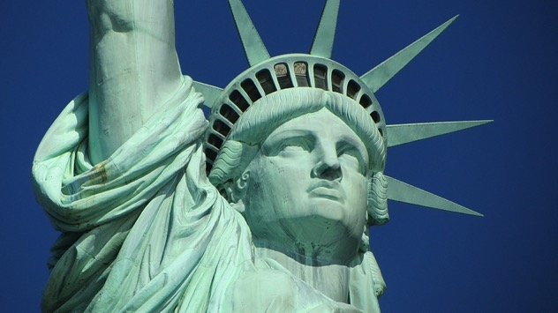
Occurrences of Corrosion
Corrosion happens naturally in our everyday lives and can be found in bridges, buildings, pipes, nails, ships, cars, and train tracks.
Spontaneous corrosion increases when structures are openly and regularly exposed to air and water, changes in humidity, and varying concentrations of salt and other chemicals.
Preventing corrosion is critical in the upkeep of many structures, including the Eiffel Tower, Statue of Liberty, and Taj Mahal.

Slide 12

Consequences of Corrosion
When unchecked, corrosion can cause very damaging effects and issues that are harmful to society.
Corrosion is a costly problem around the world, with billions of dollars spent yearly to replace iron containing structures destroyed by corrosion.
Some of the possible impacts of corrosion include:
      The collapse of buildings and bridges, oil pipelines break, chemical plants leak, and bathrooms flood.
      Fires caused by corroded electrical circuits and switches.
      Blood poisoning because of corroded medical implants such as blood clot filters and artificial joints.
      The inability to safely dispose of toxic chemical waste that must be stored in containers for thousands of years.

Slide 13


How to Clean the Eiffel Tower
Video Link & Handout
A Day in the Life of a Corrosion Engineer

Slide 14
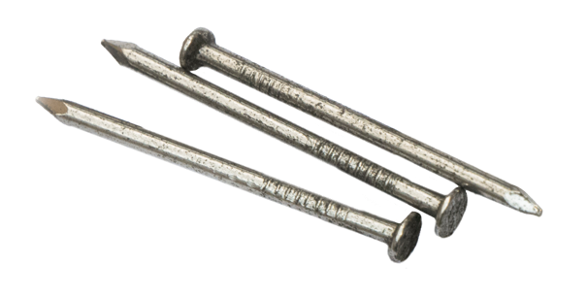
Learning Activity
Nail Corrosion
Notes:
Beak the group into teams of X people per team. Instruct teams to sit together.
Distribute the student handouts and materials to each team.

Slide 15
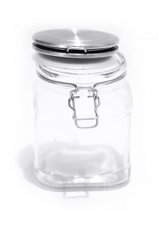
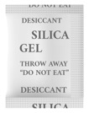
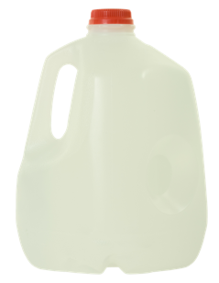

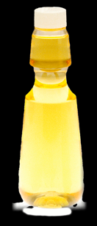
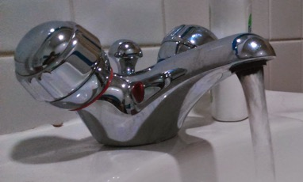
Corrosion of Iron-based Nails
LEARNING ACTIVITY
In this team-based activity, you will:
Materials
Take on the role of a Corrosion Engineer.
Test conditions affecting corrosion on iron-based nails.
Record your observations in your student handout and answer the activity questions.
silica gel desiccant
3 jars with lids
3 iron nails
distilled water
Olive, canola,
sunflower, or baby oil
tap water

Slide 16
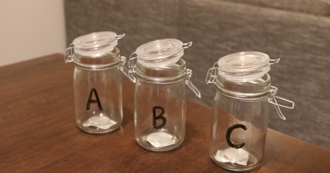
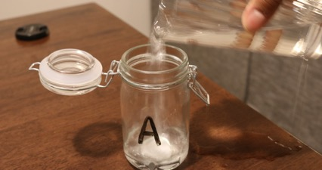
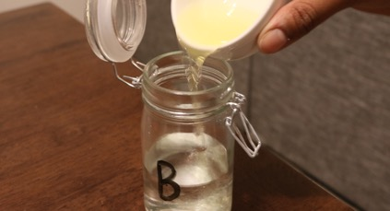
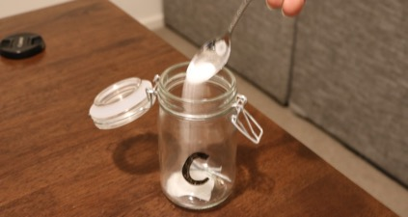
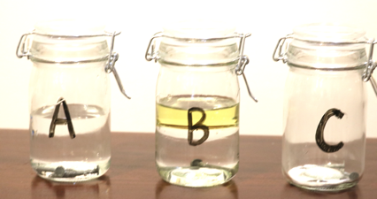
LEARNING ACTIVITY
Instructions
Nail Corrosion
Prepare three glass jars and label them A, B, and C. Insert an iron nail into each jar.
1
You will work in teams of three.
2
3
Fill glass jar A up halfway with tap water. Cap the lid.
4
5
6
Fill glass jar B halfway with distilled water. Add a layer of oil. Cap the lid.
Place silica gel desiccant
in glass jar C. Cap the lid.
Leave for 7–14 days.

Slide 17

LEARNING ACTIVITY
Results
Discussion
Think about the following questions:
What did you expect would happen to the nail? Were the results as you expected?
What are some of the 'variables' in this experiment?
  What did adding the oil to the water do the nail? Why?
  Silica gel is a salt that does not contain water. How did it affect the nail in Jar C? Why?
Are there any other conditions you can test to see how iron rust? What are they? Why did you choose them?
How might a maintenance engineer prevent the nail from rusting?

Slide 18
Preventative Methods and Application
There are many ways to prevent and slow down corrosion. Some examples are:
Electroplating – Plating the structure with other metals more resistive to rusting
Corrosion inhibitors – Chemicals applied to the outside of a structure that may slow or prevent corrosion
Choice of material – Choosing to use materials that are resistant to rusting e.g., Fiberglass or stainless steel
Environmental factors – Reducing exposure to factors that contribute to corrosion.
Protective coatings – Application of paint or other coatings to avoid exposure to elements

Slide 19
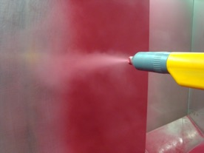
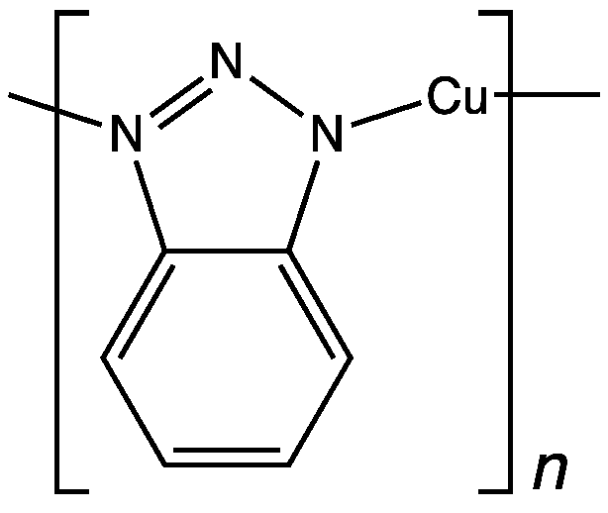
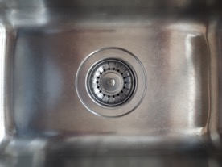
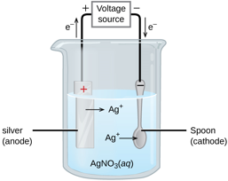
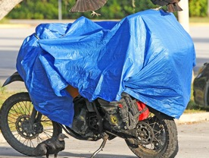
Preventative Methods: Matching
Prevention Method
1. Choose the
right metal
2. Protective
coatings
3. Environmental measures
4.
Metal plating
5. Corrosion
inhibitors
Application Examples
a.
Chemicals react with surface of the metal and suppress electrochemical reactions
b.
Electroplating;
hot dip galvanization
c.
Stainless steel, duplex, super duplex, nickel alloy
d.
Painting;
powder coating
e.
Reducing the exposure to
rain or seawater
i.
ii.
iii.
iv.
v.

Slide 20
Preventative Methods: Matching Answers
1 c iii
2 d i
3 e v
4 b iv
5 a ii
1. Choose the
right metal
2. Protective
coatings
3. Environmental measures
4.
Metal plating
5. Corrosion
inhibitors
a.
Chemicals react with surface of the metal and suppress electrochemical reactions
b.
Electroplating;
hot dip galvanization
c.
Stainless steel, duplex, super duplex, nickel alloy
d.
Painting;
powder coating
e.
Reducing the exposure to
rain or seawater
i.
ii.
iii.
iv.
v.

Slide 21
STEM²D Careers in the Corrosion Industry
Corrosion Engineer
Design Engineer
Maintenance Engineer
Project Engineer
Reliability Engineer
Research & Development Scientist

Slide 22
Reflection
What did you learn about corrosion?
Was there anything difficult to understand about corrosion and how detrimental it can be to buildings and other structures?
What did you learn about working in a team?
What would you change about the nail rusting activity if you were to do it again?
Can you see how corrosion affects our everyday lives? How could you make a difference through the study of corrosion?
What is one thing you learned that you did not know coming into today?

Slide 23
IMAGE SOURCES (where necessary)
Slides 3 and 9:
Pittsburgh Post-Gazette. “Fern Hollow Bridge was severely decaying before collapse, 2021 report indicates.” https://www.post-gazette.com/local/city/2022/05/19/fern-hollow-bridge-inspection-2021-report-severely-decaying-rust-corrosion-penndot/stories/202205190154. Accessed 12 June 2022.
Slides 3 and 6:
“Romagne 86 Portail atelier 2008” by JLPC is licensed under CC BY-SA 3.0 / Changes: Photo was cropped and the edges feathered.
Slides 3 and 8:
“The Eiffel Tower, Paris” by Joe deSouza is licensed under CC0 1.0 / Changes: Photo was cropped.
Slide 4:
“Fence – Arlington, MA” by Daderot is licensed under CC0 1.0 / Changes: Photo was cropped.
“1955 Cadillac Coupe de Ville” by Greg Gjerdingen is licensed under CC BY-2.0 / Changes: Photo was cropped.
Slide 5:
“Pitting corrosion on a pipe” by Vsolymossy is licensed under CC BY-3.0 / Changes: Photo was cropped.
“Chain link” by Micke is licensed under CC BY-SA 3.0 / Changes: Photo was cropped.
Slide 8:
“Taj Mahal 2018” by Almbauer is licensed under CC BY-3.0 / Changes: Photo was cropped.
“Statue of liberty head 2013-10-28” by Ronile is licensed under CC0 1.0 / Changes: Photo was cropped.
Slides 16–17:
“Pulverlack-Applikation” by Hardcoreraveman is in the public domain / Changes: Photo was cropped.
“CuBTA Polymer” (chemical structure of Cu-benzotriazole polymer) by Smokefoot is licensed under CC BY-SA 3.0 / No changes were made.
“Electroplating” by Paul Flowers, William R. Robinson, PhD, Richard Langley, Klaus Theopold is licensed under CC BY 4.0 / No changes were made.
“Black Vulture - Coragyps atratus, Everglades National Park, Homestead, Florida” by Judy Gallagher is licensed under CC BY 2.0 / Changes: Photo was cropped.

