Slide 1
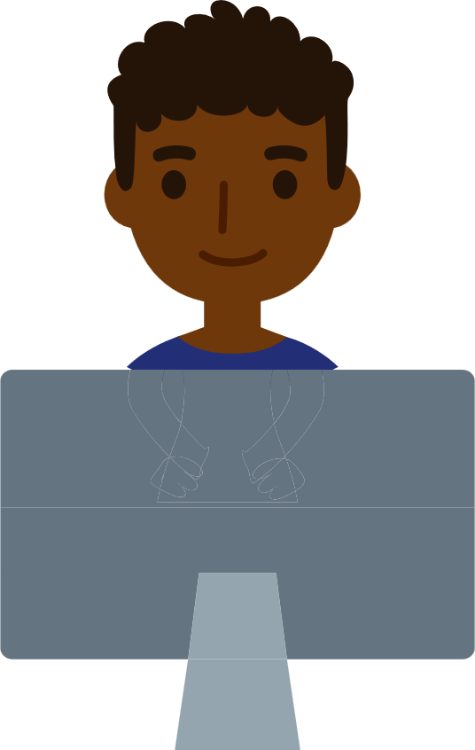
Building a Scientific Research Vessel
STEM²D Topics: Science, Engineering,
Math, and Design
[Presenter Name]
[Presenter Organization]
[Date]

Slide 2
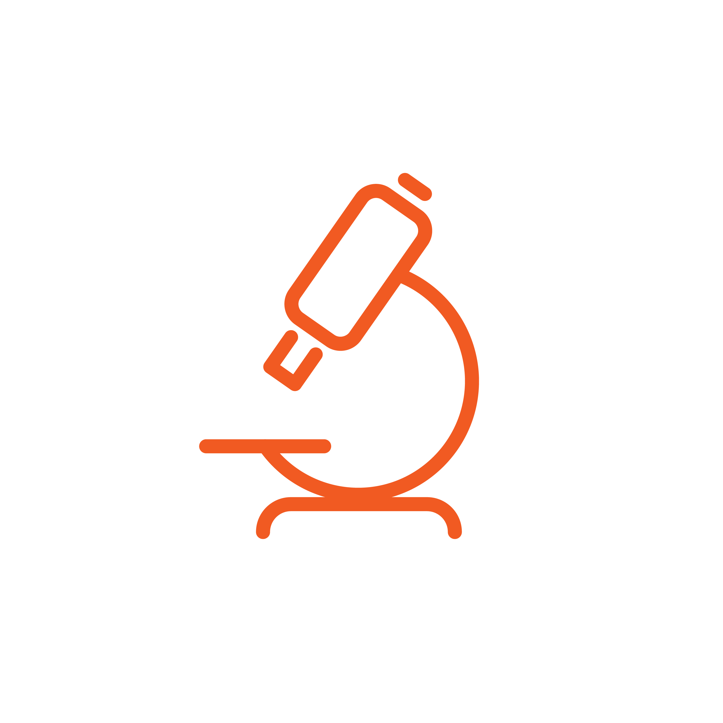
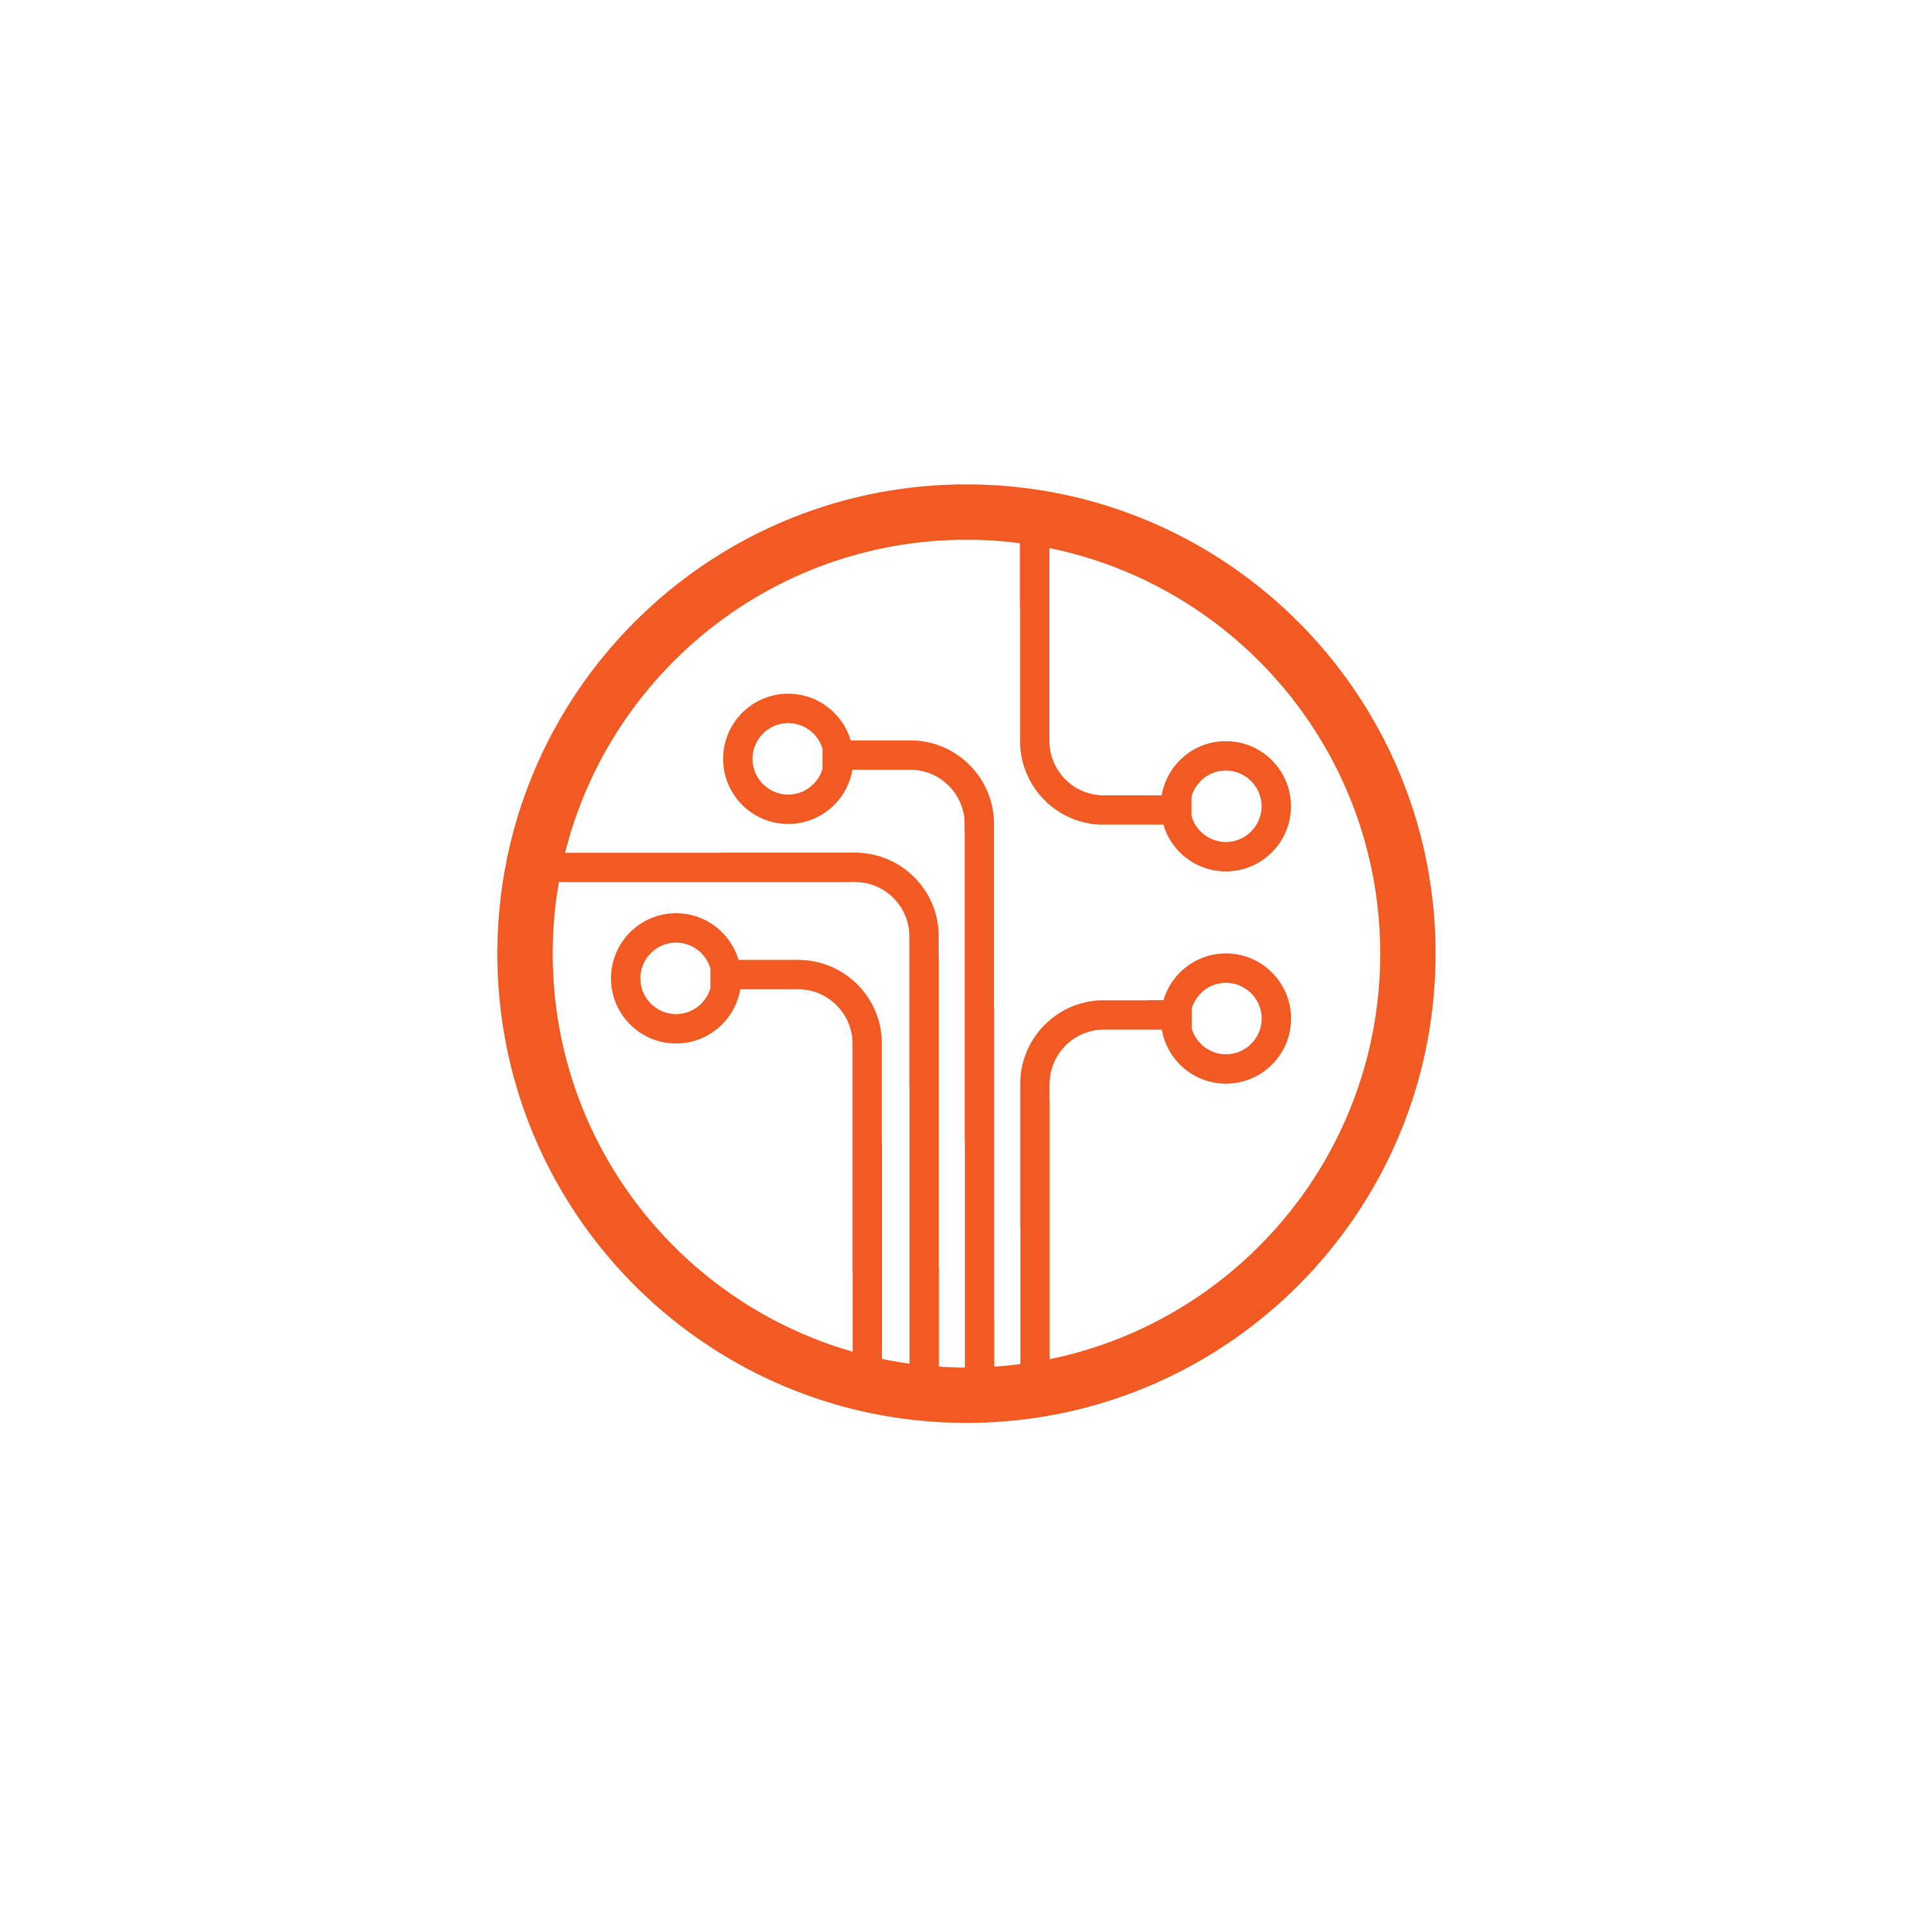
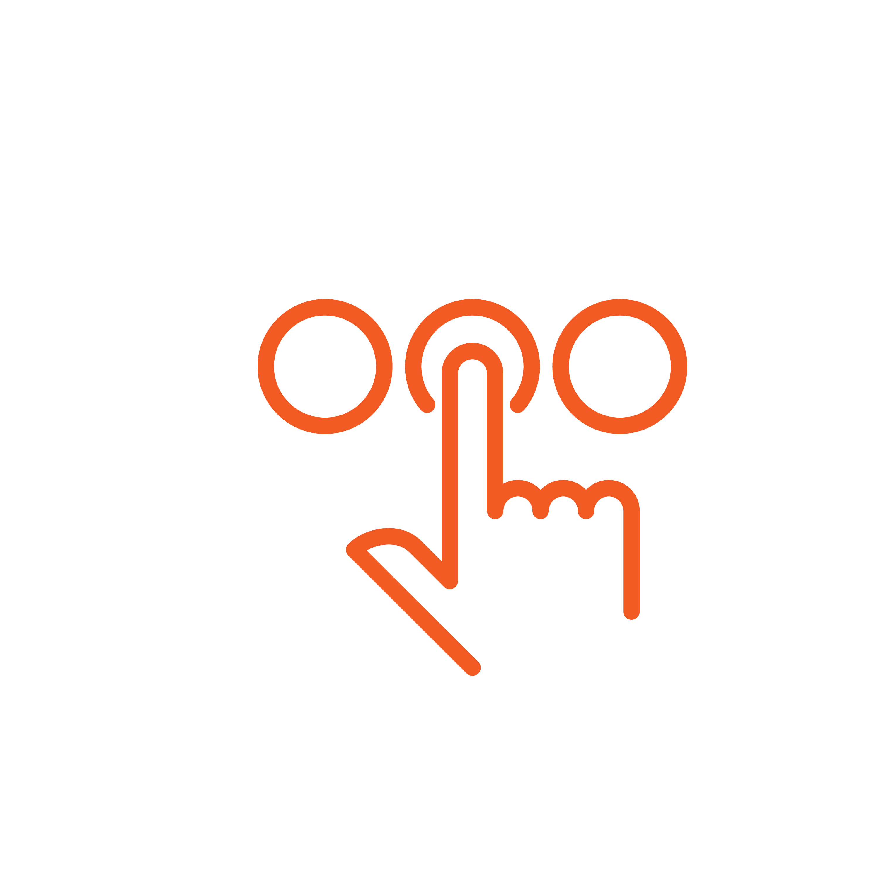
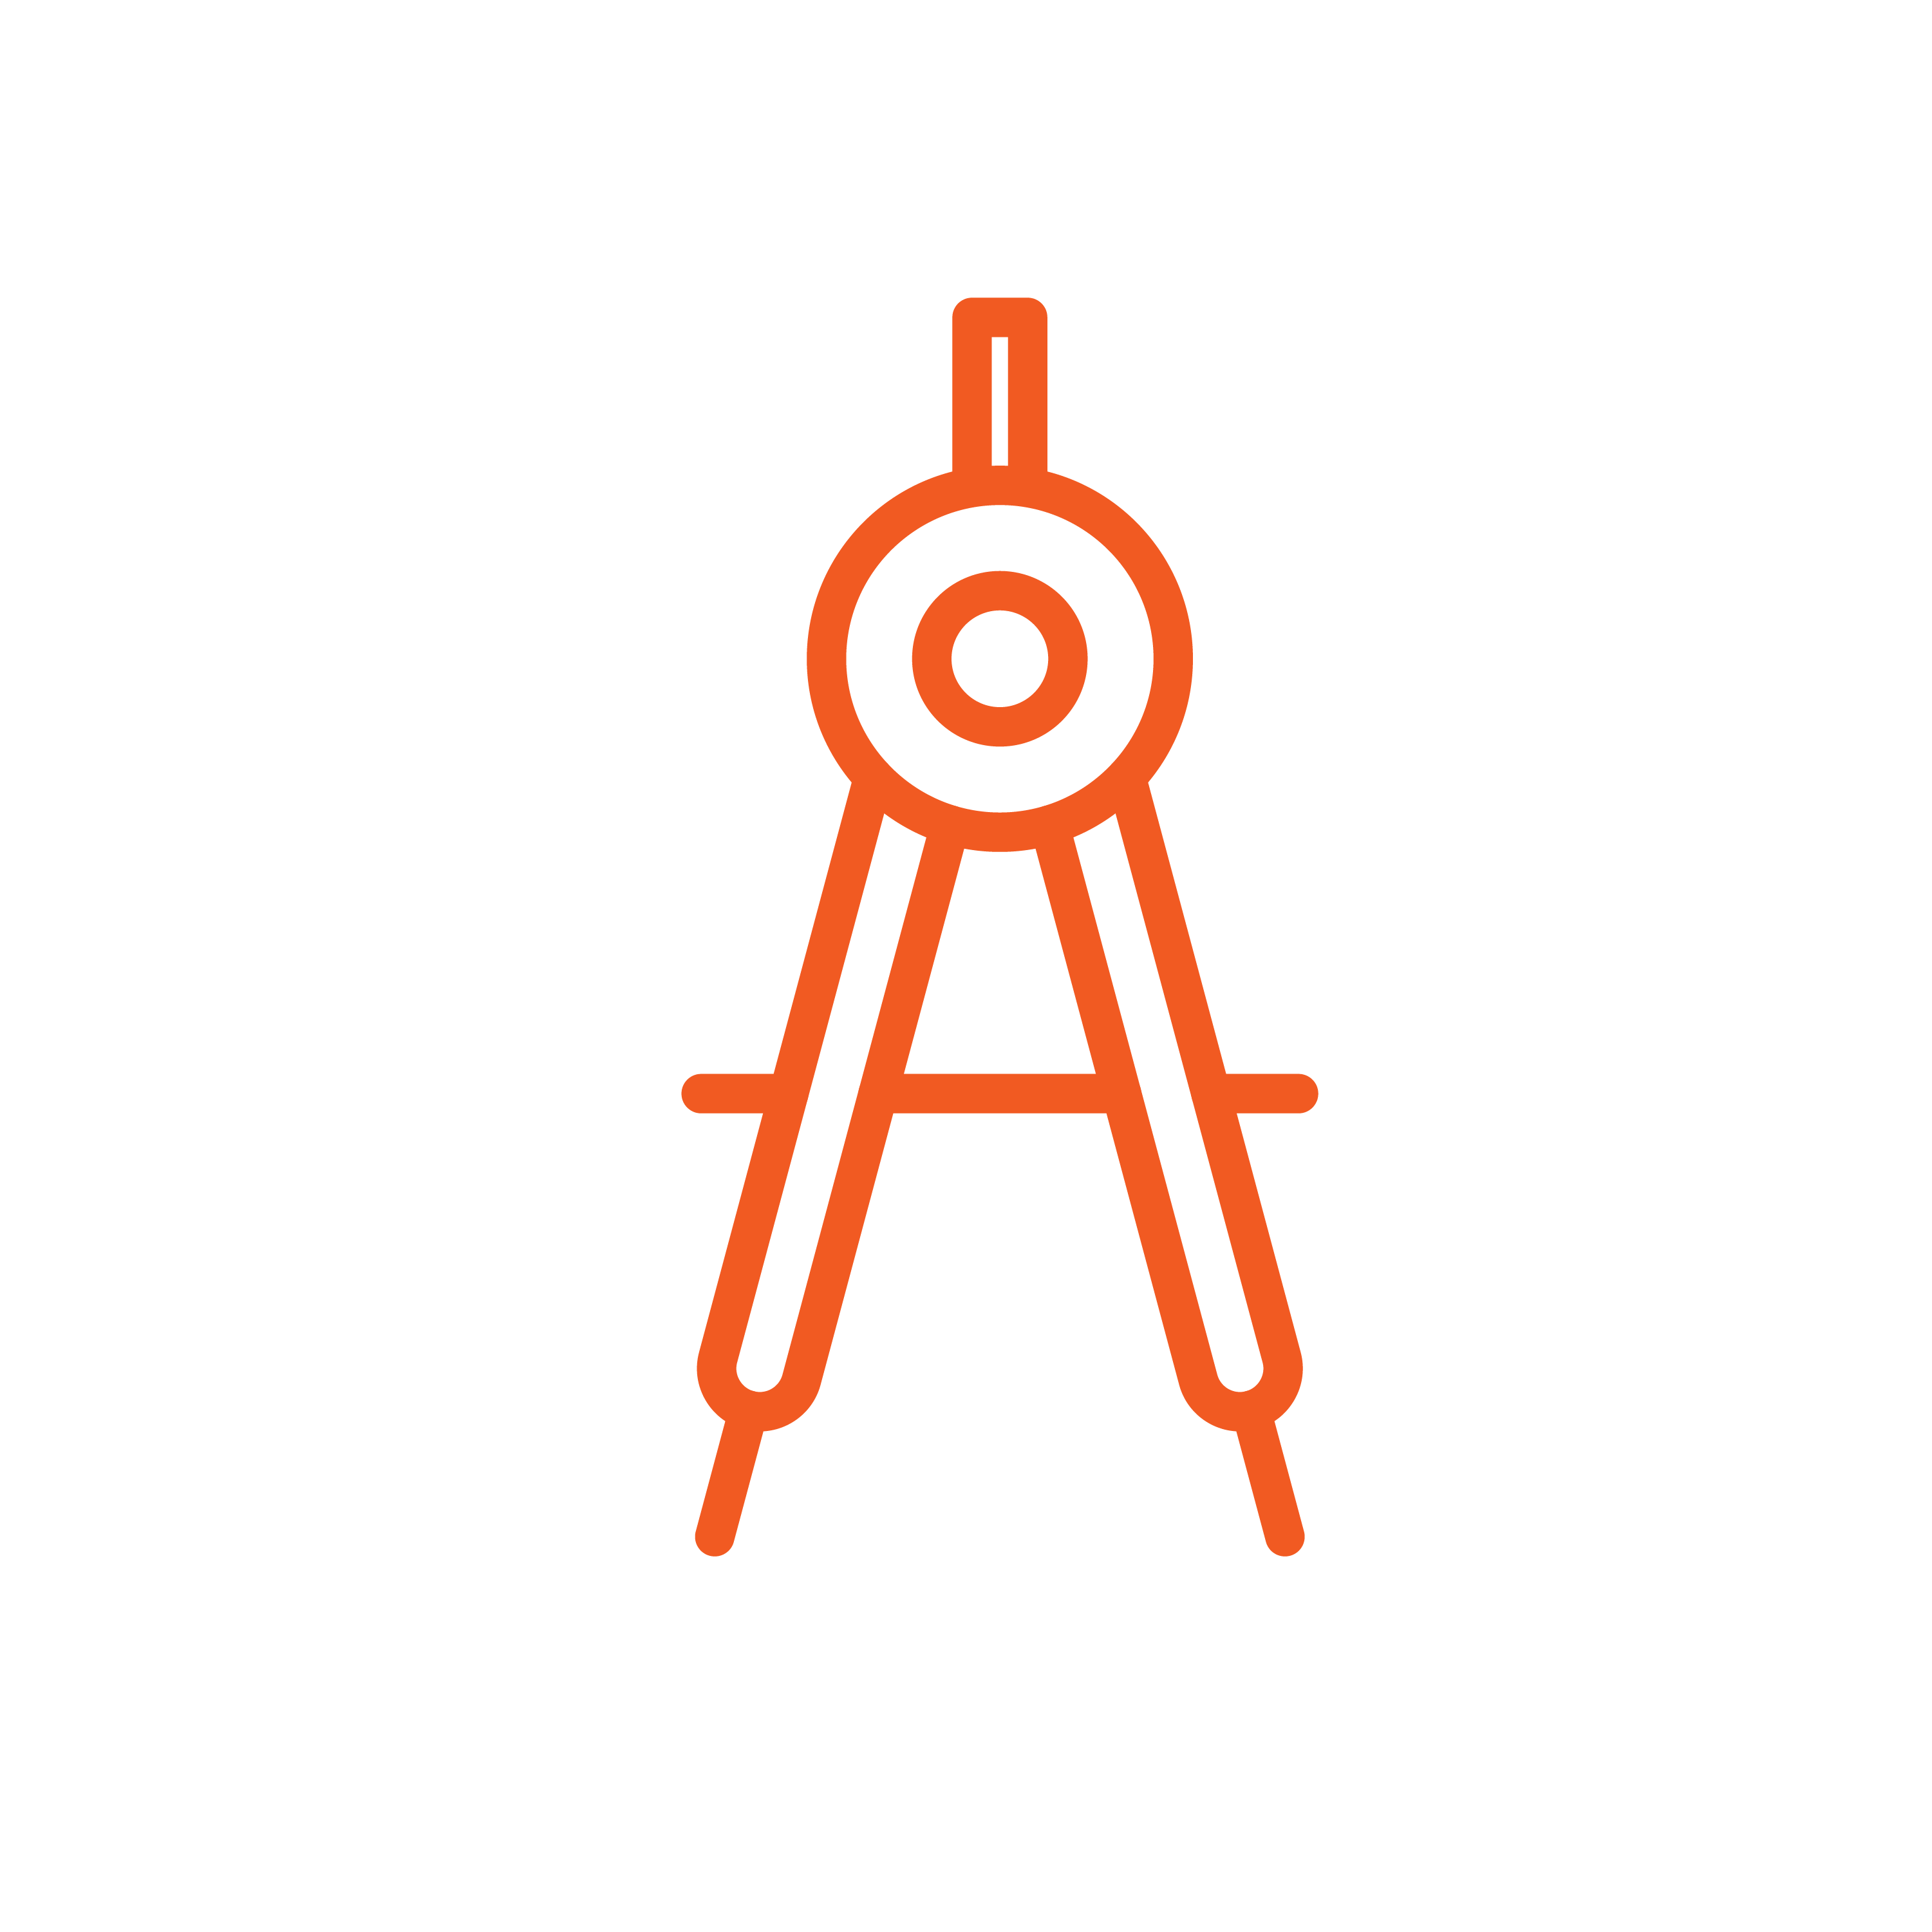
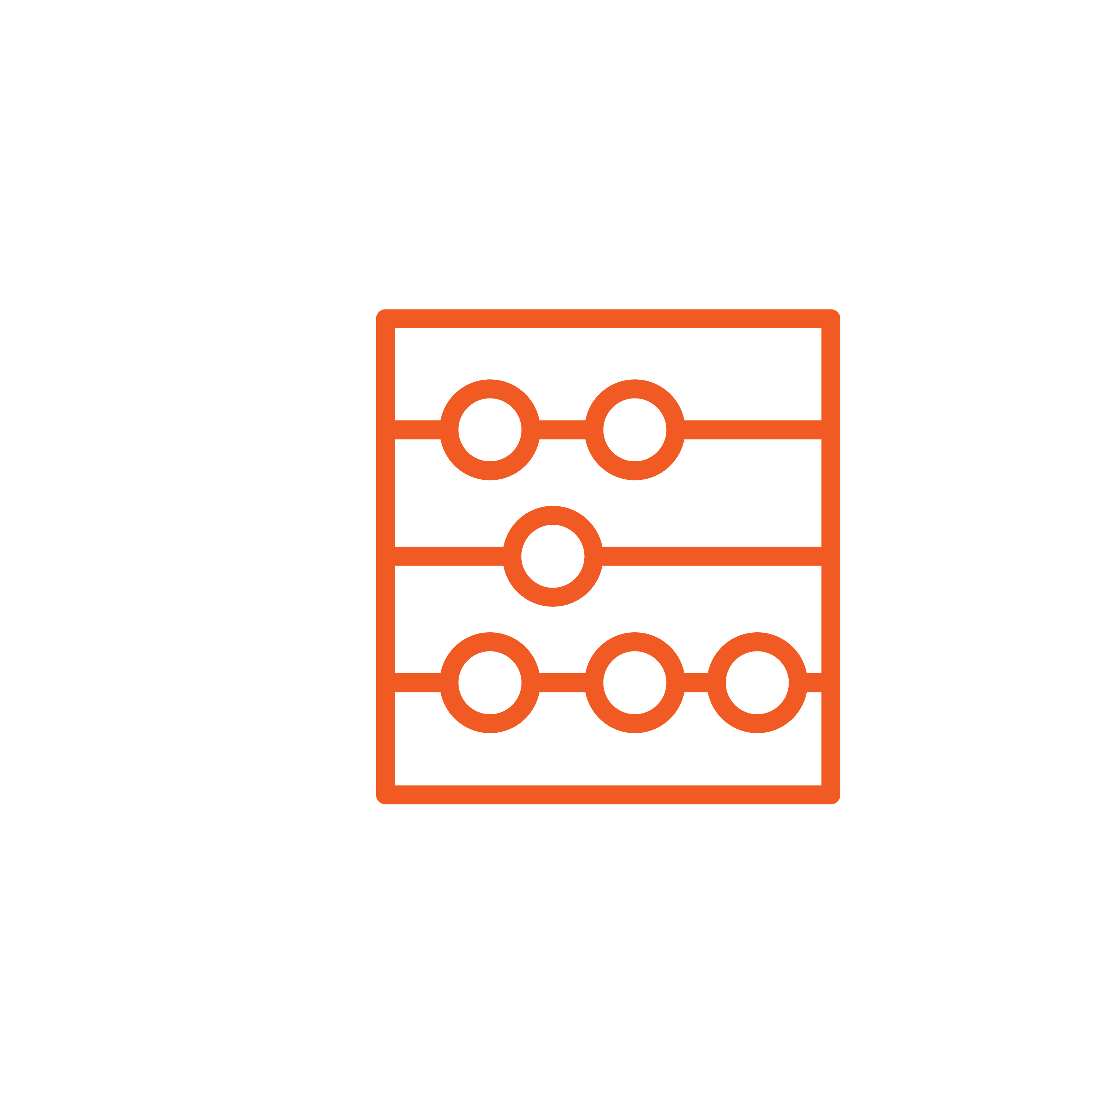

What is STEM²D
Science
Technology
Engineering
Math
Manufacturing
Design

Slide 3
Todays Plan
Introductions
Engineering and Design in the World of Work
Team Challenge: Building a Scientific Research Vessel
Vessel Testing and Inspection
Reflection

Slide 4

Engineering and Design in the World of Work
How do you think engineering and design are used every day in the workplace?
What kinds of careers do you think people with an interest, aptitude for, or degree in design or engineering would have?
Notes:
Share that STEM²D careers are high-demand, high-growth careers.
Share with students that there are many different kinds of careers related to STEM²D
STEM²D careers related to this activity:
Marine biologist
Environmental protection worker
Hydrologist
Geologist
Mechanical engineer
Manufacturing engineer

Slide 5
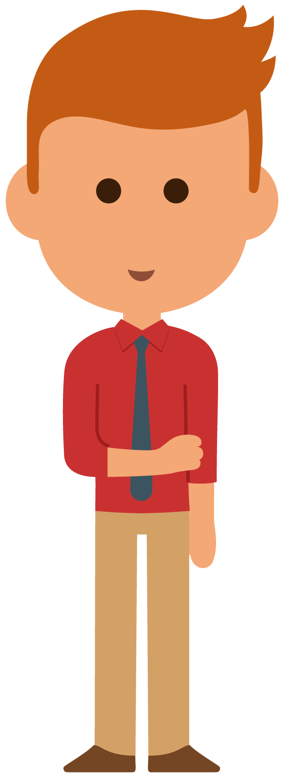
Tell My Story

Slide 6
My Story (delete if not using)

Slide 7
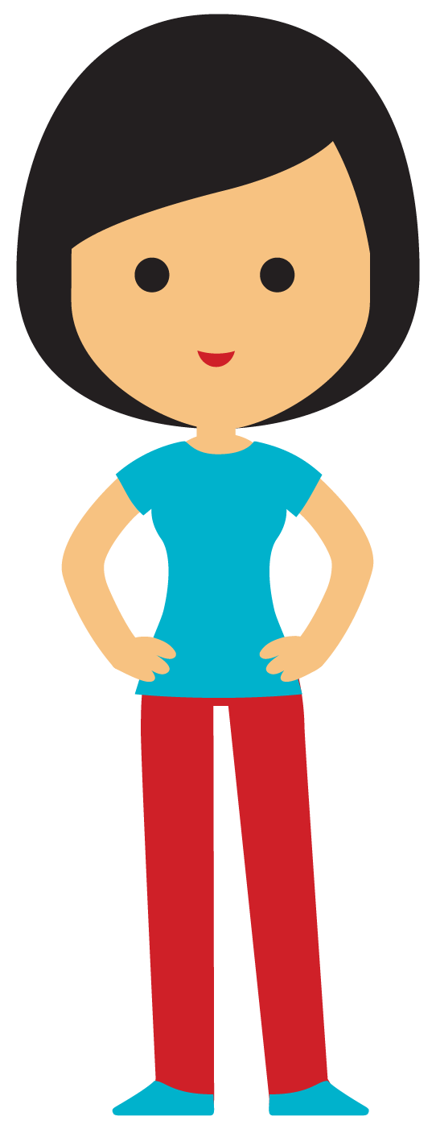
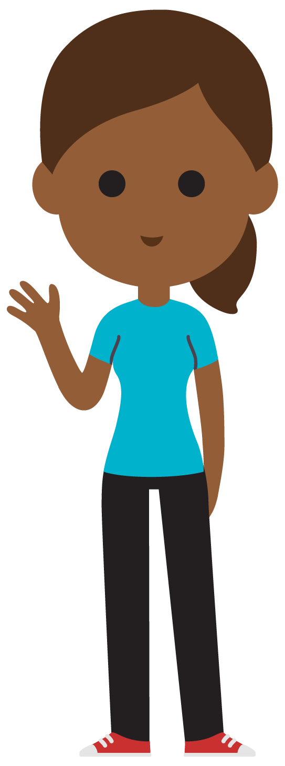
Buoyance

Slide 8
What is Buoyance?
+
Buoyance is the ability or tendency to float in water or air
or some other fluid.

Slide 9

Why Do
Vessels Float?
Notes:
Vessels float because of their density in relation to water.

Slide 10
What is Density? Why is it Important?
Density is the mass of a unit volume of a material substance.
Whether something sinks or floats is determined by density.
If the density is greater than that of water, the object will sink.
If the density is less than (or the same as) that of water, the object will float.

Slide 11
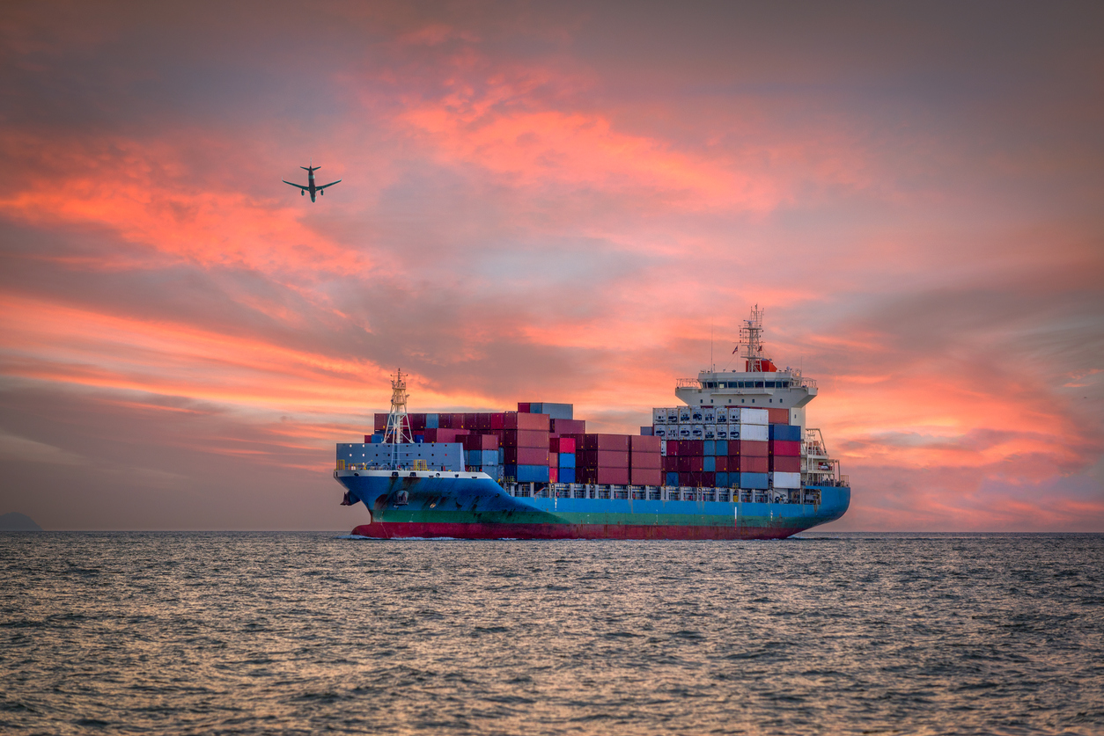
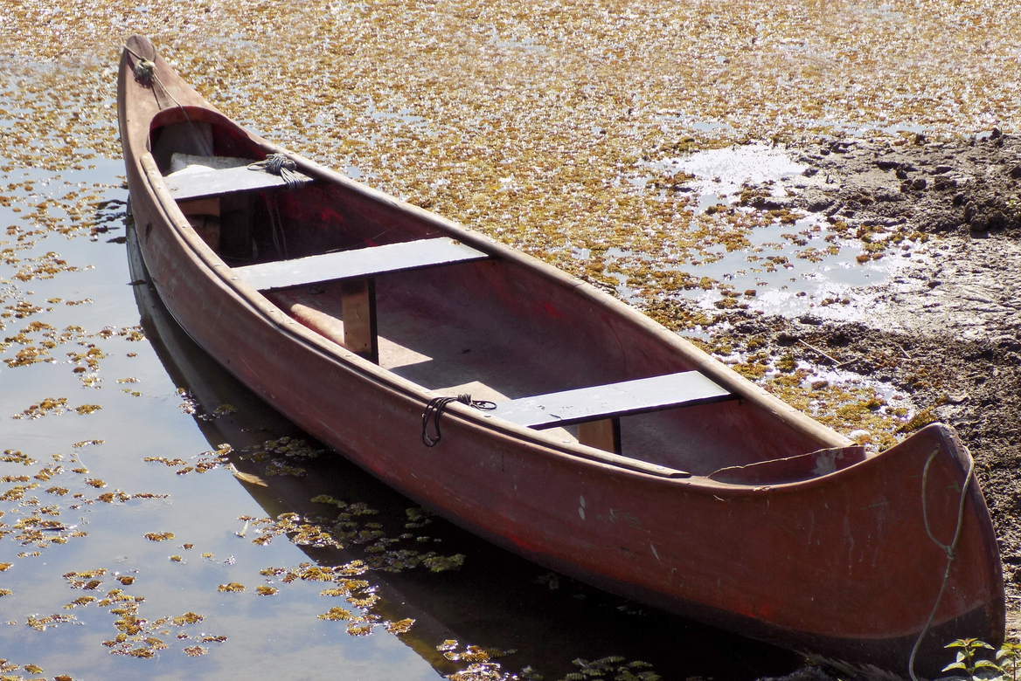
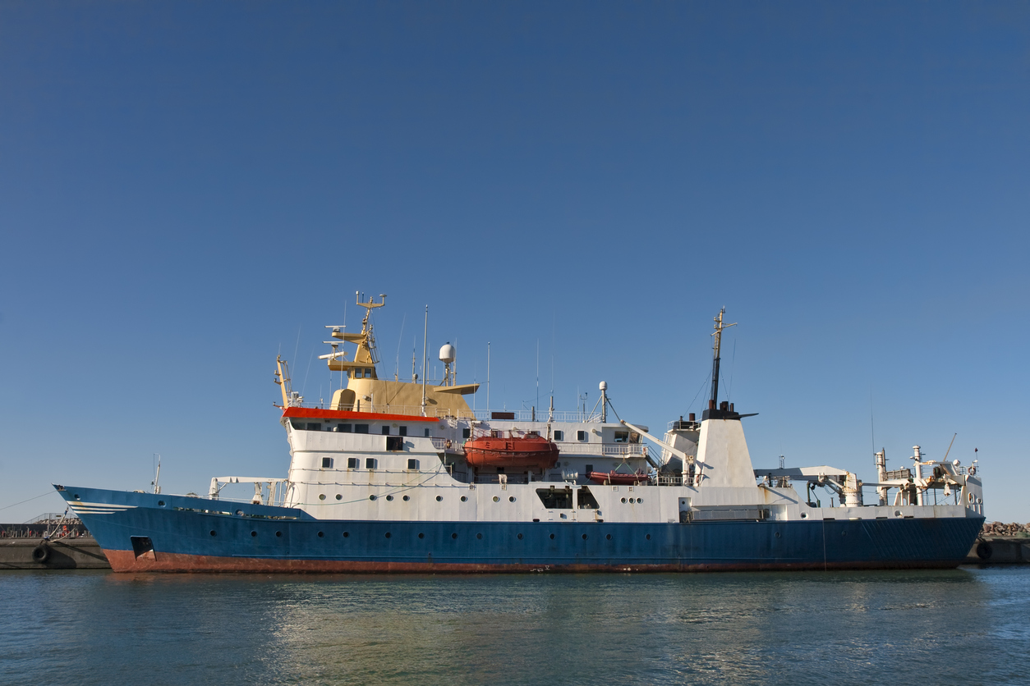
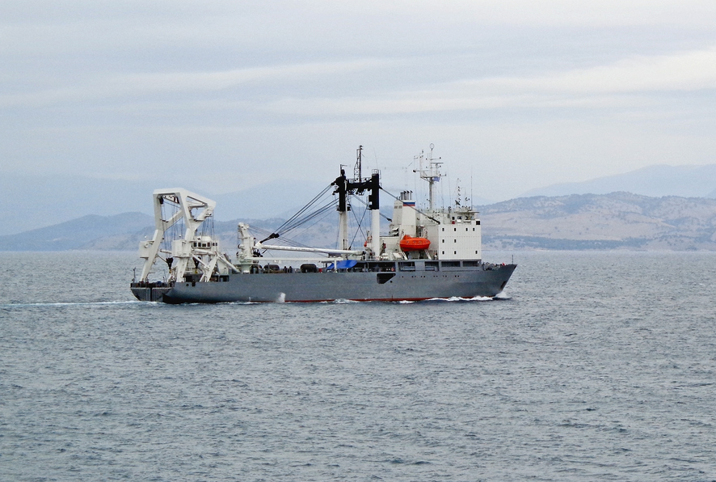
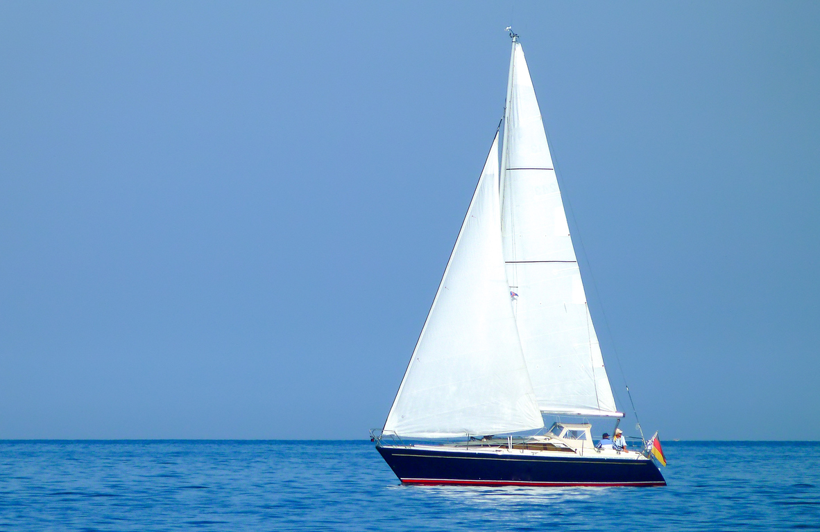
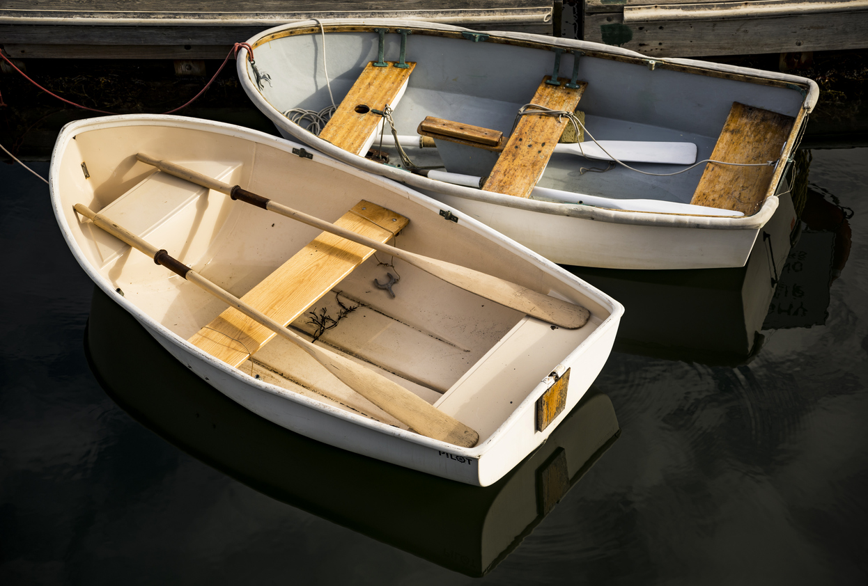
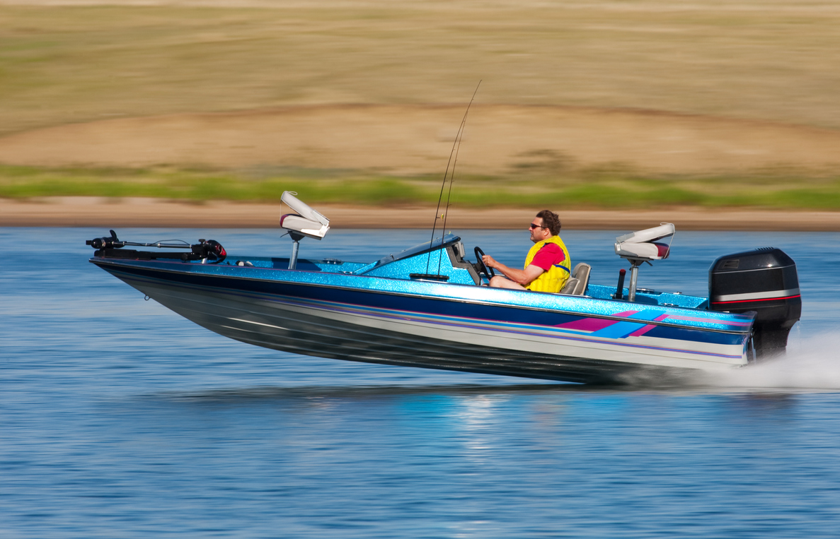
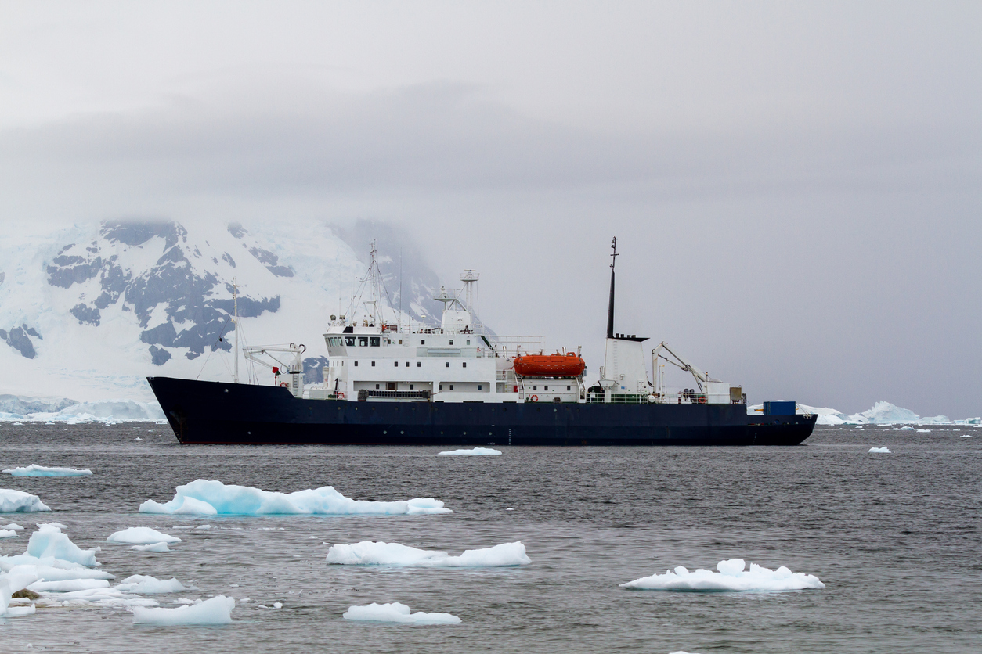
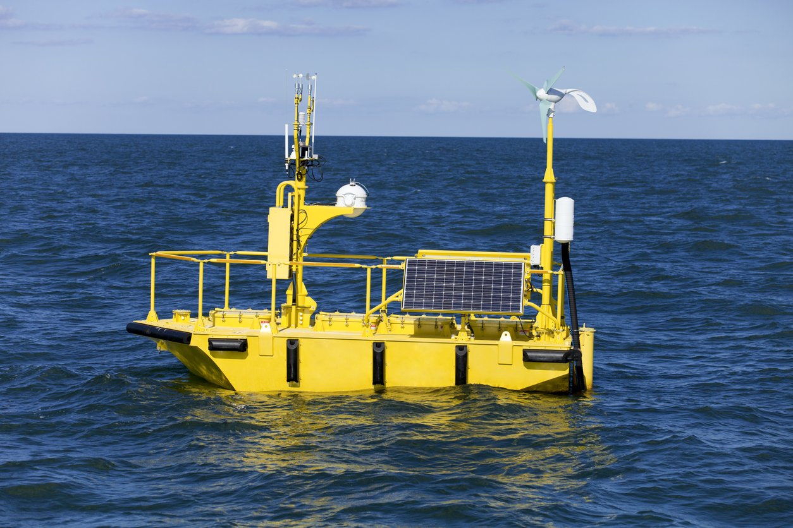
Types of Vessels
Notes:
Ask the following questions:
Why do vessels have different shapes?
Vessels have different shapes based on their uses, the materials they are made of, and the amount of weight they need to be able to carry.
Which of these vessels is most stable?
The canoe, rowboat and sail boat are the least stable.
The freighter is the most stable. The ship contains tanks below the water level that are filled with water and create stability.
Which of these vessels could support the most weight? Why?
The freighter is the most stable. The ship contains tanks below the water level that are filled with water and create stability.
Which of the vessels could go the fastest? Why?
The speed boat is the fastest.
Photos (from top, left) #1, #3, #4, #8, and #9 are all scientific research vessels.

Slide 12
Vessels for Scientific Purposes
Fisheries Research Vessel
Deep Sea Research Vessel
Acoustic Research Vessel
Polar Research Vessel
Coastal Research Vessel
Notes:
Fisheries Research Vessel—requires platforms that are capable of towing different types of fishing nets, collecting plankton or water samples from a range of depths, and carrying acoustic fish-finding equipment. A fisheries research vessel is often designed and built along the same lines as a large fishing vessel, but with space given over to laboratories and equipment storage, as opposed to storage of the catch.
Deep Sea Research Vessel—designed to perform hydrographic surveys or oceanographic research, among just a few of their purposes. These vessels often mount equipment on a towed structure. This might include air cannons to generate a high-pressure shock wave to sound the strata beneath the seabed, for example. Or, a depth sensor might be mounted on the keel. These vessels may carry equipment for collecting water samples from a range of depths as well as environmental sensors, scientific divers, and unmanned water vehicles.
Acoustic Research Vessel—designed especially for underwater acoustic research. They may be equipped with extensive and sophisticated navigation, communications, and computer equipment. They may have winches, cranes, loading frames, and other deck machinery for the deployment, towing, and recovery in all sea conditions of a variety of sensor arrays and oceanographic instrumentation.
Polar Research Vessel—A polar research vessel is constructed around an icebreaker hull, allowing it to engage in ice navigation and operate in polar waters. These boats usually have dual roles, particularly in the Antarctic where they also function as polar replenishment and supply vessels to the Antarctic research bases.
Coastal Research Vessel—designed to provide a stable yet flexible sea going scientific platform suitable for operations in shallower waters. They have state-of-the-art communication and navigation systems as well as substantial deck handling equipment.

Slide 13
Building a Scientific Research
Vessel Challenge
    Instructions:
    Choose a scientific purpose for your vessel.
    Note the specifications for the selected vessel in terms of: maximum length, endurance, number of crew, and minimum amount of weight to be supported.
    Design the vessel as a team.
    Determine the supplies and calculate the cost.
    Show the completed design to a Volunteer and obtain sign-off. This is required and must be done before moving on to the next step.

Slide 14
Building a Scientific Research
Vessel Challenge (continued)
    Purchase materials and begin building. You may return at any time to purchase additional supplies, as long as you have money remaining in your budget.
    Test your vessel’s seaworthiness at any time during the building process.
    Total Time:
    15 minutes
    What’s Next?
    Vessel Testing & Inspection

Slide 15

Vessels Testing
& Inspection

Slide 16
Reflection
  Think about the following questions…
    What did you learn about Building a Scientific Research Vessel?
    What was difficult about designing and building your vessel?
    What would you change about your design if you were to do it again?
    How do you think this activity relates to a career in engineering, design, and/or working at Johnson & Johnson?
    Can you see yourself as a STEM²D professional? Why or why not?
    What would you need to do to make that happen?

