Slide 1






Building a
Medical Device
STEM²D Topics: Design and Engineering
[Presenter Name]
[Presenter Organization]
[Date]

Slide 2





What is STEM²D?
Science
Technology
Engineering
Math
Manufacturing
Design
Notes:
Explain that STEM²D refers to: Science, Technology, Engineering, Math, Manufacturing, and Design.
Ask students and other volunteers to introduce themselves and state their favorite areas of STEM²D (Science, Technology, Engineering, Math, Manufacturing, and Design).

Slide 3
Today’s Plan
Introduction
STEM²D in the World of Work
What is Engineering?
Engineering a New Product
Team Challenge: Building a Medical Device
Team Presentations & Performance Testing
Reflection
Notes:
Review the agenda. Explain that today students will design, build, and test a medical device that meets a customer’s needs.

Slide 4
STEM²D in the World of Work
How do you think STEM²D is used every day in the workplace?
Notes:
Share that STEM²D careers are high-demand, high-growth careers.
Initiate an opening discussion and brainstorming activity. Consider asking:
How do you think design and engineering are used every day in the workplace?
What kinds of careers do you think people with an interest, aptitude for, or degree in design or engineering would have?

Slide 5
My Story
Notes:
Talk about your educational and career path. Use the “Tell My Story” form as the basis for your remarks. Be prepared to describe your job or a typical day, and provide information about your background including:
When/why you developed an interest in engineering.
The classes/courses you took in secondary school.
Your post-secondary path, including the institution you attended and your degree. If you switched disciplines, make sure you explain why to the students.
What your current position entails. Be sure to include how you use design and manufacturing and what you do on a typical work day.
Weave in facts about engineering and STEM²D careers:
Tell the students that your career is only one of the many careers available in the STEM²D disciplines—science, technology, engineering, math, manufacturing, and design.
Explain that STEM²D careers are high-demand, high-growth careers and are predicted to remain in demand over the next ten years.
Share a few Johnson & Johnson job titles and careers that may align with this activity.

Slide 6
What is Engineering?
Engineering is the application of scientific, economic, social, and practical knowledge to design, build, maintain, and improve structures, machines, devices, systems, materials, and processes.
  The discipline of engineering is extremely broad and encompasses a range of specialized fields, each with an emphasis on a particular area, technology, or type of application.

Slide 7
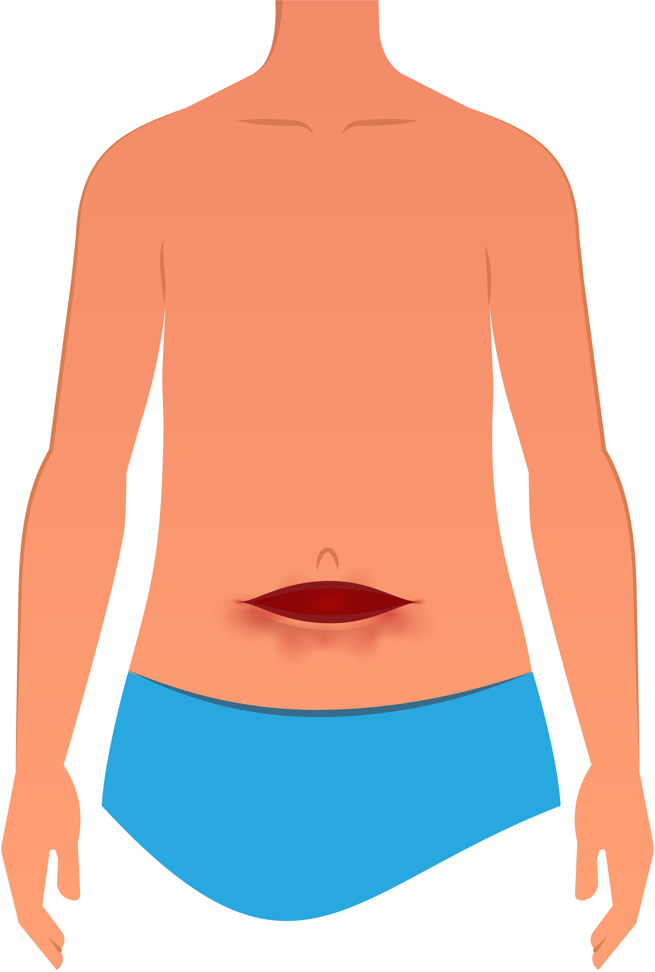
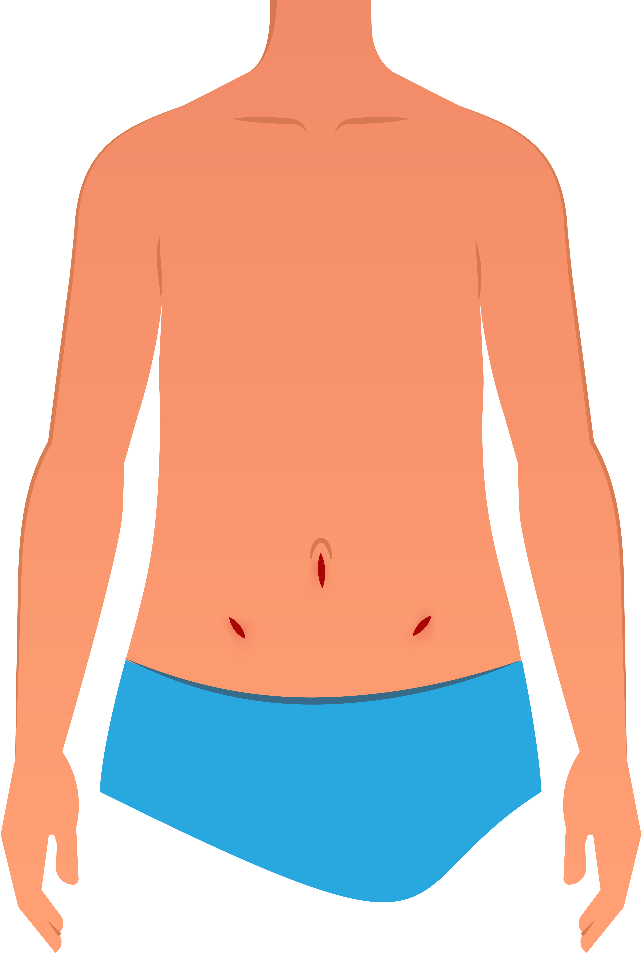
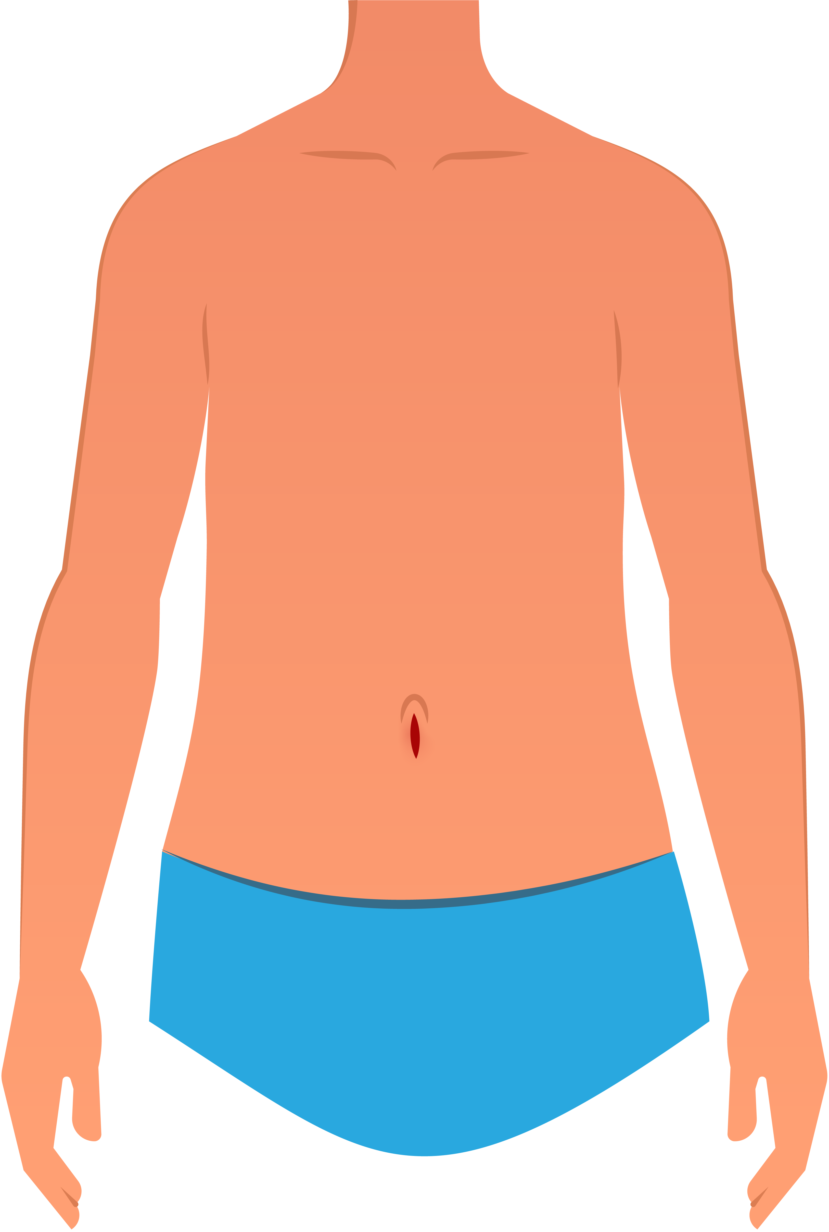
Background of Surgery
Open surgery
Laparoscopy
Robotic surgery
Notes:
State that engineering has led to significant improvements in surgery. For example:
Surgeons used to make large incisions to access muscles, organs, bones, etc.
Today, surgeons are able to access these areas through three to four small incisions (laparoscopy).
Robotic systems are also being used now to access the same areas with single incisions or a single small hole, to achieve the same surgical results.

Slide 8

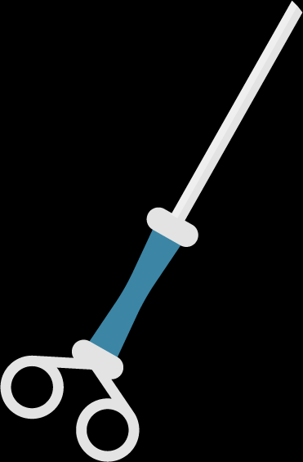
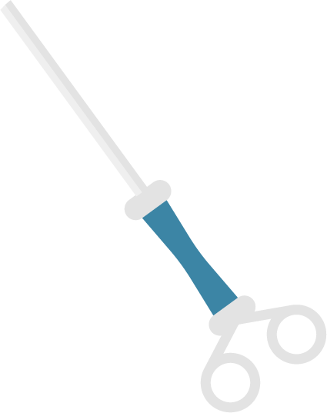
Laparoscopic Surgery:
A surgical procedure in which a fiber-optic instrument is inserted through the abdomen (a single hole or three to four incisions) to view the organs and perform the procedure
Laparoscopy
Benefits:
Less post-operative discomfort
Quicker recovery times
Shorter hospital stays
Earlier return to full activities
Smaller scars
Possibly less internal scarring
Notes:
Benefits of Laparoscopic Surgery:
Less post-operative discomfort
Quicker recovery times
Shorter hospital stays
Earlier return to full activities
Smaller scars
Possibly less internal scarring
Explain: Laparoscopy is a surgical procedure in which a fiber-optic instrument is inserted through the abdomen to view the organs and perform the procedure. There are many benefits compared to traditional open surgery, including those listed on the slide.

Slide 9
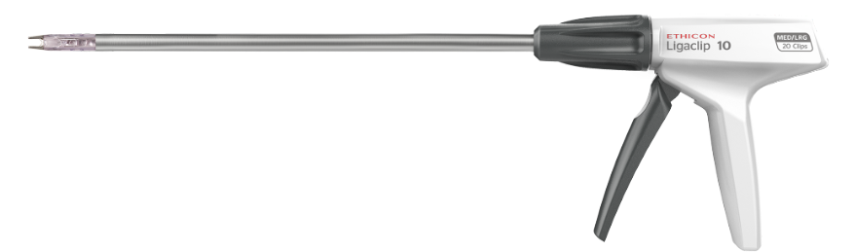
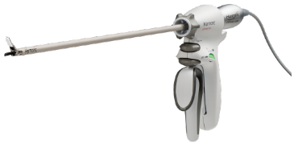
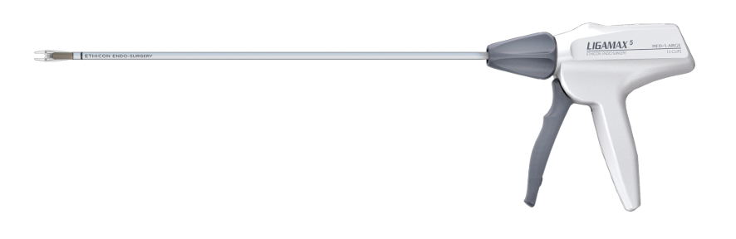
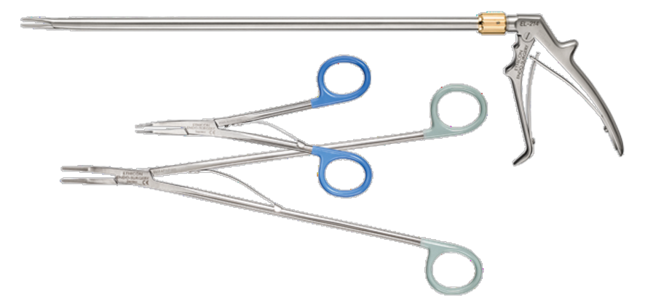
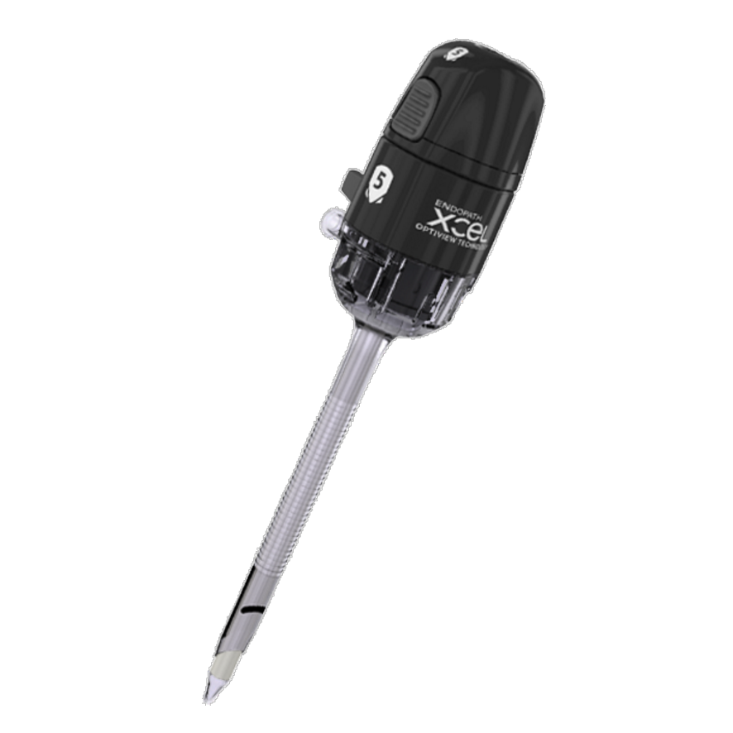
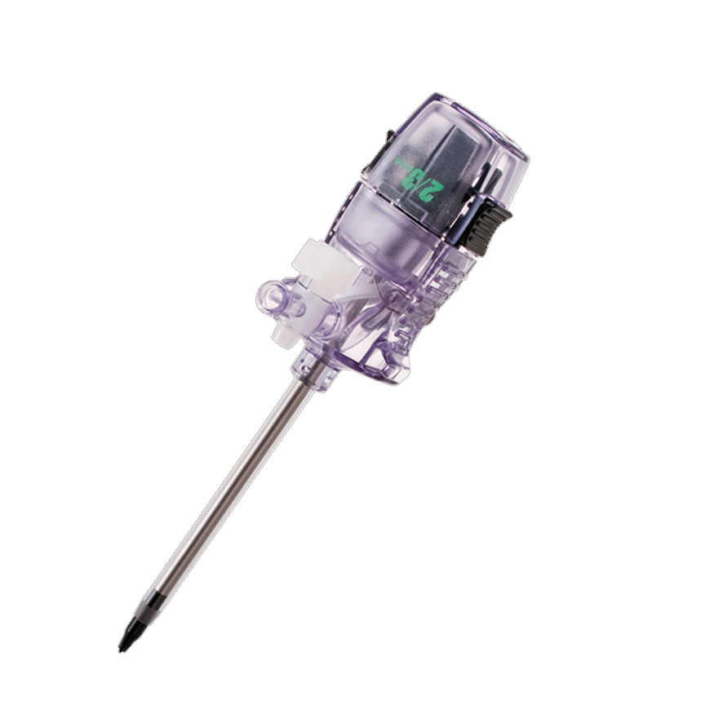
Examples of Laparoscopic Devices
Sold by J&J
Clip appliers
Shears
Trocars
Notes:
Explain: J&J Medical Devices (ETHICON), a division of Johnson & Johnson, develops laparoscopic devices and has contributed to many advances in the field of laparoscopy, such as vessel-sealing devices, cutting devices, stapling devices, ligation devices, and many more!

Slide 10
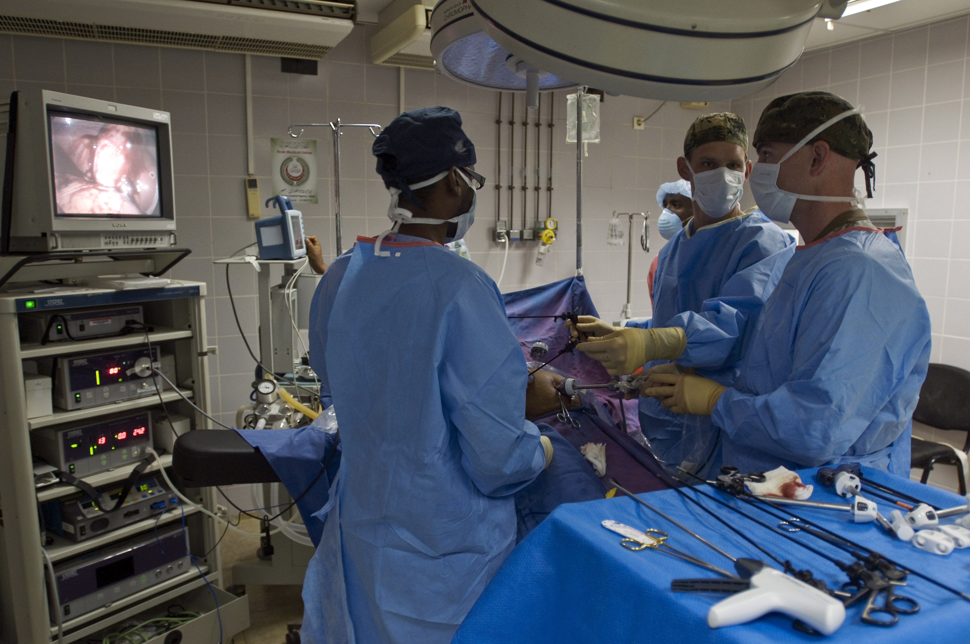
US Navy surgeons and nurses assist Djiboutian doctors with surgeries and other complex medical procedures.
Trocars
Photo: Marc Rockwell-Pate, US Navy
Notes:
Explain: A trocar device is a surgical instrument with a three-sided cutting point enclosed in a tube, used for withdrawing fluid from a body cavity. It is minimally invasive, which is extremely beneficial to the patient, as seen in the image.
Photo: https://commons.wikimedia.org/wiki/Category:Laparoscopy#/media/File:US_Navy_081117-N-7526R-568_Cmdr._Thomas_Nelson_and_Lt._Robert_Roadfuss_discuss_proper_procedures_while_performing_a_laparoscopic_cholecystectomy_surgery.jpg
Credit: Mass Communication Specialist 2nd Class Marc Rockwell-Pate, US Navy
DJIBOUTI CITY, Djibouti (Nov. 17, 2008) Cmdr. Thomas Nelson, a general surgeon, and Lt. Robert Roadfuss, an operating room nurse, both assigned to Camp Lemonier, discuss proper procedures while performing a laparoscopic cholecystectomy surgery at Peltier Hospital. Nelson, Roadfuss and other Camp Lemonier surgeons travel to Peltier three times a week to assist Djiboutian doctors with surgeries and other complex medical procedures.

Slide 11
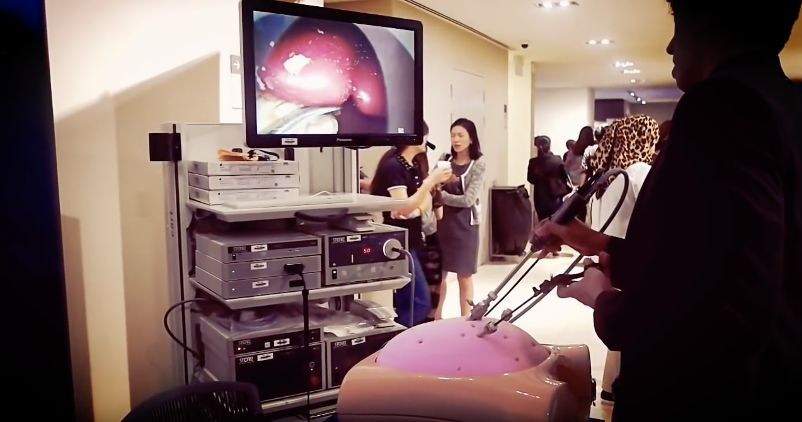
Simulated
Laparoscopy Surgery
Notes:
If you have time, you may want to show the following video:
https://www.youtube.com/watch?v=gwocfmcKebc

Slide 12
Engineering a New Product
Design
Development
Production
Concept Design
  Analyze need
  Brainstorm
  Create concept
Product Planning
  Business case
  Specifications
  Design
  Sourcing
Prototype Building
  Samples
  Testing
Pilot Production
  Production process design
  Pilot assembly
  PVT
Mass Production
  Volume production
  Global distribution
Sustaining Support
  Technical support
  Marketing/Sales
DESIGN REVIEW
Notes:
Phase 1: Design. Key steps during this phase include:
Concept Design. This first step is critical; it includes analyzing and identifying what the customer wants or needs and creating a concept (idea or plan) based on those inputs.
Product Planning. This step lays out the reason the business should pursue the concept and provides a plan for how the concept will be achieved (what the design looks like, who will provide the parts, what the critical wants/needs are, and how long it will take to develop).
Phase 2: Development. Steps include:
Prototype Building. This step involves creating the first fully functioning prototype (model) of the proposed product to showcase. This original prototype is not likely to be manufactured; the design is apt to change significantly along the way, based on testing in a controlled environment. Testing is conducted to see if the prototype produces the desired outcome. Redesign and rebuilding occur to perfect the working prototype.
Pilot Production. This step involves testing your manufacturing process to determine if you can create your final design consistently. During this phase packaging is also taken into account.
Phase 3: Production. Steps include:
Mass Production. This step begins when you have demonstrated that you can create your final design consistently using the manufacturing process developed and can begin producing the product to sell to customers.
Sustained Support. This step begins after you launch the product to customers and does not end until the product is no longer sold. Activities can include technical support, customized marketing and sales, warranty and complaint support, and design improvements.
THROUGHOUT:
Design Review. Indicate that throughout the engineering process—in every phase and in all steps—design review occurs. The entire team continuously evaluates the capability and performance of the design to meet requirements; if concerns or shortcomings are identified, the design is modified.

Slide 13

It Takes a Village
Biomedical Engineers
Industrial Design/ Design Engineers
Labeling Specialists
Manufacturing Engineers
Marketing and Sales Representatives
Medical Affairs
Packaging Engineers
Procurement Managers
Quality / Testing Analysts
Regulatory Affairs
Sterilization Scientists
Many jobs are required to launch a product!
Notes:
Explain: Many jobs are required to launch a new product – especially in the health or medical sectors. These jobs include:
Biomedical Engineers: Specialize in the development and design of medical products
Industrial Design/Design Engineers: Design products
Labeling Specialists: Write instructions for use
Marketing and Sales Representatives: Promote or sell the product
Manufacturing Engineers: Establish the production line
Procurement Managers / Supply Chain Specialists: Obtain raw materials and determine logistics for bring the manufacturing product to the customer
Medical Affairs staff: Provide medical expertise regarding procedures
Packaging Engineers: Design product packaging
Pre-Clinical Scientists: Test products to ensure they work properly
Quality & Testing Analysts: Responsible for product functionality, reliability, and patient safety
Regulatory Affairs staff: Work with Food and Drug Administration (FDA) to approve devices
Sterilization Scientists: Work on sterilization (the process of making something free from bacteria or other living microorganisms) processes to ensure devices are sterile when used

Slide 14
Questions?
Notes:
Ask the students if they have any questions about the challenge before getting started.
Answer questions posed by the students.
Remind students they will have 50 minutes to design, build, and test their designs.

Slide 15
Building a Medical Device
Challenge
Notes:
Beak the group into teams of five people per team. Instruct teams to sit together.
Distribute the student handouts and a ruler to each team.

Slide 16
Making Engineering Real
The Challenge:
Design a medical device prototype that meets customer needs, safety standards, and business constraints.
Notes:
.

Slide 17
Challenge Tasks
Tasks:
  Work as a team. Each member should assume a specific role.
  Design a prototype that meets all product requirements.
  Build the prototype using only the materials available for purchase.
  Determine the device name and product selling points.
  Present the prototype.
Time: 50 minutes
Presentation Time: 3 minutes, maximum
Notes:
Review the main tasks:
Work as a team. Each member will assume a specific role.
Design a prototype of a medical device that meets all product requirements (customer needs, safety standards, and business constraints).
Build the prototype using only the materials available for purchase.
Determine the device name and product selling points.
Present the prototype.
Teams have 50 minutes to complete all tasks and three minutes to present to the judge.
Introduce the Judge (the volunteer assigned to this role). Indicate that the judge will hear the presentations and determine if each team meets the customer, safety standards, and business requirements.

Slide 18
Challenge Roles
and Responsibilities
Each team member MUST play a role!
  Each team member will take one of the following roles:
  Design Engineer: Develops a concept (idea or plan) that meets all product requirements (customer needs, safety standards, and business constrains)
  Procurement Manager: Purchases (buys) and tracks all materials used and costs
  Manufacturing Engineer: Builds / rebuilds the prototype based on input from the design engineer and quality / testing analyst
  Quality / Testing Analyst: Ensures the product is functional and meets safety standards
  Marketing and Sales Manager: Develops requirements for the product and means to sell it to the customer
Notes:
Explain the roles and provide description of the main responsibilities for each.

Slide 19

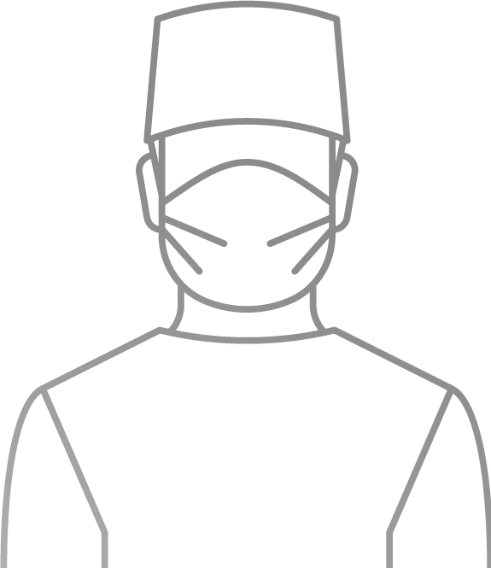
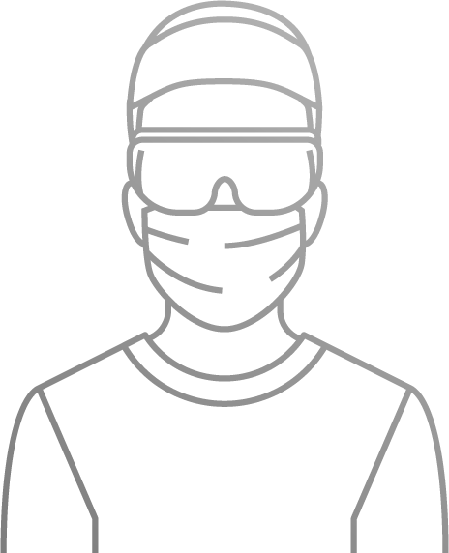
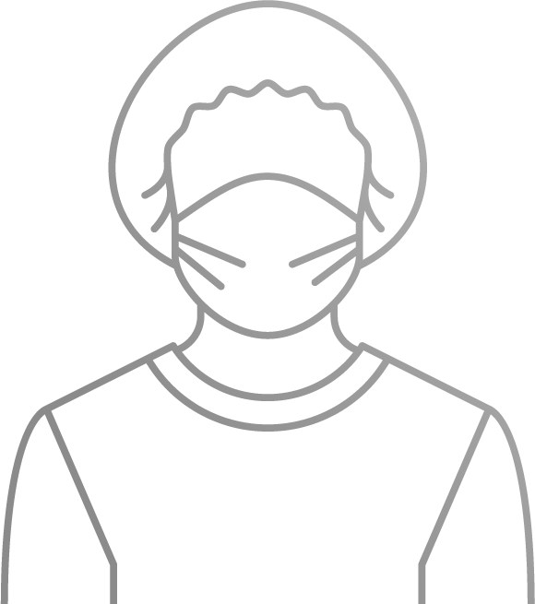
Product Requirements
Voice of Customer
Surgeon
Dr. Anderson:
“I am left-handed. I want it to be easy to use.”
Here’s what a panel of surgeons wants:
Surgeon Dr. Wu:
“I want it to be a natural extension of my hand.”
Surgeon Dr. Johnson: “I need to be able to see the tip of the device when it’s in the tissue.”
Surgeon Dr. Smith: “I want to be able to push tissue out of my surgical sight.”
Notes:
Explain: Your customers have specific needs for the medical device you will be designing.
Review what the panel of surgeons want in a device.
Stress: It must be easy/natural to use (i.e., by left or right hand).

Slide 20
Product Requirements
Safety Standards:
The medical device must:
  Be atraumatic: it can’t do
  any damage to the tissue
  Fit through an 18 mm trocar
  Be long enough to extend through a 15 cm port
  Stay assembled when immersed in water for one minute
Business Constraints/Requirements:
The medical device must:
  Have a name and detailed designs:
  for the patent application
  Be cost efficient: the sales price is
  $20.00, maximum
  Be profitable: keep the Cost of Goods (COGs)
  to less than 20% of the sales price ($16.00, maximum)
  Include a Tracking Sticker
Notes:
Explain: There are safety standards and business constraints/requirements that must be met.

Slide 21
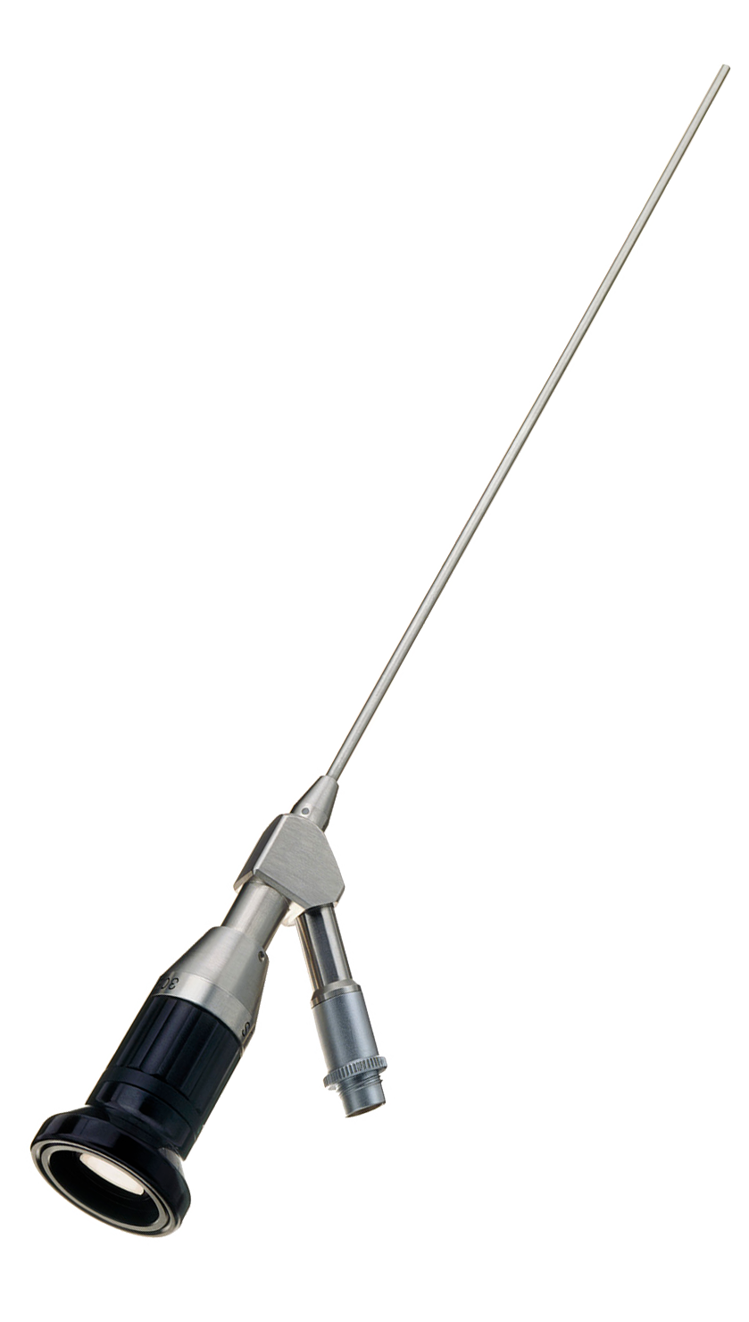
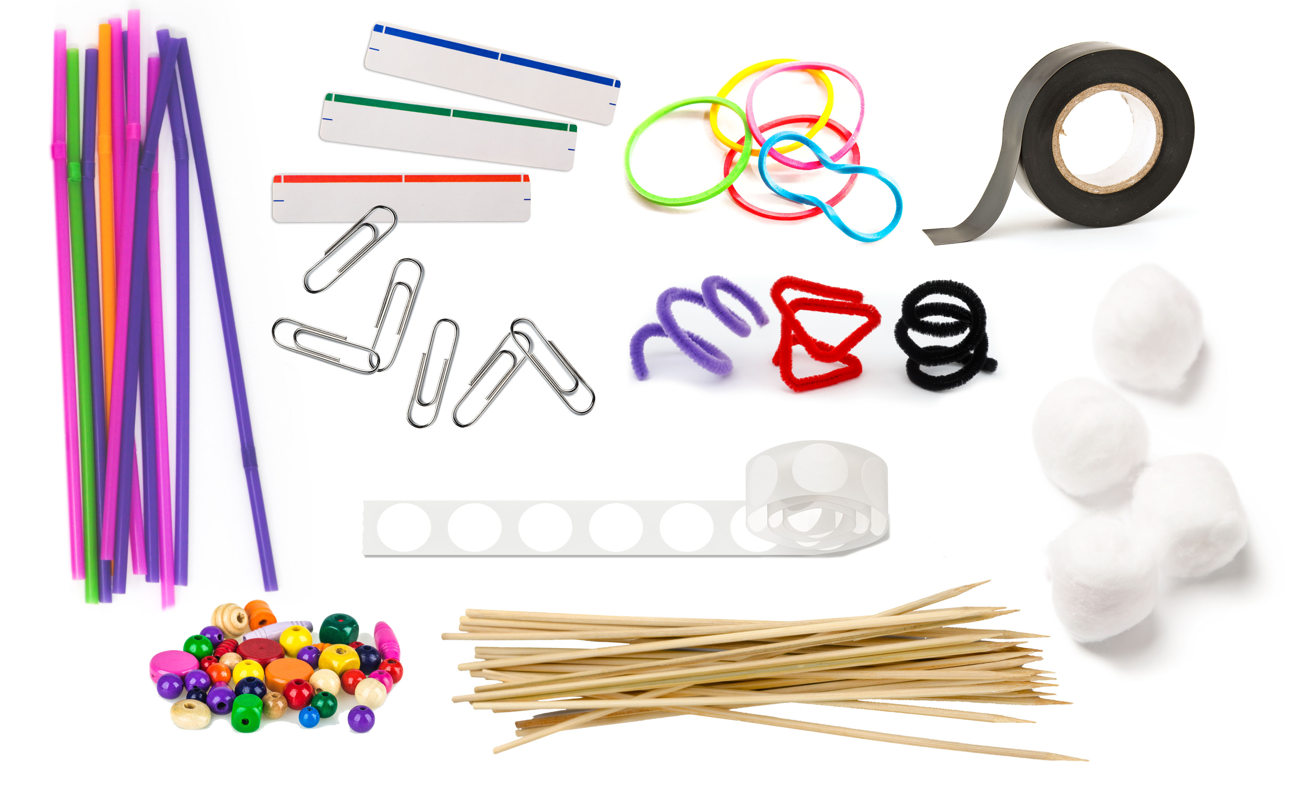
Can you turn THIS…
into
THIS?
Notes:
Every product starts out as a concept (a general idea or plan) before being sold to a customer. In many instances the original concept is developed into an initial prototype using basic materials to help visualize what the final design might look like.

Slide 22
Materials
The sales price for the device is $20. The cost of materials is below. Materials must be less than 20% of sale price.
Material | Cost | Material | Cost
Wood Skewer | $1.00 | Electrical Tape (6 inches in length) | $0.25
Pipe Cleaner | $0.75 | Glue | $0.20
Cotton Ball | $0.75 | Glue Stick | $0.20
Plastic Straw | $0.65 | Color Label | $0.20
Plastic Bead | $0.65 | White Label | $0.10
Wood Bead | $0.50 | Star Sticker | $0.10
Rubber Bands | $0.50 | Circle Sticker | $0.05
Paper Clip | $0.50
Notes:
Explain: The medical device will sell for $20. The costs of materials are shown on the slide. Total materials costs must be less than 20% of sales price.
Introduce the Supplier (the volunteer assigned with this task).
Explain:
You will purchase your materials from the Supplier at the materials store. You must record the cost of the materials you purchased (and used) on the Cost of Materials form. Any unused materials must be returned to the materials store. Remember that your cost of materials must be less than 20% of the sales price.

Slide 23
Questions?
Notes:
Ask the students if they have any questions about the challenge before getting started.
Answer questions posed by the students.
Remind students they will have 50 minutes to design, build, and test their designs.

Slide 24
Building a Medical Device
Challenge

Slide 25
Scoring
Customer Criteria | YES (✓) | Safety Criteria | YES (✓) | Business Criteria | YES (✓)
Is it easy to use? |  | Is it safe to use on tissue? |  | Does it have a name?
Can it be used with the left and right hand? |  | Does it fit through an 18 mm trocar? |  | Are detailed designs provided?
Can it safely push the tissue? |  | Is it long enough to extend through a 15 cm long port? |  | Does it meet 20% COGs?
Can the tip be seen? |  | Does it stay assembled when immersed? |  | Is a tracking sticker attached?
Notes:
Re-introduce the Judge (the volunteer assigned with this task).
Explain: The Judge will verify each team’s cost of materials and score the protype based on the product requirements. Refer to the checklist on the slide.

Slide 26
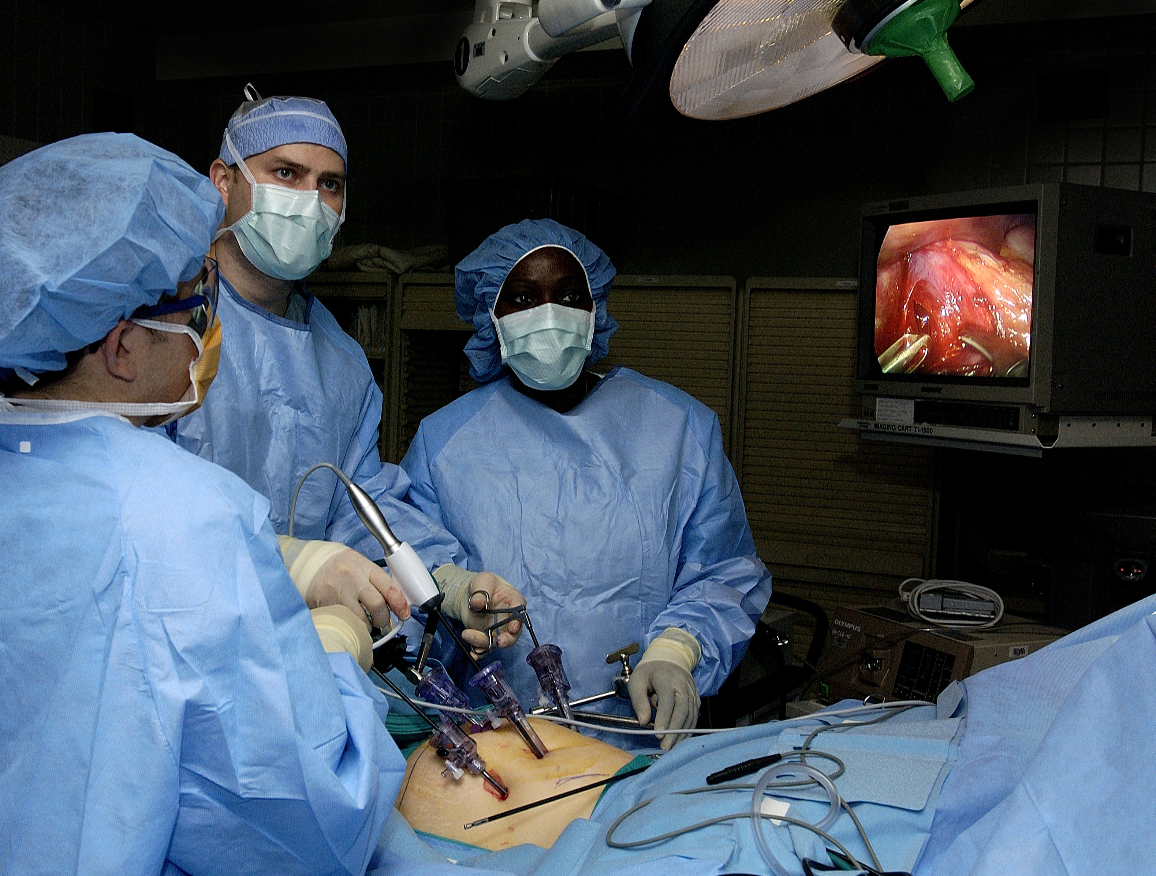
Presenting and Testing
Your
Medical
Device
Physicians perform laparoscopic surgery to remove the gall bladder.
Photo: Samuel Bendet, US Air Force
Notes:
Explain: Now it is time to present and test the devices in front of the whole group. We’ll do this one team at a time.
The team’s Marketing Manager will make the 3-minute presentation. After the presentation, I will test the device with the Quality Engineer.
Test each device:
Place the device through the 18 mm trocar.
Measure the device using the metric ruler to verify the device is longer than 15 cm.
Use the device to push a water balloon a distance of 6 inches inside the water-filled bin.
Fully submerge the device in the water-filled bin for one minute. (Ask the Judge to use the timer.)
Photo: https://commons.wikimedia.org/wiki/File:Laparoscopic_stomach_surgery.jpg
Credit: Samuel Bendet, US Air Force
Physicians perform laparoscopic stomach surgery. The surgery will involve the removal of the gall bladder to help alleviate acid reflux disease.

Slide 27
What did we learn?
What was the most critical decision your team made during the design process?
What did you learn about working in a team?
What was the most critical decision your team made during the manufacturing process?
What was difficult about designing and building your medical device?
What would you change about your design if you were to do it again?
Notes:
Ask students to reflect on the activity. Have students spend a few minutes thinking about the following questions and then ask some of the following:
What was the most critical decision your team made during the design process?
What did you learn about working in a team?
What was the most critical decision your team made during the manufacturing process?
What was difficult about designing and building your medical device?
What would you change about your design if you were to do it again?

Slide 28
Reflection
Think about the following questions…
What did you learn about Engineering?
How do you think this activity relates to a career in Engineering and/or working at Johnson & Johnson?
Can you see yourself as a STEM²D professional? In what role? Why or why not?
What would you need to do to make that happen?
What is one thing you learned that you did not know coming into today?
Notes:
What did you learn about Engineering?
How do you think this activity relates to a career in Engineering and/or working at Johnson & Johnson?
Can you see yourself as a STEM²D professional? In what role? Why or why not?
What would you need to do to make that happen?
What is one thing you learned that you did not know coming into today?

