Slide 1
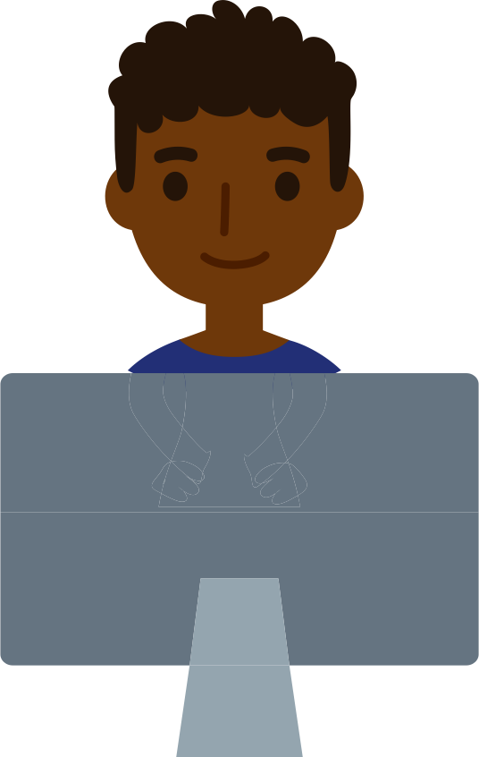
Build a Prosthetic Arm Stem²D Topics: Design and Manufacturing
[Presenter Name]
[Presenter Organization]
[Date]

Slide 2





What is STEM²D?
Science
Technology
Engineering
Math
Manufacturing
Design

Slide 3
Today’s Plan
Introduction
STEM²D in the World of Work
Design & Manufacturing Overview
Team Challenge: Build a Prosthetic Arm
Group Activity: Performance Test
Reflection

Slide 4


Tell My Story
Notes:
Talk about your educational and career path. Use the “Tell My Story” form as the basis for your remarks. Be prepared to describe your job or a typical day, and provide information about your background including:
When/why you developed an interest in design or manufacturing?
The classes/courses you took in secondary school.
Your post-secondary path, including the institution you attended and your degree. If you switched disciplines, make sure you explain why to the students.
What your current position entails. Be sure to include how you use design and manufacturing and what you do on a typical work day.
Weave in facts about design and manufacturing and STEM²D careers:
Tell the students that your career is only one of the many careers available in the STEM²D disciplines – science, technology, engineering, mathematics, manufacturing, and design.
Explain that STEM²D careers are high-demand, high-growth careers and are predicted to remain in demand over the next 10 years.
Share a few Johnson & Johnson job titles and careers that may align with this activity.

Slide 5
My Story (delete if not using)
Notes:
Talk about your educational and career path. Use the “Tell My Story” form as the basis for your remarks. Be prepared to describe your job or a typical day, and provide information about your background including:
When/why you developed an interest in design or manufacturing?
The classes/courses you took in secondary school.
Your post-secondary path, including the institution you attended and your degree. If you switched disciplines, make sure you explain why to the students.
What your current position entails. Be sure to include how you use design and manufacturing and what you do on a typical work day.
Weave in facts about design and manufacturing and STEM²D careers:
Tell the students that your career is only one of the many careers available in the STEM²D disciplines – science, technology, engineering, mathematics, manufacturing, and design.
Explain that STEM²D careers are high-demand, high-growth careers and are predicted to remain in demand over the next 10 years.
Share a few Johnson & Johnson job titles and careers that may align with this activity.

Slide 6

STEM²D in the World of Work
How do you think STEM²D is used every day in the workplace?
Notes:
Share that STEM²D careers are high-demand, high-growth careers.
Initiate an opening discussion and brainstorming activity. Consider asking:
How do you think design and manufacturing are used every day in the workplace?
What kinds of careers do you think people with an interest, aptitude for, or degree in design or manufacturing would have?

Slide 7
The Design Process
Define the Need
Brainstorm
Design
Build
Rebuild
Test & Evaluate
Share the Solution
Notes:
The design process can have many steps. Today we will learn about a 7-step design process.
Define the need – determine what problem you’re trying to solve.
Brainstorm – think of different ways to tackle the challenge. Record the ideas.
Design – Determine which brainstormed ideas are really possible given your time, tools, and materials. Explore ideas in further detail. Create sketches of ideas. Determine materials to be used. Create working drawings so the idea can be built.
Build – make a model using materials so the solution to the problem.
Test and Evaluate – test the model in a controlled and working environment. Gather data on the performance. Check the results to determine if the model solved the problem. Identify areas of concern and shortcomings and determine any changes to be made.
Rebuild – make any necessary changes to the design based on testing and evaluation.
Share the solution – Answer the following questions: What’s the best feature of your design? What were the different steps you did to get your project to work? Did you have to do something a few times to get it to work?

Slide 8
Manufacturing
Creating something from raw materials, by hand or by machinery.
Johnson & Johnson
https://www.youtube.com/watch?v=0qRXyCQHkoM
Ford Motor Company
https://www.youtube.com/watch?v=jLud5XYfY_c
Notes:
Manufacturing is creating something from raw materials, either by hand or by machine.
Click the links to watch one or both the videos.
The Johnson & Johnson video is 4 minutes long.
The Ford Motor Company video is 2 minutes long.

Slide 9
Questions?

Slide 10

Build a Prosthetic Arm Challenge

Slide 11
The Prosthetic Arm Challenge
The Challenge:
Design, and build a prosthetic arm that fulfills the customer’s needs.
Guidelines:
Be profitable.
The prototype must cost less than $60 to make@
Use only supplies provided or purchased
Be able to pick up a 16 oz. water bottle that is empty, ½ full, and full.
Complete in 80 minutes
Notes:
Explain: Your challenge is to design, create and deliver a prosthetic arm that fulfills the customer’s needs. Your prototype must cost less than $60 to make and be able to pick up a 16oz. water bottle (empty, ½ full, and full). Define prototype - a simple model that lets you test your idea.

Slide 12
The Customer’s Needs
The customer has expressed the following needs for their prosthetic arm:
I want it to be lightweight.
I want it to be stable.
I want it to be able to grasp things of different weights.
I want it to be cost efficient.
I want it to be aesthetically pleasing (colorful/cheerful)/beautiful.
I want it to work and look better than the one I currently have.
I want it to be comfortable.

Slide 13
The Prosthetic Arm Kit
Contents:
Box Cutter
Glue Gun and Glue Sticks
Scissors
Pencil
Cardboard
String
Velcro
Ruler,
Sharpie Marker
Stickers
Straws
Wooden Skewer
Cost:
$50
Notes:
Define profitable - a business or activity yielding profit or financial gain.

Slide 14



Additional Supplies
Supplies for Purchase:
Box cutter = $5
Glue gun = $10
Glue stick = $3
Pair of scissors = $3
Pencil = $1
Piece of string (3 feet long) = $1
Piece of Velcro (1 foot long) = $5
Ruler = $1
Sharpie marker = $1
Sheet of stickers = $1
Straw = $1
Wooden skewer = $1

Slide 15
Roles and Responsibilities
Each team member will take one of the following roles:
Marketing: Ensures that the team’s prototype meets the needs and priorities of the customer.
Research and Development (R&D): Leads the team in the design of the prototype.
Operations: Buys the materials required by R&D and informs finance of all items purchased. Leads the team in building the prototype.
Finance: Records all materials purchased on the Bill of Materials (BOM). Confirms that the design is within budget and that the product is profitable.
Quality: Reviews the final product for quality assurance. Ensures that all parts used match the BOM.
Notes:
Explain: Now it’s time to move on to the design and build stage of the Build a Prosthetic Arm. Each member of your group will have a role in the creation of a prototype (in addition to building the device).

Slide 16
Pre-Work
Before any designing and building takes places, you must first accomplish the following tasks:
Choose a team name.
Assign each team member one of the following roles:
Marketing
Research and Development (R&D)
Operations
Finance
Quality

Slide 17
Pre-Work, continued
Complete individual tasks:
Marketing: Review the customer’s needs and priorities; be ready to share these with the team.
R&D: Review the contents in the supply kit. Think about how the materials could potentially be used in the prosthetic arm prototype. Start a list of potential additional items that may be required.
Operations: Organize the supplies and work with the Quality team member.
Finance: Review the Bill of Materials handout; be sure you know how to calculate the total expenses and determine if prototype is profitable.
Quality: Talk with the Operations team member and come to an agreement on criteria for accepting the design. The criteria (rules or principles for evaluating or testing something) should be documented on the Criteria for Acceptance handout.

Slide 18
Design Your Prototype
As a team, complete the following:
Define the Need: Review the needs of the customer with the team; prioritize the needs.
Lead: Marketing
Brainstorm: Share ideas and discuss potential solutions to help meet the top prioritized needs.
Lead: R&D
Design: Sketch potential designs and agree on a design for the prototype.
Lead: R&D
Design: Determine the materials to use.
Lead: Operations
Record: Complete the BOM and confirm whether the design is within budget. If necessary, draft a new BOM, eliminating lower priority parts.
Lead: Finance

Slide 19
Manufacture Your Design
Once you have agreed on a design and made a final determination of the materials to be used, complete the following tasks:
Build: Make a model using materials that provides a solution to the problem.
Lead: Operations
Test: Test the model using the water bottle in a controlled and working environment; fill the bottle with varying amounts of water when testing. The final design should be able to withstand the weight of a full water bottle. Gather data on the performance. Check the results to determine if the model solved the problem. Identify areas of concern and shortcomings. Lead: Quality
Evaluate: Determine if any changes to be made to the design.
Lead: R&D
Notes:
Explain: Once you have agreed on a design and made a final determination of the materials to be used, complete the following steps, remembering the steps we discussed earlier in the design process.

Slide 20
Manufacture Your Design
Rebuild: Make any necessary changes to the design, based on testing and evaluation.
Lead: Operations
Remember to track any changes in your use of supplies on your BOM!
Lead: Finance
Share the Solution: As a team, answer the following questions: What is the best feature of the design? What different steps were taken to get the product to work? What modifications were made? Should this prototype be recommended for “market testing” and manufacturing?
Lead: Marketing
Notes:
Explain: Once you have agreed on a design and made a final determination of the materials to be used, complete the following steps, remembering the steps we discussed earlier in the design process.

Slide 21
Finalize Your Product
Once you have built and conducted initial tests of the design, complete the following tasks:
Create a final BOM and have all team members sign it.
Lead: Finance
Take the final BOM to the Supplier and return any supplies not listed on the BOM.
Lead: Operations
Check that the materials used in the prototype match the BOM and all the acceptance criteria are met.
Lead: Quality
Deliver the prosthetic arm to the judge.
Lead: Quality

Slide 22
Questions?

Slide 23

Get Started!
Pre-Work
Design the Prototype
Manufacture the Design
Finalize the Product
Total Time: 80 Minutes

Slide 24
Performance Testing
Notes:
Explain: It is now time to test your devices.
Line bottles up on a table at the front of the room from least filled to most filled.
The lead facilitator should now choose one group at a time and ask the group to come to the front of the room with their design.
First, the Judge needs to make sure the team has a correct BOM for their device . (Note: the Judge verifies the BOM form against the items used to build the device. If the form is incorrect, the Judge identifies what is incorrect and the team either corrects the form or removes the item from the device).
Ask the team to choose a representative to describe their design, present the final cost of their materials, and showcase functionality of the prosthetic arm.
A member of the team is then to test the team’s product by lifting water bottles, one at a time from least to greatest, filled with the following amounts: empty, filled ¼ way, ½ way, ¾ way and full. If the device breaks or the bottle is too heavy for the device to lift, then the testing stops at that point.
Record the level of success for each of the tests on the chalkboard/whiteboard. (i.e. Team 1: full bottle, Team 3: ½ way)
Once all the devices have been tested, on the board, circle which device(s) lifted the most water.
Announce which device(s) were the most successful in lifting water bottles with the most amount of water in them, as well as the amount of water they contained (i.e. team 1’s device lifted a full bottle of water).
Remind students that products are often redesigned or rebuilt after going through the test and evaluate phase of the design process, as they learned earlier.
Share that they will not be moving onto the reflection part of the activity.

Slide 25
Reflection

Slide 26
What Did We Learn?
What was the most critical decision your team made during the Design Phase?
What was the most critical decision your team made during the Manufacture Phase?
What was the most critical decision your team made during the Finalize Your Product Phase?
What was difficult about designing and building your prosthetic arm?
What would you change about your design if you were to do it again?
Notes:
See slide for questions to ask

Slide 27
Reflection
Think about the following questions…
What did you learn about Design and Manufacturing?
How do you think this activity relates to a career in Design and Manufacturing and/or working at Johnson & Johnson?
Can you see yourself as a STEM²D professional? In what role? Why or why not?
What would you need to do to make that happen?
What is one thing you learned that you did not know coming into today?
Notes:
See slide for questions to ask

Slide 28

Thank you for participating!

