Slide 1
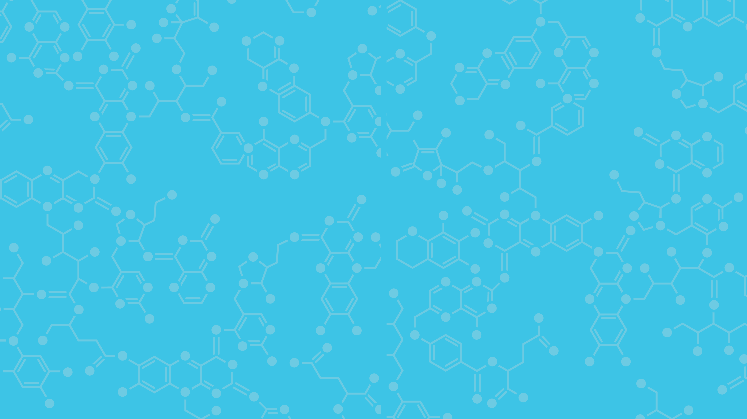
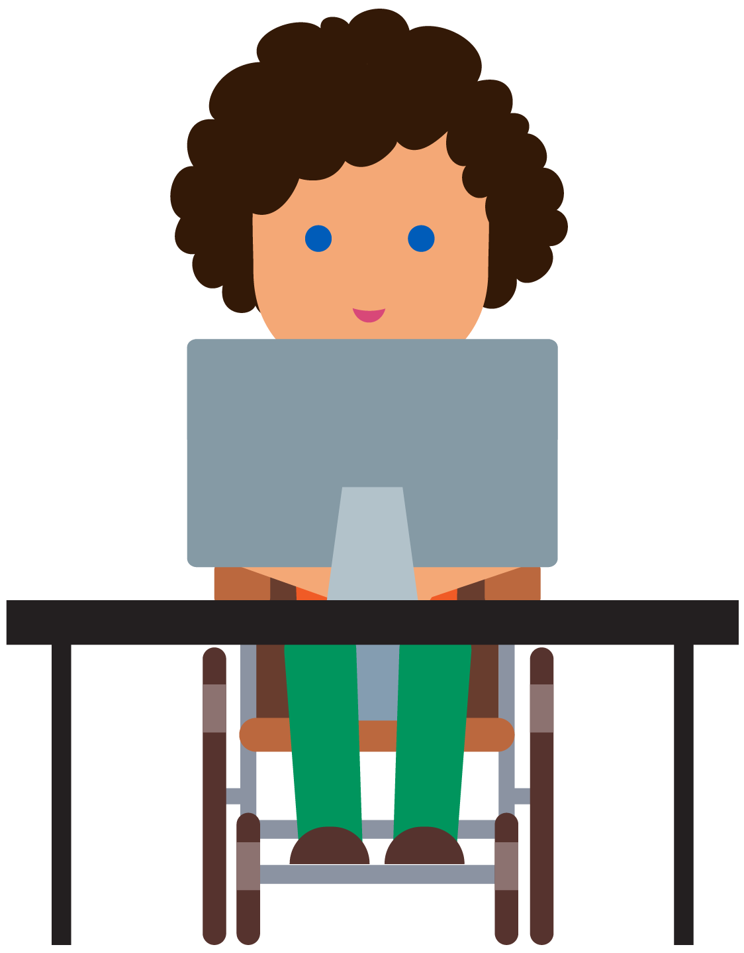
Biomimicry in Design and Engineering
Stem²D Topics: Design and Engineering
[Presenter Name]
[Presenter Organization]
[Date]

Slide 2
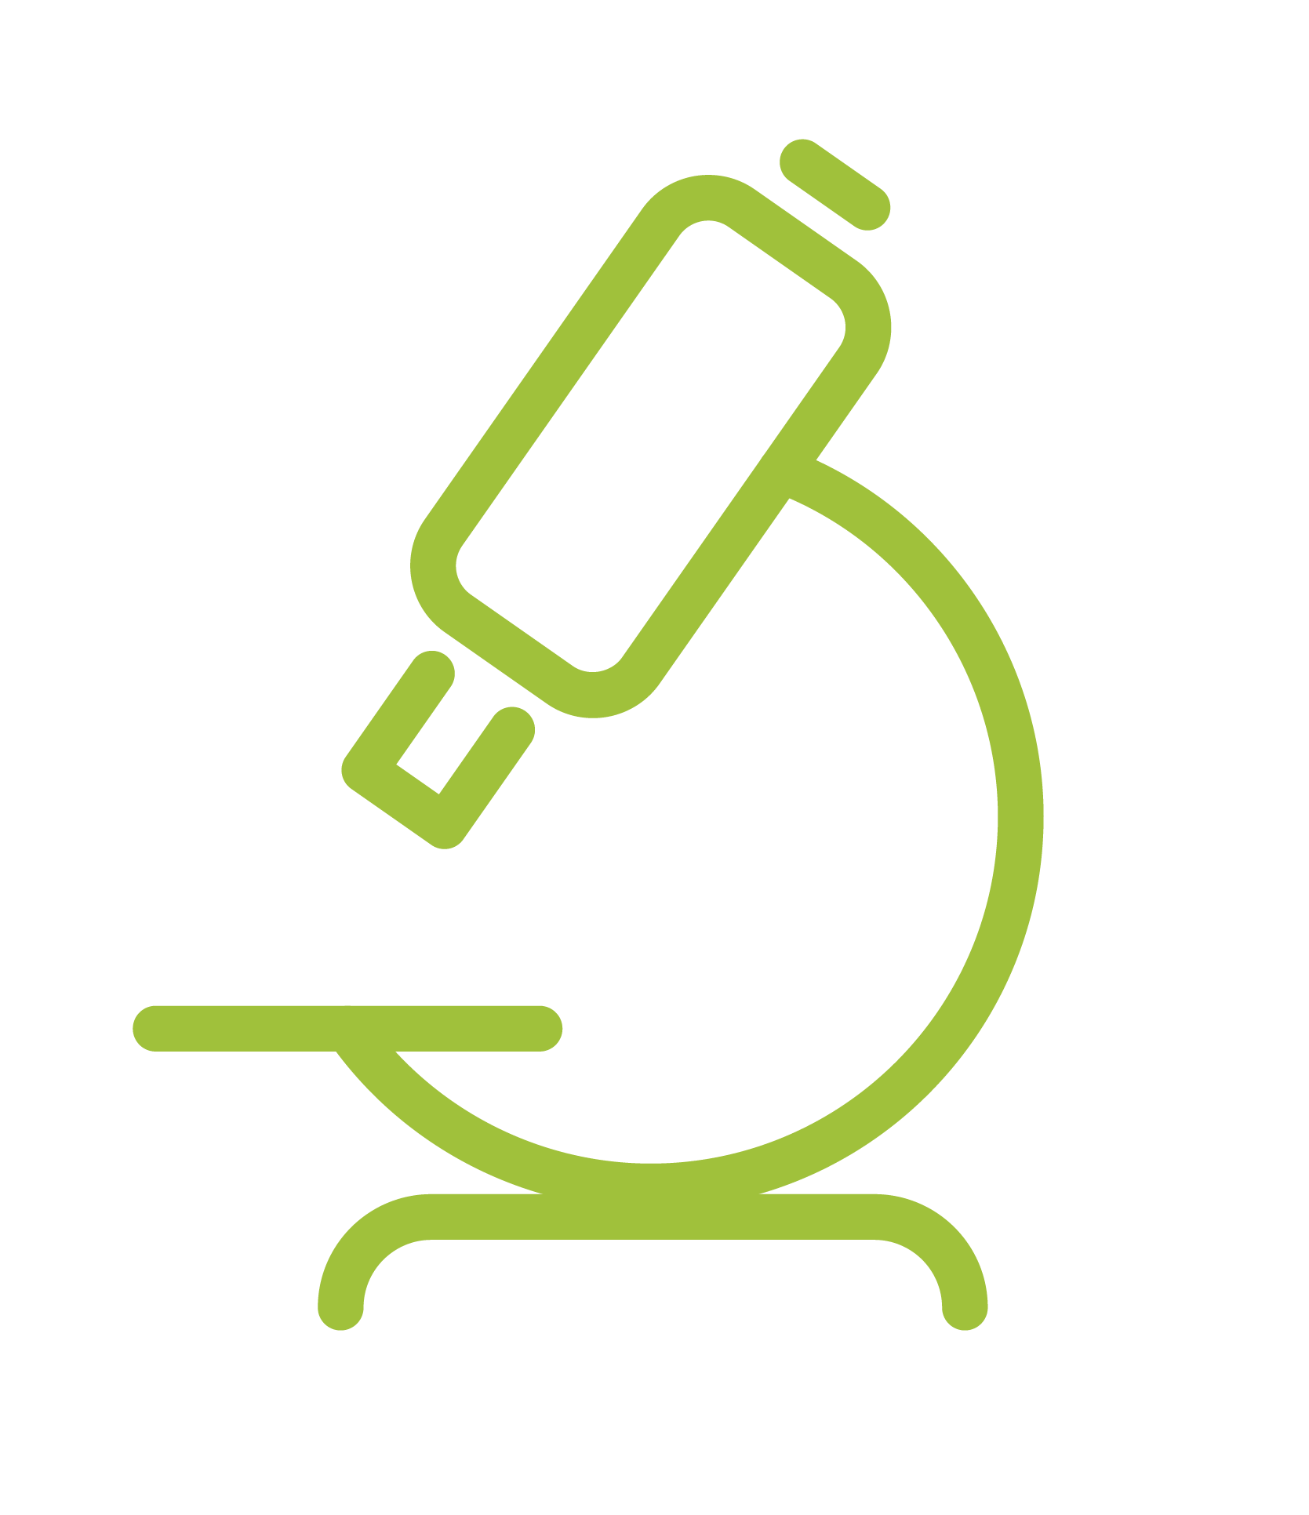

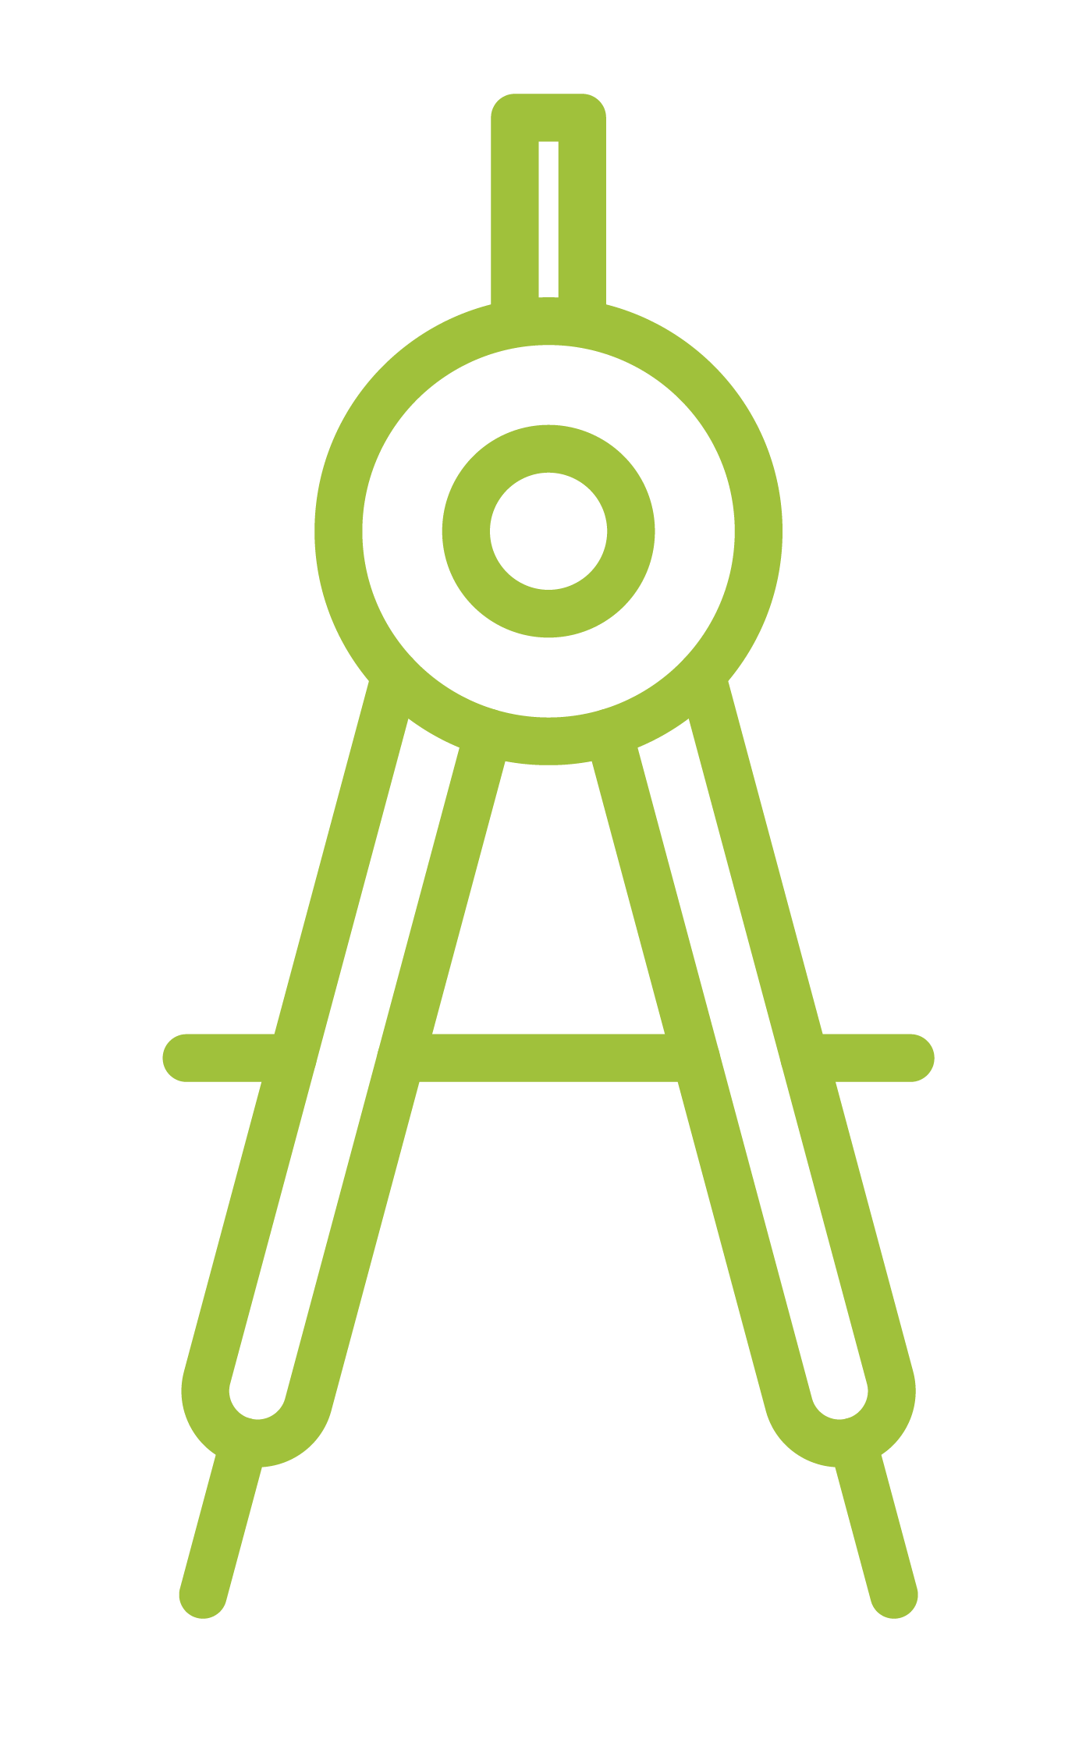
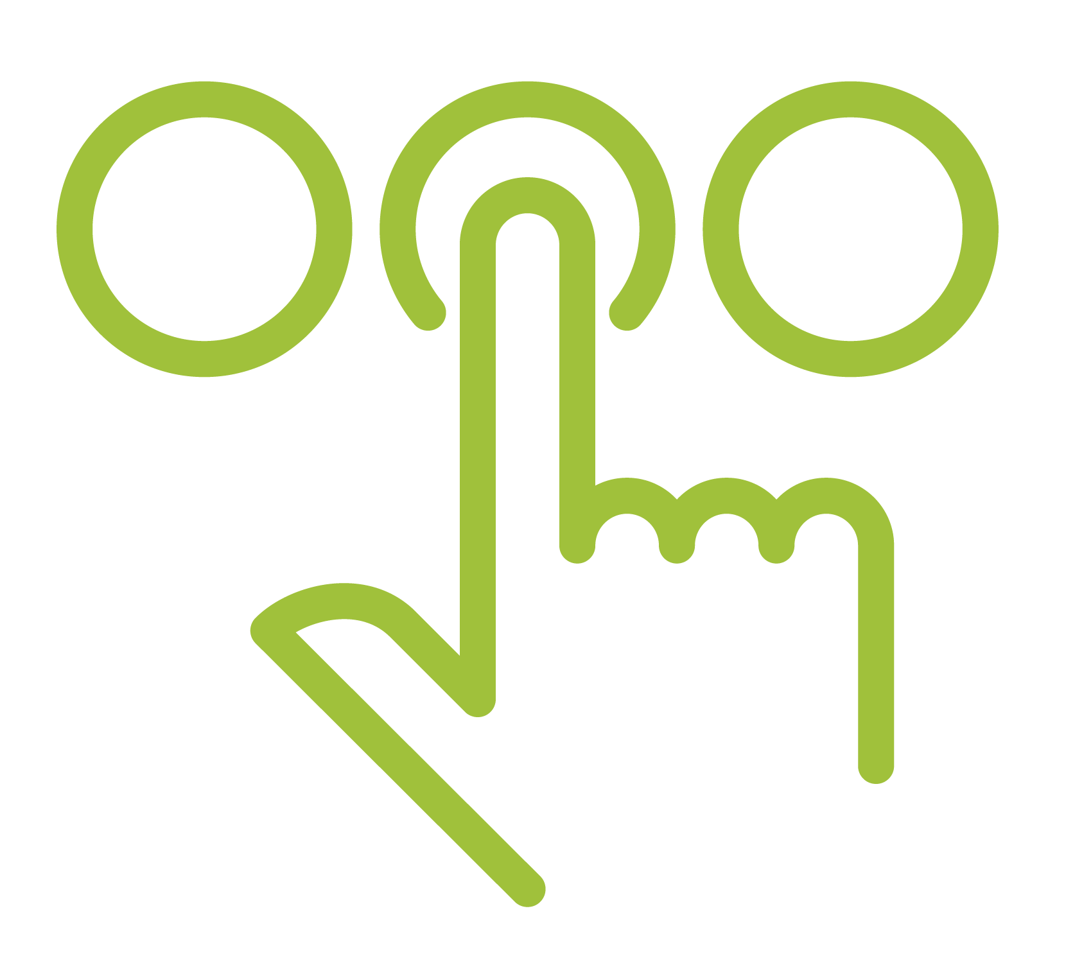


What is STEM²D?
Science
Technology
Engineering
Math
Manufacturing
Design

Slide 3
Today’s Plan
Introductions
Design and Engineering in the World of Work
Biomimicry Challenge
Presentations
Reflection

Slide 4

Design and Engineering in the World of Work
How do you think Design
and Engineering are used
every day in the workplace?
What kinds of careers do you think people with an interest, aptitude for, or degree in design or engineering would have?
Notes:
Share that STEM²D careers are high-demand, high-growth careers.
Share with students that there are many different kinds of careers related to STEM²D
STEM²D careers related to this activity:
Biomedical engineer
Environmental engineer
Mechanical engineer
Automotive engineer
Wildlife biologist
Aquatic biologist
Industrial designer

Slide 5
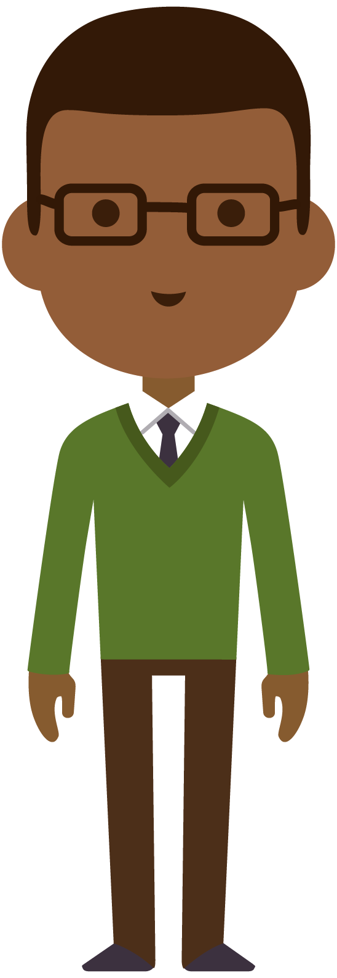
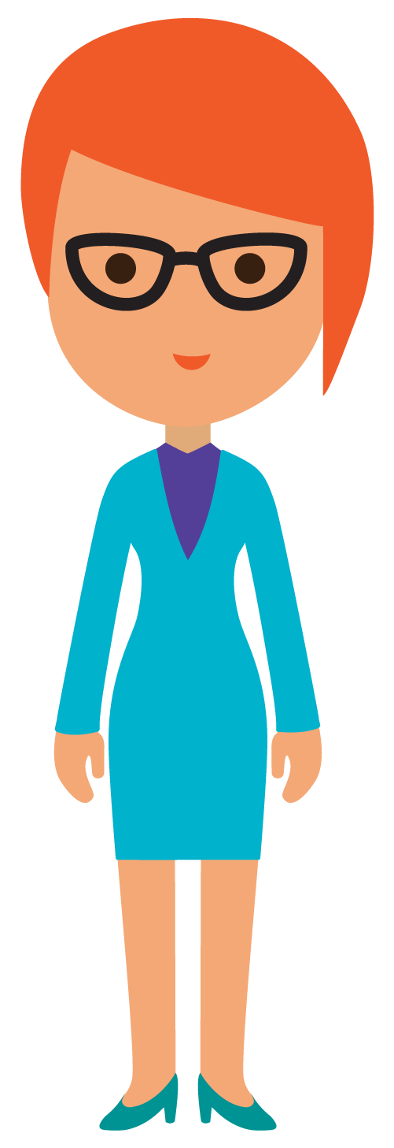
Tell My Story

Slide 6
My Story (delete if not using)

Slide 7
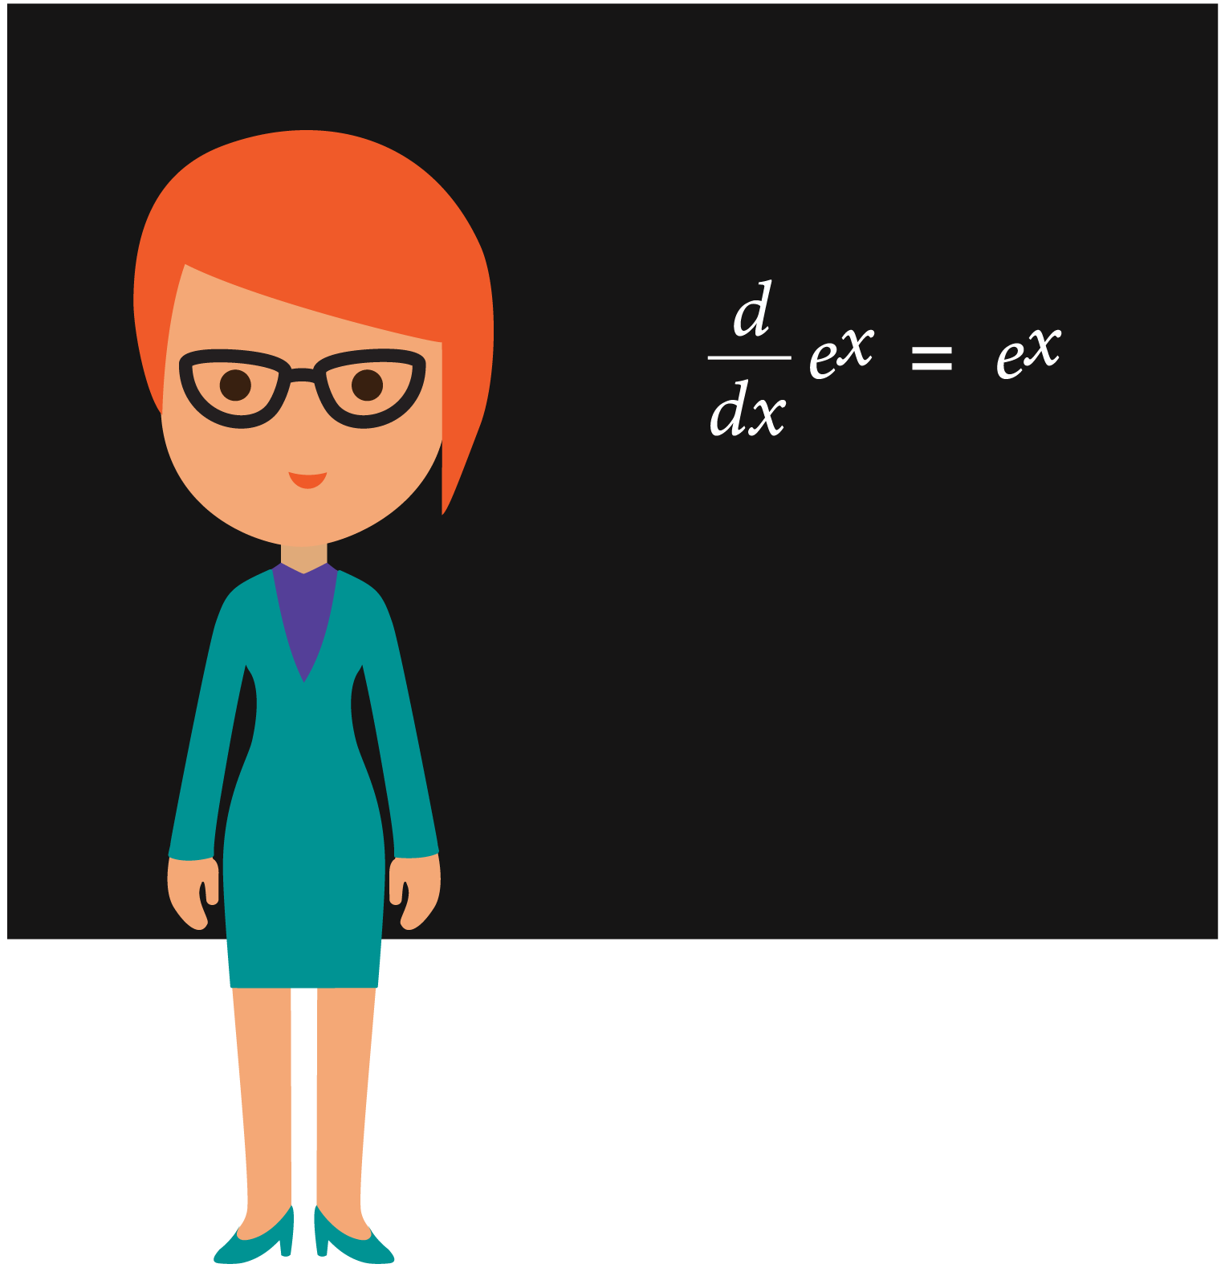
Biomimicry

Slide 8
What is Biomimicry?
Biomimicry is an approach to innovation that seeks sustainable solutions to human challenges by imitating nature’s patterns and strategies.
Source: Biomimicry Institute
Notes:
Definition:
Biomimicry: an approach to innovation that seeks sustainable solutions to human challenges by imitating nature’s patterns and strategies.
Sustainable: capable of being maintained at a steady level without exhausting natural resources or causing severe ecological damage

Slide 9
Why Biomimicry?
Why might engineers and
designers use biomimicry?
+
Notes:
Explain that biomimicry can help solve problems to challenges faced by humans.
Consider referencing a famous quote by Albert Einstein: “Look deep into nature, and then you will understand everything better.”

Slide 10
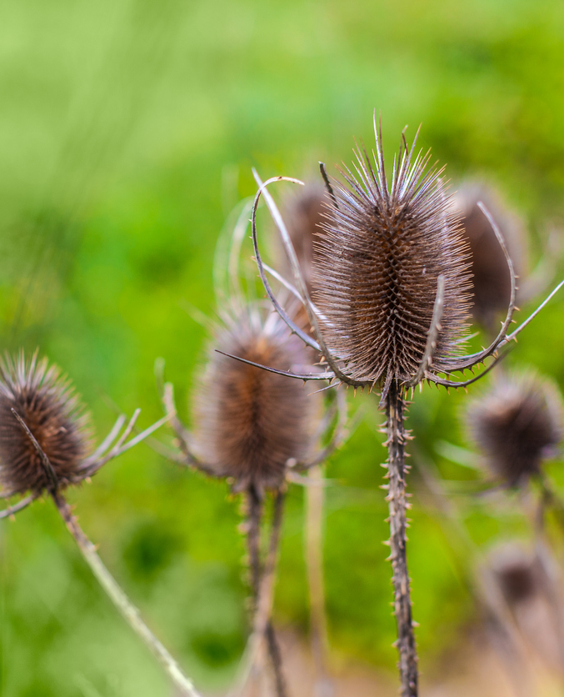
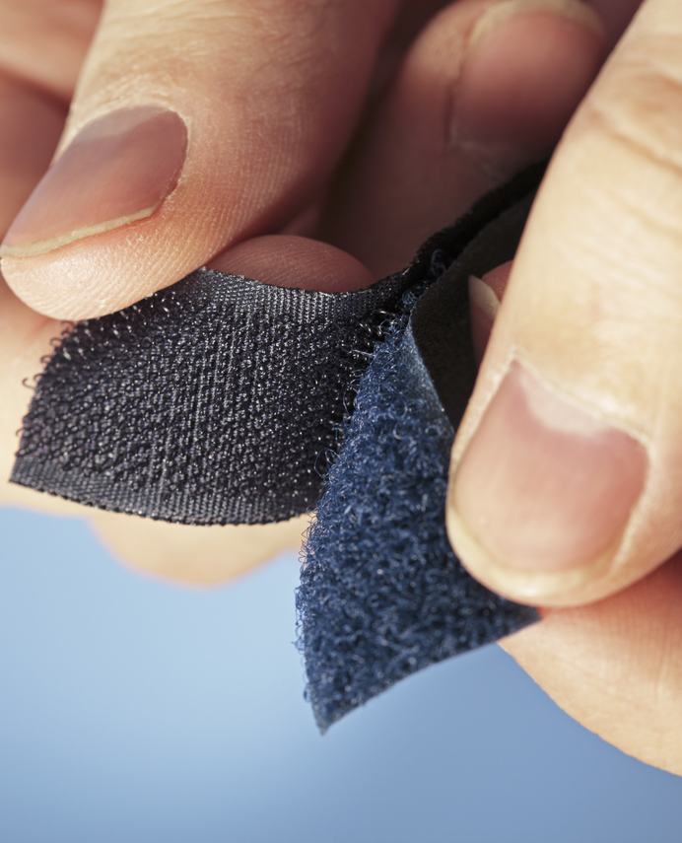
Biomimicry in Consumer Products
Velcro
Photo credit: iStock
Notes:
Velcro was invented by Swiss engineer George de Mestral in 1941 after he removed burrs from his dog and decided to take a closer look at how they worked.
The small hooks found at the end of the burr needles inspired him to create Velcro.

Slide 11
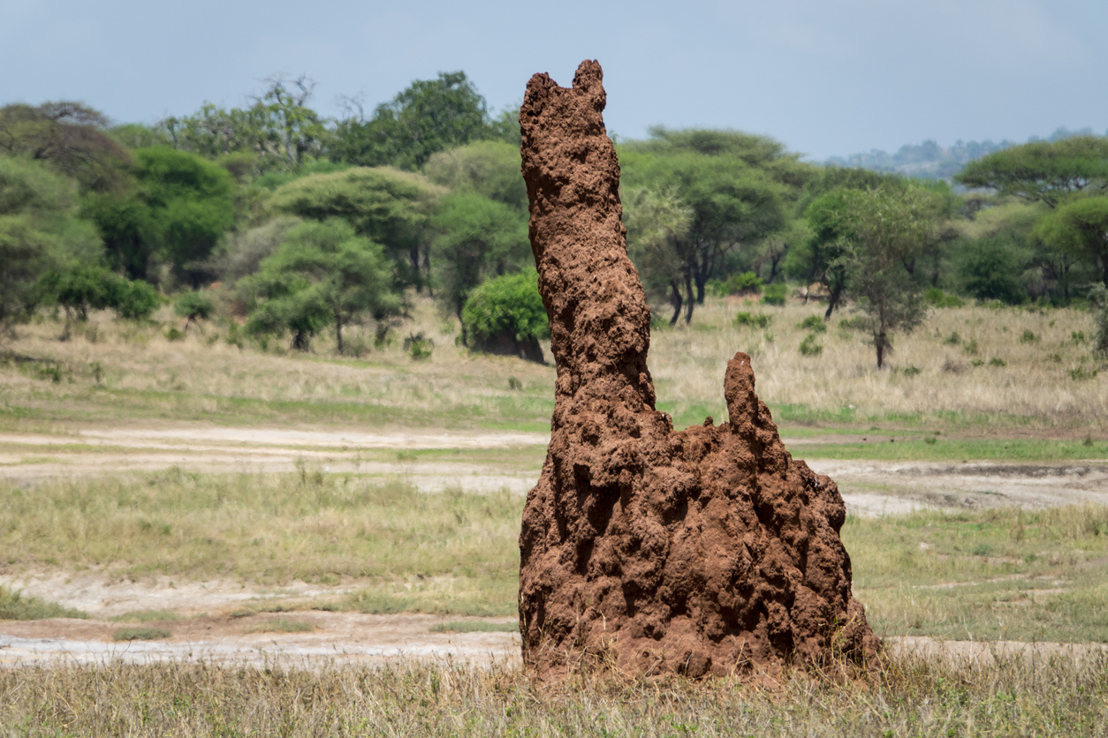
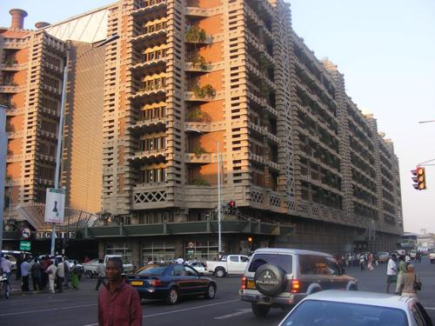
Biomimicry in Architecture
Eastgate Centre, Harare, Zimbabwe
Photo credit: iStock
Photo credit: The Pinsta
Notes:
From Biomimicry Institute:
We generally think of termites as destroying buildings, not helping design them. But the Eastgate Building, an office complex in Harare, Zimbabwe, has an internal climate control system originally inspired by the structure of termite mounds.
The operation of buildings represents 40% of all the energy used by humanity, so learning how to design them to be more sustainable is vitally important.
The architect collaborated with engineers to design Eastgate, which uses 90% percent less energy for ventilation than conventional buildings its size, and has already saved the building owners over $3.5 million dollars in air conditioning costs.

Slide 12
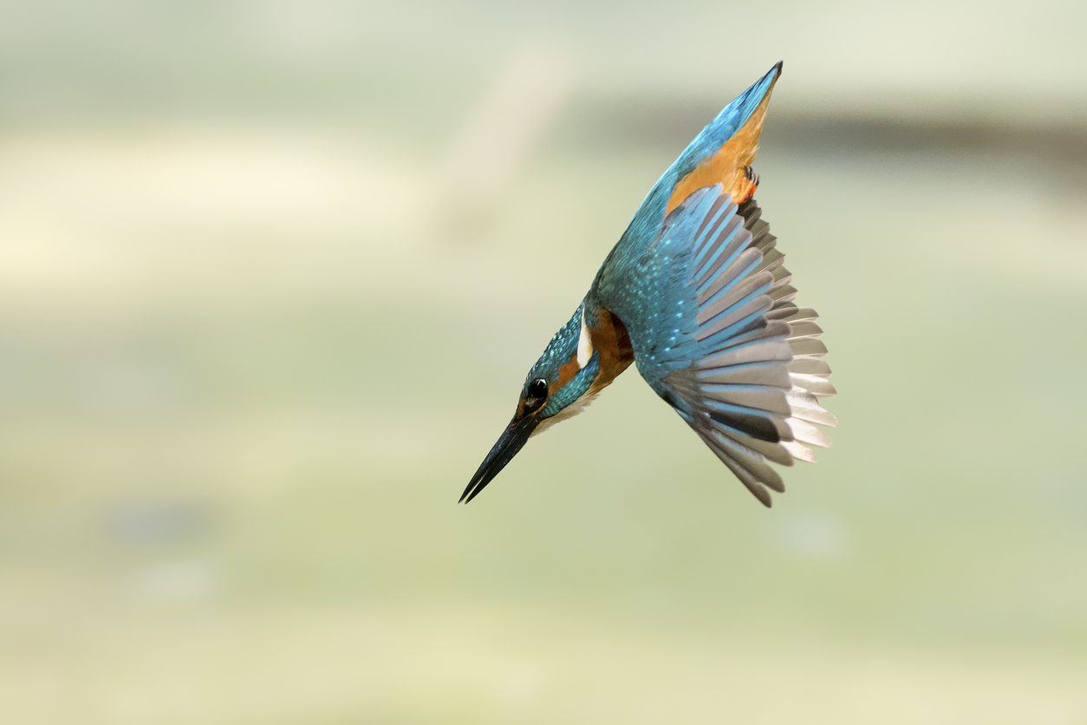
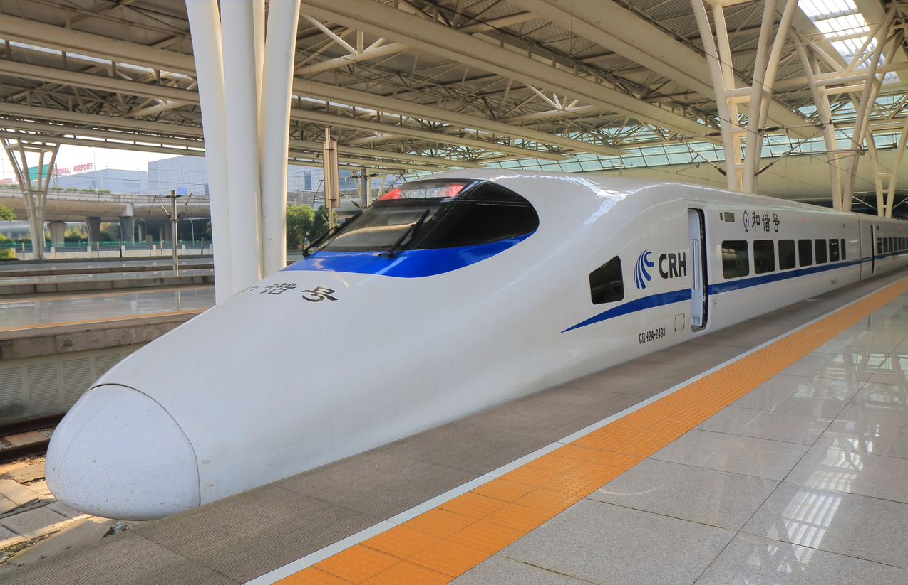
Biomimicry in Transportation
Shinkansen Bullet Train
Photo credit: iStock
Photo credit: iStock
Notes:
From Biomimicry Institute:
The Shinkansen Bullet Train was the fastest train in the world, traveling 200 miles per hour. The problem? Noise.
Air pressure changes produced large thunder claps every time the train emerged from a tunnel, causing residents one-quarter a mile away to complain.The train’s chief engineer and an avid bird-watcher, asked himself, “Is there something in Nature that travels quickly and smoothly between two very different mediums?”
Modeling the front-end of the train after the beak of kingfishers, which dive from the air into bodies of water with very little splash to catch fish, resulted not only in a quieter train, but 15% less electricity use even while the train travels 10% faster.

Slide 13
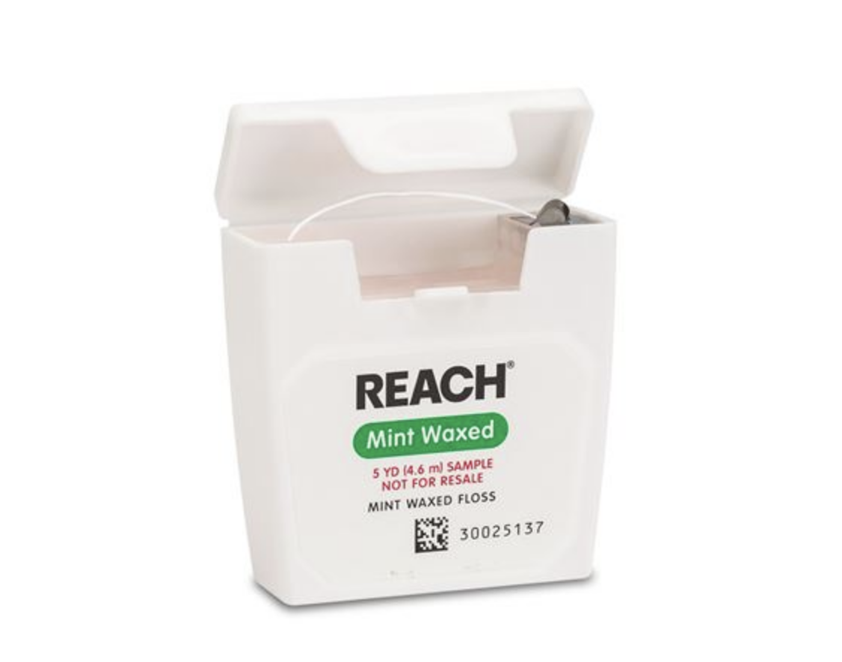
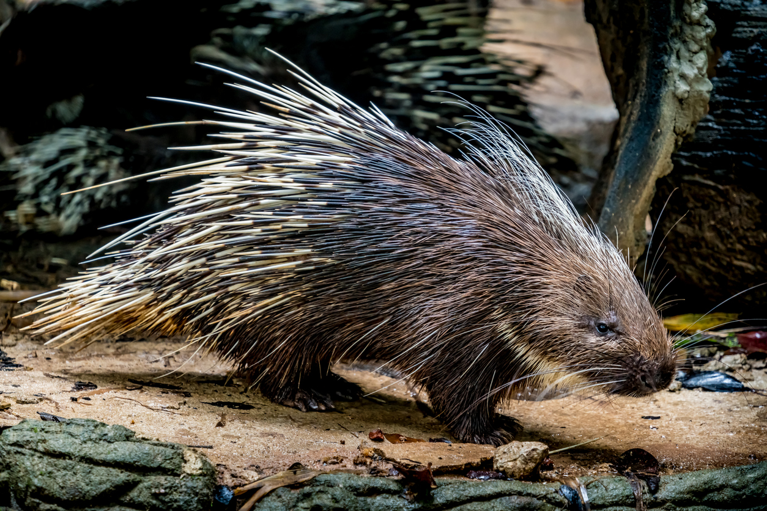
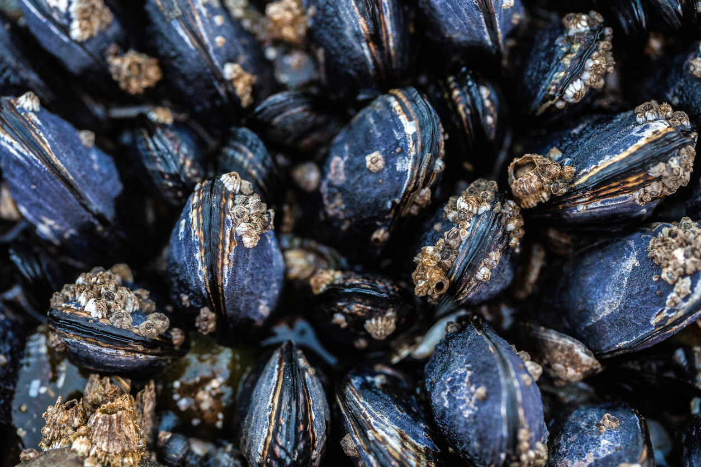
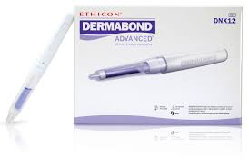
Biomimicry in Healthcare
Photo credit: iStock
Photo credit: iStock
Photo credit: J&J
Photo credit: J&J
Surgical Adhesives
Dental Floss
Notes:
From Biomimicry Institute and Johnson & Johnson “Our Story”:
In the late 1800’s people were apt to use the sharpened ends of porcupine quills, writing quills, or slivers of wood to clean between their teeth because silk dental floss was too pricey. Johnson & Johnson decided to use the excess silk left over from its suture-manufacturing business to make a more affordable version of floss for the average consumer. It is interesting to note that porcupine quills, with their ease of entry, also serve as a model for injection needles and suture needles.
Mussels possess the unique ability to attach to wet, solid surfaces such as rocks, fish, and boats and are able to withstand strong wind and even waves. The remarkable adhesive powers of the mussels inspired medical adhesives. In 1998 Ethicon Inc., introduced a breakthrough alternative to traditional stitches. Dermabond® became the first FDA-cleared topical skin adhesive used to close up cuts that would otherwise require sutures or staples.

Slide 14
Biomimicry Challenge
Challenge
  Design a structure, mode of transportation, or consumer product that is based on something in nature and solves a human challenge.
Instructions
  Get inspired! Use the photos on the next slide as inspirations for the design. Alternately, use the Internet to perform research; websites are listed on the Biomimicry Resources handout.
  Brainstorm different designs. Sketch potential ideas on the Design Ideas handout.
  As a team, select one design to present to the large group.
  Draw your group’s final design on the flip chart paper using the materials provided.
  One person from each team will share the group’s design and give an explanation of why the design is a sustainable solution to a human challenge.
  Each group will have 2 minutes to present to the class.
  Keep an eye on the time to make sure you leave enough time to draw your design to share with the whole group

Slide 15
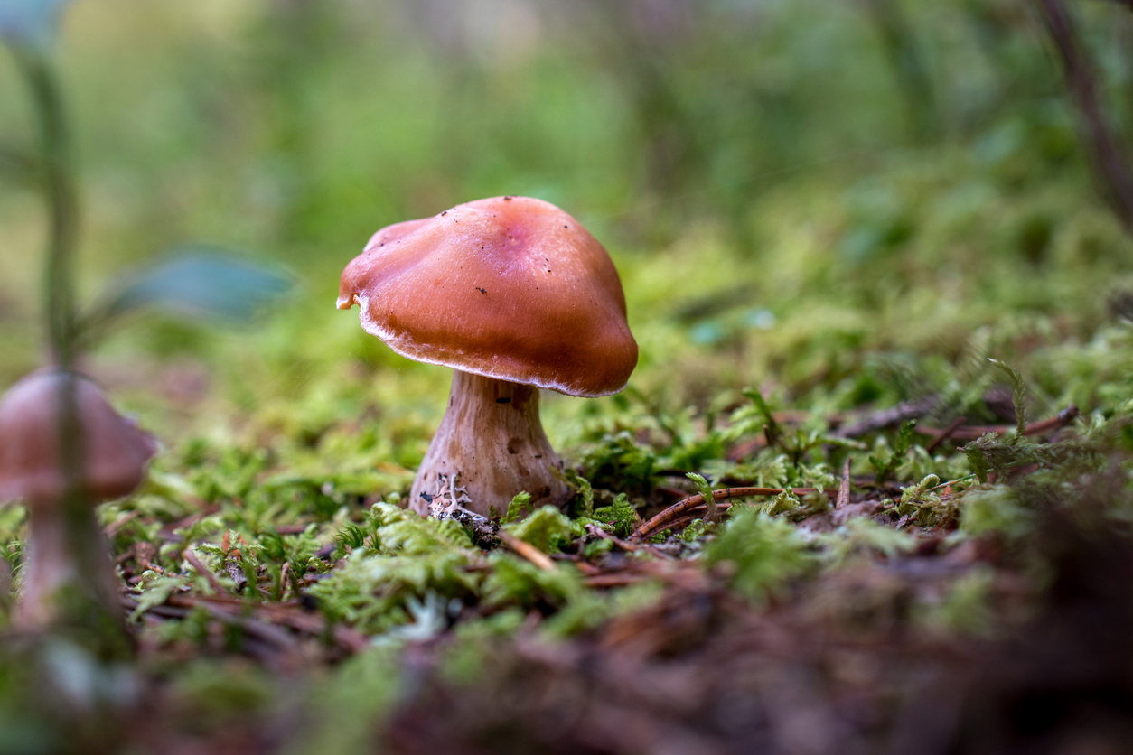
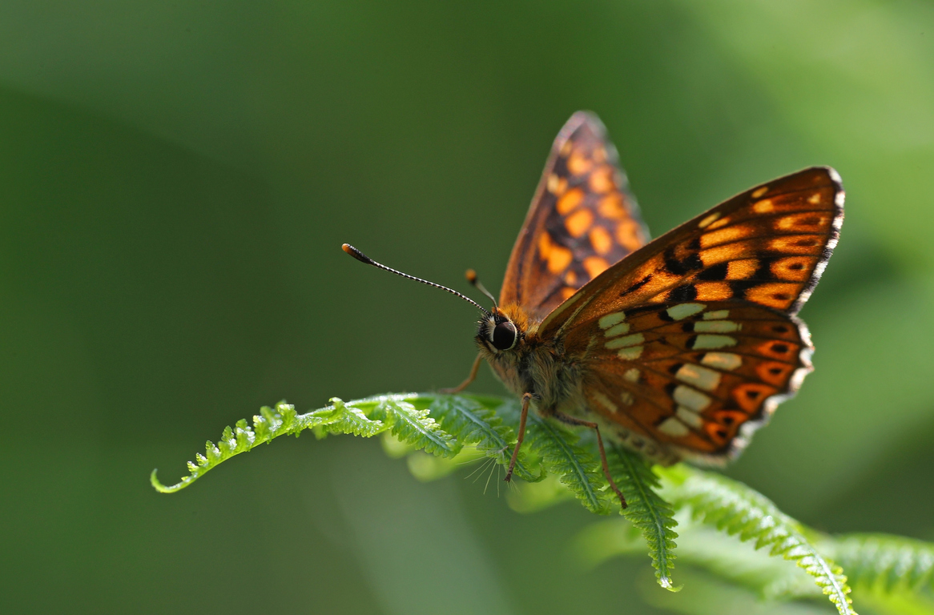
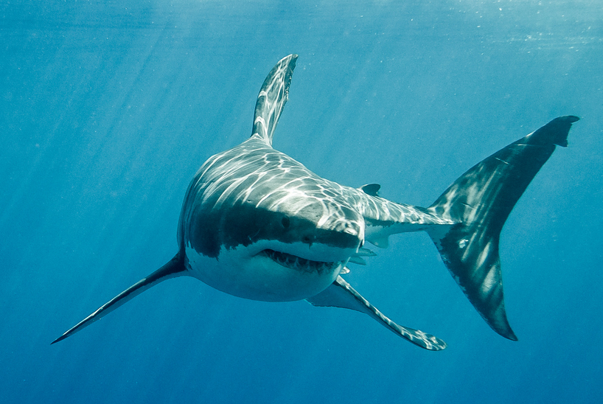
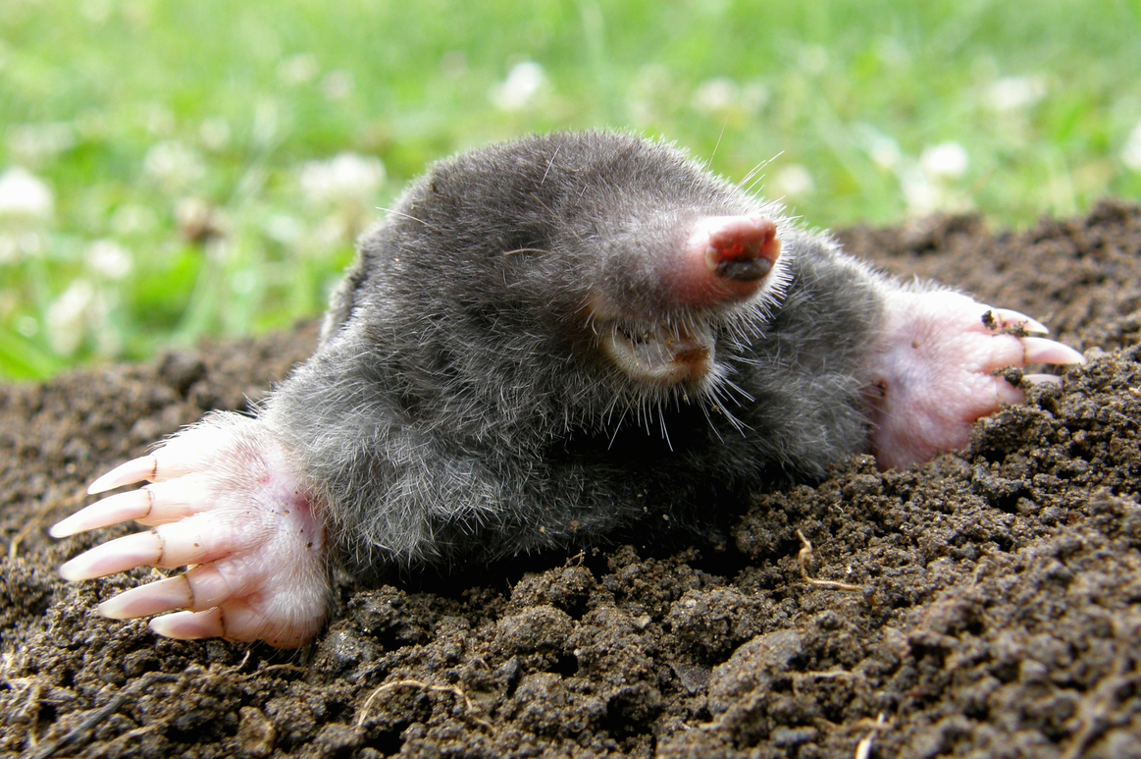
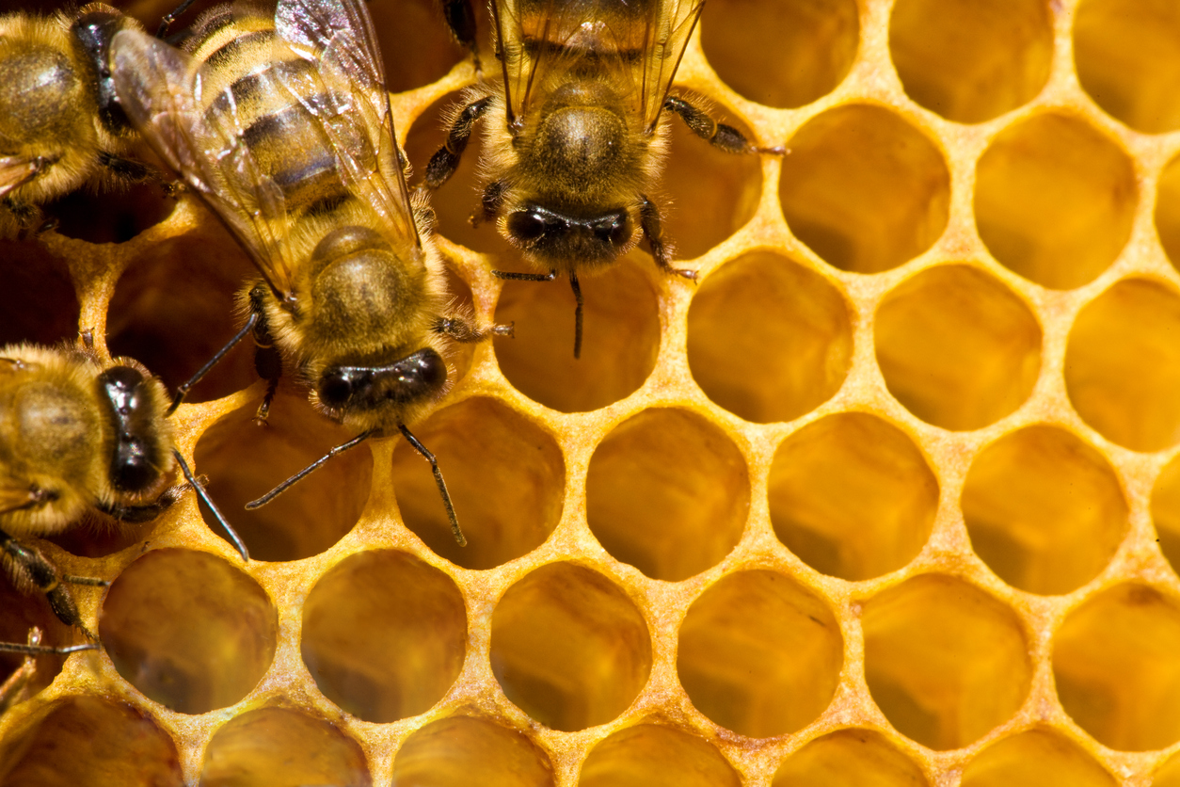
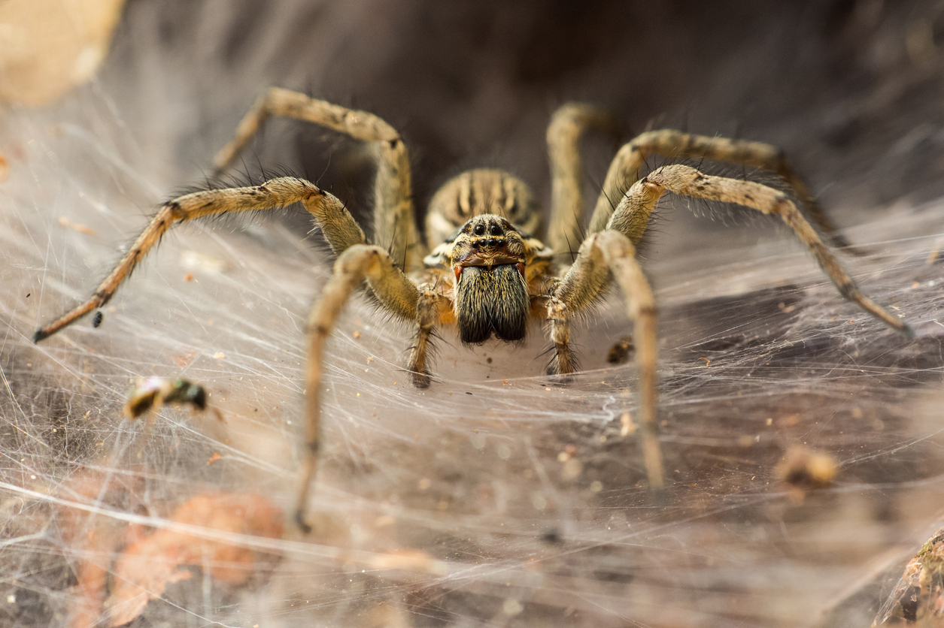
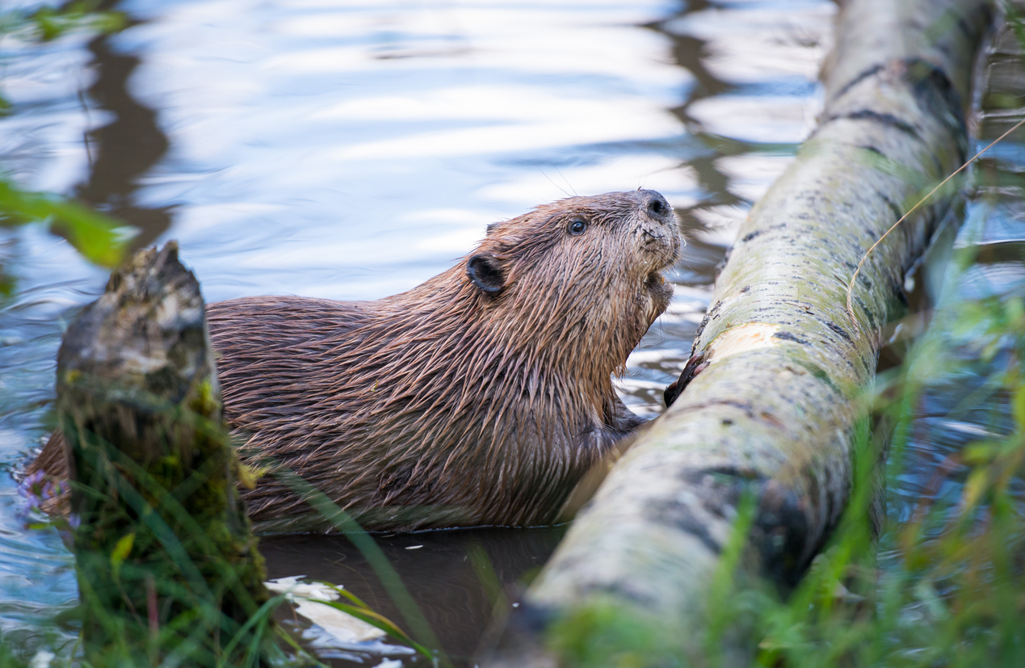
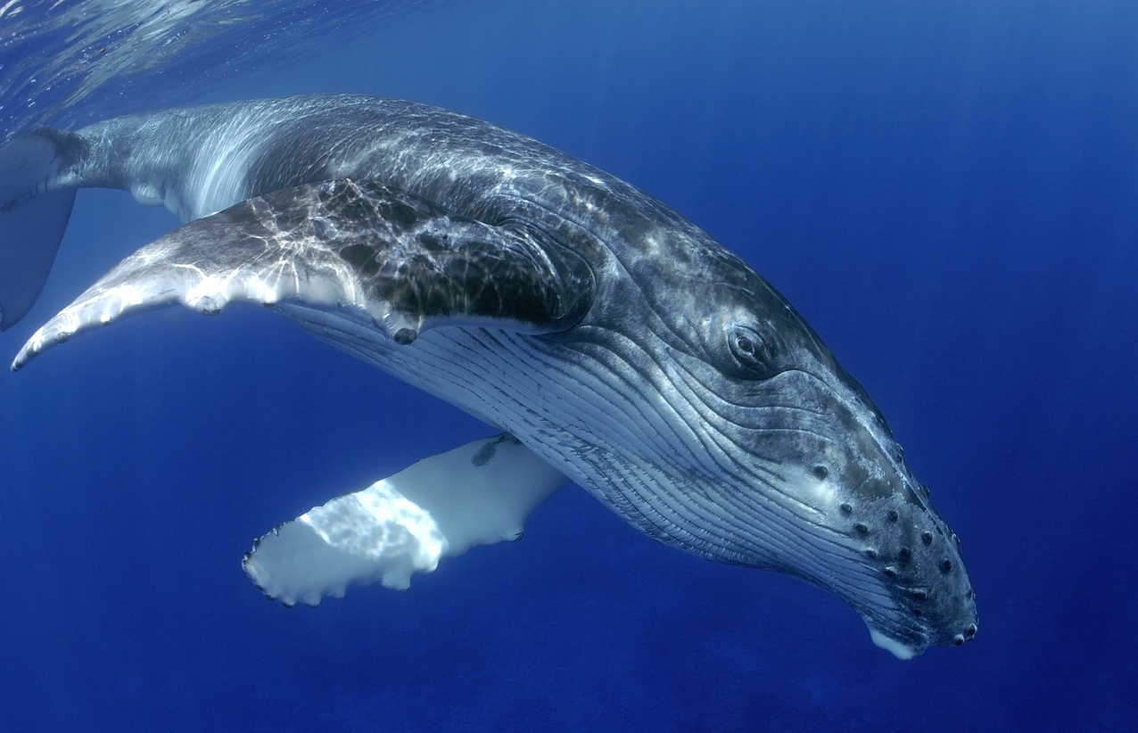
Inspirations in Nature
Photo credits: iStock
Notes:
ROW 1
Images from left to right:
Mushrooms can be used as inspiration for housing—the shape of the mushroom cap allows mushrooms to absorb a large amount of sunlight to convert to energy.
The butterfly is lightweight, can fly long distances, and can maneuver easily. Its design can be used as inspiration for airplanes.
A shark’s skin is made up of countless overlapping scales. The scales have grooves that allow water to pass by faster. The sharkskin has been used to help design swimsuits.
A mole is known for its tunnel building. Tunnel building is a solution being explored in cities with severe traffic problems. In Los Angeles, California, Elon Musk, the co-founder of Tesla, is currently building a network of tunnels under the city that will someday transport people from one place to another.
ROW 2
Images from left to right:
The cells in beehives are already being used as inspiration for capsule hotels where people sleep in small adjacent capsules instead of hotel rooms.
Spiders have the ability to travel vertically and horizontally and also travel long distances. The hairs on their feet help grip the surface, and they create silk parachutes using techniques similar to those used in creating a web. These characteristics may one day change how humans move around the earth.
Beavers have a thick layer of blubber that keeps them warm while they're diving and swimming in their water environments. Their fur is so dense that it traps warm pockets of air in between the layers, keeping these aquatic mammals not only warm, but dry. Engineers are using these features to help design wetsuits for surfing—when an athlete moves frequently between air and water environments.
The front edge of a whale fin has bumps that greatly increase its efficiency, reducing drag and increasing lift. Companies are applying the idea to wind turbine blades, cooling fans, airplane wings, and propellers.

Slide 16
Reflection
Think about the following questions…
What did you learn about Biomimicry in Design and Engineering?
What role do you think Biomimicry will have for how we may live in the future?
Can you see yourself as a STEM²D professional? Why or why not?
What would you need to do to make that happen?

