Slide 1




Backpack
Design
Challenge
STEM²D Topic: Design
[Presenter Name]
[Presenter Organization]
[Date]

Slide 2






What is STEM²D?
Science
Technology
Engineering
Mathematics
Manufacturing
Design

Slide 3
Today’s Plan
Introductions
STEM²D in the World of Work
What is the Design Process?
Team Challenge: Backpack Design
Team Presentations
Reflection

Slide 4
STEM²D in the World of Work
How do you think STEM²D is used every day in the workplace?
Notes:
Share that STEM²D careers are high-demand, high-growth careers.

Slide 5
My Story

Slide 6
What do you
know about
Design
Thinking?

Slide 7
DESIGN
is creating, constructing, or inventing an object, plan, product, or system; it is also a human-centered mindset and collaborative approach that results in better experiences by uncovering unmet needs and championing meaningful relationships through
user-friendly products, environments, and systems.
Notes:
Renewable – replaced naturally and can be used again
Cost-effective - productive in relation to its cost
Sustainable - able to be maintained at a certain rate or level
Pollute - to contaminate with harmful or poisonous substances
Fossil fuels - fuels that come from old life forms that decomposed over a long period of time)

Slide 8
What is DESIGN THINKING?
Design Thinking is a design methodology that provides a solution-based approach to solving problems.
Design Thinking:
  Is a process in which we seek to understand the user
  Is a collection of hands-on methods
  Involves ongoing-experimentation

Slide 9
7-step Design Process
    Define the Need
    Brainstorm
    Design
    Build
    Test and Evaluate
    Rebuild
    Share the Solution
Notes:
Click below to watch the 5-minute video.
https://thinktv.pbslearningmedia.org/resource/phy03.sci.engin.design.desprocess/what-is-the-engineering-design-process/#.XV2zR5NKjOQ

Slide 10
Questions?

Slide 11
Backpack
Design
Challenge

Slide 12
Backpack Design Challenge
The Challenge:
Design a new backpack in order to improve the utility, comfort, and aesthetic of backpacks currently on the market.
Tasks:
Work as a team
Follow the first three steps of the design process.
Present the design. Each team member should have a role in the presentation.
Notes:
.

Slide 13
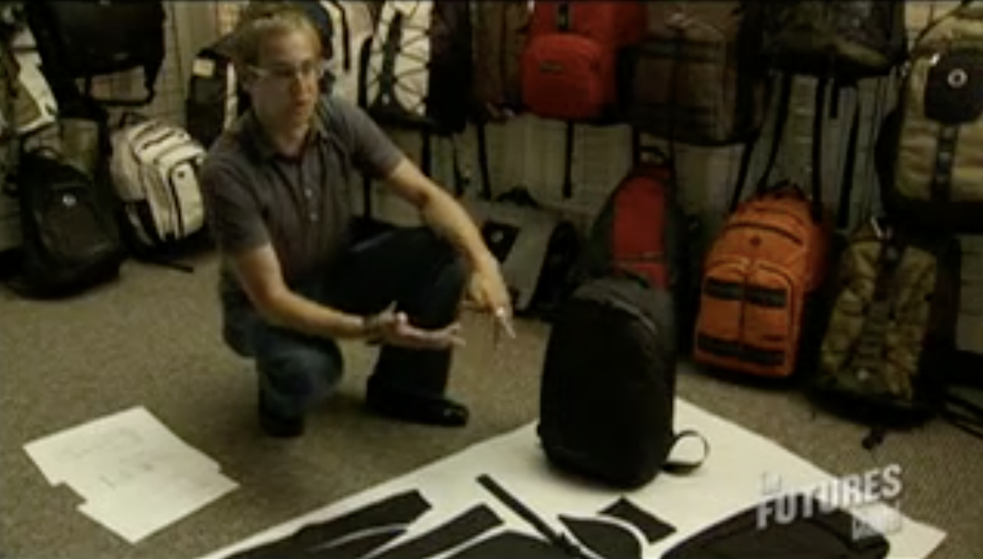
Backpack Design Video
https://youtu.be/OlUji_v5rkg
Notes:
.

Slide 14
Backpack Design Challenge
Define the Need
Determine the problem you’re trying to solve.
Conduct research by asking questions of potential consumers.
Come up with four questions to ask potential consumers. (Students in the class who are not on your team are your potential consumers.)
Get four to five answers to each question.
Review the responses and describe the problem.
Notes:
.

Slide 15
Backpack Design Challenge
Brainstorm
Generate potential solutions.
Think about different ways to design a backpack that addresses the needs of consumers and solves the identified problem.
Draw, sketch or write down potential ideas.
Notes:
.

Slide 16
Backpack Design Challenge
Design
Once you have recorded your ideas, it is time to move on to the design stage of the process.
Remember that during this stage you are to:
  Determine which brainstormed ideas are really possible.
  Select the best idea and explore it in further.
  Create working drawings of the best idea.
Notes:
.

Slide 17
Just do it!
As a team:
  Conduct Research: 10 minutes
  Brainstorm and Design: 30 minutes
  Present Design: 5 minutes
Notes:
.

Slide 18
Questions?

Slide 19
Backpack
Design
Challenge

Slide 20
Team
Presentations

Slide 21
Reflection
Think about the following questions…
?
    What did you learn about Design?
    How do you think this activity relates to a career in Design and/or working at Johnson & Johnson?
    Can you see yourself as a STEM²D professional? In what role? Why or why not?
    What would you need to do to make that happen?
    What is one thing you learned that you did not know coming into today?

