Slide 1

The Amazing Eye
Science, Technology, Math
Presenter
Date

Slide 2
Today’s Plan
Introduction
Science and Math in the World of Work
All About the Eye
Challenge: Testing Polymers
Reflection

Slide 3
Amazing Eye Challenge
Pre-Work
Instructions:
Use the marker to label and number each of the four cups: Cup #1 Cup #2 Cup #3 Cup #4
Fill Cup #1 and Cup #2 with water, each halfway.
Put an unwrapped Swedish Fish in Cup #1.
Add 2 Jelly Sphere beads into Cup #2.
Set aside all items for later!

Slide 4





What is STEM²D?
Science
Technology
Engineering
Math
Manufacturing
Design

Slide 5
Science and Math in the World of Work
How do you think science and math are used every day in the workplace?
How might they be used are in vision/eyecare fields?
What kinds of careers do you think people with an interest, aptitude for, or degree in a science or math would have?

Slide 6
My Story
(delete if not using)

Slide 7
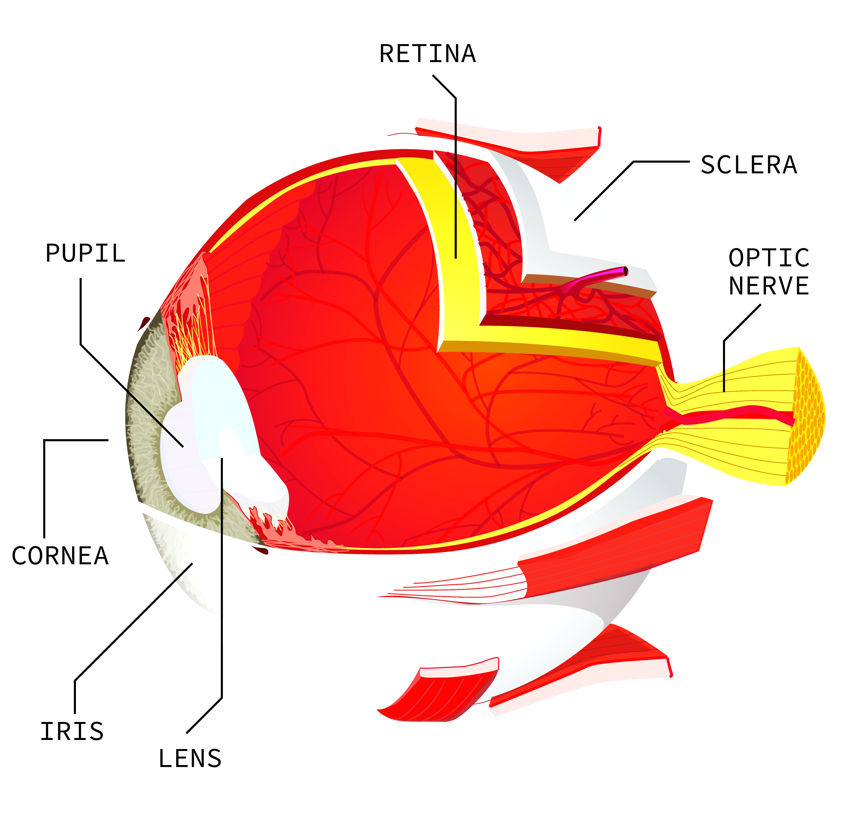

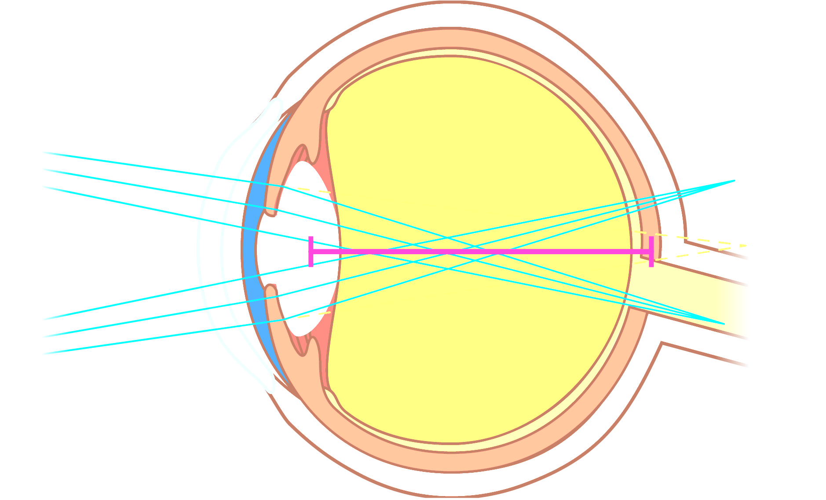
All About the
EYE

Slide 8
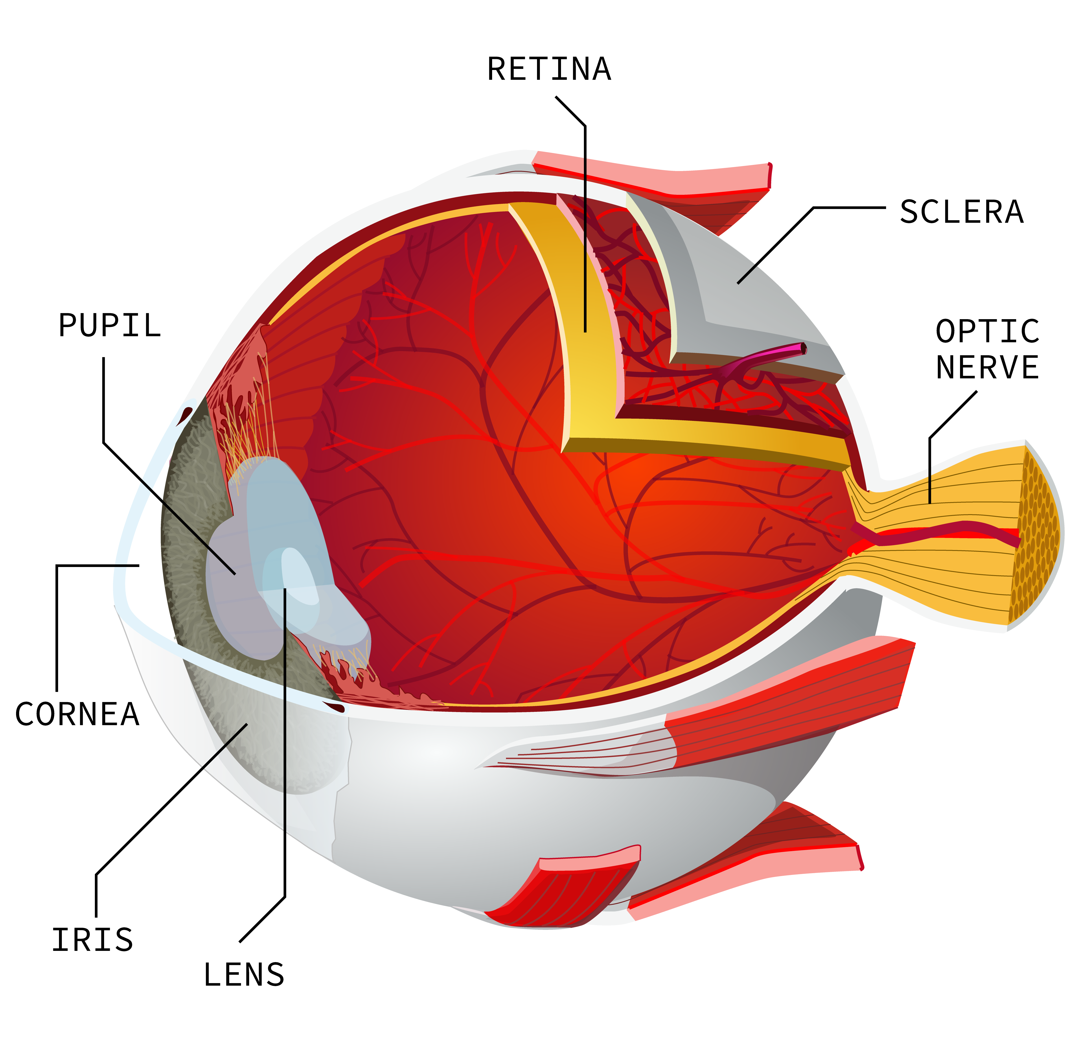
How do we see?
All About the Eye
Without our eyes the world we all know would be entirely different.
They eye is the sensory organ of the visual system.
Our eyes are like a camera: they detect light, focus the light onto a surface, and take a picture.
The eye is made up of multiple parts working together:
CC BY-SA 3.0
Chabacano/https://commons.wikimedia.org/wiki/File:Eye-diagram_ no_circles_border_1.svg
Notes:
.

Slide 9
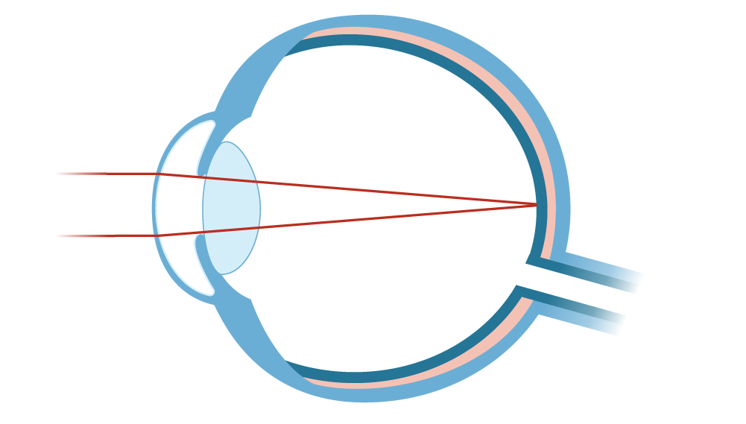
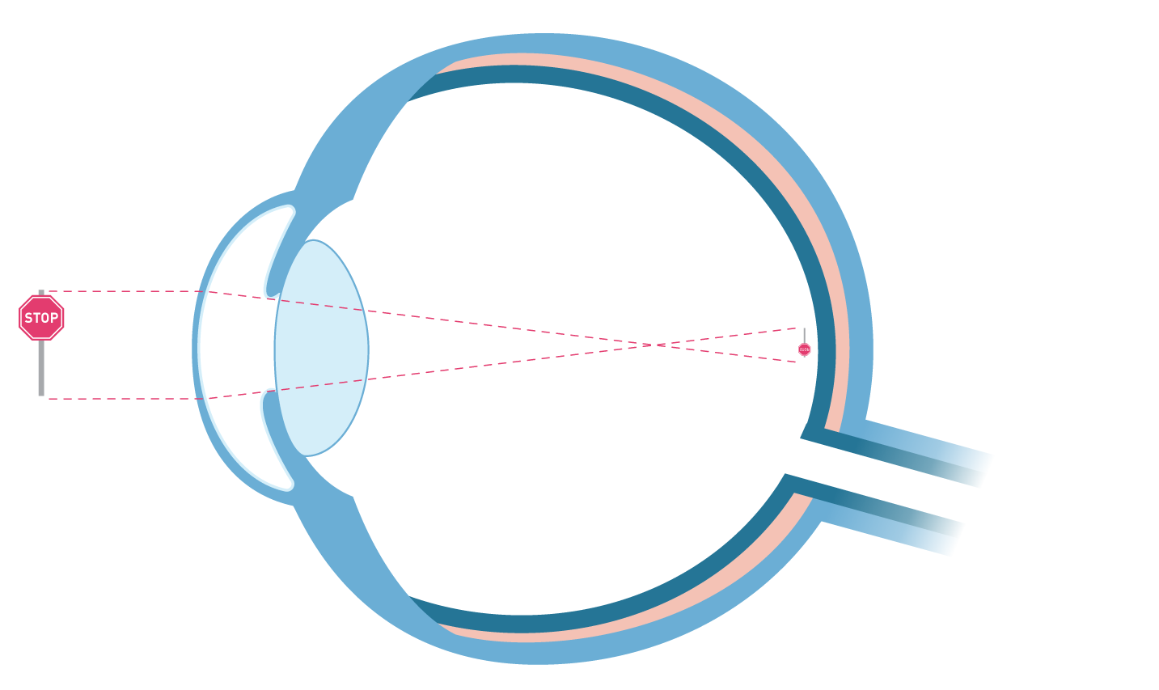
Focusing: The Cornea and Lens
All About the Eye
Retina
The cornea, the front surface of the eye, does most of focusing in the eye.
Focus point
The lens helps to fine-tune the focus.
Light waves
Our lens does not allow us to see close and far objects in focus at the same time (small depth of field).
Pupil
Optic nerve

Slide 10


Focusing Problems
All About the Eye
What happens if the eye has problems focusing?
Refractive Error
Farsightedness
Nearsightedness
Notes:
.

Slide 11
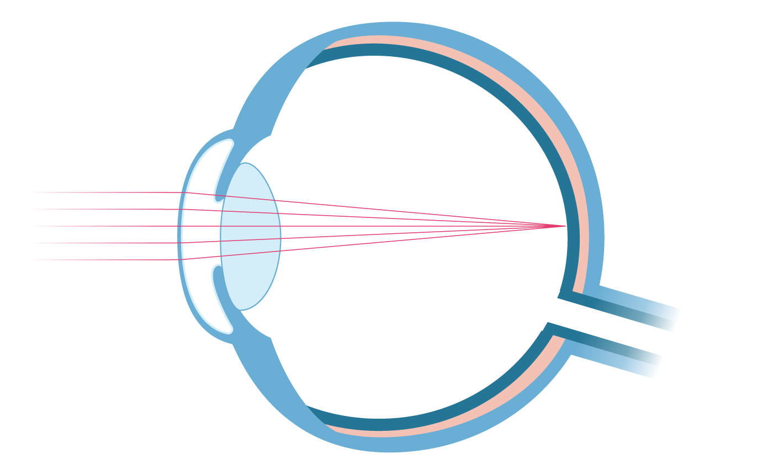
Refractive Error: Hyperopia (Farsightedness)
All About the Eye
Problem seeing close objects.
Occurs when the distance between the lens and retina is too small; it can also happen when the cornea is too flat.
Focus point
corrected
Focus point
Corrected with lens that brings the point of focus forward (converging).
Light is focused behind the retina
Notes:
.

Slide 12
Refractive Error: Myopia (Nearsightedness)
All About the Eye
Problem seeing objects far away.
Occurs when the distance between the lens and retina is too large; it can also happen when the cornea is too curved.
Focus point
corrected
Corrected with lens that spreads light outwards and moves the point of focus back (diverging).
Focus point
Light is focused in front of the retina
Notes:
.

Slide 13
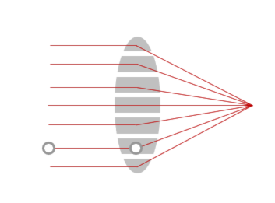
Vision Correction
All About the Eye
STEM²D professionals work with Vision corrective lenses to improve blurred vision of nearsightedness and farsightedness by bending light to achieve the desired focal length
Both eyeglasses and contact lens use the same basic optical design principles.
Myopia and mild hyperopia can be corrected by LASIK surgery.
A laser is used to reshape the cornea to provide the desired focal length
Notes:
.

Slide 14
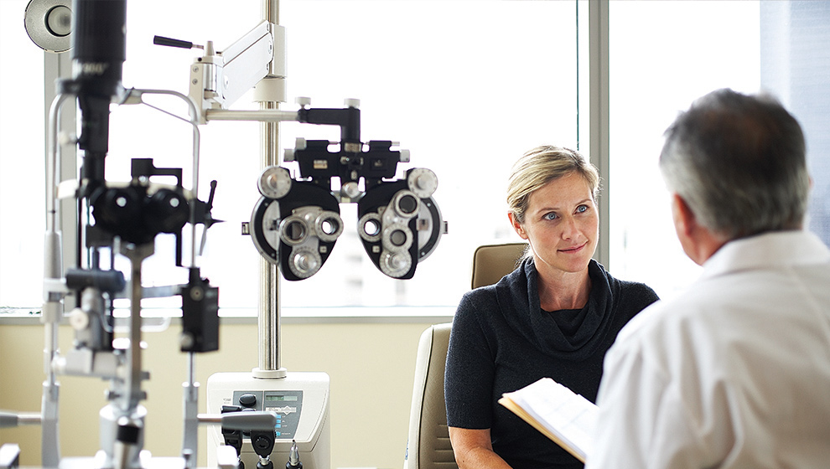
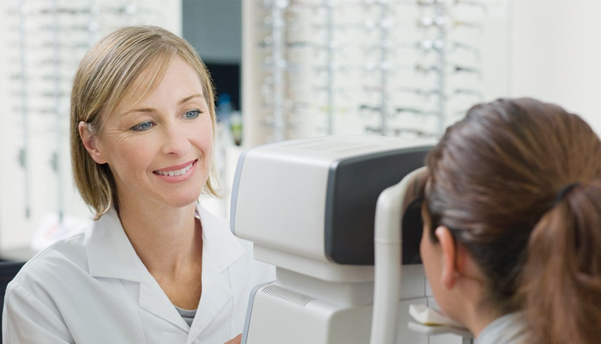
Eye Exams
All About the Eye
Have you had your eyes checked by a doctor?
Who is wearing glasses today?
Who is wearing contacts?
Notes:
.

Slide 15

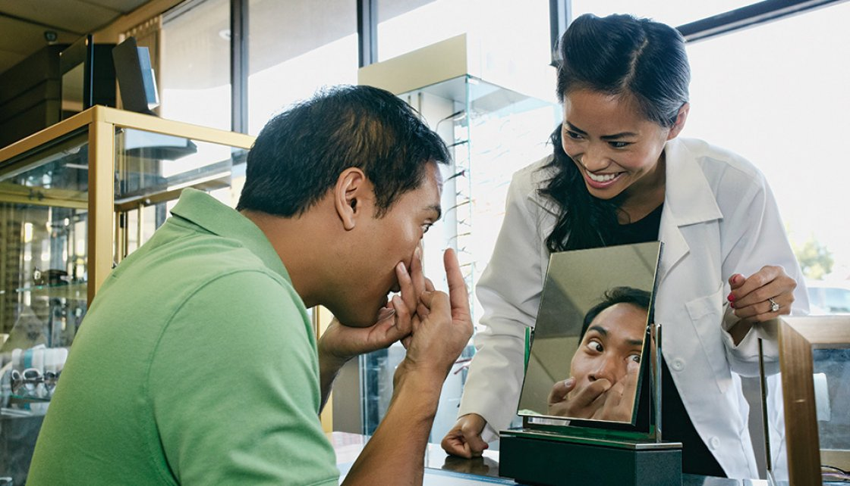
Contact Lenses
All About the Eye
45 million people in the U.S. wear contact lenses.
3.6 million or 8% are under 18 years old
To be commercially desirable by a customer, contact lenses must be:
Soft so that they drape on the eye
Clear
Strong enough to withstand blinking (up to 28,800 blinks per day)
People wear contact lenses for several reasons.
Freedom to not wear glasses
They do not fog up with temperature change
They are more convenient when playing sports
Notes:
.

Slide 16

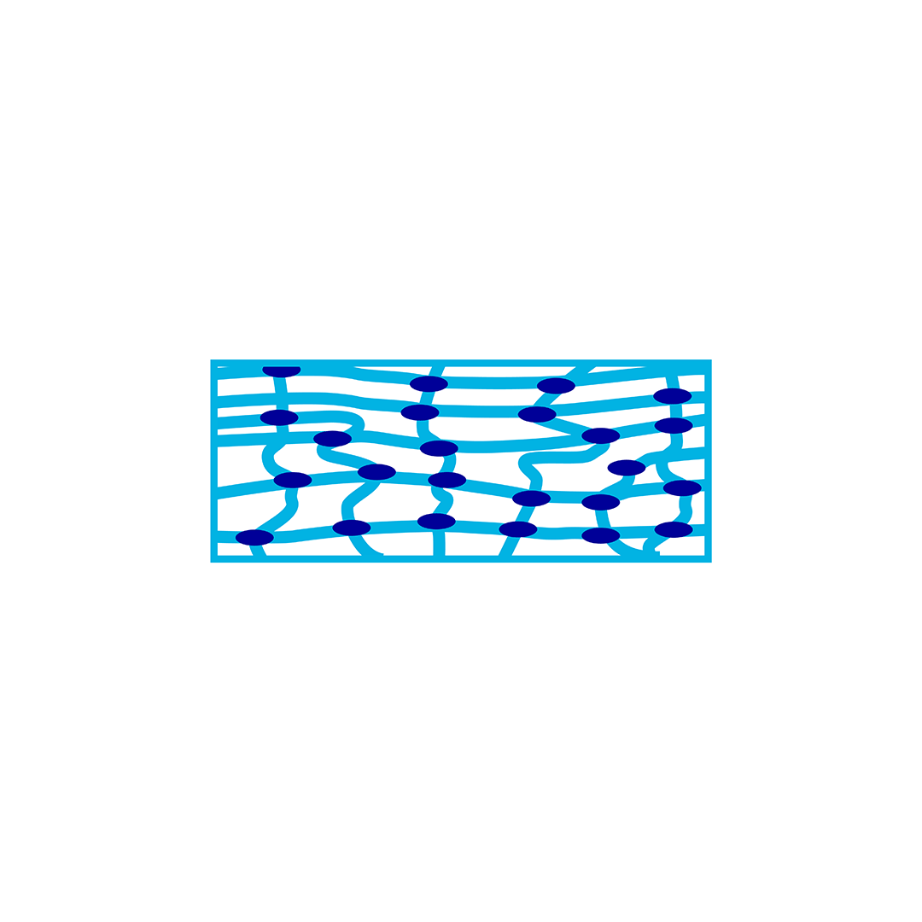
About Contact Lenses
All About the Eye
Dry hydrogel
(Hard)
The first contact lens was invented in 1887 and made of glass.
Glass was replaced with hard (rigid) plastic, in the 1940s, and soft plastics (hydrogels) were introduced in the 1970s.
Hydrogels are crosslinked (dark blue dots) and can absorb over 500 times their own weight in water!
+ hydration (H₂O)
Squishy
Notes:
.

Slide 17
What are Polymers?
Large molecules of repeating smaller units
Monomer = One Unit
Mono
Poly
Initiator = starts reaction
(polymerization)
one
many
Polymer = Many Units
linear
____
mer
unit
Uncrosslinked: beads on a necklace
Crosslinked: mesh in a net
branched
crosslinked

Slide 18

What are Polymers?
https://spaces.hightail.com/receive/rEXGOiDvrQ

Slide 19
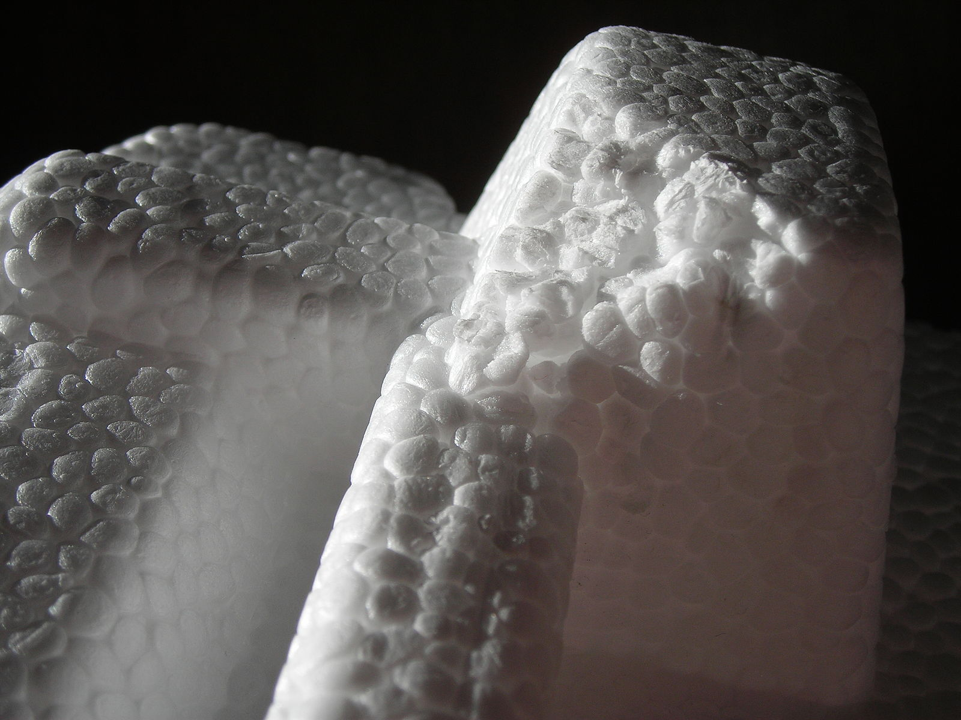
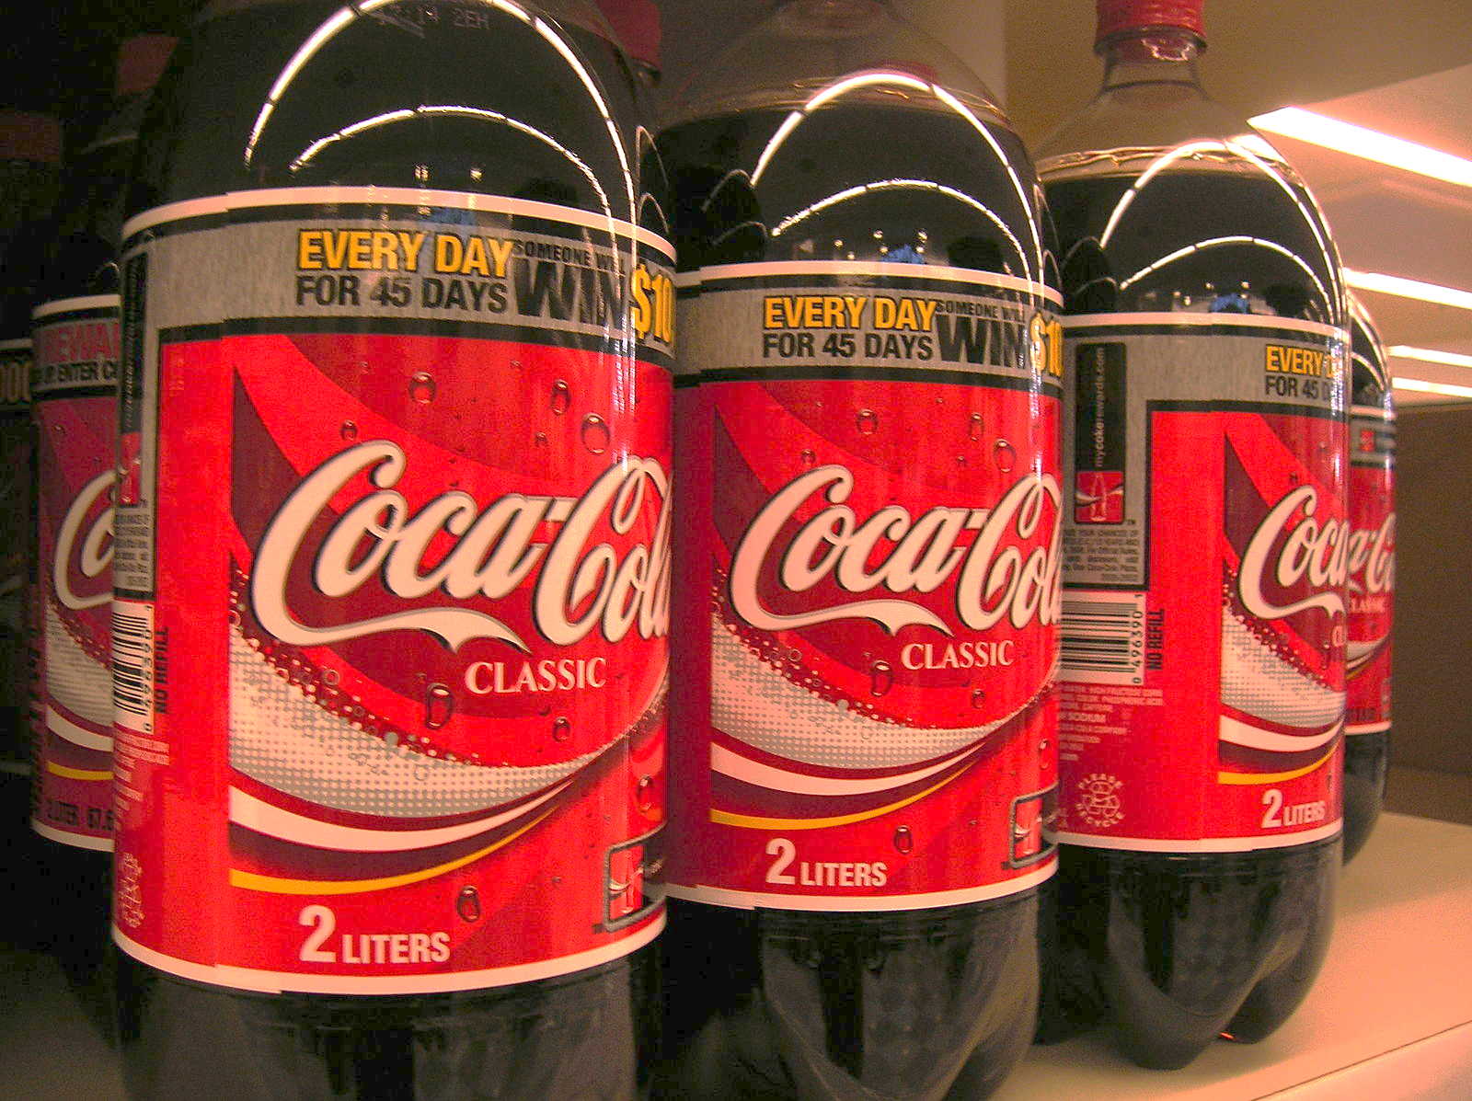
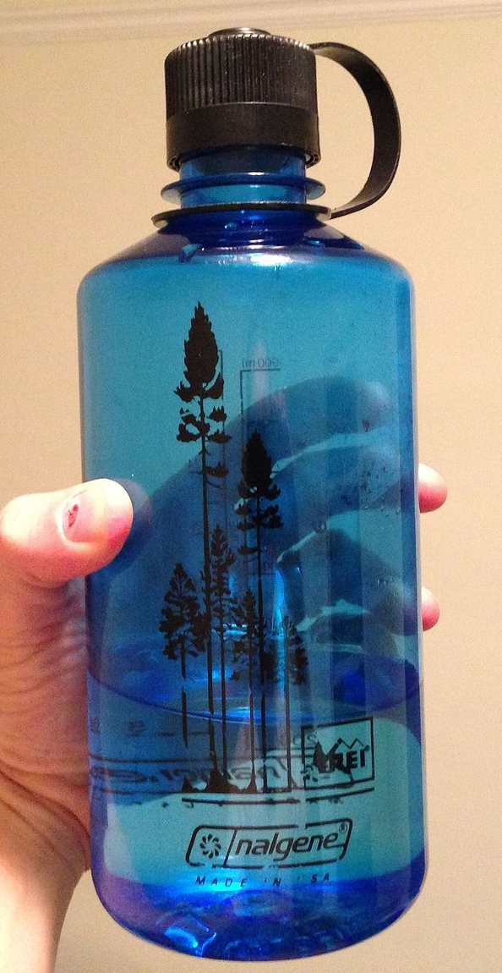
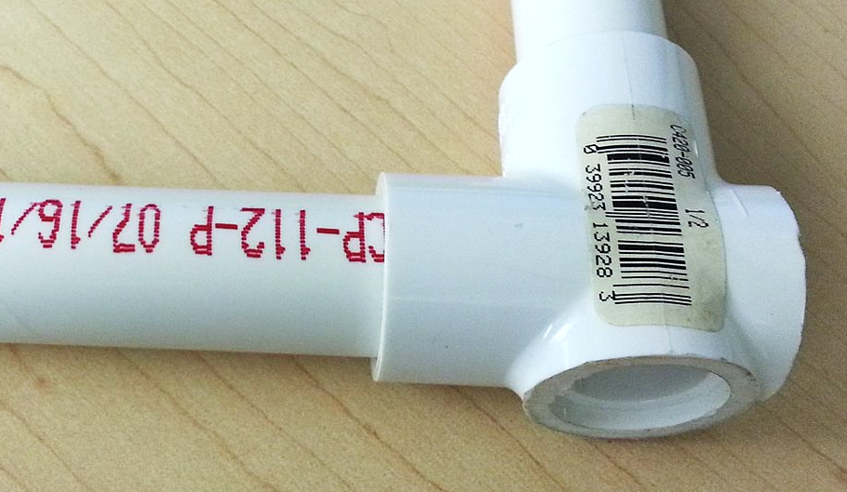
Polymers You Know
Natural:
Proteins
Carbohydrates
Polystyrene
Polyethylene terephthalate (PET)
Synthetic:
Rubber
Plastic bags
Bottles
Paint
Housewares: plates, cups, Tupperware
Surgical sutures
Contact lenses
Polyvinyl chloride (PVC)
Polycarbonate
Polystyrene: CC BY-SA 3.0
PVC: CC BY-SA 3.0
Polycarbonate: CC BY-SA 3.0
Phyrexian/https://commons.wikimedia.org/wiki/File:Polistirolo.JPG
UsKhalid/https://commons.wikimedia.org/wiki/File:The_PVC_pipe.jpg
diablanco/https://commons.wikimedia.org/wiki/File:Nalgene.jpg

Slide 20
The Amazing Eye
Challenge

Slide 21
About the
Amazing Eye Challenge
As a team of polymer scientists, your challenge is to:
Test and evaluate 3 different types of polymers for use in corrective lenses.
Recommend the best polymer to Johnson & Johnson’s Research Team to advance to the next round of testing.

Slide 22
What’s the Scientific Method?
A set of procedures scientists use to answer questions and create solutions that help people, animals, and the environment.
Observation and Asking a Question
Hypothesis
Experiment
Data
Analyze
Report
Use the Scientific Method
to discover the behavior and properties
of three (3) polymers.

Slide 23
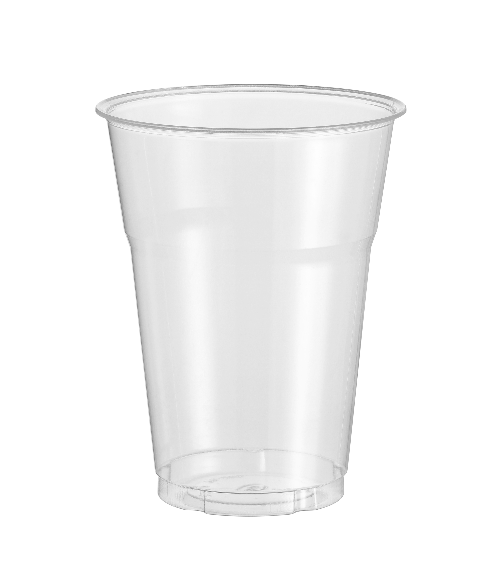
Amazing Eye Challenge
Instructions
Tasks: Test three different polymers:
Swedish Fish
Jelly Spheres
Plastic Cups
Record your observations in the tables and answer the questions posed on the handout
Determine the advantages and disadvantages of each polymer
Calculate market demand
Make an informed recommendation to the research team
Time: 60 minutes

Slide 24
Challenge Recap
Which of the three polymers did your team recommend to Johnson & Johnson?
Why?

Slide 25
What Did You Learn?
Let’s discuss …
What did you learn about the eye? Vision?
How did hydration impact the polymers?
What were the advantages and disadvantages for each polymer?
What did you learn about working in a team?

Slide 26
Reflection
Think about the following questions…
?
How do you think this activity relates to a career in science and/or working at Johnson & Johnson?
Can you see yourself as a STEM²D professional? In what role? Why or why not?
What do you need to do to make this happen?
What is one thing you learned that you did not know coming in today?

Slide 27
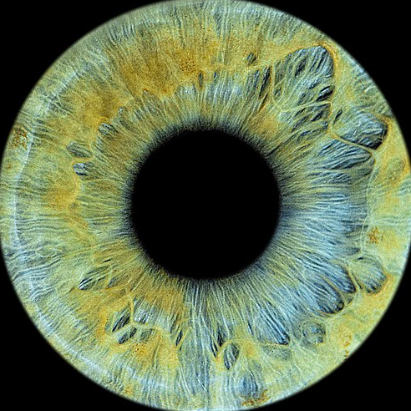
Calculating Eye Color Distribution
Extended Learning Activity
Eye color depends on melanin, a natural pigment that deposits color in the tissue of the iris, skin cells, and hair follicles.
Brown is the most common eye color in the U.S, while green is the least common.
Use the table (handout) to record the eye color of your classmates.
Calculate the percentage for each eye color and compare to the U.S. [(# of students with color/total # of students) x 100]
Eye Color | % U.S. | # in Students | % Eye Color for Class | Observation
Brown | 45%
Blue | 27%
Hazel | 18%
Green | 9%
Other | 1%
CC BY 4.0
Lizapopova143/https://commons.wikimedia.org/wiki/File:Beautiful_iris.jpg
Notes:
.

